Slide 1


Slide 2
Mathematics in Context (Core Maths)
Getting Ready to Teach

Slide 3
Agenda
Introducing the specification
Content
Comprehension
Assessment
Planning
Recruitment and staffing
Recognition and performance tables
Support and resources
Action plan

Slide 4
Core Maths qualifications Purpose
‘Core Maths qualifications should consolidate and build on students’ mathematical understanding and develop further mathematical understanding and skills in the application of mathematics to authentic problems, thereby offering progression from GCSE Mathematics. Qualifications should provide a sound basis for the mathematical demands that students will face at university and within employment across a broad range of academic, professional and technical fields.’
Department for Education, Core Maths Technical Guidance, July 2014

Slide 5
Core Maths qualifications
Intended for learners who achieve A* to C (Grade 4 or above) in GCSE Mathematics, who choose not to study AS or A Level Mathematics
Measured as Level 3 qualifications, accredited by Ofqual
Distinct from AS/A Level Mathematics which are orientated towards preparation for higher study with a significant mathematical focus
At least 180 guided learning hours in overall size
Carefully selected range of GCSE content with at least 20% drawn from beyond GCSE
GCSE (9-1) Foundation tier content is assumed knowledge
Linear assessment.

Slide 6
Context based planning for your students
Find out what your students are interested in or what sparks their
interest. For example, if your students have been inspired by having
British astronaut, Tim Peake, spending six months on the International
Space Station you could present them with a space themed question.
‘What would cost me more, a tower of one pound coins to the moon or
building a rocket and launching it?’
(This question is from one of the CMSP Case Study schools; Queen Elizabeth’s School, Dorset.)
‘Star Trek originally had a five year mission. How far could a spaceship travel in five years? How many stars could it visit in that time?’
6
Mathematics in Context - Launch events
Notes:
6

Slide 7
Suggested course plan for the 180 guided learning hours over 2 years
Title
Estimated teaching time
Year / Term
Topic
3
4
1
2
1
2
- Year 1 Term 1
- Year 1 Term 2
- Year 1 Term 3
- Year 2 Term 1
- Year 2 Term 2
- Topic 1
- Topic 2
- Topic 3
- Topic 4
- Topic 5
- Topic 6
- Topic 7
- Topic 8
- Topic 9
- Topic 10
- Topic 11
- Topic 12
- Social media
- Society
- Sport
- Clothing industry
- Finance
- Creative arts
- Health
- Economy
- Travel
- Environment
- Disasters
- Engineering
- 4-6 hours
- 20-22 hours
- 8-10 hours
- 16-18 hous
- 13-15 hours
- 11-13 hours
- 18-20 hours
- 15-18 hours
- 6-8 hours
- 10-12 hours
- 4-6 hours
- 10-12 hours
7
Mathematics in Context - Launch events
Presentation itle Arial Bold 7 pt
Notes:
7

Slide 8
Context based planning
The first topic from the suggested 2 year plan is ‘Social Media’.
You may wish to investigate the effects of social media on:
mental health
political movements
the environment
social reform movements
crime
8
Mathematics in Context - Launch events
Notes:
8

Slide 9
Open Chat window 1:
Where in their studies or lives are your Year 12 and Year 13 students who have already achieved A*-C GCSE Maths encountering mathematics?
9
Mathematics in Context - Launch events

Slide 10
Timeline
2014 | 2015 | 2016 | 2017
Qualifications accredited |  | 18 & 25 May: First assessment opportunity | May/June: Second assessment opportunity
Autumn: Early Adopter centres start teaching | September: Early Developer and other centres start teaching | September: Roll out continues | September: First cohort with GCSE (9-1) – start teaching
Assessment from May/June 2016

Slide 11
Our design principles
100% externally assessed
Two papers – each can cover all content areas
Extended themed tasks in both papers
Relevant, adult, real world, context-based tasks throughout
Authentic extracts and data from a range of sources
Questions at a range of demand within each themed task
A range of question types and a mix of short and longer response questions across both papers
Calculators may be used in both papers; formula sheet provided
11
Mathematics in Context - Launch events
Notes:
11

Slide 12
Overview of the specification
100% externally assessed
Paper | Title | Content assessed | Summary of assessment
Paper 1 (40%) 1 hour 40 mins 60 marks | Comprehension | Applications of statistics Probability Linear programming Sequences and growth | Pre-released source booklet Section A: 1 task Section B: 1 task
Paper 2 (60%) 1 hour 40 mins 80 marks | Applications | Applications of statistics Probability Linear programming Sequences and growth | Section A: 1 task Section B: 3 tasks

Slide 13
Assessment structure
Paper 1: Comprehension | Paper 2: Applications
Pre-released source booklet
Section A: first context Questions based on extract(s) in the source booklet Total: 30 marks Section B: second context Questions based on extract(s) in the source booklet Total: 30 marks | Section A One task based on one of the contexts in Paper 1 Additional stimulus material may be provided Total: 20 marks Section B 3 other tasks, each on a separate theme Total: 60 marks

Slide 14
Link between Paper 1 and Paper 2
One of the contexts from Paper 1 is carried into Paper 2 Section A. Either context may be carried forward – learners don’t know beforehand which it will be.
Additional unseen content – as well as the original data for that task from Paper 1 – may be provided in the source booklet for Paper 2 Section A.
Paper 1: Comprehension
Section A context
Section B context
Paper 2:
Applications
Section A
Sections B:
Tasks 1, 2, 3
One of the contexts from
Paper 1 is taken into Paper 2

Slide 15
Content
Applications of Statistics: sampling and its limitations; time series and moving averages; histograms; interpret, analyse and compare distributions; correlation; explanatory and response variables; product moment correlation coefficient; linear regression; Spearman’s rank
Probability: samples v. theoretical probability; independent and dependent combined events; conditional probabilities; probability notation and its applications; Venn diagrams and other representations; probability formulae; risk
15
Mathematics in Context - Launch events
Notes:
15

Slide 16
Content
The following strands integrate a selection of algebraic techniques.
Linear programming: translate situations into algebraic expressions; plot graphs of linear equations; recognise linear functions; solve linear equations, inequalities, and pairs of simultaneous equations; use algebra to support and construct arguments
Sequences and growth: encompasses financial and other real life contexts and includes quadratic, reciprocal, polynomial and exponential functions; interpret gradient of curve as rate of change; linear, quadratic and other sequences; arithmetic and geometric series
16
Mathematics in Context - Launch events
Notes:
16

Slide 17
Students who followed Foundation Tier GCSE
Will need to develop skills in:
Applications of Statistics
Box plots, cumulative frequency tables and graphs, histograms,
quartiles and inter-quartile range.
Probability
Conditional probability.
Linear Programming
Finding the solution of linear inequalities in two variables and representing the solution set on a graph.
17
Mathematics in Context - Launch events
Presentation Title Arial Bold 7 pt
Notes:
17

Slide 18
Students who followed Foundation Tier GCSE
Will need to develop skills in:
Sequences and Growth
Compound interest, setting up, solving and interpreting answers to growth and decay problems, the use of roots, integer and fractional indices, recognising, sketching and interpreting graphs of quadratic functions, reciprocal functions and functions of the form y = x^{n} and y = k^{x}, quadratic sequences.
18
Mathematics in Context - Launch events
Presentation Title Arial Bold 7 pt
Notes:
18

Slide 19
Content not already covered at GCSE
Applications of Statistics
Moving averages, variance and standard deviation, knowledge of
independent and dependent variables, product moment correlation
coefficient, linear regression and Spearman’s rank correlation
coefficient.
Probability
Use of the various formulae for probability using set notation and the
need to understand and interpret risk.
19
Mathematics in Context - Launch events
Presentation Title Arial Bold 7 pt

Slide 20
Content not already covered at GCSE
Linear Programming
The formulation of a problem as a linear program with up to three
variables, the solution and interpretation of two-variable problems
graphically and the consideration of such problems that have integer
values. Students will be expected to be able to write down the
objective function for a linear programming problem.
Sequences and Growth
Arithmetic series and geometric series with the use of sigma notation.
20
Mathematics in Context - Launch events
Presentation Title Arial Bold 7 pt

Slide 21
The Comprehension paper
It is important to consider how you are going to teach mathematical comprehension skills.
Edexcel have comprehension material that you can download and use on their website. Here we will look at the Ebola comprehension.
21
Mathematics in Context - Launch events
Notes:
21

Slide 22
Overview of topic – Ebola virus
PRACTICE TASK: The Ebola virus is MUTATING, and 'could become more contagious', warn scientists.
A team of researchers from the Institut Pasteur in France first identified the outbreak of Ebola in Guinea, in March 2014. Patient zero - the first person to be infected - was two-year-old Emile Ouamouno from the rural village of Meliandou. He died in December 2013, four days after he fell ill, with a sky-high fever and vomiting.
Just weeks later his sister succumbed, followed by their mother and grandmother.
From there the virus spread. Three months later, the scientists at Institut Pasteur identified it as Ebola, after it was reported to the health authorities.
The team have since been tracing the virus' spread through Guinea, to establish if the disease could become more contagious. They examined hundreds of blood samples from Ebola patients in the West African nation where the first cases struck..
Human geneticist, Dr Anavaj Sakuntabhai, told the BBC: 'We know the virus is changing quite a lot. That's important for diagnosing and for treatment. We need to know how the virus (is changing) to keep up with our enemy.‘
He told Radio 4's Today programme that viruses have to 'fight a balance' between infecting people and spreading. 'We have seen several cases that don't have any symptoms at all when infected,' he said. 'These people may be the ones who could spread the virus better, we do not know yet. A virus can change from more deadly into less deadly but more contagious and that is something we are afraid of.‘
Viruses do change over a period of time.
22
Mathematics in Context - Launch events
Presentation Title Arial Bold 7 pt
Notes:
22

Slide 23
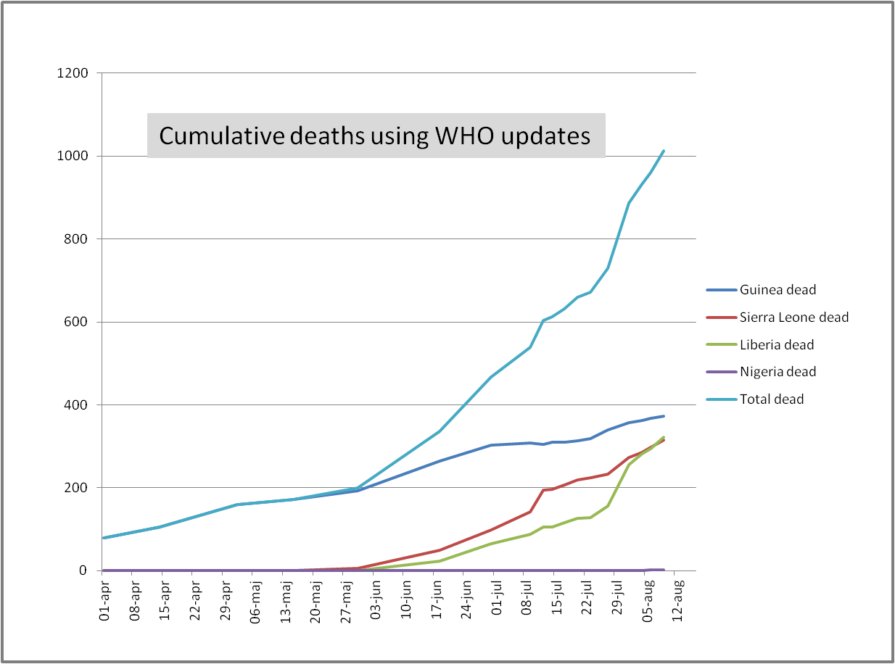
Overview of topic – Ebola virus
Data source B
Using data from WHO, scientists have plotted a graph to show the progression of Ebola.
Graph 2:
The cumulative number of deaths in countries in West Africa, April - August 2014
Mathematical modelling of the spread of diseases is well established and has had some success in predicting such outcomes as the likely number of people who will be infected and the length of time the disease will affect a significant number of people.

Slide 24
Overview of topic – Ebola virus
Assume that the total number of deaths from Ebola can be modelled by exponential growth and
the number of deaths on day 1 is 75
the rate of increase in the total number of deaths is 1.98% per day.
Compare the prediction for August 10th of the model with the data shown on Graph 2.
(3 marks)

Slide 25
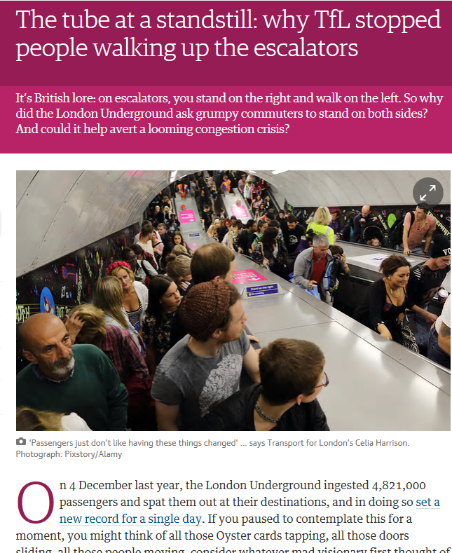
Comprehension
It is recommended that you take into the classroom articles that you come across. These could be from newspapers, magazines or online.
For example there was an article in the Guardian recently about crowd management at Holborn tube station (right).
Any article that you use should be used for classroom discussion, teaching and learning and student practice.

Slide 26

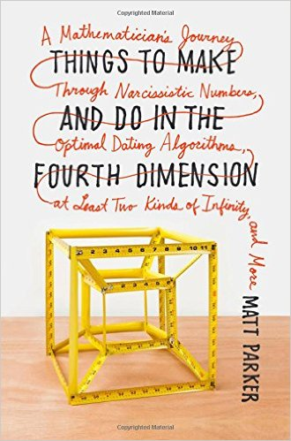



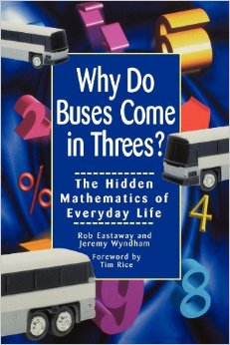




Comprehension: some suggestions

Slide 27
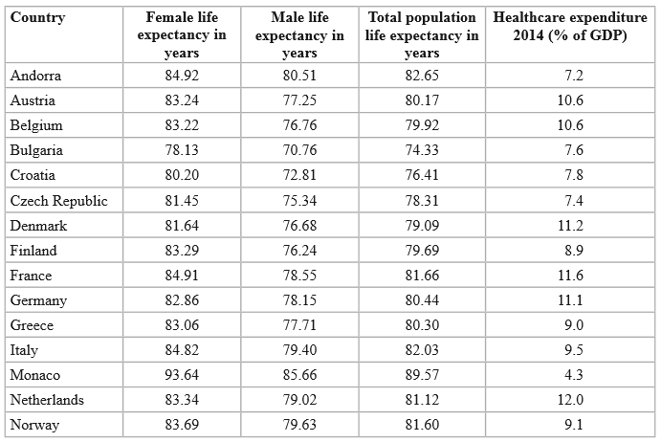
The pre-released source booklet
This a table from the specimen pre-released source booklet.
27
Mathematics in Context - Launch events
Notes:
27

Slide 28
The pre-released source booklet
28
Mathematics in Context - Launch events
Possible maths content that could link to the table:
Comparing percentages
Averages
Drawing, analysing and comparing box plots, including identifying outliers
Recognising correlation
Using and interpreting a correlation coefficient
Comparing distributions
Notes:
28

Slide 29
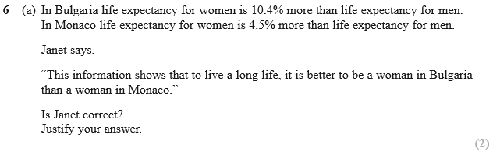
An exam question
This is part of a question from the specimen paper which uses information from the table.
29
Mathematics in Context - Launch events

Slide 30
Suggested course plan for the 180 guided learning hours over 2 years
Title
Estimated teaching time
Year / Term
Topic
3
4
1
2
1
2
- Year 1 Term 1
- Year 1 Term 2
- Year 1 Term 3
- Year 2 Term 1
- Year 2 Term 2
- Topic 1
- Topic 2
- Topic 3
- Topic 4
- Topic 5
- Topic 6
- Topic 7
- Topic 8
- Topic 9
- Topic 10
- Topic 11
- Topic 12
- Social media
- Society
- Sport
- Clothing industry
- Finance
- Creative arts
- Health
- Economy
- Travel
- Environment
- Disasters
- Engineering
- 4-6 hours
- 20-22 hours
- 8-10 hours
- 16-18 hous
- 13-15 hours
- 11-13 hours
- 18-20 hours
- 15-18 hours
- 6-8 hours
- 10-12 hours
- 4-6 hours
- 10-12 hours
30
Mathematics in Context - Launch events
Presentation itle Arial Bold 7 pt
Notes:
30

Slide 31
Context based planning – Social media
The first topic from the suggested 2 year plan is ‘Social Media’.
You may wish to investigate the effects of social media on:
mental health
political movements
the environment
social reform movements
crime
31
Mathematics in Context - Launch events
Notes:
31

Slide 32
Open chat window 2:
What mathematics could you get from the following topic?
The effects of social media on mental health

Slide 33
Overview of topic – Social media
An increasing number of people access and use social media in some
form. The number of adults accessing the Internet every day in Great
Britain increased from 16 million to 33 million between 2006 and
2012. One of the most significant changes to the ways in which
individuals communicate over the Internet has been the recent growth
in social networking. Almost half of all adults in Great Britain, (48%)
used social networking sites such as Facebook and Twitter in 2012.
33
Mathematics in Context - Launch events
Presentation Title Arial Bold 7 pt
Notes:
33

Slide 34
Topic – Social media The effects of social media on mental health
You could start by giving students access to the following sources, this will give them access to a wealth of data:
Core Maths Support Programme: Scams
PewResearchCenter
Ofcom
Office for National Statistics
Ericsson
34
Mathematics in Context - Launch events
Notes:
34

Slide 35
Topic – Social media The effects of social media on mental health
The mathematics content that could be developed in this topic:
Infer properties of populations or distributions from a sample, while knowing the limitations of sampling
Construct and interpret diagrams for grouped discrete data and continuous data, i.e. histograms with equal and unequal class intervals and cumulative frequency graphs, and use them appropriately
interpret, analyse and compare the distributions of data sets from univariate empirical distributions through appropriate graphical representation, including box plots
35
Mathematics in Context - Launch events
Notes:
35

Slide 36
Topic – Social media The effects of social media on mental health
The mathematics content that could be developed in this topic:
interpret, analyse and compare the distributions of data sets from univariate empirical distributions through appropriate measures of central tendency, including quartiles, inter-quartile range, calculate and use variance and standard deviation
recognise correlation and know that it does not indicate causation
draw estimated lines of best fit and make predictions; use and interpret the product moment correlation coefficient, recognising its limitations
36
Mathematics in Context - Launch events
Notes:
36

Slide 37
Considerations for planning
Are there topics from students’ other courses that you could use in
your planning?
What are the interests of your students? What appeals to your
students?
What current affairs topics could you use?
Would the feedback from the Case Studies be helpful?
You can find information on these on the Core Maths Support Programme website at
http://www.core-maths.org/about/core-maths-support-programme/
37
Mathematics in Context - Launch events
Notes:
37

Slide 38
Why offer Mathematics in Context?
Only 15% of our students currently go on to study Maths at level 3.
Some centres have reported that they benefit because Mathematics in
Context widens the portfolio of courses they are able to offer to
students post-16.
Students involved in the pilot have reported that they value the
practical and problem-solving approach to the course.
Mathematics in Context uses and develops the mathematics students
have learned during their GCSE study. It provides an opportunity for your students to maintain and develop their mathematical skills.

Slide 39
Poll 1:
Approximately how many of your learners achieve A*-C in GCSE Mathematics but do not choose to study mathematics at AS/A level?
Less than 20
21-50
51-100
101-150
150-200
More than 200
39
Mathematics in Context - Launch events

Slide 40
The students: Who will you target for the Mathematics in Context course?
Do you have students...
who have achieved an A/A* in GCSE Maths, but have not chosen to study A level Maths?
who want to do AS/A-level Maths but don't have your required grade in GCSE e.g. B/C?
studying AS/A-level Sciences, Business Studies, Economics, Computing, Geography and Psychology but have not chosen A level Maths?
studying BTEC Applied Science, Business, Health and Social Care and IT but have not chosen A level Maths?
who start the AS/A level Maths course but drop out because they cannot cope with the level of difficulty?

Slide 41
How will you recruit these students?
Will you create a shortlist of students to target? If so, how will you
target them?
Will you target students from particular courses, for whom studying
Mathematics in Context would have an obvious benefit? Is there a
strong partnership with other subject teams that would benefit from
students opting for Mathematics in Context?
Will you offer taster sessions? Will these be to a target audience?
Will you successfully promote Mathematics in Context at open
evenings?

Slide 42
How will you recruit these students?
Can Mathematics in Context be timetabled in such a way that it is
easily accessible to students?
Can Mathematics in Context be made compulsory for any GCSE C+
student not opting for AS/A-level Maths?
Can Mathematics in Context be made compulsory for any GCSE C+
student who has also opted for certain subjects?
Could you run a common maths course for the first two weeks of
Year 12?

Slide 43
Poll 2:
Consider your learners who obtain A*–C in Maths but do not choose AS/A Level Maths. If all these learners opted for Core Maths, roughly how many extra staff will you need (based on a 2 year course running on 2–3 hours per week)?
0
1 part time equivalent
1 full time
2
3
4 or more

Slide 44
Who will teach the Mathematics in Context course?
Could you recruit more Maths teachers?
Can you create capacity in your department?
Are there opportunities for joint planning within and/or outside your school or college?
With focused CPD, do you think teachers with no experience of teaching Maths beyond GCSE could teach Mathematics in Context?
Could Mathematics in Context be taught by existing teachers of other
subjects who already apply mathematics at a high level in their
disciplinary areas? Would this help with the content and context links
to other subjects?

Slide 45
Poll 3:
Approximately how many of your learners achieve A*–C (Grade 4 or above) in GCSE Mathematics but do not qualify for AS/A Level Mathematics in your school/centre (e.g. you may have A/A* or Grade 7 as an entry requirement)?
Less than 20
21-50
51-100
101-150
150-200
More than 200

Slide 46
What model will you use to deliver the Mathematics in Context course?
You could teach the Mathematics in Context course
for the recommended 180 hours over two years
for one year and use it as a stepping stone for AS-level Maths
as part of the Techbacc over one or two years
combined with resit GCSE to improve higher grade passes
You could come up with an alternative suggestion better suited for your centre and students.

Slide 47
Advantages to delivering the course in two years
To better support other subjects
To better support progression ambitions
To better support students in using and developing their GCSE Maths skills in preparation for their Higher Education or employment
To better support students in keeping their maths ‘ticking over’
To better support students in developing their confidence and problem-solving strategies

Slide 48
Advantages and disadvantages to delivering the course in one year
Advantages:
You could use it as a stepping stone for AS-level Maths
You could teach the Mathematics in Context course combined with re-sit GCSE to improve higher grade passes
Disadvantage:
Students may become rusty if they do no mathematics in Year 13.

Slide 49
Considerations for planning
How much time per week should you allocate to teaching
Mathematics in Context?
The guidance is 180 hours over two years, this amounts to approximately 3 hours per week.
One early adoption centre has allocated 1.5 hours per week and feels that this is sufficient with their very small groups, others allocate 2 or 3 hours per week.
How much time should you allocate to each topic?
Topics will vary in length depending on what Maths you think you can get out of it.
One early adoption centre recommends a half term per topic. For others it varies, depending on where the students take the topic.

Slide 50
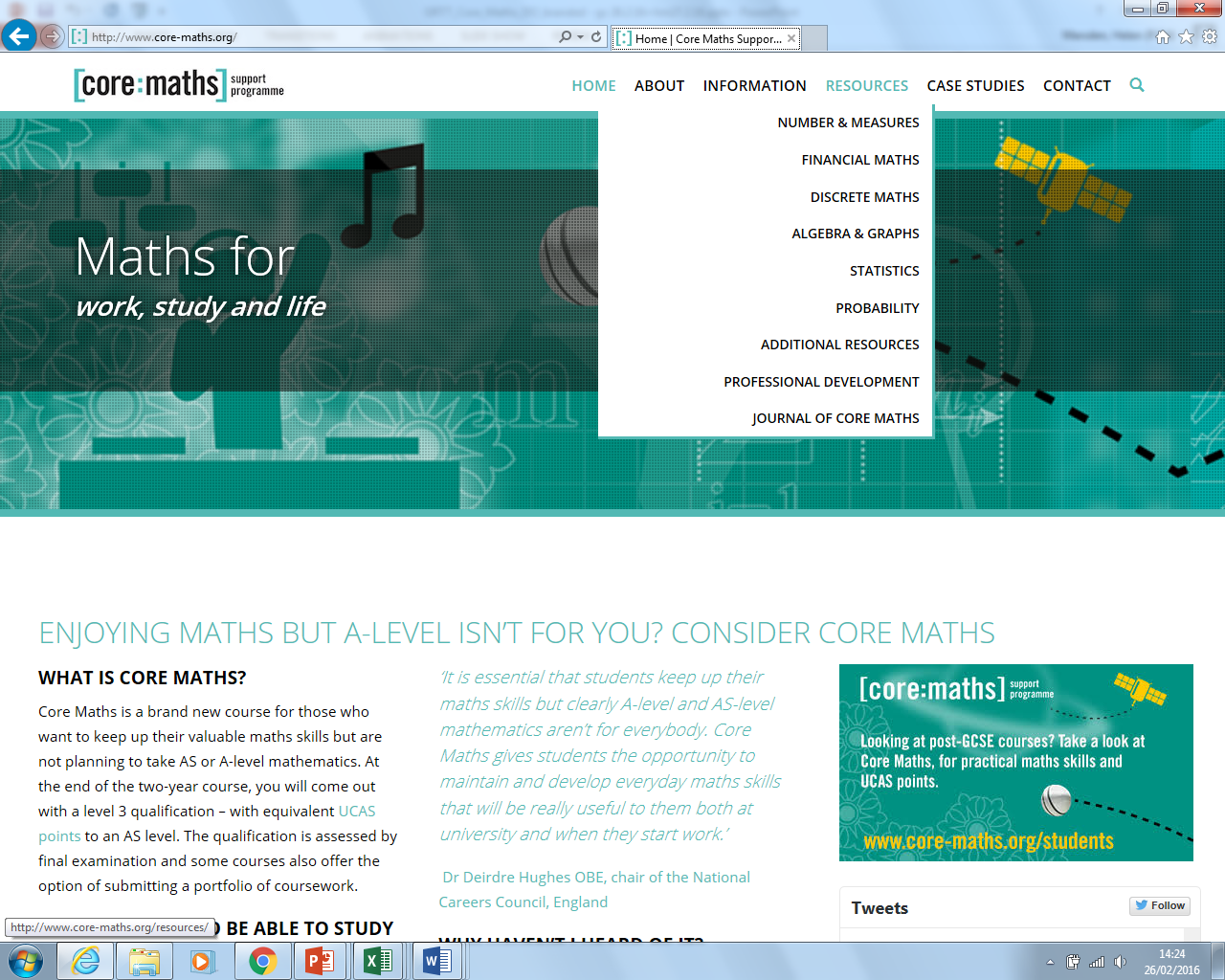
Core Maths Support Programme*
*These resources are not owned or endorsed by Pearson
50
Mathematics in Context - Launch events
Notes:
50

Slide 51
Free resources available*
The Core Maths Support Programme produced many resources directly relevant to Core Maths: https://www.stem.org.uk/core-maths
On the Nuffield website there are many other relevant resources that can be used for Core Maths:
http://www.nuffieldfoundation.org/nuffield-mathematics/using-nuffield-mathematics-resources-core-maths
*These resources are not owned or endorsed by Pearson

Slide 52
Free resources available*
MEI: Critical Maths http://www.mei.org.uk/critical-maths
National Stem Centre https://www.stem.org.uk/
Cambridge University http://www.cam.ac.uk/
Centre for Innovation in Mathematics Teaching (CIMT) http://www.cimt.plymouth.ac.uk/
Khan Academy https://www.khanacademy.org/math
*These resources are not owned or endorsed by Pearson

Slide 53
Performance tables
Approved for 16-19 schools and colleges performance tables from 2016.
TechBacc
The number of students achieving the required combination of a Tech Level qualification, a recognised mathematics qualification at Level 3, and the Extended Project qualification.
Level 3 Maths measure
The proportion of students entering the school/college with GCSE grade C or above, and who go on to achieve an approved Level 3 mathematics qualification (including Core Maths, AS and A level).
53
Mathematics in Context - Launch events
Notes:
53

Slide 54
UCAS and Higher Education recognition
Awarded UCAS tariff points equivalent to an AS Level as below:
Grade | Old tariff | New tariff
A | 60 | 20
B | 50 | 16
C | 40 | 12
D | 30 | 10
E | 20 | 6
Recognition among HE institutions and employers is growing
54
Mathematics in Context - Launch events
Notes:
54

Slide 55
UCAS and HE recognition is growing
DfE and BIS have written jointly to university vice-chancellors to provide information on the Core Maths qualifications as they will begin to see an increasing number of applicants with Core Maths from 2016.
‘Whilst we would not discriminate against students who do not/are unable to take a Core Maths course from 2015 we welcome the ethos behind this development. For example, students in social sciences, business, psychology, sciences and health sciences who are not taking A/AS level Maths may find the Core Maths element useful in preparing for university study where a working application of maths or statistics may be required.’
Aston University statement on A-Level and GCSE reform in England
55
Mathematics in Context - Launch events
Notes:
55

Slide 56
Maximising learner engagement and progression
Plan
Teach
Track & Assess
Develop
Free qualifications support:
www.edexcel.com/mathsincontextgrtt
Published resources:
www.pearsonschoolsandfe.co.uk/micgrtt
Notes:
56

Slide 57
Free support for planning
Scheme of work – available now
Mapping to other maths qualifications – available now
Assumed knowledge listing – available now
Getting started guide – available now
57
Mathematics in Context - Launch events
Notes:
57

Slide 58

Free support for teaching
Guides for learners & parents and teachers – available now
Comprehension teaching and practice tasks – available now
Topic practice questions – available now
Existing available resources – available now
58
Mathematics in Context - Launch events
Notes:
58

Slide 59
Published resources
We are committed to helping teachers deliver our Edexcel qualifications and students to achieve their full potential. To do this, we aim for our qualifications to be supported by a wide range of high-quality resources, produced by a range of publishers. However, it is not necessary to purchase endorsed resources to deliver our qualifications.

Slide 60
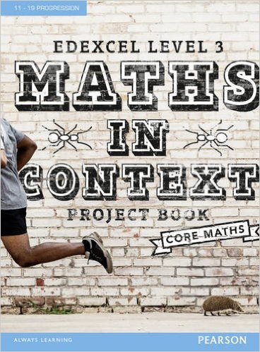
Plan and teach: Published resources*
60
Mathematics in Context - Launch events
Based on best practice for context-led teaching, the Project Book includes themes that are relevant to adult-life and helps develop skills for future education or career paths.
Teach the content that you need for the specification:
Motivate students to solve problems using maths
Save time planning
Support independent learning
Evaluate for FREE - visit www.pearsonschoolsandfe.co.uk/coremathseval
*You do not have to purchase any resources to deliver our qualification.
*You don’t need to purchase resources to deliver our qualifications.
Notes:
60

Slide 61
Free support for tracking and assessment
Additional specimen papers – available now
Student exemplars with examiner commentary – available now
61
Mathematics in Context - Launch events
Notes:
61

Slide 62
ResultsPlus and examWizard
examWizard is a free exam preparation tool containing a bank of past Edexcel Mathematics exam questions, mark schemes and examiners’ reports, so you can create mock papers, homework or practice tests in minutes – available now with sample, specimen and actual papers for Mathematics in Context
ResultsPlus provides the most detailed analysis available of your students’ exam performance. This free online service helps you identify topics and skills where students could benefit from further learning, helping them gain a deeper understanding of Mathematics – from 2017 for Mathematics in Context
62
Mathematics in Context - Launch events
Notes:
62

Slide 63
Action plan
1 or 2 year model
Teaching time
Staffing
Recruitment
Planning/topics
Resources
Assessments
63
Mathematics in Context - Launch events
Notes:
63

Slide 64
Contact details
Website: www.edexcel.com/coremaths
Mathematics Emporium: www.edexcelmaths.com
Email: mathsemporium@pearson.com
64
Mathematics in Context - Launch events
Notes:
64

