Slide 1
BTEC LEVEL 1 Intro
How Exercise Affects the Body

Slide 2
Using this resource
This resource is provided to you by Pearson for educational use as part of the Level 1 Introductory qualification suite.
The resource is a starting point to teaching the named unit on the title page. The intended purpose of this resource is to support teaching by helping to explore some of the key themes within the unit.
This resource does not cover nor is intended to cover all the full content for the unit and should be used in conjunction with additional teaching and learning materials to ensure full coverage.
All content is accurate at of time of publication and should be reviewed by the user before use in the classroom to ensure it is appropriate for centre needs
Any external content has been fully credited with the owner of the resource

Slide 3
In a safe space practice the following activities *check with your teacher if you can complete these activities safely
Run on the spot for 60 seconds
Do 10 star jumps
Do 10 sit ups
Jump on the spot for 2 minutes
Notice how your body feels after each activity.
Why do you think your body felt this way?

Slide 4
Now repeat these activities- with a partner *check with your teacher if you can complete these activities safely
Run on the spot for 60 seconds
Do 10 star jumps
Do 10 sit ups
Jump on the spot for 2 minutes
This time you are going to measure your pulse
after each activity- why does the pulse increase?
Your partner will need a stopwatch to time you

Slide 5
Ways we can measure fitness- Harvard step test
©(29) 3-minute step test timer | test aerobic fitness without the beep test! - YouTube
Notes:
Cardiovascular Assessment - Strong Links Fitness for how to measure

Slide 6
Ways we can measure fitness - Cooper Test
©(29) How to do the Cooper Run- 12 Minute Run Test - YouTube

Slide 7
Ways we can measure fitness- Multistage fitness test
©(29) Multistage fitness test, or bleep test - YouTube

Slide 8
Muscular, respiratory, cardiovascular activities
Breath through your mouth for 1 minute, watch your body move as you do this
Now do the same activity breathing through your mouth. Notice the changes
Stand on your tip toes for a minute what do you notice
Put your leg in the air, what do you notice?
Stand on all fours. What do you feel?
How about when you yawn?
Finally lie down, scan you body for feelings what do you notice?

Slide 9
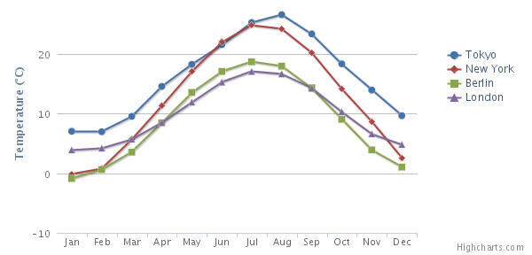
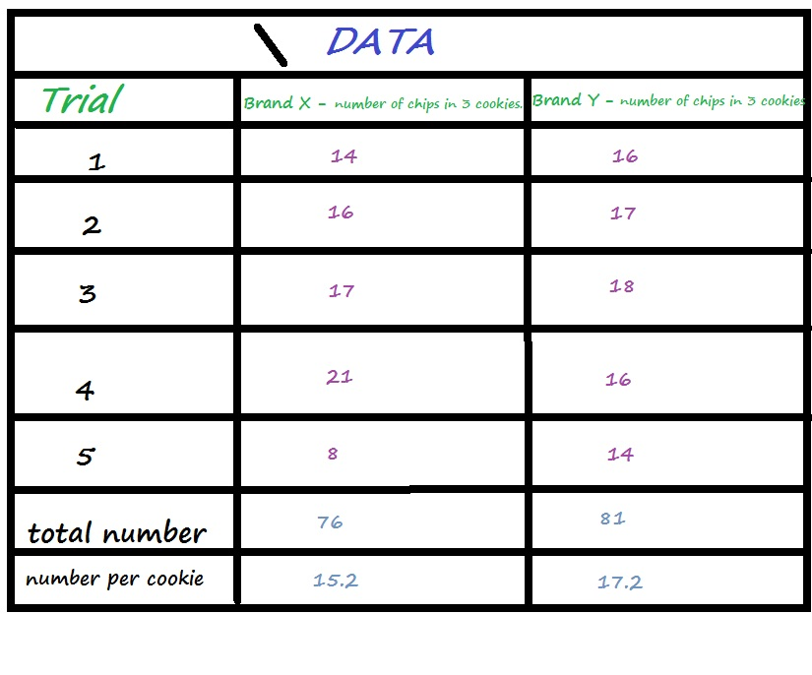
Presenting information collected from tests
What could we record using these methods?
This Photo by Unknown Author is licensed under CC BY-NC
This Photo by Unknown Author is licensed under CC BY-SA
This Photo by Unknown Author is licensed under CC BY-SA
How do we decide which methods to use?
This Photo by Unknown Author is licensed under CC BY-SA-NC

Slide 10
End of Presentation
Notes:
Closing Slide

