Slide 1
BTEC LEVEL 1 Intro
Creating an Art Image

Slide 2
Using this resource
This resource is provided to you by Pearson for educational use as part of the Level 1 Introductory qualification suite.
The resource is a starting point to teaching the named unit on the title page. The intended purpose of this resource is to support teaching by helping to explore some of the key themes within the unit.
This resource does not cover nor is intended to cover all the full content for the unit and should be used in conjunction with additional teaching and learning materials to ensure full coverage.
All content is accurate at of time of publication and should be reviewed by the user before use in the classroom to ensure it is appropriate for centre needs
Any external content has been fully credited with the owner of the resource

Slide 3
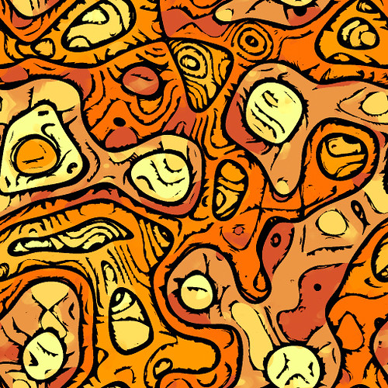
What is 2d Art?
This is art that exists in two dimensions.
It can include drawings, paintings, prints and photographs.
This can include art made by pencil, charcoal, ink, watercolour and oil paint and now also using specialist software.

Slide 4
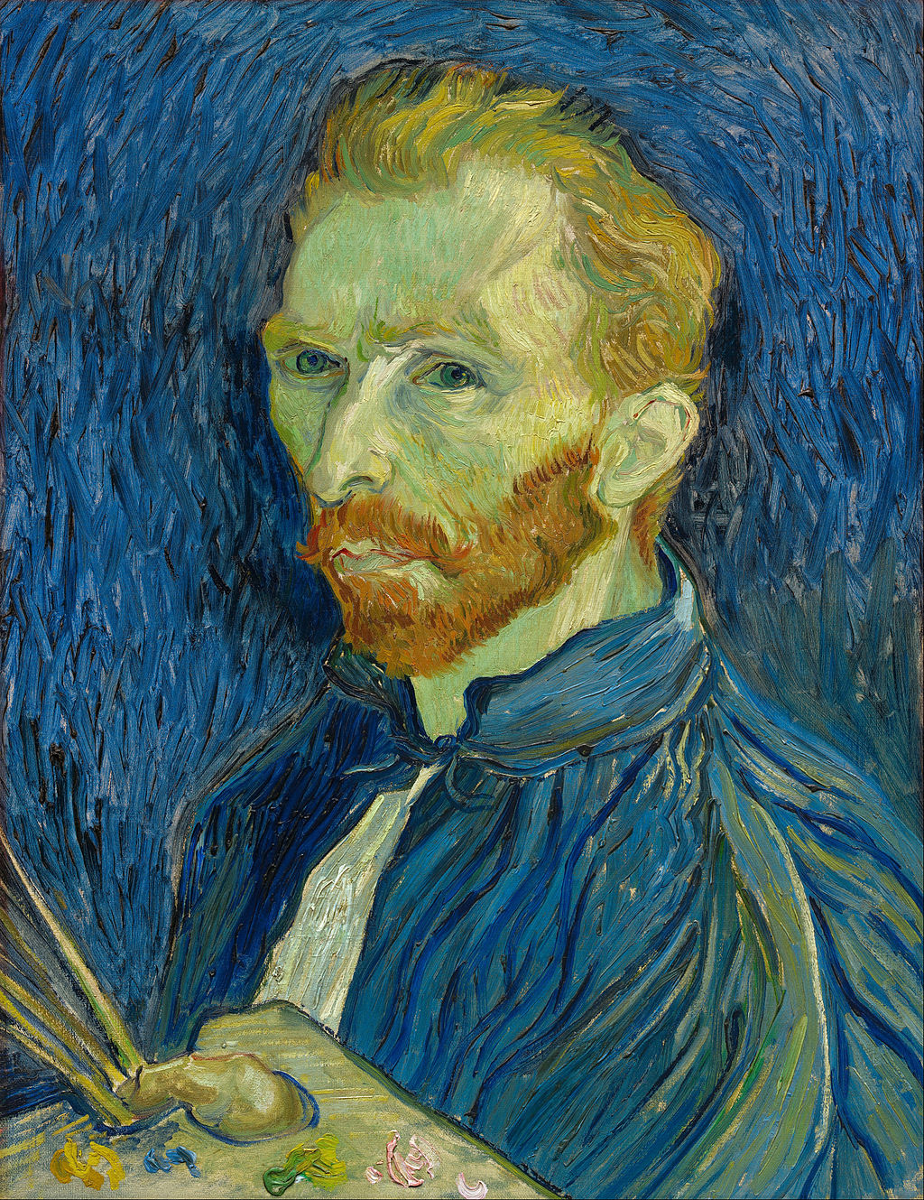
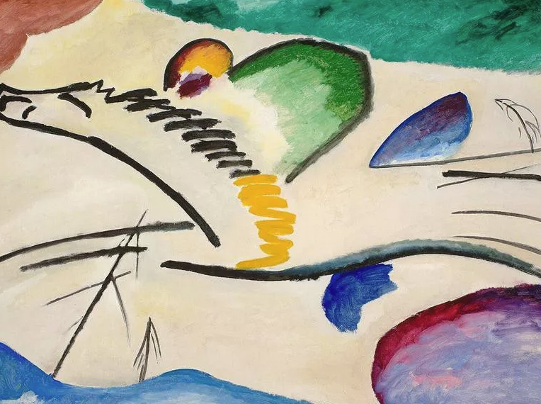
Examples of Famous 2d Art
©26 Best European Artists — and Where to See Their Work | Far & Wide (farandwide.com)
©Nineteenth Century 2D Art - AP Art History (varsitytutors.com)
©strongstuff — FALLOUT NEW VEGAS
Notes:
Can You Name All 50 Famous Paintings In This Quiz? | HowStuffWorks optional to play this quiz

Slide 5
Where can I find examples of art?
In the class room
On the walls of your home
On TV
Art Museum
Books
Can you think of any more?
Internet
Magazines

Slide 6
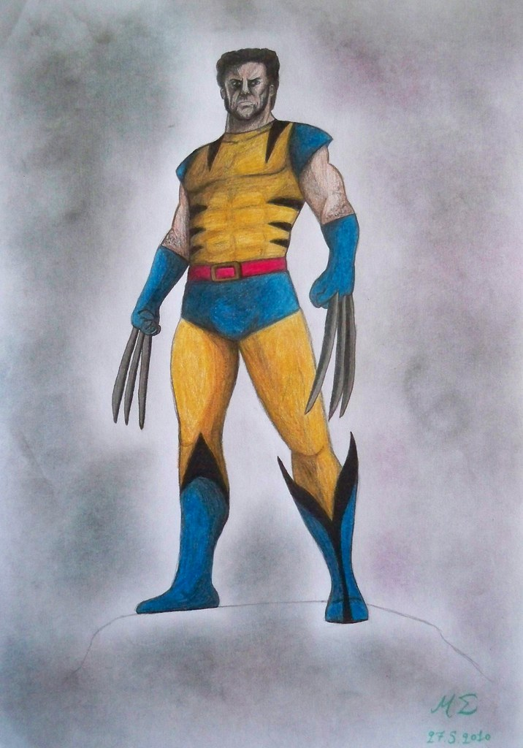
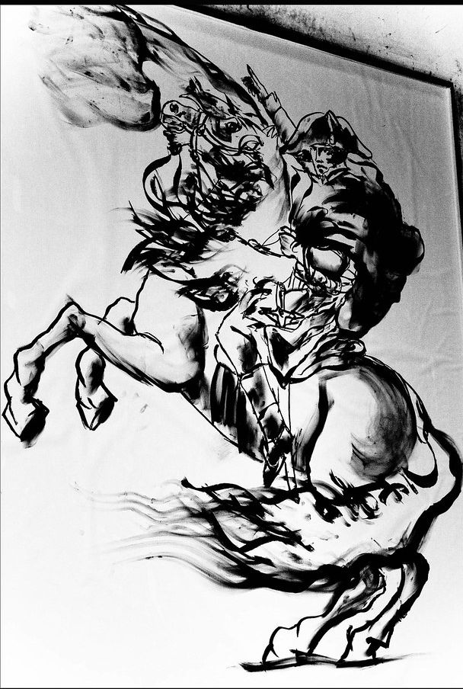
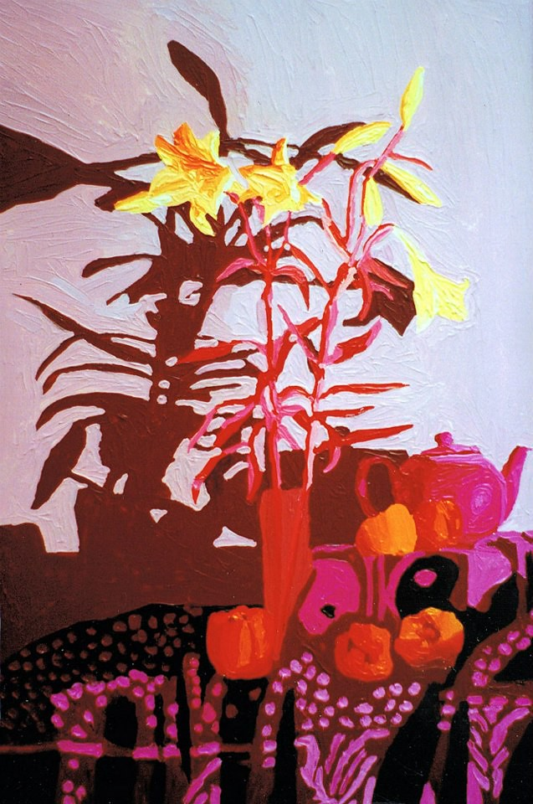
Different 2’d art techniques
Pencil Drawing
Charcoal Drawing
Oil Painting Drawing
©marthouli
©BBayanaa
©Raphael Perez Israeli Artist

Slide 7
Theme- Create a character for a computer game
Ideas
©dronepicr

Slide 8
2d computer game artists- Mario Shigeru Miyamoto
(c) Shigeru Miyamoto fala sobre a arte 2D dos games Mario dos anos 80 e mais | A Casa do Cogumelo

Slide 9
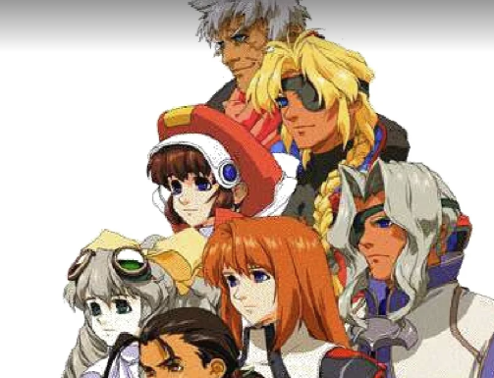
2d computer game artists- Final Fantasy Hironobu Sakaguchi
© https://www.slideshare.net/ReiTifa/hironobu-sakaguchis-works
Notes:
Drawings for final fantasy

Slide 10
2d computer game artists- Pokemon Ken Sugimori
©Hi-Res Pokémon! - Rescuing old Pokémon Art! on Twitter | Old pokemon, Pokemon, Pokemon art (pinterest.co.uk)

Slide 11
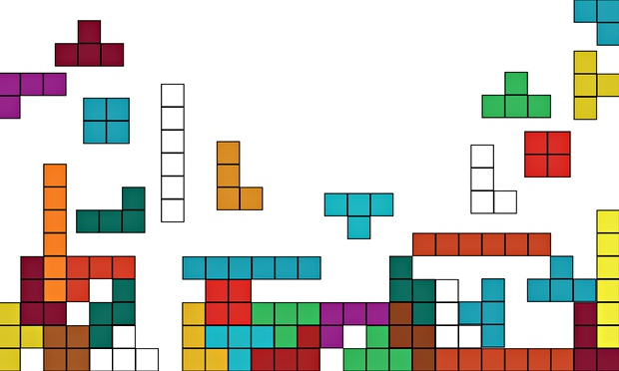
2d computer game artists- Tetris Alexey Pajitnov
©Tetris: how we made the addictive computer game | Art and design | The Guardian)

Slide 12
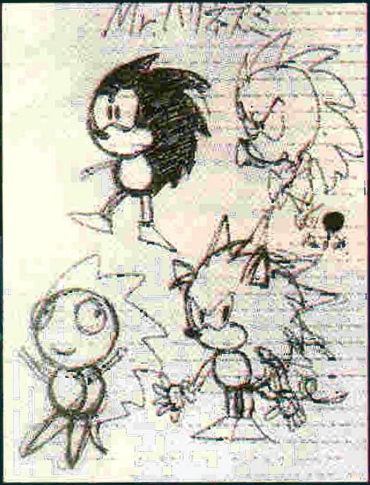
2d computer game artists- Sonic Yuji Naka
© 21 Things You Probably Didn't Know About Sonic The Hedgehog | Sonic the hedgehog, Sonic, Hedgehog (pinterest.co.uk)

Slide 13
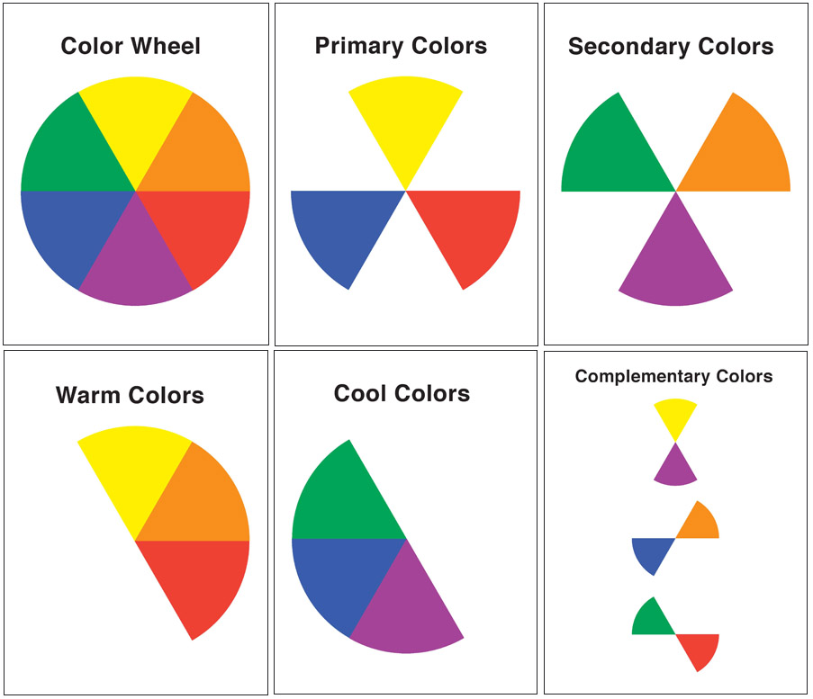
Colour Wheel Exploring Colours
©creat[ed]: Color Wheel - elementary art class (createdreno.blogspot.com)

Slide 14
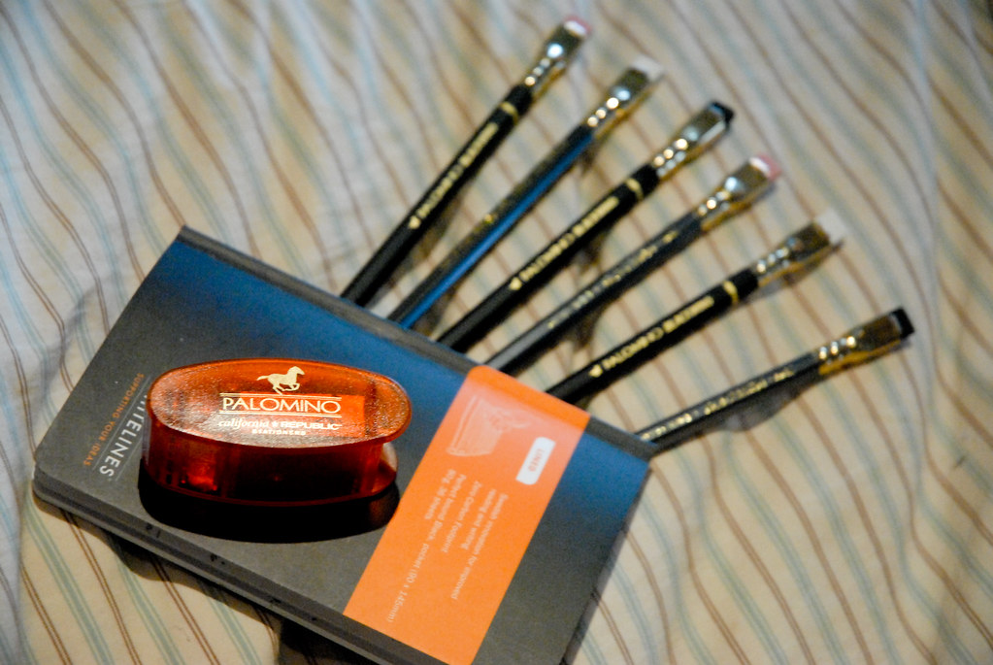
Practising Mark Making
©tsuacctnt
Work with your teacher to practice different kinds of mark making

Slide 15
Starting to plan your image
Take your ideas from the mind map activity
Start to plan your ideas

Slide 16
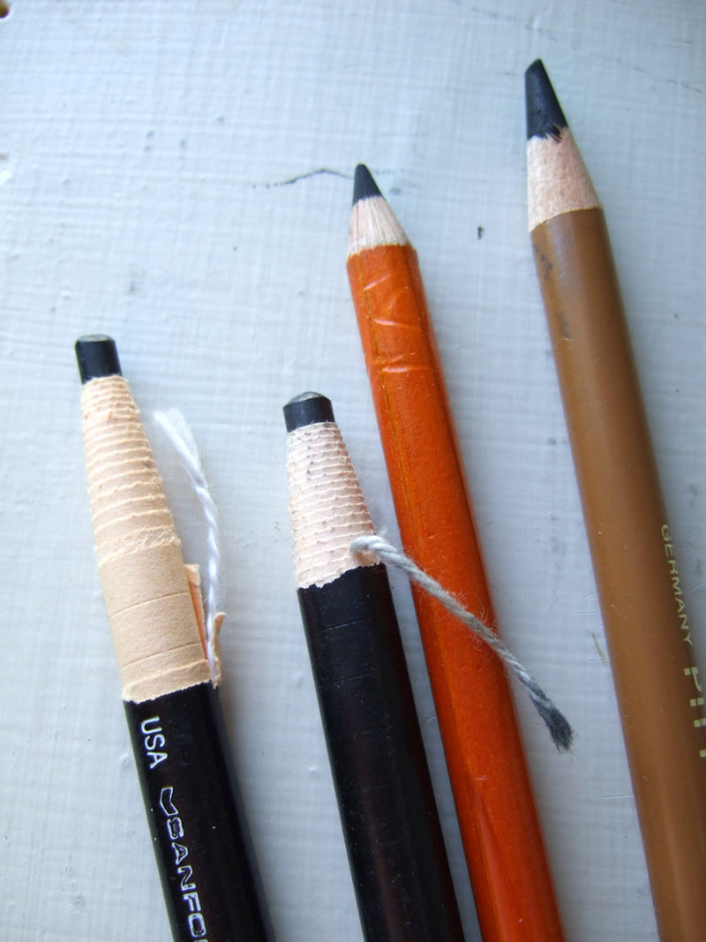
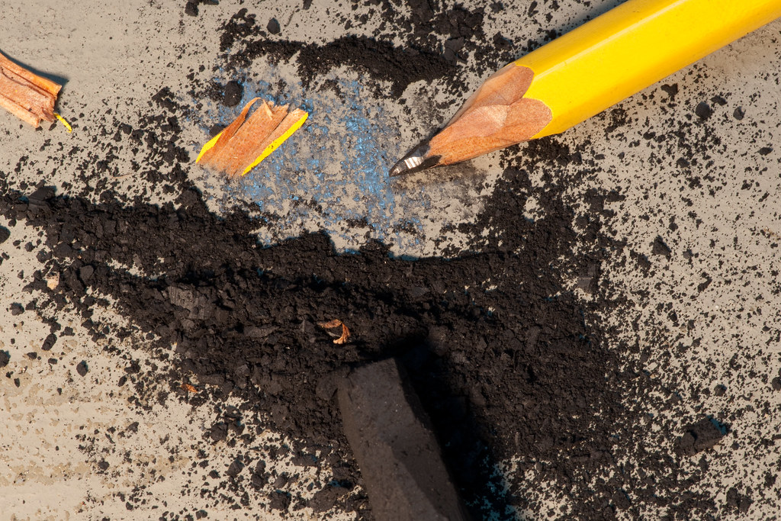
What method is this?
©exquisitur
©Charcoal pencils 051907 - Charcoal (art) - Wikipedia

Slide 17
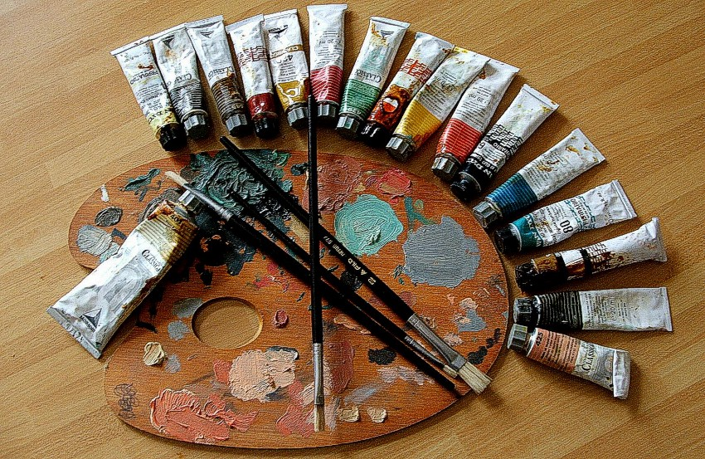
What method is this?
©Pittura-Painting4 - Category:Oil paintings - Wikimedia Commons

Slide 18
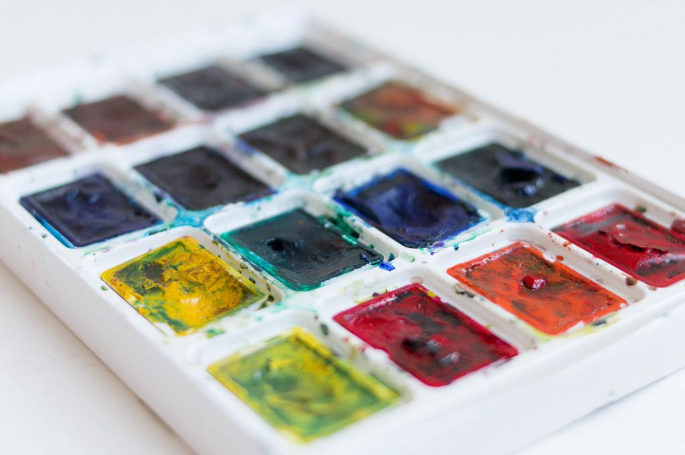
What method is this?
©Set of watercolor paints / Wassermalfarbe - Creative Commons Bilder (wuestenigel.com)

Slide 19
What method is this?
©artnews.com/art-news/product-recommendations/best-water-soluble-fabric-markers-1202693649/

Slide 20
What method is this?
hyyy (cracksforme.blogspot.com)

Slide 21
What method is this?
©Super great 100 Colored Pencils Sets ; Lapis de cor 100 Cores; Crayon de couleur; Dicke buntstifte; Renkli kalemler - AliExpress

Slide 22
End of Presentation
Notes:
Closing Slide

