Slide 1
BTEC LEVEL 1 Intro
Testing the Quality of Products

Slide 2
Using this resource
This resource is provided to you by Pearson for educational use as part of the Level 1 Introductory qualification suite.
The resource is a starting point to teaching the named unit on the title page. The intended purpose of this resource is to support teaching by helping to explore some of the key themes within the unit.
This resource does not cover nor is intended to cover all the full content for the unit and should be used in conjunction with additional teaching and learning materials to ensure full coverage.
All content is accurate at of time of publication and should be reviewed by the user before use in the classroom to ensure it is appropriate for centre needs
Any external content has been fully credited with the owner of the resource

Slide 3
What does the following word mean:
Quality Control

Slide 4
What does the following word mean:
Production Line

Slide 5
What does the following word mean:
Visual Inspection

Slide 6
What does the following word mean:
Testing

Slide 7
What does the following word mean:
Product Specification

Slide 8
What does the following word mean:
Defect

Slide 9
What does the following word mean:
Standard Test Method

Slide 10
What does the following word mean:
Standard Test Method

Slide 11
Qualitative Vs Quantitative The Difference
© (24) Qualitative vs. Quantitative Cheer - YouTube

Slide 12
Role of a quality control technician
© (24) A Day in the Life: Machine Operator & Quality Assurance Technician - YouTube

Slide 13
Units of Measurement
Length | Mass | Capacity
KM | G | L
M | KG | ML
CM | T | CC
MM | MG

Slide 14
Which unit of measurement would you use to measure this?
© Newcastle Libraries

Slide 15
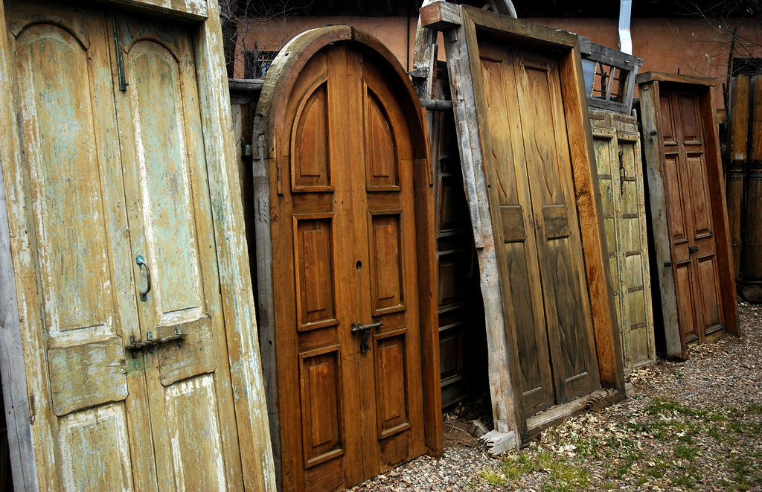
Which unit of measurement would you use to measure this?
© anyjazz65

Slide 16
Which unit of measurement would you use to measure this?
©Thomas Tolkien

Slide 17
Which unit of measurement would you use to measure this?
©Nottingham to MARITIME MAPS - Google Maps

Slide 18
Which unit of measurement would you use to measure this?
©JeepersMedia

Slide 19
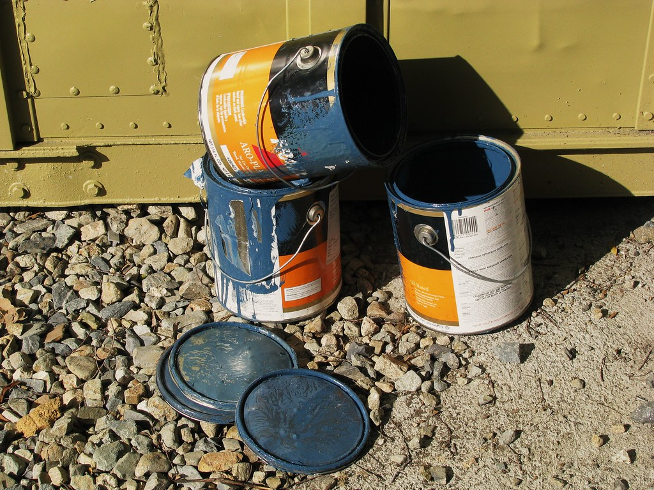
Which unit of measurement would you use to measure this?
©DBduo Photography

Slide 20
Which unit of measurement would you use to measure this?
©Dru Bloomfield - At Home in Scottsdale

Slide 21
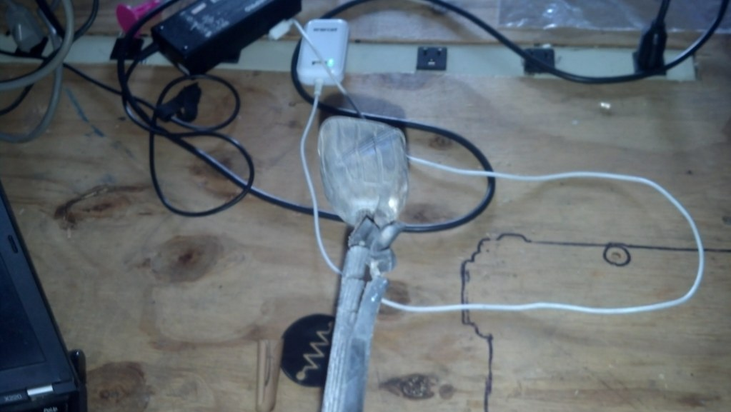
Spot the fault
©openfly

Slide 22
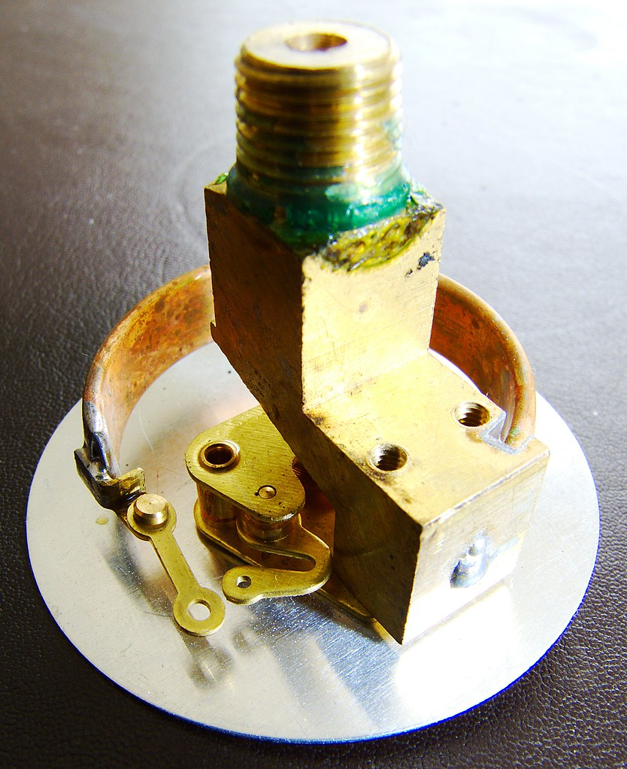
Spot the fault
©selkovjr

Slide 23
Spot the fault
©lyudagreen

Slide 24
Spot the fault
©Lee J Haywood

Slide 25
Which do you think will affect a company the most and why?
Loss of Revenue due to wastage or design fault
The risk of products going to market in unsafe conditions
Damage to company reputation

Slide 26
End of Presentation
Notes:
Closing Slide

