Slide 1
Dyspraxia in the Level 1 Classroom- What to look out for and how to support
Kelly Adams
Product Manager Level 1 below including Workskills and Personal Growth and Wellbeing

Slide 2
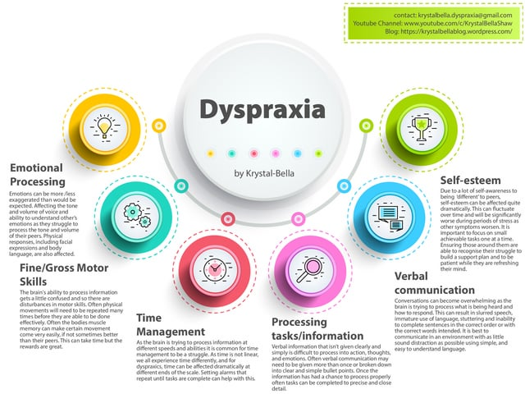
What is Dyspraxia
Dyspraxia, also known as Developmental Coordination Disorder (DCD), is a neurological condition that affects a person's ability to plan and coordinate physical movements.
These can include Fine Motor Skills (small muscles) and Gross Motor Skills (large muscles)
Prevalence: It affects approximately 5-10% of the population, with varying degrees of severity.
(c)
Notes:
Content Slide color accent left

Slide 3
Symptoms of Dyspraxia
Poor fine and gross motor skills
Difficulty with tasks like tying shoelaces, buttoning clothes, or using cutlery
Balance and spatial awareness challenges
Poor handwriting and drawing skills
Difficulty with organization and time management
Trouble with hand-eye coordination
May have difficulties with spelling and punctuation
Effect's ability to process large amounts of reading fully
Sensory sensitivities may be present

Slide 4
Challenges for the learner
Fine Motor Skills:
Challenges in writing, drawing, and using small tools.
Gross Motor Skills:
Difficulty in sports, physical education, and navigating the physical environment.
Organizational Skills:
Struggles with planning, time management, and keeping track of belongings.
Social and Emotional Impact:
Frustration, anxiety, and a potential impact on self-esteem

Slide 5
Strategies to support Level 1 learners with Dyspraxia
Occupational Therapy: Helps improve fine and gross motor skills.
Assistive Technology: Tools and software to aid in writing, organization, and note-taking.
Individualized Education Plans (IEPs): Tailored support in schools, including accommodations and modifications.
Structured Routines: Consistent schedules and visual aids for organization.
Sensory Support: Addressing sensory sensitivities and providing sensory breaks.

Slide 6
Links between SpLD conditions
©Pin on Books Worth Reading (pinterest.co.uk)

Slide 7
To discover more about the qualifications we offer in this suite please visit BTEC Entry Level | Level 1 | Level 1 Introductory | Pearson qualifications

Slide 8
End of Presentation
Notes:
Closing Slide

