Slide 1
Dyscalculia in the Level 1 Classroom- What to look out for and how to support
Kelly Adams
Product Manager Level 1 below including Workskills and Personal Growth and Wellbeing

Slide 2
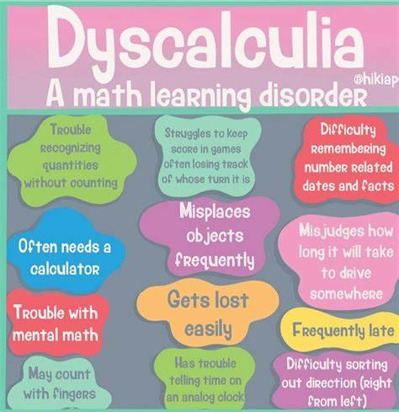
What is Dyscalculia?
Dyscalculia is a learning disability characterized by difficulty in understanding and working with numbers, arithmetic concepts, and mathematical symbols.
It affects approximately 5-7% of the population, with varying degrees of severity.
©Dyscalculia is so much more - Dyscalculia HeadlinesDyscalculia Headlines

Slide 3
Symptoms of Dyscalculia
Difficulty in understanding basic number concepts (e.g., counting, place value).
Struggles with arithmetic operations (addition, subtraction, multiplication, and division).
Challenges with telling time, understanding money, and measuring.
Poor sense of estimation and quantity.
Difficulty in grasping mathematical symbols and concepts.
Inconsistent mathematical performance.
This Photo by Unknown Author is licensed under CC BY-SA-NC

Slide 4
Challenges for the learner
Academic Challenges:
Poor performance in math-related subjects.
Low Confidence:
Frustration and reduced self-esteem can develop.
Time Management:
Difficulty in planning and estimating time.
Spatial Awareness:
Challenges with spatial and geometric concepts.

Slide 5
Strategies to support Level 1 learners with Dyscalculia
Multisensory Instruction: Using visual, auditory, and tactile methods to teach mathematical concepts.
Concrete Examples: Relating math problems to real-life situations.
Individualized Education Plans (IEPs): Tailored support in schools, including accommodations and modifications.
Assistive Technology: Tools and software for calculation and problem-solving.
Extra Time and Support: Providing additional time for math-related tasks.
Maths Anxiety Management: Techniques to reduce anxiety related to maths.

Slide 6
Links between SpLD conditions
©Pin on Books Worth Reading (pinterest.co.uk)

Slide 7
To discover more about the qualifications we offer in this suite please visit BTEC Entry Level | Level 1 | Level 1 Introductory | Pearson qualifications

Slide 8
End of Presentation
Notes:
Closing Slide

