Slide 1
BTEC LEVEL 1 Intro
A1 Being Organised

Slide 2
Using this resource
This resource is provided to you by Pearson for educational use as part of the Level 1 Introductory qualification suite.
The resource is a starting point to teaching the named unit on the title page. The intended purpose of this resource is to support teaching by helping to explore some of the key themes within the unit.
This resource does not cover nor is intended to cover all the full content for the unit and should be used in conjunction with additional teaching and learning materials to ensure full coverage.
All content is accurate at of time of publication and should be reviewed by the user before use in the classroom to ensure it is appropriate for centre needs
Any external content has been fully credited with the owner of the resource

Slide 3
Prioritising Tasks
Shopping List
Birthday Card for Ronnie on Monday
Friend’s grandma’s 50th Wedding anniversary gift
24 pack crisps
Mobile phone charger
Paper plates for party Saturday night
1kg oranges
Something for tonight’s meal
Flea treatment for cat
Sunflower seeds
Pencil case for school/college
You need to go into the town/city centre
You only have 2 hours
Each of the items you want to buy comes from a different store. Ideally you would like to buy all of them.
You usually go by bus from school, however the direct bus to town is delayed for 30 minutes
You have £20
Plan your route to town
Consider what on the shopping list is essential and which is not
Plan how you will collect the items
Consider what the items might cost and how you might pay
Notes:
Encourage learners to prioritise shopping list and time wisely. They may want to plan a route and alternative method of transport.

Slide 4
Time management- potential consequences
What might be the potential consequences to yourself be if you:

Slide 5
Time management- potential consequences
Didn’t know your timetable for lessons?
In the a) long Term and b) short Term

Slide 6
Time management- potential consequences
Came late to this class 10 times in one month?
In the a) long term and b) short term

Slide 7
Time management- potential consequences
If you did not hand in ANY homework on time?
In the a) long term and b) short term

Slide 8
Time management- potential consequences
Stopped coming to school when it was raining?
In the a) long term and b) short term

Slide 9
Time management- potential consequences
Turned up late to a job interview?
In the a) long Term and b) short Term

Slide 10
Time management- potential consequences
Did not have any structure to your day?
In the a) long Term and b) short Term

Slide 11
Time management- potential consequences
Forgot to set your alarm clock?
In the a) long Term and b) short Term

Slide 12
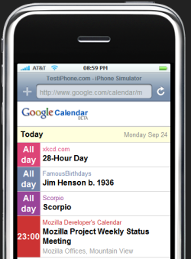
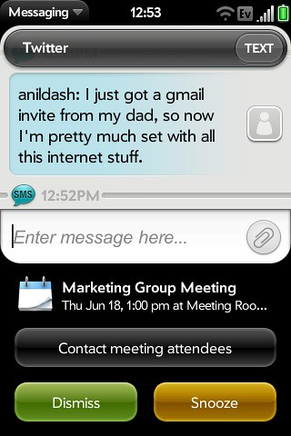
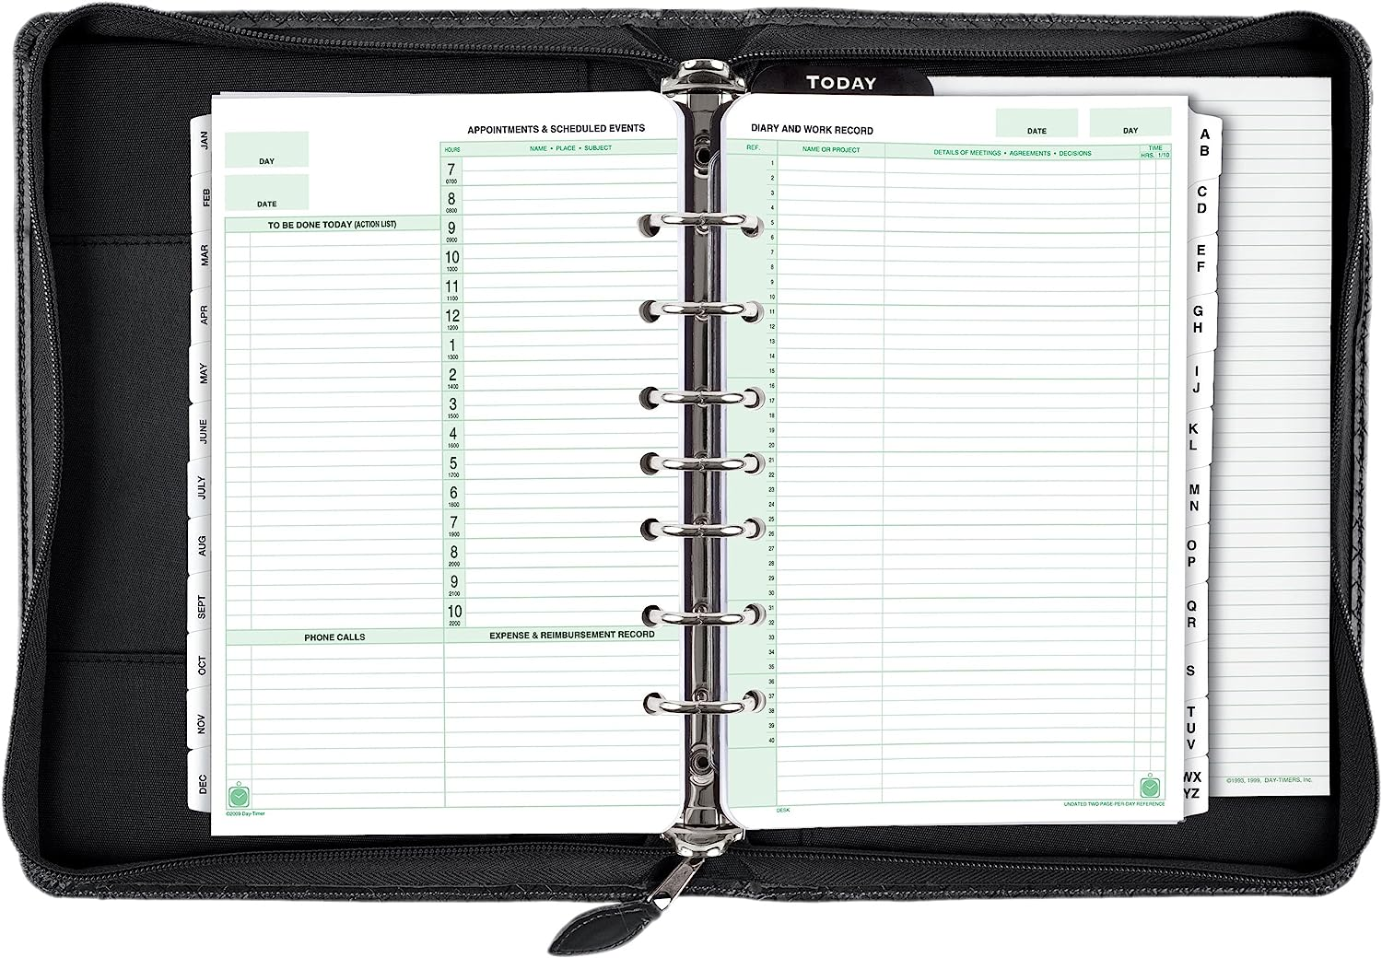
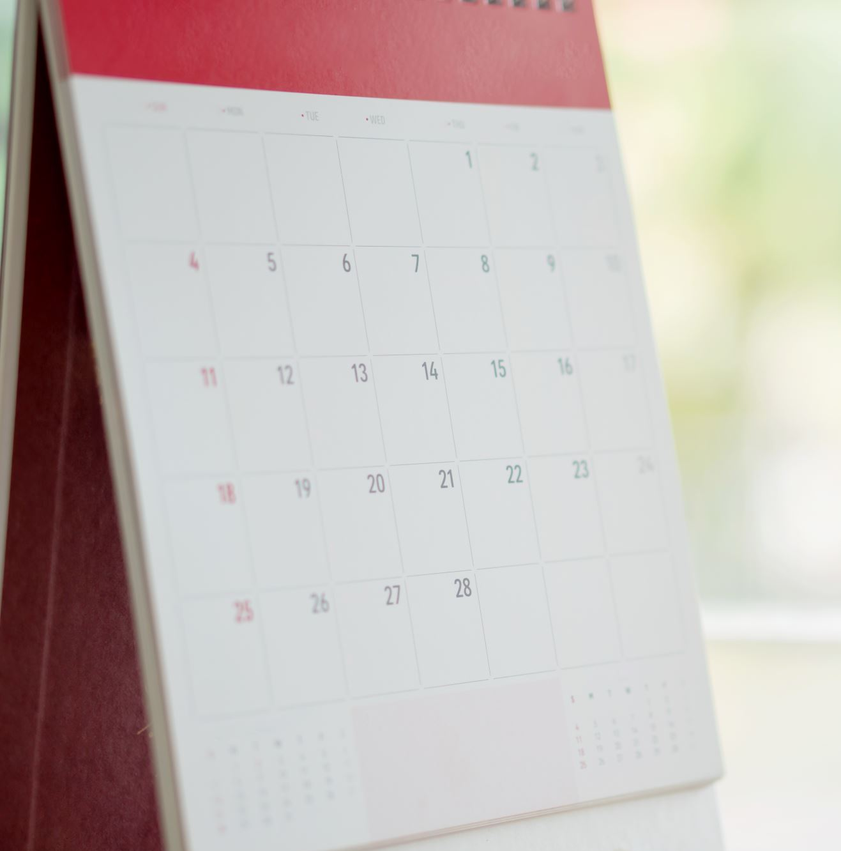
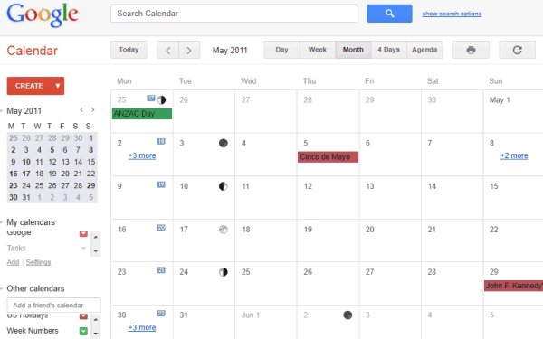
How can you organise your time??
©Amazon.com : Day-Timer Desk Size Multi-Pocket Organizer, 5 1/2 x 8 1/2 Page Size, Black Cover (40671) : Appointment Books And Planners : Office Products
©This Photo by Unknown Author is licensed under CC BY-SA-NC
© This Photo by Unknown Author is licensed under CC BY
©This Photo by Unknown Author is licensed under CC BY

Slide 13
Filing and Folders
How can we label paper files and folders ?
How about electronic files and folders?

Slide 14
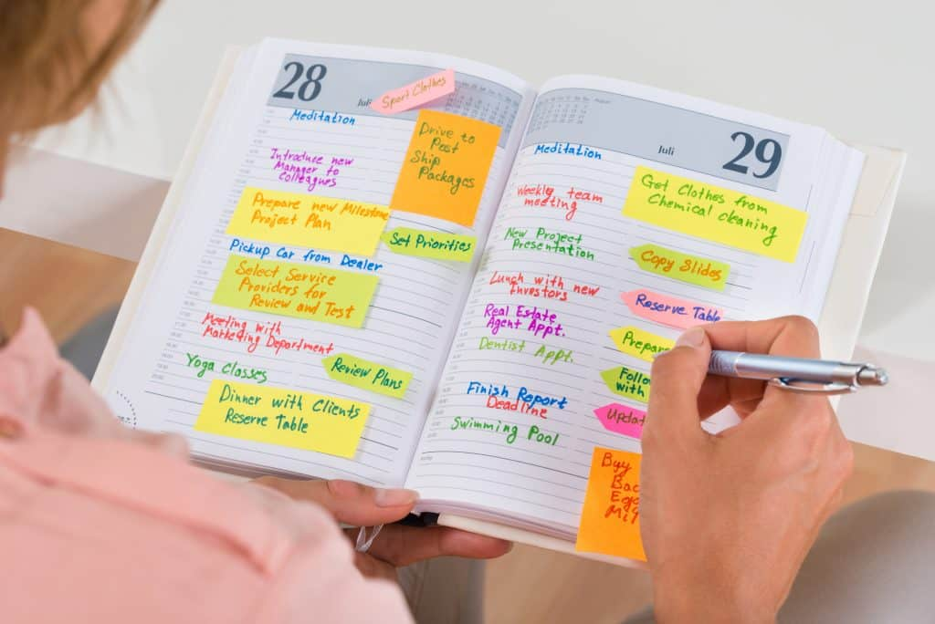
Planning using a planner
How can this be done?
Let’s practice these skills with a partner.
Identify a planner you would like to use and work with a partner to construct a weekly plan for them to follow.

Slide 15
How long should each task take?
1) Writing a letter to a Pen pal in Spain wishing them Happy Birthday. Their birthday is in 2 weeks time.
2)Completing your English homework due on Friday describing what you did last weekend.
3)Calling a relative to talk about going to stay in the summer holiday
4) Attend drum practice at the local church on Wednesday
5) Play in a computer game tournament with 3 friends
6) Learn how to make a Cottage Pie
7) Go to corner shop to buy potatoes for Cottage Pie
8) Wash up dishes
Notes:
The purpose of this activity is to get learners to consider the length of time tasks take. They should then prioritise these tasks and consider a plan to achieve them.

Slide 16
End of Presentation
Notes:
Closing Slide

