Slide 1
BTEC LEVEL 1 Intro
Branding

Slide 2
Using this resource
This resource is provided to you by Pearson for educational use as part of the Level 1 Introductory qualification suite.
The resource is a starting point to teaching the named unit on the title page. The intended purpose of this resource is to support teaching by helping to explore some of the key themes within the unit.
This resource does not cover nor is intended to cover all the full content for the unit and should be used in conjunction with additional teaching and learning materials to ensure full coverage.
All content is accurate at of time of publication and should be reviewed by the user before use in the classroom to ensure it is appropriate for centre needs
Any external content has been fully credited with the owner of the resource

Slide 3
Name The Slogan
I’m Lovin it
Notes:
McDonalds

Slide 4
Name The Slogan
Melts in your mouth,
Not in your hand
Notes:
M&M’s

Slide 5
Name The Slogan
The best a man can get
Notes:
Gillette,

Slide 6
Name The Slogan
Think Different
Notes:
Apple

Slide 7
Name The Slogan
The Happiest Place on Earth
Notes:
Disney

Slide 8
Name The Slogan
Finger lickin’ good
Notes:
KFc

Slide 9
Name The Slogan
Live Unboring
Notes:
Ikea

Slide 10
Name The Slogan
Eat Fresh
Notes:
Subway

Slide 11
Name The Slogan
Every Little Helps
Notes:
Tesco

Slide 12
Name The Slogan
It gives you wings
Notes:
Red bull

Slide 13
Branding Quiz
(c) (24) Guess the correct logo..! | 100 famous logos | Logo quiz - YouTube
Notes:
Will require you to pause for thinking time.

Slide 14
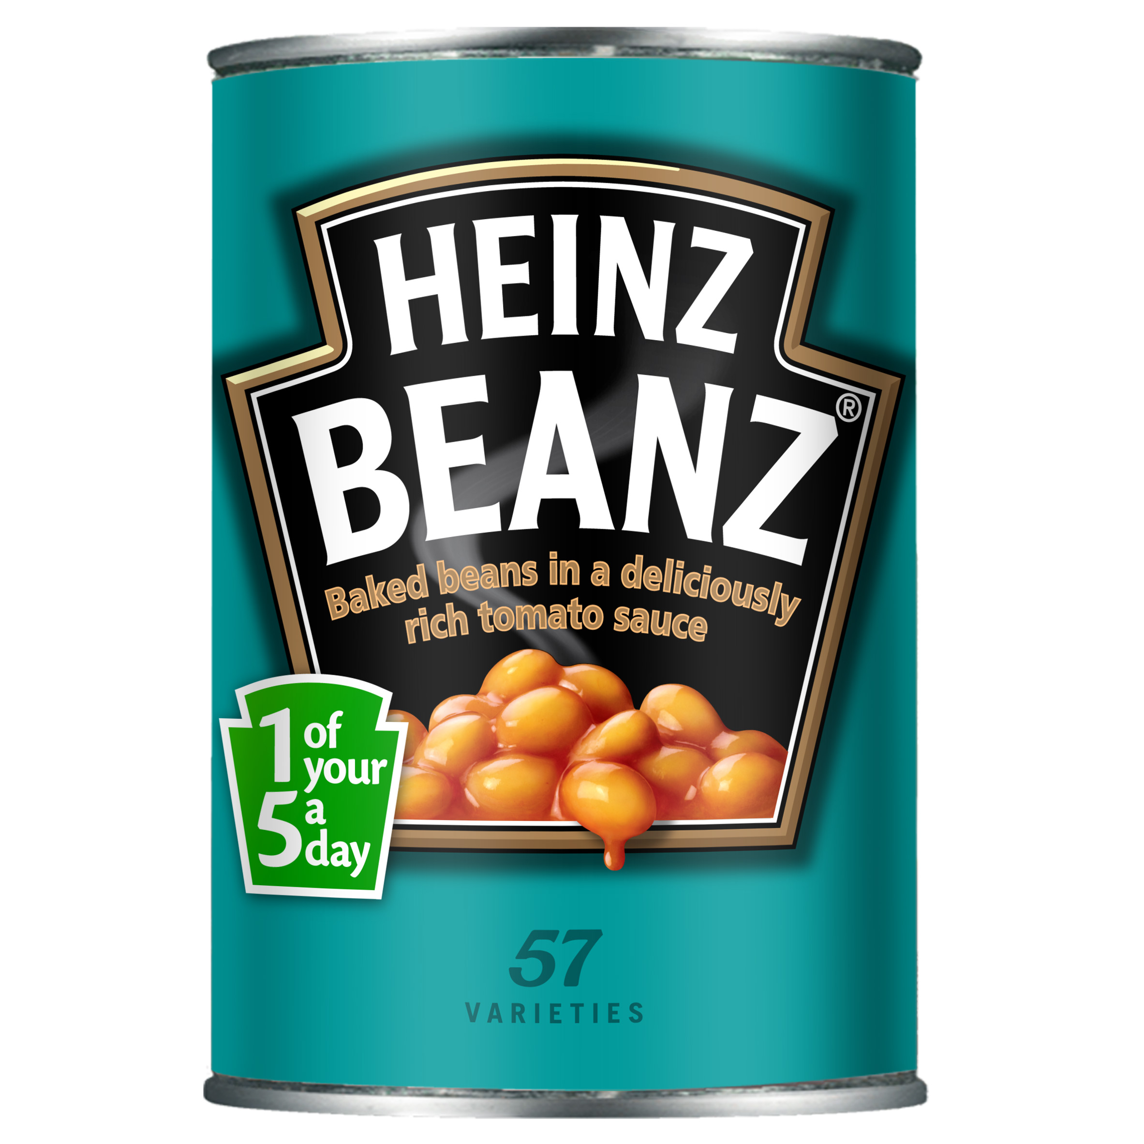
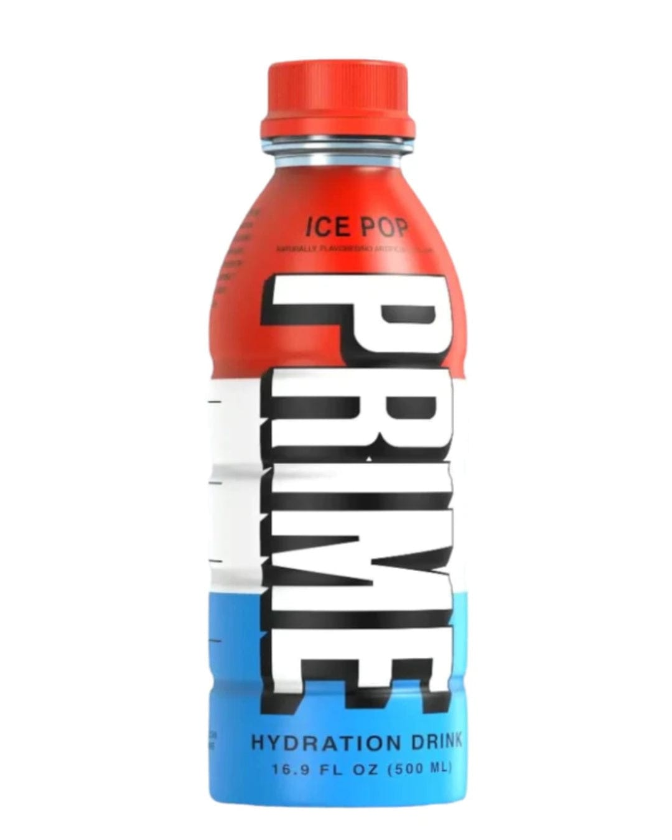
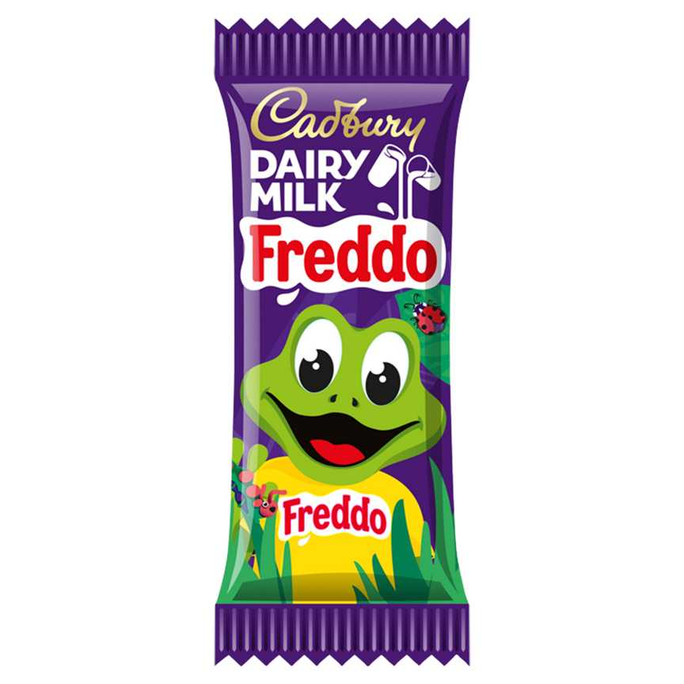
What Makes the Product Stand Out?
©Cadbury Dairy Milk Freddo Chocolate Bar - ASDA Groceries
©The Kraft Heinz Company
©Prime Ice Pop Hydration Drink, 500 ml – The Bottle Club

Slide 15
Why is it important these appeal to the target audience?
©Warburtons Wholegrain & Oats 400g | Brown & Wholemeal Bread | Iceland Foods
Colour
Images
Words
Font

Slide 16
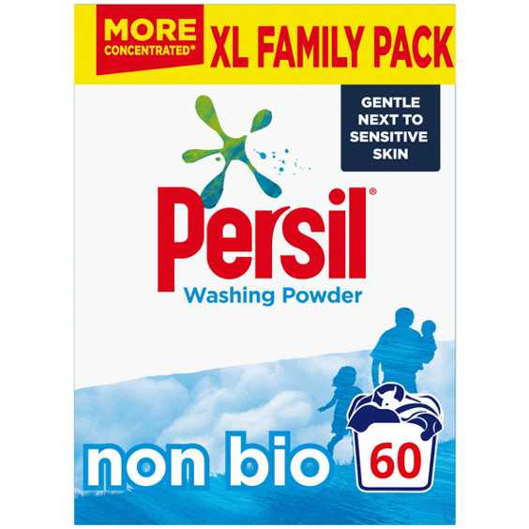
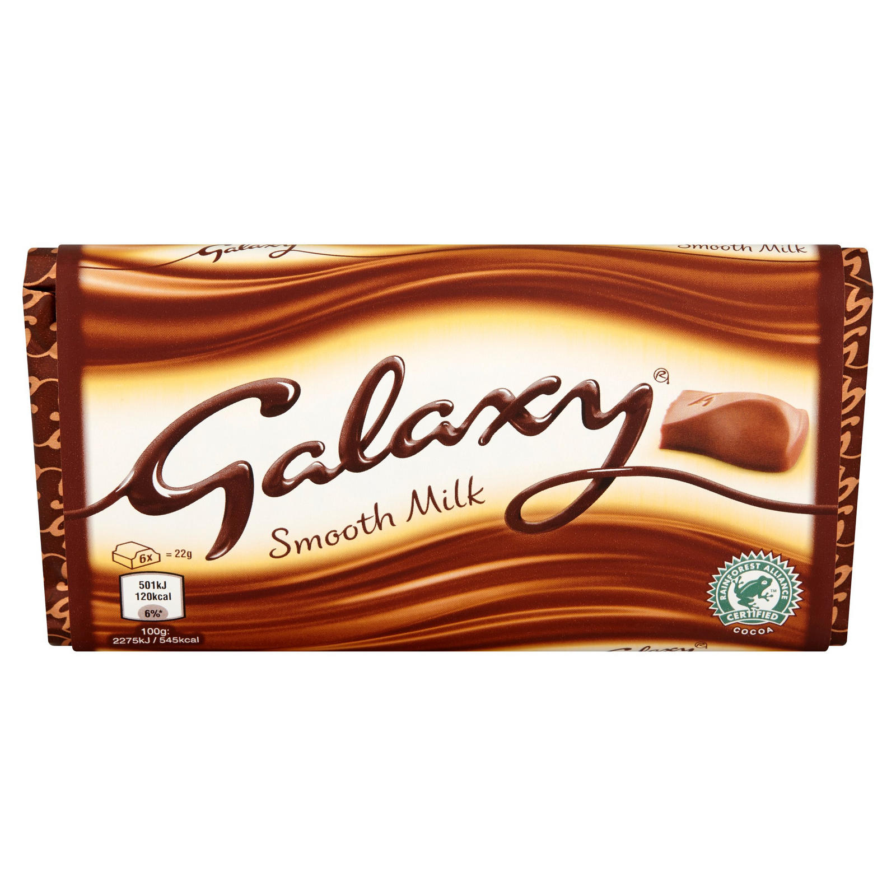
What are the messages are giving about their brand?
© Galaxy Smooth Milk Chocolate Block Bar Vegetarian 100g | Single Chocolate Bars & Bags | Iceland Foods
©Persil Non Bio Fabric Cleaning Washing Powder 60 Wash - ASDA Groceries
(c)Pin on Recipes (pinterest.co.uk)

Slide 17
End of Presentation
Notes:
Closing Slide

