Slide 1
Getting Started with Workskills 2017 Specification
Image by Photographer’s Name (Credit in black type) or
Image by Photographer’s Name (Credit in white type)
16BVWS01/01
May 2017
Presentation Title Arial Bold 7 pt
1

Slide 2
Outline
1 Introduction
2 Qualification structure
3 What existing centres need to check
4 Suggested programmes for centres
5 Creative Programming
6 Internal Verification and Assessment
Getting Started with New Specification Workskills
Notes:
Discuss the aims for the session to build upon the launch events but to look more practically at how the specification and qualification can be used to develop learners. It will look at what changes centres may need to make to current plans and approaches but will stress the opportunities that the new qualification offers

Slide 3
Introduction
Notes:
This should offer an introduction to the speaker and be a get to know the audience slide through the use of polls 1-4

Slide 4
The Context
Young People need to build their workplace skills on solid education foundations
CBI Education and Skills 2015
‘It is essential that we give people the skills to stay in work’
IPPR Think tank
18% of young people feel they will end up on benefits
Prince’s Trust
Skill levels have a major impact on individual life choices and those with high academic attainment usually have the poorest employability skills’
OECD Skills Report 2013
‘Careers guidance offered to young people lacks aspiration’
Barnardos
..only 1 in 4 UK employers offers work placement
UKCES
Getting Started with New Specification Workskills
Notes:
This slide provides an overall perspective to the need for skills development. A range of organisations make comment on the state of employability and ‘soft skills’ the need to develop skills that ensure that the workforce is ready to face the challenges of the current and future economy. An ability to identify that many jobs that exist now will not be there in ten years and that people must be resilient and dynamic.
Key survey’s and reports quoted:
States of uncertainty: Youth unemployment in Europe IPPR 2013
Helping the Inbetweeners – Barnardos August 2013
Abandoned Ambitions – Princes Trust August 2013
Learning to Grow: What Employers need from Education and Skills June 2012
Scaling the Youth employment Challenge: March 2013
OECD Skills Outlook 2013
Illustrates the points that it is not just youth but these are hardest hit but in the best position to receive quality advice and engagement. Equally skills of the older jobless must not be overlooked and is often more difficult to change attitudes and behaviours

Slide 5
UK Labour Market
UK Unemployment Rate for January to March 2016 for people aged 16 and over is 5.1%, this can be compared to a figure of 13.7% for young people aged 16 to 24. Other vulnerable groups also have higher figures.
Pearson/CBI Survey 2015 identifies that demand for high level skills will grow especially in construction, manufacturing, engineering, science and hi tech industries. Many businesses report weaknesses in the basic skills of graduates including business and customer awareness and use of English.
Pearson/ AELP ‘Routes into work….it’s Alright for Some’ identifies a labour market that instead of being triangular is hourglass shaped. In other words lots of low skilled jobs, lots of high skilled jobs but fewer in the middle that allow people to progress between the two.
Getting Started with New Specification Workskills
Notes:
Just some of the stark statistics that provide the backdrop to the need to be effectively prepared for the modern workplace – mention the role of WorkSkills also for those in work
Mention the importance of LMI and draw delegates’ attention to the new NOMIS government website which contains a wealth of important information at local level.

Slide 6
About Workskills Qualifications
Purpose
Workskills develops Learners’ Employability Skills either to start work immediately or in the future
There is nothing ‘Typical’
We have learners from 14 to 60 taking Workskills
programmes can be anything from 2 weeks to 2 years
Schools deliver as part of Enhancement/ Alternative Curriculum/ Study Programme
FE/ Training Providers deliver SFA-funded back to work programmes/ Work programme/ Traineeships/ Study programme
Can be Standalone or part of Skilled for Life programme
Getting Started with New Specification Workskills
Notes:
Illustrates the previous point. Workskills is a complex qualification that is taken every year by over 50 thousand learners who are undertaking programmes where their personal objectives are different. It means that Workskills is very widely recognised as a result and has played a part in developing many lives.
It is important to keep looking at the education landscape, in these stormy waters it is the need to develop employability skills alongside English and Maths that are the only constant. Increasingly the DFE is talking about a ‘transition year’ designed for learners who are not ready for a full level 2 performance table qualification. A popular approach is to centre this around soft skills and confidence development

Slide 7
Why do you do what you currently do?

Slide 8
Your Employability Provision
Activity 1 - With your table teams identify:
Why are you delivering this programme?
Are there any other types of programme that you would consider?
Why are your learners on the programme?
What is successful delivery to you?
What will your learners see as success?
Who has overall responsibility for the learners?
How do you do it now?
How much do you want to change?
Getting Started with New Specification Workskills
Notes:
Discussion activity that will extract the reasons behind providers wanting to deliver programmes, honest responses required (20 mins plus 10 feedback)
In response the starting pints of discussions need to be:
You need to know your learner motivations
You need to know who ‘owns’ the learners – are you responsible for their whole programme? Are you just the careers teacher? Are they candidates for a particular role? What are the drivers behind the learners?
BTECS are vocational qualifications You need to know your learner motivations
Don’t be surprised if learners don’t like being taught theory!

Slide 9
Qualification Structure
Notes:
Talk about the reasons that the new version is GLH rather the Credit based namely:
The RQF does not effectively support flexible credit-based qualifications as the structure allocates a GLH figure that is too low. GLH is needed to be accurate for centres as this is what everything is based on, including funding, resource allocation in centres and values for Welsh performance tables.
Explain that the impact of this for centres is limited, as credit is also a measure of time but divided by 10.

Slide 10
Workskills Qualifications - Features
Meeting learner needs
Qualifications available in different sizes at Entry to Level 2
A wide range of choice of different, up to date units with a flexible rule of combination
Assessment is entirely internal and adaptable to programme and centre requirements
Learners can be entered for Workskills and Certificated throughout the whole year
Getting Started with New Specification Workskills
Notes:
Review of what Workskills is all about it’s a flexible qualification, with flexible assessment and aims to meet a wide range of employability needs.

Slide 11
Workskills qualifications from 1.2.17
 | AWARDS |  |  | CERTIFICATES |  | DIPLOMA
 | 30 GLH | 70 GLH | 95 GLH | 130 GLH | 200 GLH | 400 GLH
Entry 3 | YES | YES | YES | YES | NO | NO
Level 1 | YES | YES | YES | YES | YES | YES
Level 2 | NO | YES | YES | YES | YES | YES
Getting Started with New Specification Workskills
Notes:
There are still a wide range of different sized qualifications available from Entry to Level 2. The full range of qualifications is available at Level 1. At Entry 3 Workskills is available from 30GLH to 130GLH and the reason for this is that these are introductory qualifications for learners who are motivated by the prospect of work to move them onto level 1. At level 2 the expectation for stretch is seen with a larger number of combinations driven by learner ability and independence. So fewer small steps are necessary which is the reason for starting at 70GLH with this being the least flexible combination.

Slide 12
New Qualification Titles and Numbers
Pearson BTEC Entry Level 30-GLH Award in Workskills (Entry 3) | 601/9011/5
Pearson BTEC Entry Level 70-GLH Award in Workskills (Entry 3) | 601/9016/4
Pearson BTEC Entry Level 95-GLH Award in Workskills (Entry 3) | 601/9018/8
Pearson BTEC Entry Level Certificate in Workskills (Entry 3) | 601/9015/2
Pearson BTEC Level 1 30-GLH Award in Workskills | 601/9014/0
Pearson BTEC Level 1 70-GLH Award in Workskills | 601/9019/X
Pearson BTEC Level 1 95-GLH Award in Workskills | 601/9013/9
Pearson BTEC Level 1 Certificate in Workskills | 601/9012/7
Pearson BTEC Level 1 Extended Certificate in Workskills | 601/9009/7
Pearson BTEC Level 1 Diploma in Workskills | 601/9010/3
Pearson BTEC Level 2 70-GLH Award in Workskills | 601/9008/5
Pearson BTEC Level 2 95-GLH Award in Workskills | 601/9017/6
Pearson BTEC Level 2 Certificate in Workskills | 601/9007/3
Pearson BTEC Level 2 Extended Certificate in Workskills | 601/9004/8
Pearson BTEC Level 2 Diploma in Workskills | 601/9005/X
Getting Started with New Specification Workskills
Notes:
No specific notes, is simply a list of Qualification numbers and titles for delegate reference

Slide 13
Selected New Units
Supporting Employability and Personal Effectiveness
Level 1 (50GLH)
Personal Behaviour for Success
E3 and Level 1 (30GLH)
Online Branding for Career Success
Level 2 (10GLH)
Developing your CV
Level 2 (10GLH)
Managing Transition into Work
Level 1 and 2 (10GLH)
How and why Businesses Operate
Level 1 and 2 (10GLH)
Getting Started with New Specification Workskills
Notes:
Explain that the two units at the top are high quality units that originate from other qualifications. These are also award-sized qualifications in their own right. Suggest centres putting larger programmes together look at how these can be used to support learners develop new skills in the context of a particular activity or industry.
The other units have been developed in response to feedback from customers. These go well alongside some of the other units that are already in existence, so Online branding (and a similar one is available at level 1) goes well alongside Applying for Jobs; Developing your CV can be taken alongside one of the other CV units, so you do the CV then move on and improve it. Managing transition into work was something that we were told was needed by schools and it goes well alongside behavioural units. How and why Businesses operate gives that background to the programme and the importance of the learner’s future role as an employee.

Slide 14
Rules of Combination – Entry 3
Qualification | Overall GLH | GLH at Entry 3
30 GLH Award | 30 (minimum of 2 units) | All
70 GLH Award | 70 | 40
95 GLH Award | 95 | 50
Certificate | 130 | 70
Getting Started with New Specification Workskills
Notes:
The rule of combination at Entry 3 is simple and straightforward. Learners have to complete a minimum of 2 units to achieve a qualification and this includes the 30GLH Award so all units included in this qualification are 25 GLH or smaller. The rule of combination in all qualifications is flexible and as a result learners are able to choose the units that they want to take.
At Entry Level in qualifications 70GLH and larger there are also units included at Level 1. The Level 2 units are not included as there is too large a gap between the levels. The main purpose of Entry Level Workskills is progression to level 1 for learners who are engaged by the prospect of work.

Slide 15
Rules of Combination – Level 1
Qualification | Overall GLH | Min GLH from Mandatory Group A | Max GLH from Optional Group B | GLH at Level 1
30 GLH Award | 30 | 30 (minimum 2 units) | None Permitted | All
70 GLH Award | 70 | 70 | None Permitted | 40
95 GLH Award | 95 | 95 | None Permitted | 50
Certificate | 130 | 100 | 30 with a maximum of one unit from group B1 | 70
Extended Certificate | 200 | 140 | 60 with a maximum of one unit from group B1 | 110
Diploma | 400 | 210 | 180 with a maximum of one unit from group B1 | 210
Getting Started with New Specification Workskills
Notes:
At Level 1 there are qualifications all the way from an introductory level 1 qualification to a 400 GLH Diploma. For qualifications of certificate-size and larger we have introduced an optional group, which includes sector-based units in Group B1 and PSD units in Group B2. This is to allow learners to investigate their interests further and also develop wider employability skills in longer programmes.
The small, introductory 30GLH Award requires all of the GLH to be at level 1. From 70GLH there can be a mixture of Entry 3, level 2 and Level 1, although a minimum GLH must be at Level 1 as stated. This allows learners to develop and progress through the levels during their programme. Make sure that you check the specification carefully to make sure that the units that you intend to take at different levels are not barred against each other as many very similar ones are.

Slide 16
Rules of Combination – Level 2
Qualification | Overall GLH | Min GLH from Mandatory Group A | Max GLH from Optional Group B | GLH at Level 2
70 GLH Award | 70 | 70 | None Permitted | All
95 GLH Award | 95 | 95 | None Permitted | 50
Certificate | 130 | 100 | 30 with a maximum of one unit from group B1 | 70
Extended Certificate | 200 | 140 | 60 with a maximum of one unit from group B1 | 110
Diploma | 400 | 210 | 180 with a maximum of one unit from group B1 | 210
Getting Started with New Specification Workskills
Notes:
At level 2 there are no longer introductory qualifications, and as a result the smallest qualification is 70GLH. This is because we expect learners to achieve more in order to achieve a qualification at level 2, particularly one that is developing generic skills.
In the 70GLH qualification, all of the units are expected to be at level 2. In the larger qualifications (95GLH and above) it is permitted to include some units that are at level 1. Once again make sure you carefully check unit barrings in the specification.

Slide 17
What is the same?
Flexible rule of combination | The employability units are still included in a flexible rule of combination so that the programme can be formed according to the needs of the learner
Core content | Unit content is still based on core employability skills. The content included in the original version is still included in the new version
Range of different-sized qualifications | There is a range of different sized qualifications, from Entry 3 to Level 2
Purpose of developing employability skills | The new qualifications are designed to be used with the same learners and for the same purpose as the previous versions
Assessment methodology | WorkSkills is still assessed internally for all units as previously
Getting Started with New Specification Workskills
Notes:
Explain that we didn’t want to ‘throw the baby out with the bathwater’ so have kept much of what had worked before, just updating and bringing into the 21st century and beyond

Slide 18
What has changed?
Rule of Combination | Is now based on Guided Learning Hours
New content | There is new updated content , leading to some new units and in other cases slightly changed units.
More emphasis on practical skills | Assessment is now more based on the practical skills that learners need for work
New optional group for sector units | There is an optional group of units that include sector units. No one has to take these units but they will help to support many programmes
Level 3 Workskills | Has been withdrawn without replacement
Level 2 Workskills | The 3-credit award has been withdrawn without replacement.
Getting Started with New Specification Workskills
Notes:
The qualification offers a greater level of ‘centre lead’ flexibility in content to allow you meet the local skills agenda. The qualification also attempts to be more skills based in assessment outcomes.
The biggest change is that the Rule of combination is now based on GLH. This change has been made due to changes in qualification frameworks and an increased emphasis by government and funding agencies on minimum GLH rather than the overall qualification size.
Some things have changed for the better, we have introduced new units such as “managing the transition into work (level 2), Preparing for the recruitment process (2) ” , we have combined some units ( applying for a Job and Searching for a job are now Applying for Jobs) and have equally taken a pragmatic approach in saying that some units simply didn’t work e.g. Leadership at E3

Slide 19
What existing centres need to check

Slide 20
It is vital to check:
GLH
GLH of individual units as some of these have changed even from previous 2016 version.
GLH of each qualification. You may have to do more units.
Units
Some have changed outcomes from the 2011 version. The Learning outcomes and assessment criteria have not changed from the version shared in 2016, however.
Guidance
Even when the Learning Outcomes and assessment criteria are the same you must carefully check the assessment guidance to make sure you are meeting all requirements.
Getting Started with New Specification Workskills
Notes:
Alongside the notes on slide, this is also a useful point to remind centres that you should check whether your unit combinations actually still meet your learners needs. Read the new units even if the unit titles seem the same as some of these have been re-purposed. Consider if there is a better combination that meets needs.

Slide 21
So what do you need to consider?
All of the answers from your table discussions!
New or changed units
Size of programme
Flexibility of programme
Resources available
Staff
Locality
Physical resources
Time
Getting Started with New Specification Workskills

Slide 22
Suggested Programmes for Centres
Notes:
Discuss that the following slides cover suggested programmes only, they are not how you must but are how you might.

Slide 23
Suggested plans
For Unemployed Learners undertaking short programmes.
Programme A: Supporting unemployed learners to find work
Self Assessment (Entry 3 10 GLH)
Using a CV and Covering Letter to apply for a Job (Level 1 20 GLH)
Maintaining a suitable online presence for Employment (Level 1 10 GLH)
Applying for Jobs (Level 1 15 GLH)*
Achieving Success at Interview (Level 1 15 GLH)*
Programme B: Supporting learners about to start searching for work
Investigating Rights and Responsibilities at Work (Level 1 10 GLH)
Personal Behaviour for success (Level 1 30 GLH)
Personal Presentation for the Workplace (Level 1 15 GLH)*
Managing your Own Money (Level 1 15 GLH)*
bb
Image by Photographer's Name (Credit in black type) or
Image by Photographer's Name (Credit in white type)
Individually, programme A and B achieve:
Pearson BTEC Level 1 70-GLH Award in Workskills
Could be combined to achieve:
Pearson BTEC Level 1 Certificate in Workskills
* Achieves Pearson BTEC Level 1 30-GLH Award in Workskills
Getting Started with New Specification Workskills

Slide 24
Suggested plans
To support learners undertaking enterprise
Programme C – Level 1
- Planning an Enterprise Activity (Entry 3 10 GLH)
- How and Why Businesses Operate (Level 1 10 GLH)
- Producing a Product (Level 1 20 GLH)*
- Running an Enterprise Activity (Level 1 10 GLH)*
- Working in a Team (Level 1 20 GLH)
Programme D – Level 2
- Planning an Enterprise Activity (Level 2 10 GLH)*
- How and Why Businesses Operate (Level 2 10 GLH)*
- Producing a Product (Level 2 20 GLH)*
- Running an Enterprise Activity (Level 2 20 GLH)*
- Working in a Team (Level 2 30 GLH)
- Reviewing and Improving Own Performance (level 2 10 GLH)
Image by Photographer's Name (Credit in black type) or
Image by Photographer's Name (Credit in white type)
Programme C achieves:
Pearson BTEC Level 1 70-GLH Award in Workskills
Units with * combine to achieve the 30-GLH Award
Programme D achieves:
Pearson BTEC Level 2 95-GLH Award in Workskills Units with * combine to achieve the 70-GLH Award
)
Getting Started with New Specification Workskills
Notes:
Enterprise is a key element of the Statutory Careers guidance and also a key government focus. Increasing number of individuals are self-employed and these unit combinations can provide a useful gateway to self-employment

Slide 25
Suggested plans
To support learners on Work Placement
Programme E - Level 1
- Managing Transition into Work (Level 1 10 GLH)*
- Preparing for Work Placement (Level 1 10 GLH)*
- Health and Safety at Work (Level 1 20 GLH)
- Learning from More Experienced People (Level 1 20 GLH)
- Learning From Work Placement (Level 1 10 GLH)*
Programme F - Level 2
- Managing Transition into Work (Level 2 10 GLH)
- Preparing for Work Placement (Level 2 10 GLH)
- Health and Safety at Work (Level 1 20 GLH)
- Learning from More Experienced People (Level 2 15 GLH)
- Learning from Work Placement (Level 2 20 GLH)
- Developing Resilience for Work (Level 2 10 GLH)
- Reviewing and Improving Own Performance (Level 2 10 GLH)
Image by Photographer's Name (Credit in black type) or
Image by Photographer's Name (Credit in white type)
Programme E achieves:
Pearson BTEC Level 1 70-GLH Award in Workskills
Units with * combine to achieve the Level 1 30-GLH Award
Programme F achieves:
Pearson BTEC Level 2 95-GLH Award in Workskills
Getting Started with New Specification Workskills
Notes:
Work Placement is a mandatory part of traineeships and study programmes. Adding structure to that experience enables learners to remain focused and again positive outputs that will develop their future employment opportunities by allowing them to have a story to tell within interviews.

Slide 26
Suggested plans
For Sector Based Work Academy
Image placeholder
Programme G – Achieves Level 1 Extended Certificate in Workskills (200GLH)
- Self Assessment (Level 1 15GLH)
- Personal Behaviour for Success (Level 1 30GLH)
- Supporting Employability and Personal Effectiveness (Level 1 50GLH)
- Health and Safety at Work (Level 1 20GLH)
- Personal Presentation for the Workplace (Level 1 15GLH)
- Understand how to deal with Customers Requests, Queries and Problems (Level 1 20GLH)
- Building Working Relationships with Customers (Level 2 20GLH)
- Applying for Jobs (Level 1 15GLH)
- Achieving success at Interview (Level 1 15GLH)
Image by Photographer's Name (Credit in black type) or
Image by Photographer's Name (Credit in white type)
Programme description
This programme has an introduction, where learners develop generic skills. In the middle part of the programme they then develop job specific skills, towards the end achieving a customer relations unit at level 2. The final part concentrates on securing a job.
Getting Started with New Specification Workskills
Notes:
Units within the SBA here may have some learners having covered content at lower levels in this case the opportunity is to deliver these for some candidates at Level 2.

Slide 27
Creative Programming
Notes:
WorkSkills is a flexible qualification that allows you as deliverers to think differently and in innovative ways that can really bring employability education out of the classroom and closer to the workplace.

Slide 28
Using the Changes to suit staffing
Lots of unit content is now generic to suit your local circumstances
Clear crossovers exist with units and other qualifications
Teaching and assessment team can be developed using input from any area of vocational specialism
Teaching and Learning is most effective when teachers are knowledgeable and passionate
Should you base your programme around teachers availability?
Getting Started with New Specification Workskills
Notes:
This slide considers approaches that centres can take to delivery of the qualification and the key factors hat can be considered. The final bullet is a discussion point as there are pro’s and cons to this approach.

Slide 29
Implications for Teaching
Successful Employability Programmes are:
Image placeholder
Learner focused from Day 1
Rooted in the ‘Real World’
Engaging and interesting
Reflective
Image by Photographer's Name (Credit in black type) or
Image by Photographer's Name (Credit in white type)
“You don’t learn to walk by following rules, you learn by doing and falling over”
Richard Branson
Getting Started with New Specification Workskills
Notes:
Learner Progression need to be a clear focus from Day 1 of the programme
In essence the most successful employability programmes have
- clear pathways to success (not necessarily from Day 1 allowing for exploration and transfer also successful)
Enjoyable and engaging delivery it should feel like a linked package
Have workplace / work placement focused elements and assessment hand in hand keepinglearners focused and on task when not under your direct control
Contextualised English and Maths

Slide 30
Building a Programme (Activity 2)
1
2
3
4
What are the aims for your learners?
What areas of Employability do you need to consider to meet these aims?
How long have you got to deliver, including mop-ups?
What opportunities exist to do more?
30
Getting Started with New Specification Workskills
Notes:
Key questions that centres need to consider to build effective programmes. This is an opportunity to think back to the morning activity as centres seek to develop programmes using the new specifications.
1. What does this mean for centres, in terms of funding opportunities, what does the funding profile look like? What are the characteristics of the learner groups?
2. Knowing the learners is key, WorkSkills in its new guise provides a solution for most learners employability needs, maybe learners only need one or two areas, use the flexibility of the qualification to meet the aims, it can be complementary to or stand alone in nature
3. The qualification offers opportunities for flexible delivery, for unit cross over and assessment for learning which can mean that programmes can be delivered efficiently but leave enough time for effective evidence collection and assessment
4. But when a programme is taking shape keep an open mind on the selection of units, don’t give things away for free! Which means if you plan to deliver it see if you can assess it. Adaptation of existing programmes can create great opportunities!
Use the slide as the lead into the activity. Centres to then package units form new qual to meet learner needs

Slide 31
Activity 3
Consider the employability areas you identified in Activity 2
Select the units from the programme that meet those aims
Read units and consider if any overlap?
Do the units have a natural sequence?
Create an engaging assignment 'outline' on your table that considers two (or more units)
Swap with another table and 'internally verify' it
Feedback
Getting Started with New Specification Workskills
Notes:
Aim here is get centres to think about learners needs rather than simply selecting a batch of units. Reinforce that the full unit should be read, not just the introduction or the content. Workskills is holistic and works most effectively when that approach. The sharing allows for the percolation of ideas and ‘stealing’ ideas of others is actively encouraged!!

Slide 32
Fresh Start- Fresh ideas?
Thinking imaginatively
“Success consists of going from failure to failure without loss of enthusiasm.”
Winston Churchill
WorkSkills can be a tailored programme that allows your learners to gain the skills that they need
Nowhere does it say:
Unit x must be followed by unit y
That assessment has to be written
That assessment must be knowledge driven
To succeed in work is to enjoy it, to match skills to interests and to develop by making mistakes and learning from them
Creative approaches to WorkSkills are more fun to be part of and to deliver
Tips
Think about what your learners need to succeed and not about what you fancy delivering
Think about units that complement each other
Think about exciting and engaging projects and work backwards from the outcome to the units and assessment
DON’T repeat yourself if you notice a crossover capitalise on it!
Getting Started with New Specification Workskills
Notes:
The idea is talk about the fact that WorkSkills maintains its versatility in assessment. The most creative programmes allow learners to learn by doing, with assessment gained practically in ‘real situations’.
The slide discusses the creative ways that the work can be assessed and delivered. It is designed for assessment to be as practical as possible, it is hoped that units are delivered together rather than positively discouraged.
It will however provide great evidence that employability is being delivered in a way that matters to learners
Anybody can teach a learner to complete an application form, but only creative and imaginative delivery of a whole programme can make that application form stand out as something special worthy of an interview.

Slide 33
Fresh Start- Creative Programmes
Thinking imaginatively
A local company are looking for support with a social media marketing strategy.
Learners investigate the company, carry out market research, devise a strategy, prepare a pitch to the MD, obtain feedback and review then implement the strategy.
Possible Units:
- Supporting Employability and Personal Effectiveness (Level 1 50GLH)
- Online Branding for Career Success (Level 2 10GLH)
- How and Why Businesses Operate (Level 2 10GLH)
- Working in a Team (Level 2 30GLH)
- Solving Work Related Problems (Level 2 20GLH)
- IT Communication Fundamentals (Level 2 15GLH)
Outcome is Pearson BTEC Level 2 Certificate in Workskills (130GLH)
The basis for creative programmes is to work from the project outcome and not from the unit titles or learning outcomes
Projects could be:
- Social Enterprises
- Community Volunteering
- Concerts/ Events
- Commissioned Work
Units such as SEPE allow a range of different experiences to be captured. Many units can be delivered in the context of a specific industry or learner.
Getting Started with New Specification Workskills
Notes:
Of course creative assessment is dependent on creativity in programme delivery and design.
Workskills is able to support a wide range of different types of programme for different learners while developing Skills that are central to work. It is normal in vocational skills-based qualifications for there to be a mixture of levels for different types of unit, so where appropriate include units that are at different levels to the overall programme.

Slide 34
Activity 4
Consider the creative programme on the previous slide
Identify the 'milestones' in the programme
Identify the taught elements
Identify the 'products' that learners will produce that could be assessed
Sequence the learning and assessment in a flowchart
Swap with another table and 'internally verify' it
Feedback
Getting Started with New Specification Workskills
Notes:
Aim here is get centres to think about learners needs rather than simply selecting a batch of units. Reinforce that the full unit should be read, not just the introduction or the content. Workskills is holistic and works most effectively when that approach. The sharing allows for the percolation of ideas and ‘stealing’ ideas of others is actively encouraged!!

Slide 35
How best to succeed
Teach in a project based way
If your delivery and assessment is case study and research focused learners are better prepared for work and assessment
Combine teaching across units
Identify the 'products' that learners will produce that could be assessed
By taking a practical approach learners get what they want and you can guide them ‘in teaching’
Getting Started with New Specification Workskills

Slide 36
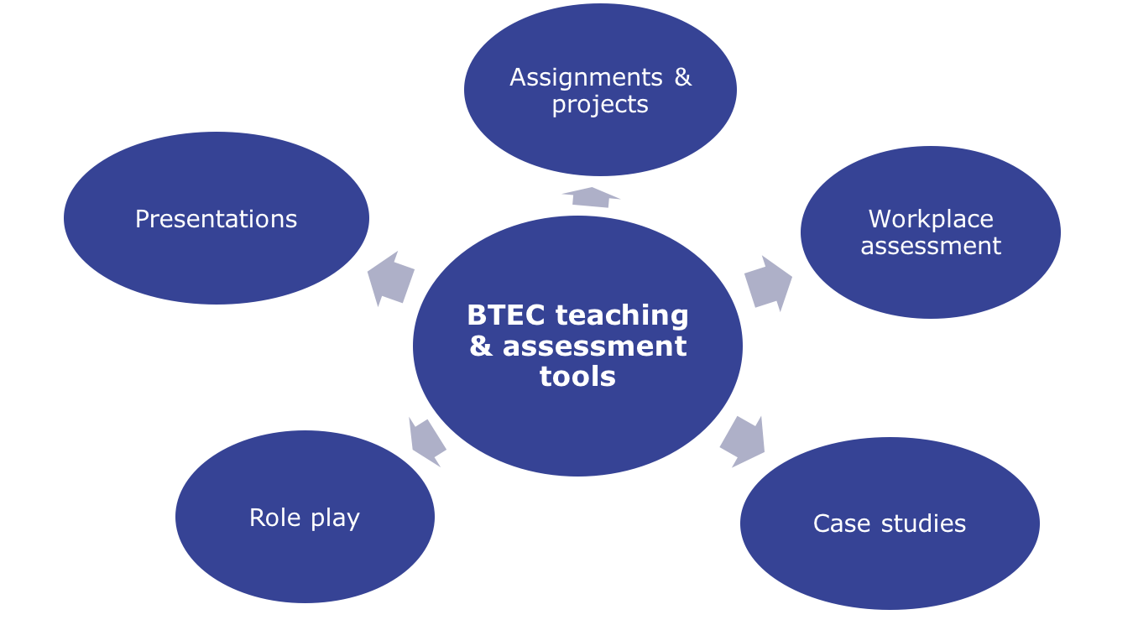
Assessment tools & assignments
Getting Started with New Specification Workskills
Notes:
Effective internal assessment is driven by variety and matching to learners ability. You have to cover the assessment criteria but it is not explicit how you do it, as long as you do!!

Slide 37
The Principles of Effective Assessment design
Basics
Must be engaging
Must be relevant
Think about assessments that prevent repetition
Think local
Getting Started with New Specification Workskills
Notes:
Basics - minimum requirements (qualification title, Level, Assessor name, Learning Outcomes, Assessment criteria against each task (not broken down), Hand out and hand in dates (not set in stone), scenario

Slide 38
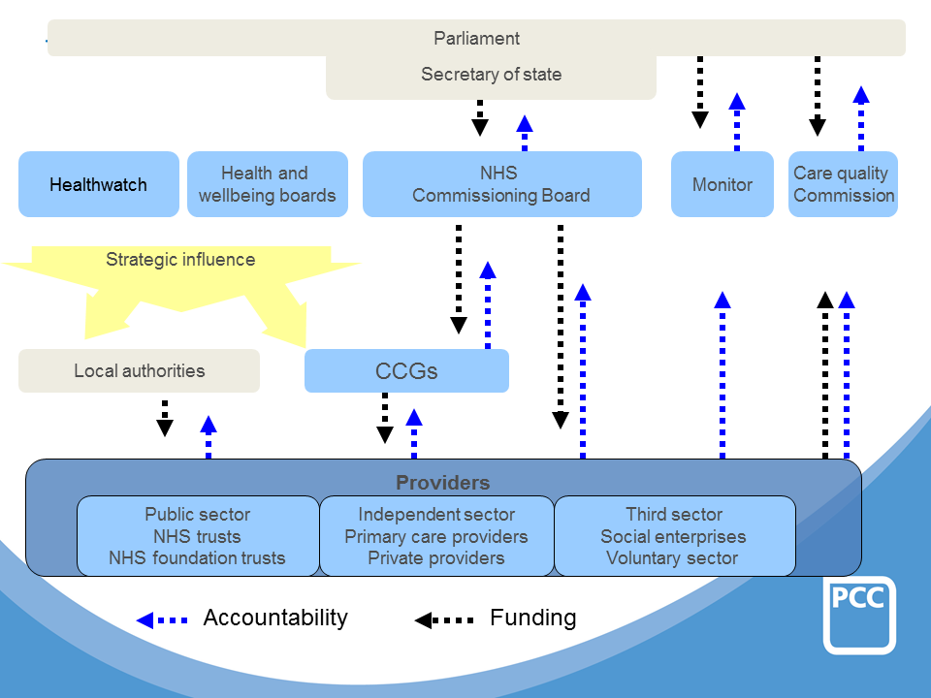
Bringing the Outside World In
Getting Started with New Specification Workskills
Notes:
Adding real world experience will develop knowledge and embed its application which is essential for transferable success. This is an NHS structure diagram as an example of possible collaborative areas. at all levels you can gain access to individuals to support with delivery through work experience, visits, case studies the Third Sector is invaluable as they need help and you and your students can provide it!
Other links possible through the Careers and Enterprise Company: https://www.careersandenterprise.co.uk use link to navigate this website, showing how this government linked organisation can assist with making links with the world of employment.

Slide 39
Project Based assessment
An alternate approach is to focus delivery and assessment around key projects
This maximises time and allows for combination of units
Getting Started with New Specification Workskills
Notes:
What do students do already?
Think about the outcomes
How can you make employability real? – if you deliver this as a study programme employability will be a mandatory component so maximise that opportunity by making it explicit
Live briefs – commissioned by employers
Limitless opportunities
Combine units to decrease assessment burden – unit crossovers and exemplar employer involvement is listed so again use that, think about your learner motivations but also the significant number of external assessment and their focus
DON’T Forget the basics!
http://www.innovationunit.org/sites/default/files/Teacher's%20Guide%20to%20Project-based%20Learning.pdf

Slide 40
Activity 5
Discuss potential projects on your table
What external resources can you access to help you?
Nominate a spokesperson and feedback
Getting Started with New Specification Workskills
Notes:
Simple discussion activity, the aim is that experiences to this point will have driven and stimulated thought

Slide 41
Internal Verification and Assessment
Notes:
This is a reminder that this a qualification driven by a quality assurance framework. This is driven by the internal verifier. The IV should be there to check quality from an assessment standards perspective they shouldn’t be the ‘creativity police’. Just ensure that when delivering creative or any assessment that you talk it through with the IV let them into your world!

Slide 42
Assessing Learner Work
Always annotate wherever possible.
Always identify both the strengths of the work and suggest areas for improvement
Always link feedback to targeted assessment criteria.
Assess as soon as possible after submission.
Give a sample of assessed work to IV before giving back to learners
Getting Started with New Specification Workskills
Notes:
Simple discussion activity, the aim is that experiences to this point will have driven and stimulated thought

Slide 43
Internal Verification
Is the key to a successful programme
Tips
A good Internal Verifier believes in the programme
The internal verification follows a structured pattern that follows an assessment plan
It doesn't have to be of whole modules but should offer a representative spread of outcomes
If you are delivering creatively talk it through with your internal verifier and Standards Verifier
The quality assurance model for Workskills has not changed.
It is driven by effective internal verification and is supported by the OSCA process. If currently OSCA approved this is still valid.
Standardisation and internal verification are different. If you have more than one assessor and one internal verifier then you must do both.
Internal verifiers must review assessment instruments before issue using the specification.
Internal verifiers must then review assessment decisions based on the specification and not the assessment instruments.
Getting Started with New Specification Workskills
Notes:
This is really a reminder of good internal verification practice that should address the usual issues that are covered by this type of programme.

Slide 44
Activity 6
In your pack is some assessed learner work
Have a look at the unit spec, the brief, and have a go at assessing the work.
Consider –
Is the brief appropriate?
What comments would you make on the brief?
Which Criteria has the student achieved?
What feedback would you give?
Getting Started with New Specification Workskills
Notes:
Supervise activity and encourage open questioning, this activity can be short or long dependent upon time available but ideally should be at least 30 minutes.

Slide 45
Support with the transition
Services and support available at qualifications.pearson.com
Expert help
Subject Advisor
Resources
Ask the Expert
Assignment checking Service
Contact: Melanie Williams
Telephone 0844 463 2829
Email: teachingskills@pearson.com
Mapping document from existing to new specification (Available)
Appqual through Skilled for Life (next academic year)
Models for delivery
Getting Started with New Specification Workskills
Notes:
Describe opportunities to get direct responses on questions relating to standards through Ask the Expert and to get two briefs per centre checked through the assignment checking service (This is carried out by the SSV)
Discuss the Subject advisor role and outline the resources when available

Slide 46
Any questions?
Getting Started with New Specification Workskills

Slide 47
There’s so much more to learn
Find out more about us at
qualifications.pearson.com

