Slide 1

English Language
Live Lesson
Lesson 2
Using Language Effectively
June 2020
1

Slide 2

Introduction
I am Rebecca White and I will be hosting the session today. I am a Head of English and my aim is help you hone the skills you need to write non-fiction texts effectively.
For today’s session all you will need is a pen and some paper.
You may also find it useful to have a dictionary to hand.

Slide 3

Community Rules
We take safe-guarding seriously and we expect everyone to treat each other with respect.
We will take appropriate actions if we feel this is needed.

Slide 4

Using Language Effectively
Image by Nathalie Lees
Creating a Persona
Sustaining Tone
Audience Positioning
Developing Extended Metaphors
Choosing the Right Words

Slide 5

How this will work….
Any sentence written in blue indicates an activity for you to do. For example:
Write a list of what makes someone powerful.
2) Any task written in purple is designed to be more of an extension task. These are tasks that are more challenging and ones you may want to revisit after the lesson.
3) Key terms will be written in red. There will be a glossary of these terms at the end of each lesson as well as explanations as we go along.

Slide 6
Today’s Tasks
Write a review about a restaurant, album, film or book of your choice.
Write a letter where you persuade your local council to fund a project of your choice.

Slide 7
Creating a Persona

Slide 8

Myth Buster Moment!
Transactional or non-fiction writing does not mean you cannot be creative!
You do not have to write as yourself – sometimes you might want to adopt a different persona.
Remember to consider your authorial intent.

Slide 9

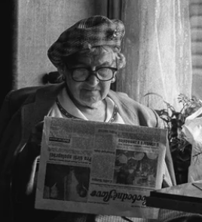

Creating a Persona
For each of these three individuals, write a list of words that could reflect their personality.

Slide 10
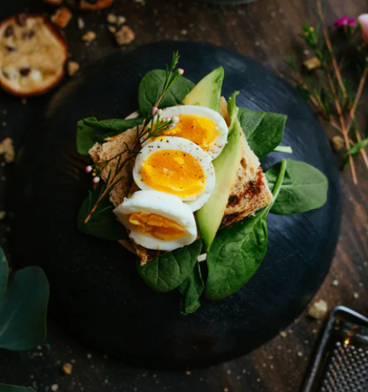
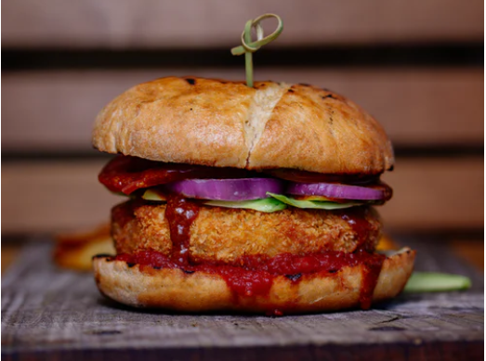
Task 1: Restaurant Review
Setting the scene:
Imagine that each of the three individuals we have met visit a restaurant and order one of these dishes.

Slide 11
Form and Purpose
Review
A critical assessment of something.
In other words, a review is a judgement or evaluation of something – going into detail and offering evidence to support the views.
It is an opinionated piece of writing.
There is also a persuasive element – you are trying to persuade your reader that your opinion is justified and valid.

Slide 12
Noun Phrase
A group of words that can be replaced by a pronoun
Developing a Voice
For each of the three characters, create an expanded noun phrase which suits the personality you have decided they have.
Determiner
Adjective
Noun
The
A
An
My
Their
Exquisite
Overpriced
Pretentious
Insta-friendly
Delicious
Unusual
Well-cooked
Eggs
Plate
Spinach
Burger
Bun
Avocado
Meal

Slide 13
Task 2
Letter to the Council
What would the three characters want from the council?
What projects would they be interested in?
Why?
Select one of the characters and list two or three things they would be interested in and reasons why.

Slide 14
Developing a Voice
Think about the projects you have selected. Write some expanded noun phrases that help express their ideas and viewpoints.
You may find it useful to think about the desire for the project as well as the project itself. For example, ‘There is a desperate need for change in our city.’
Determiner
Adjective
Noun

Slide 15
Sustaining Tone

Slide 16

Staying in Character
It is important that you stay in the voice of your character.
‘My grandson has turned vegetarian and is always trying to convince me to eat less meat so when I took him out for his birthday, I thought I would see what all the fuss is about.
Rather than go for my usual gammon and chips, I thought I would try the Portobello Mushroom Burger.
I should have stuck with the gammon.
My burger, although pretty on the plate and definitely more artistic than my usual fare, was hardly what one would call filling.
I was literally given a mushroom in a bun. I was well disappointed.

Slide 17
Avoiding Contradictions
It is important that you ensure that your whole piece stays focused and you don’t contradict yourself.
‘The eggs were the most perfectly cooked thing I have ever eaten in my life and the delicate flavours of basil butter and spinach were simply divine.
Who knew that this beautiful little café was hiding just minutes away from the office? How could I have missed it?
I probably won’t go there again though because it’s a bit far and not all that great.

Slide 18
Addressing Your Reader
For Task 2, you are trying to persuade a group of people to part with potentially a lot of money. Insulting them is not going to work!
You have completely ignored the needs of young people for decades and the pitiful park equipment we have at the moment is not fit for chimpanzees to climb on. It’s obvious you hate children because you are all too old to even remotely remember what it is like to be young.
You could make all this better by funding a skate park in the centre of town so that we have somewhere safe and fun to go.

Slide 19
Where are the problems with this text?
How would you improve it?
As soon as I walked into The Panda’s Sneeze, I knew I was in for a real treat. The walls were a warm and soothing colour and everything was laid out in a predictable and familiar way.
I took a seat near the huge windows and began to peruse the menu. With an almost audible squeal of delight, I spotted the dish I had come to sample: Eggs and Avocado Smorrebrod. Smorrebrod is a Finnish open sandwich and I had been craving one since my return from Helsinki.
I wasn’t overly sure what to order because everything looked epic but I decided that I would have the smorrebrod after all.
When it arrived, I was pleased with the presentation and took a sneaky pic before devouring it.

Slide 20
Contradictory opening.
As soon as I walked into The Panda’s Sneeze, I knew I was in for a real treat. The walls were a warm and soothing colour and everything was laid out in a predictable and familiar way.
I took a seat near the huge windows and began to peruse the menu. With an almost audible squeal of delight, I spotted the dish I had come to sample: Eggs and Avocado Smorrebrod. Smorrebrod is a Finnish open sandwich and I had been craving one since my return from Helsinki.
I wasn’t overly sure what to order because everything looked epic but I decided that I would have the smorrebrod after all.
When it arrived, I was pleased with the presentation and took a sneaky pic before devouring it.
Contradiction.
Epic feels out of place for the voice and tone.
Mixed register – the mix of formal language and informal language.

Slide 21
As soon as I walked into The Panda’s Sneeze, I knew I was in for a real treat. The walls were a warm and soothing colour and everything was laid out in a predictable and familiar way.
I took a seat near the huge windows and began to peruse the menu. With an almost audible squeal of delight, I spotted the dish I had come to sample: Eggs and Avocado Smorrebrod. Smorrebrod is a Finnish open sandwich and I had been craving one since my return from Helsinki.
I wasn’t overly sure what to order because everything looked epic but I decided that I would have the smorrebrod after all.
When it arrived, I was pleased with the presentation and took a sneaky pic before devouring it.
Rewrite this text to correct the issues discussed.

Slide 22
Audience Positioning

Slide 23
Audience Positioning
Techniques used by a writer to present and share the ideology of a text.
Think about a charity slogan:
‘Just £2 a month will help ensure that no puppy will ever have to suffer this kind of abuse again.”
The text assumes a number of things:
£2 is not a lot of money to you
You like puppies and think they shouldn’t suffer
You should want to help out.

Slide 24
What does your character want?
Thinking about Task 2 and the projects you thought your character might be interested in, you need to really consider why a particular project might be important to them.
For each of these projects, try to think which character would want them most and why:
A new community centre that hosts social events during the day
The creation of an education hub where people can learn new skills to help improve their future
New park facilities, including a park gym where people can get fit for free
Developing a community garden where people can learn to grow their own food.

Slide 25
What does your audience want?
Place yourself in the position of the council. What arguments or concerns might they have for each of the projects?
A new community centre that hosts social events during the day
The creation of an education hub where people can learn new skills to help improve their future
New park facilities, including a park gym where people can get fit for free
Developing a community garden where people can learn to grow their own food.

Slide 26
What does your audience want?
A new community centre that hosts social events during the day
Will it be used enough? How will it be staffed? What else could it be used for? Huge cost implication?
The creation of an education hub where people can learn new skills to help improve their future
Who will train them? What sort of skills are people looking for? How can we ensure it will be used properly?
New park facilities, including a park gym where people can get fit for free
Why can’t people just jog? Do we really need them? What would be the benefit?
Developing a community garden where people can learn to grow their own food.
Who would staff it? What happens to the food afterwards? Why is this useful? Where would it be?

Slide 27
Using Audience Positioning to Convince the Reader
Community Garden Project
Growing your own food – people need healthier lives and diets
Using the older people in the community to help – experience and advice – they would volunteer so no overheads to council
Food could be shared – cooked together, encourage people to learn how to take care of themselves, build up stronger relationships
Happy communities = safe communities
Improve an eyesore – wasteland that could be put to good use

Slide 28
For each of the ideas, consider how you could position the audience to compel them to agree with your plan.
Community Garden Project
Growing your own food – people need healthier lives and diets
With obesity at frightening levels, it is vitally important that we start educating people about healthy eating.
There are so many people in the area who are living without a garden and they are missing out on the huge health benefits that gardening brings. Surely we owe it to them to help improve their quality of life.
Using the older people in the community to help – experience and advice – they would volunteer so no overheads to council
Food could be shared – cooked together, encourage people to learn how to take care of themselves, build up stronger relationships
Happy communities = safe communities
Improve an eyesore – wasteland that could be put to good use

Slide 29
Developing Extended Metaphors

Slide 30

Non-Fiction and Creativity
Figurative language can be used effectively in non-fiction writing.
Review
The divine eggs were beautifully presented on an altar of the best sourdough toast I have ever had and anointed with a delicately flavoured basil butter.
What metaphors are being used in this short extract?
What do they have in common?

Slide 31
Non-Fiction and Creativity
Figurative language can be used effectively in non-fiction writing.
Review
The divine eggs were beautifully presented on an altar of the best sourdough toast I have ever had and anointed with a delicately flavoured basil butter.
Extended metaphor – where a metaphor is developed within the text, going beyond a single example.
Semantic field – a collection of words with a related meaning.
Connotation - an idea or feeling associated with a word beyond its literal or primary meaning.
What does the writer’s use of language reveal about their opinion of the meal?

Slide 32

A Different Experience
How would the use of the following semantic fields affect the way the reader interpreted the opinion of the writer?
War
Holidays
Games
Relationships
Weather
Childhood
Either roll a dice or select one of the semantic fields above and write a description of the meal using words from that field.

Slide 33

A Different Experience
I armed myself with the quirky and utterly impractical cutlery and began my attack. My taste buds were swiftly assaulted by the overbearing flavour of basil and I was almost tempted to surrender immediately. Battling on, I tackled the sourdough toast. My cutlery was useless in the face of such an adversary and I was forced into hand-to-hand combat, doing my best to rip it into with my teeth, which also turned out to be woefully inadequate for the task.

Slide 34
Task 2
Which semantic field has been used here?
What effect does it have on the reader?
The garden would breathe new life into our community, allowing people of all ages and backgrounds to embrace a new skill and grow stronger together.
This community has been crying out for a project like this, a project that will become the beating heart of a safer, happier, healthier environment for us all.
With your support, a new spirit of togetherness can be born in our streets, a spirit we can nurture and raise as one.

Slide 35
Task 2
Which semantic field has been used here?
What effect does it have on the reader?
The garden would breathe new life into our community, allowing people of all ages and backgrounds to embrace a new skill and grow stronger together.
This community has been crying out for a project like this, a project that will become the beating heart of a safer, happier, healthier environment for us all.
With your support, a new spirit of togetherness can be born in our streets, a spirit we can nurture and raise as one.

Slide 36
Choosing the
Right Words

Slide 37
Writing with Confidence
Modal Verbs – verbs that indicate the possibility or certainty of something: can, could, shall, should, will, would, may, might, must, ought.
When trying to convince someone of your opinion, modal verbs can be really useful as a way of sounding certain or confident.
For example….

Slide 38
Writing with Confidence
The new garden will bring people together, helping them to see that they can make a real difference to this community. In these current times, we should all be working towards educating people about the benefits of a healthy lifestyle and growing their own vegetables is one way we can achieve this goal.
Any meal you order off the menu will stay in your tongue’s memory for years to come – nothing will ever taste as delicious. Trust me.
We must not let the land behind the old factories go to waste, especially when we can provide facilities and resources that will help our community prosper.

Slide 39
Loaded Language -
Language that attempts to influence the audience by appealing to an emotion.
Emotive Language –
Language that is used to evoke a particular emotion.
What emotions would are you trying to evoke in the reader?
How would this manipulate the reader?
Consider this in your planning.

Slide 40
What emotions is the writer trying to evoke in the reader?
How would this manipulate the reader?
Throughout my whole married life, I tended my garden with care, enjoying the peace and pride it gave me. My garden was where I went to think, to socialise and where I got my daily dose of exercise. When my husband died, I was forced to give up my beautiful garden when I moved and that was when I realised just how fortunate I had been.
For many people in this community, a garden is a luxury they can only dream of. With over 60% of residents living in flats with no access to a safe outside space at all, surely the creation of a community garden is a logical solution. We have it in our power to give people access to one of their basic human rights: the right to feel safe outside.
We also have the opportunity to educate people about healthy living, teach them how to grow their own food, provide them with the powerful emotion of success when they get to harvest the fruits of their labour.

Slide 41
Throughout my whole married life, I tended my garden with care, enjoying the peace and pride it gave me. My garden was where I went to think, to socialise and where I got my daily dose of exercise. When my husband died, I was forced to give up my beautiful garden when I moved and that was when I realised just how fortunate I had been.
For many people in this community, a garden is a luxury they can only dream of. With over 60% of residents living in flats with no access to a safe outside space at all, surely the creation of a community garden is a logical solution. We have it in our power to give people access to one of their basic human rights: the right to feel safe outside.
We also have the opportunity to educate people about healthy living, teach them how to grow their own food, provide them with the powerful emotion of success when they get to harvest the fruits of their labour.
How does the writer position the audience to share her opinion?
How does she present herself as knowledgeable?

Slide 42
Reviews and Emotive Language
Even reviews need to evoke an emotion in the reader.
Envy
Excitement
Disappointment
Disgust
Shock
Curiosity

Slide 43
Reviews and Emotive Language
The flavours were beautifully combined to create an exquisite explosion on my taste buds.
The album is reminiscent of their earlier work and has the same raw edginess of their first album.
While the trailer promised wall-to-wall excitement, the final cut failed to deliver.

Slide 44
Review

Slide 45

What to aim for
Creating a Persona
Keeping Creative
Sustaining Tone
Audience Positioning
Extended Metaphors
Choosing the Right Words

Slide 46
Glossary of Key Terms
Authorial Intent - The aims and objectives of the writer – what the writer is trying to achieve.
Review - A critical assessment of something.
3. Noun Phrase - A group of words that can be replaced by a pronoun.
4. Mixed register – the mix of formal language and informal language.
5. Audience Positioning: Techniques used by a writer to present and share the ideology of a text.
6. Extended metaphor – where a metaphor is developed within the text, going beyond a single example.
7. Semantic field – a collection of words with a related meaning.
8. Connotation - an idea or feeling associated with a word beyond its literal or primary meaning.
9. Modal Verbs – verbs that indicate the possibility or certainty of something: can, could, shall, should, will, would, may, might, must, ought.
10. Loaded Language - Language that attempts to influence the audience by appealing to an emotion.
11. Emotive Language – Language that is used to evoke a particular emotion.

Slide 47

See you next time!
11am
17th June
Using Language
Effectively

