Slide 1

Pearson Edexcel International GCSE English Literature (4ET1)
Guide to the exam papers

Slide 2
Aims and Objectives
To walkthrough each of the questions on the International GCSE English Literature papers and understand the requirements.
To understand the underpinning framework behind each question.
To see how you can use the papers and questions to reassure students who may be nervous about exams and to help them prepare.
Notes:
The days 3 sessions

Slide 3
International GCSE English Literature
Component 1: Poetry and Modern Prose External Exam – 60% 2 hrs (90 marks) | EITHER: Component 2: Modern Drama and Literary Heritage Texts External Exam – 40% 1 hr 30 mins (60 marks) | OR: Component 3: Modern Drama and Literary Heritage Texts Coursework – 40% (60 marks)
Section A: Unseen Poetry: one 20-mark essay question exploring the meaning and effects created in an unseen poem. | Section A – Modern Drama: one 30-mark essay question from a choice of two on each of the set texts. | Assignment A – Modern Drama: one essay response to a teacher-devised assignment on the studied text.
Section B – Anthology Poetry: one 30-mark essay question from a choice of two, comparing two poems from Part 3 of the Pearson Edexcel International GCSE English Anthology. | Section B – Literary Heritage Texts: one 30-mark essay question from a choice of two on each of the set texts. | Assignment B: Literary Heritage Texts: one essay response to a teacher-devised assignment on the studied text.
Section C – Modern Prose: one 40-mark essay question from a choice of two on each of the set texts. Closed book: texts are not allowed in the examination. However, students will be provided with the anthology poems in the examination. | Open book: prescribed editions of set texts are allowed in the examination. | The assessment of this component is through two coursework assignments, internally set and assessed, and externally moderated by Pearson.

Slide 4
Assessment Objectives
 | Assessment Objective | % in International GCSE
AO1 | Demonstrate a close knowledge and understanding of texts, maintaining a critical style and presenting an informed personal engagement. | 30
AO2 | Analyse the language, form and structure used by a writer to create meanings and effects. | 40
AO3 | Explore links and connections between texts. | 10
AO4 | Show understanding of the relationships between texts and the contexts in which they were written. | 20

Slide 5
Paper 1: Walkthrough

Slide 6
Paper 1 – What changes and what stays the same?
Changes:
The unseen poem
The poems in the Anthology poetry question over the lifetime of the specification
The focus of the questions in Sections A, B and C
Stays the same:
one unseen poem
the anthology poems will be taken from Part 3 of the anthology
timing of the paper
number of questions
structure of the questions
AOs being assessed
number of marks per question

Slide 7
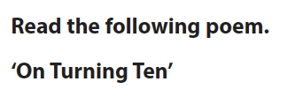
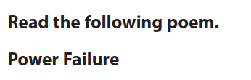
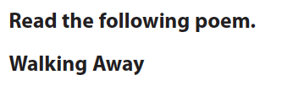








Paper 1: Facts and Figures
There are 3 sections
Section A has one unseen poem with one question assessing AO2
Section B focusses on comparing poems from Part 3 of the anthology assessing AO2 and AO3
Section C focusses on modern prose assessing AO1 and AO4
Paper 1 is a closed book exam
Notes:
Papers used are Jan 2022, June 2022 and Jan 23 – Q1
Q2 – Jan 23 and Jan 2020
Questions

Slide 8
Paper 1: Facts and Figures
 | Assessment Objective | % in International GCSE
AO1 | Demonstrate a close knowledge and understanding of texts, maintaining a critical style and presenting an informed personal engagement. | Qs 4-13
AO2 | Analyse the language, form and structure used by a writer to create meanings and effects. | Q1, Q2 & Q3
AO3 | Explore links and connections between texts. | Q2 & Q3
AO4 | Show understanding of the relationships between texts and the contexts in which they were written. | Qs 4-13

Slide 9
Paper 1 – Section A: Unseen Poetry

Slide 10
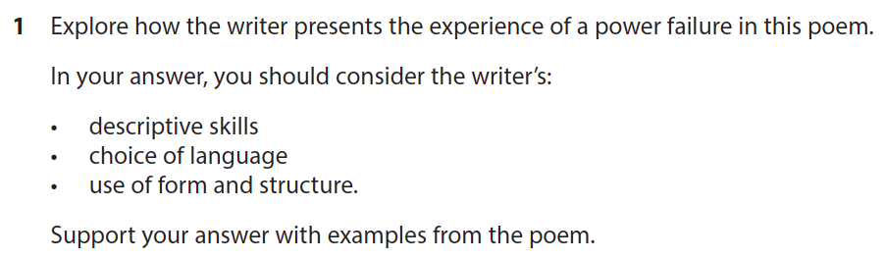
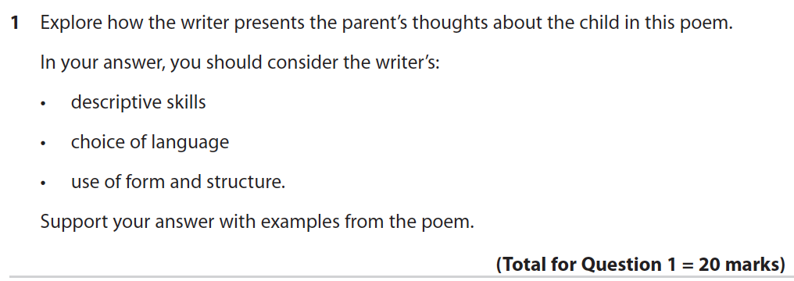

Paper 1 – Section A: Question 1
Question 1:
starts with ‘explore how the writer presents…’
has 3 supporting bullets
asks students to support their response ‘with examples from the poem’
20 marks
targets AO2
Notes:
Jan 2023
June 2022
MS – Jan 23

Slide 11
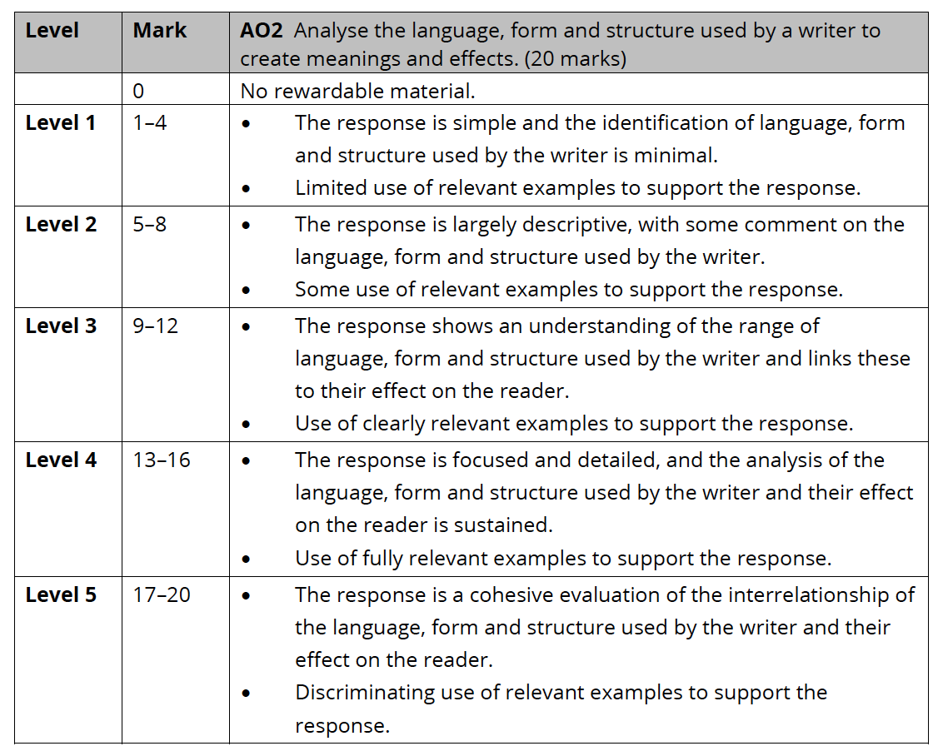
Question 1 – Mark Scheme

Slide 12
Paper 1 – Section B: Anthology Poetry

Slide 13
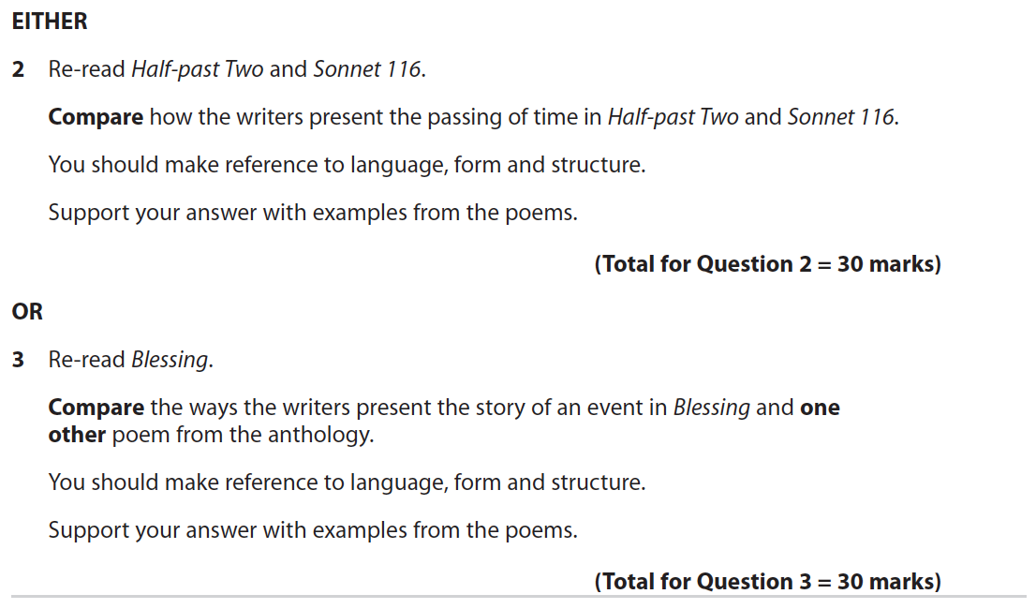
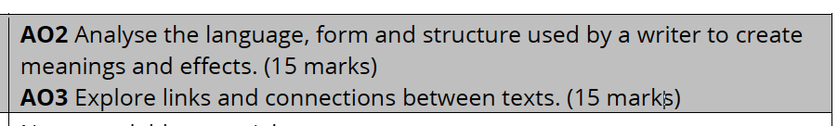
Paper 1 – Section A: Question 2 & 3
Question 2 & 3:
There is always a choice of question – one names both poems and the other names one and ‘one other poem’
asks students to ‘compare’
asks students to refer to language, form and structure as well as using examples from the poems
30 marks
targets AO2 and AO3
Notes:
Jan 2023
MS – Jan 23

Slide 14
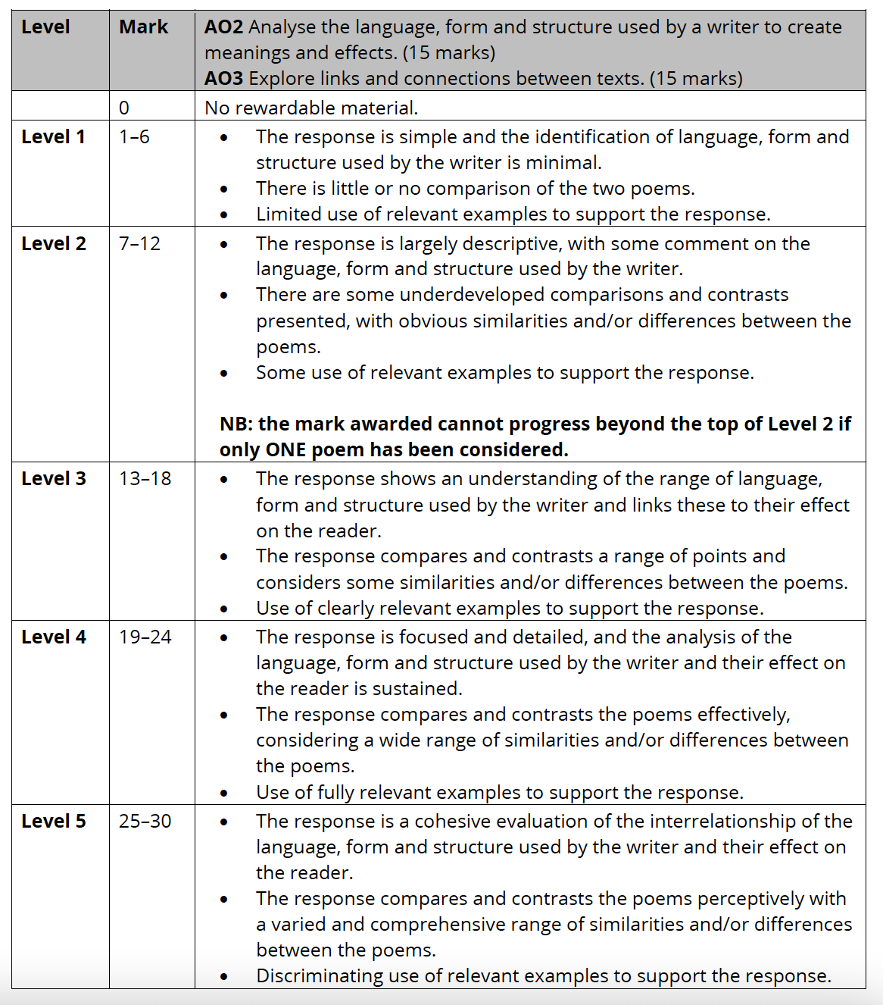
Questions 2 & 3 – Mark Scheme

Slide 15
Paper 1 – Section C: Modern Prose

Slide 16
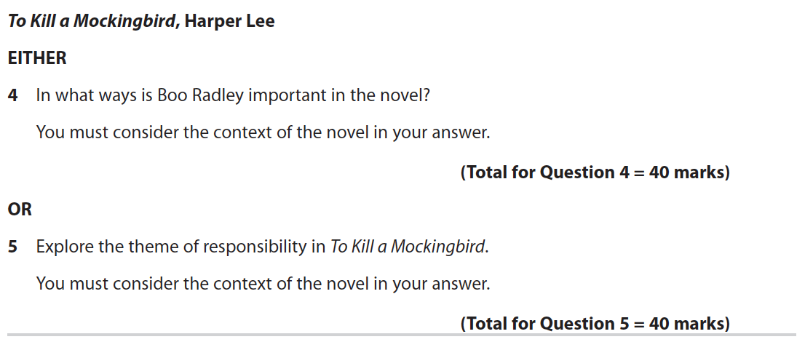
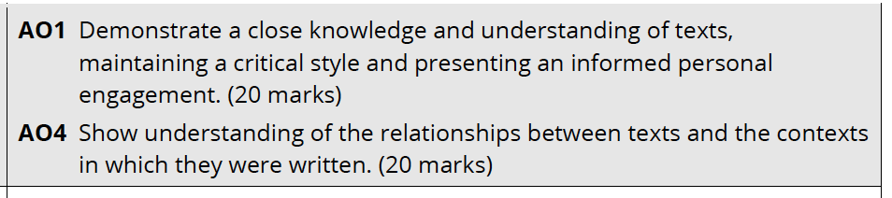
Paper 1 – Section C: Questions 4 - 13
Questions 4-13:
there is a choice of 2 questions on each novel
asks students to ‘consider the context of the novel’ in their answer to the question
40 marks
targets AO1 and AO4
Notes:
Jan 2023

Slide 17
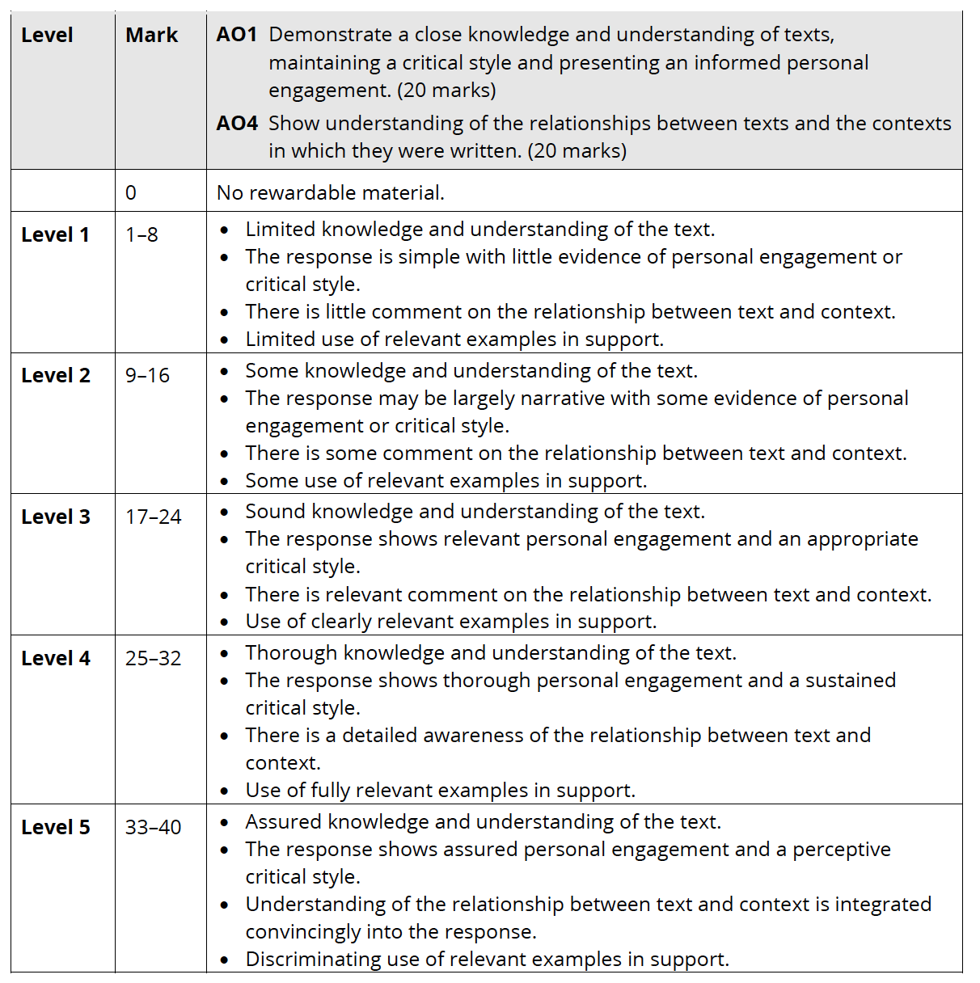
Questions 4-13 – Mark Scheme

Slide 18
Paper 2: Walkthrough

Slide 19
Paper 2 – What changes and what stays the same?
Changes:
the topics of the questions over the lifetime of the specification
Stays the same:
the set texts
timing of the paper
number of questions
structure of the questions
AOs being assessed
number of marks per question

Slide 20
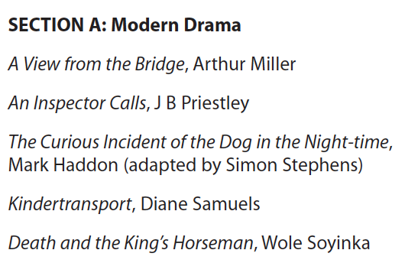
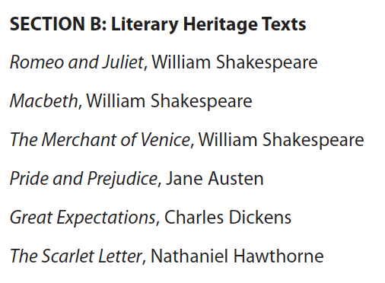
Paper 2: Facts and Figures
There are 2 sections
Section A: focusses on modern drama and assesses AO1 and AO2
Section B: focusses on literary heritage texts and assesses AO1, AO2 and AO4
Paper 2 is an open book exam

Slide 21
Paper 2: Facts and Figures
 | Assessment Objective | % in International GCSE
AO1 | Demonstrate a close knowledge and understanding of texts, maintaining a critical style and presenting an informed personal engagement. | Qs 1-10 Qs 11-22
AO2 | Analyse the language, form and structure used by a writer to create meanings and effects. | Qs 1-10 Qs 11-22
AO4 | Show understanding of the relationships between texts and the contexts in which they were written. | Qs 11-22

Slide 22
Paper 2 – Section A: Modern Drama

Slide 23
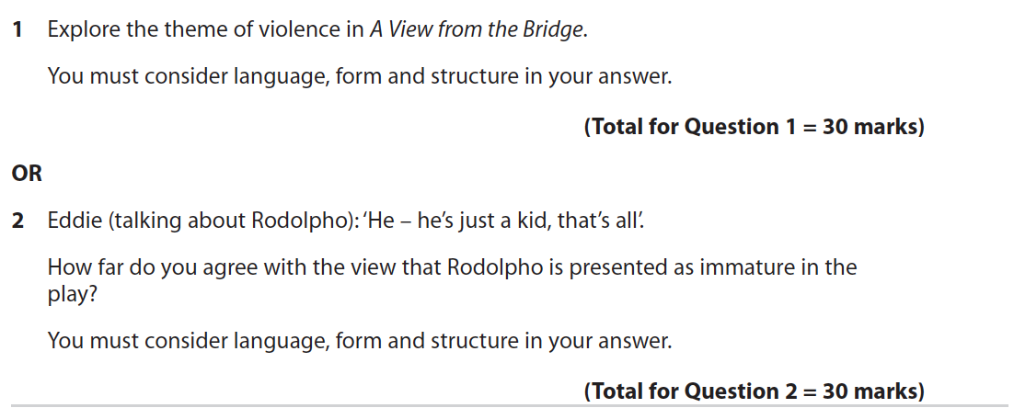
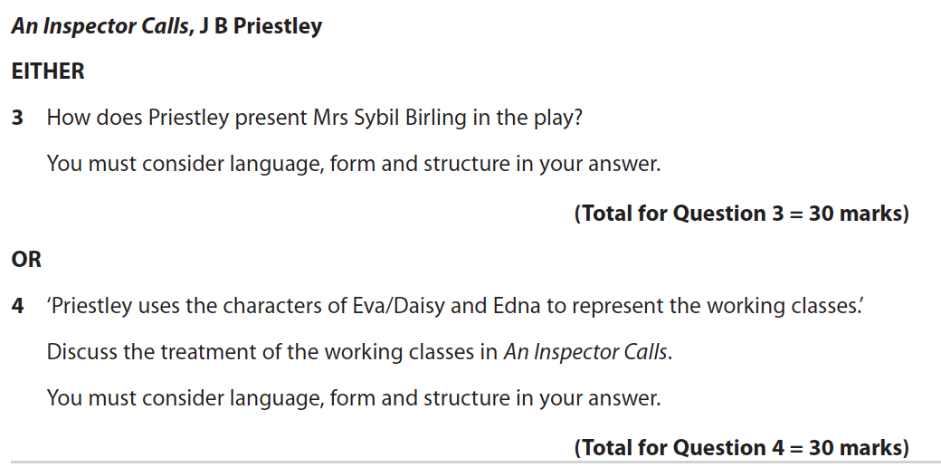
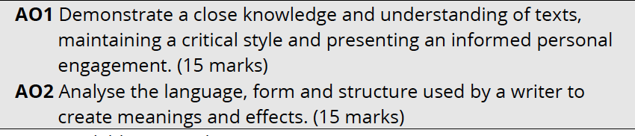
Paper 2 – Section A: Questions 1-10
Questions 1-10
there is a choice of 2 questions on each drama
asks students to ‘consider language, form and structure’ in their answer
30 marks
targets AO1 and AO2
Notes:
Jan 2023
June 2022
MS – Jan 23

Slide 24
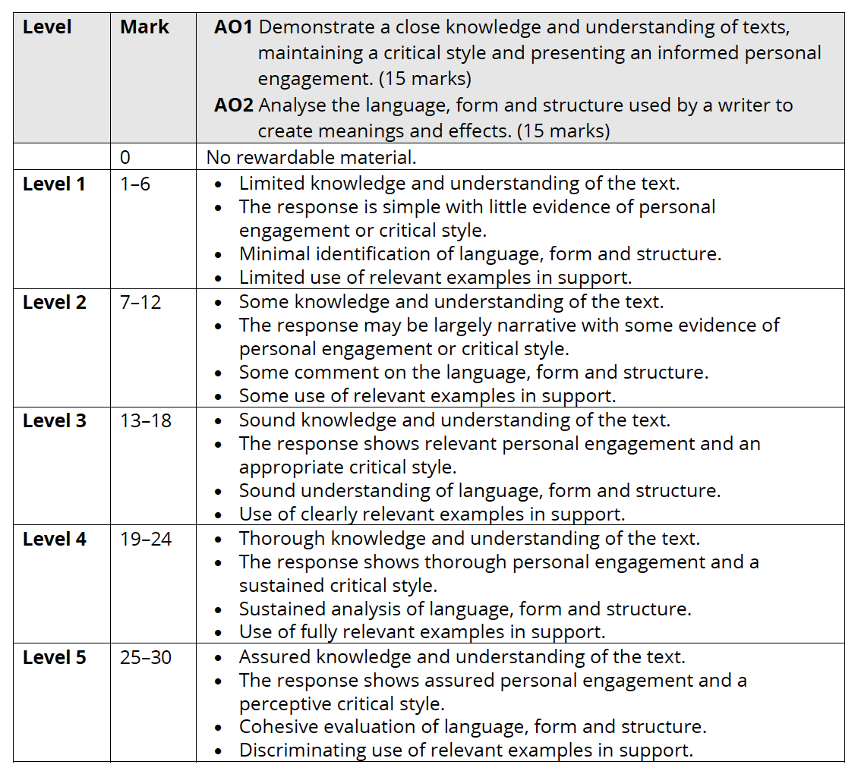
Questions 1-10 – Mark Scheme

Slide 25
Paper 2 – Section B: Literary Heritage Texts

Slide 26
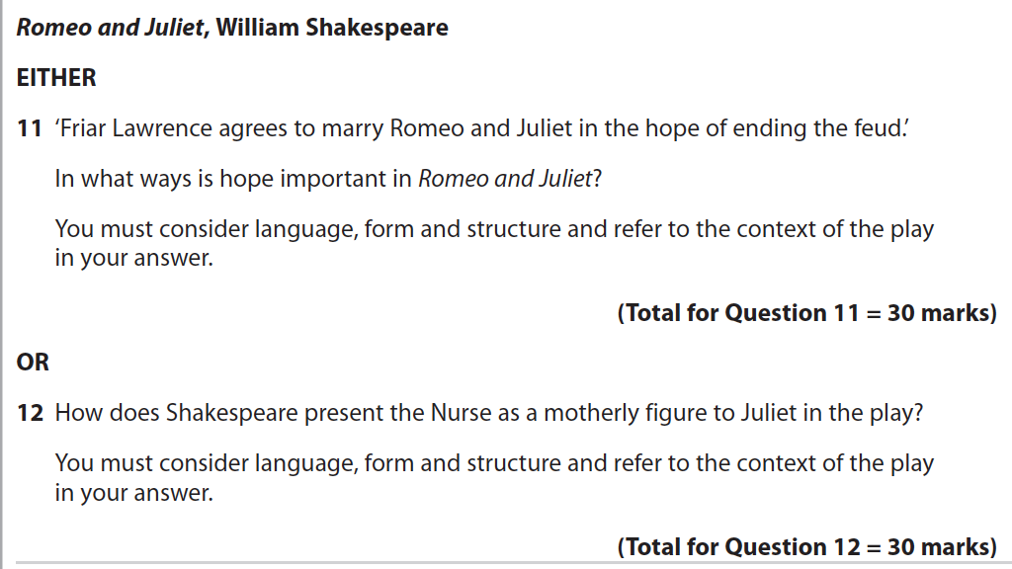
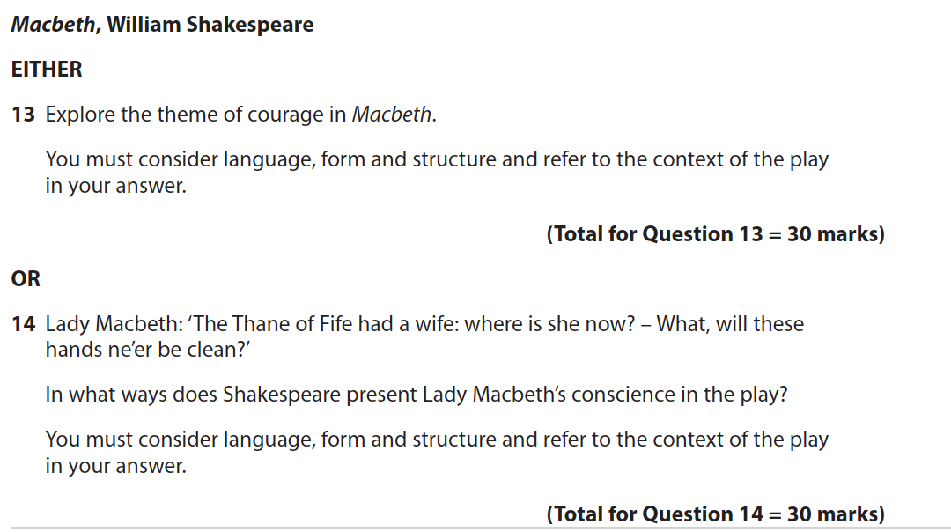
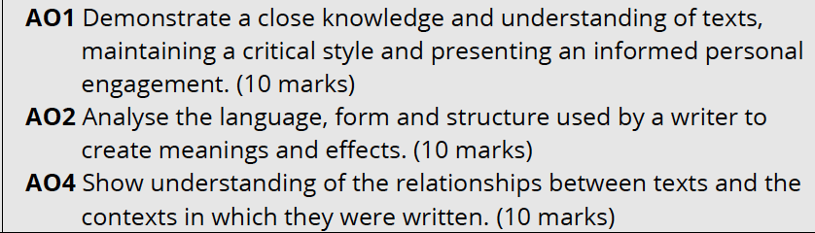
Paper 2 – Section B: Questions 11-22
Questions 11-22
there is a choice of 2 questions on each text
asks students to ‘consider language, form and structure and refer to the context’ in their answer
30 marks
targets AO1, AO2 and AO4

Slide 27
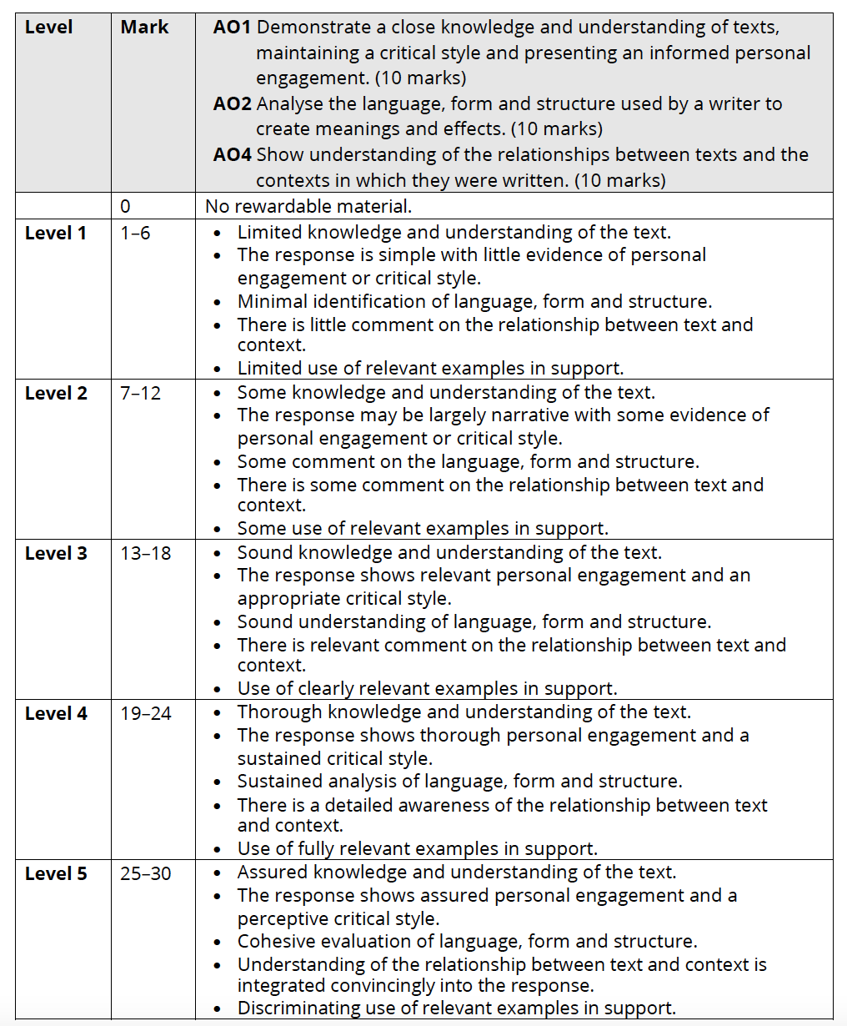
Questions 11-22 – Mark Scheme

Slide 28
Support

Slide 29
Where to find the past papers
You can download all of our past papers from the website (the most recent require your Edexcel Online login):
In this presentation, we have used examples from Jan 2020, Jan 2022, June 2022 and Jan 2023. All other past papers can be found in the exam materials area on the website
There are also some specimen papers in the teaching and learning materials area on the website
Summary documents of the questions from all series can be found in the teaching and learning materials area on the website
For all queries, please contact Clare Haviland on TeachingEnglish@Pearson.com, Twitter: @PearsonTeachEng, or LinkedIn.
Notes:
Papers used are Jan 2022, June 2022 and Jan 23 – Q1
Q2 – Jan 23 and Jan 2020

Slide 30
Thank you!

