Slide 1
GCSE French, German and Spanish
An introduction for students

Slide 2
You should know
This GCSE specification is new.
It has been re-worked in order to make it more accessible to you and to help you enjoy your language GCSE experience even more.
That means the GCSE exams you sit in French/Spanish/German will not be the same as any older friends or family members you know.
The first exams for this GCSE are in 2026.
This GCSE has a Higher Tier (Grades 4-9) and a Foundation Tier (Grades 1-5). You must take all papers at the same tier.

Slide 3
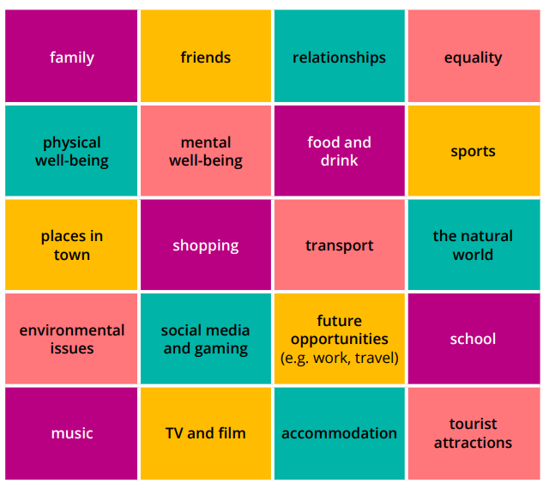
What will I learn about?
The thematic contexts of this course are:
My personal world
Lifestyle and wellbeing
My neighbourhood
Media and technology
Studying and my future
Travel and tourism
More specifically, you will be able to speak and write about a variety of subjects (see image).

Slide 4
What are the papers?

Slide 5
Paper 1 - Speaking
Worth 25% of the overall grade
Tasks include:
A reading aloud task
A transactional role play
A picture description and follow on conversation
Important to know:
In addition to your silent preparation time in another room, you will have a minute before the exam starts to practice the reading out loud, if you would like to.
The role plays are all transactional like booking hotels, buying clothes, going to the doctors so they’re useful in real life situations.
You will have a choice of two thematic contexts for your picture description and follow on conversation a few weeks in advance so you can be really prepared and confident.

Slide 6
Paper 2 – Listening and Understanding
Worth 25% of the overall grade
5 minutes reading time at the start of the paper.
Section A: Listening - multiple-choice, multiple-response and short-answer open response questions. All questions set in English.
Section B: Dictation
Each extract will be played 3 times so that you can listen, respond and then check.
The extract will be spoken at a moderate pace and there will be gaps built in to give you time to answer.

Slide 7
Paper 3 – Reading and Understanding
Worth 25% of the overall grade
Section A: Reading - multiple-choice, multiple-response and short-answer open response questions. All questions set in English.
Section B: Translation into English
There will be some pictures and glossed words (proper nouns like place names) to help you understand cultural topics.

Slide 8
Good to know about our reading and listening papers
The same question types will be in the same place for the same number of marks every year – so once you’re used to the past papers you know exactly how your exam will look.
Instructions are all in English, so you’ll always know what is expected of you.
The reading texts and listening extracts have been broken down into smaller chunks so they are more manageable for you and not a burden on your working memory.
The papers will only use names from a set list, so you aren’t confused by a French/Spanish/German name you’ve never seen before.

Slide 9
Paper 4 - Writing
Worth 25% of the overall grade.
Picture description task (foundation only)
Two open response writings (Foundation = 40-50 words & 80-90 words. Higher = 80-90 words and 130-150 words) with a choice of two for each so you can pick the one you feel more confident with.
Translation into French/Spanish/German – 5 sentences for Foundation, a short paragraph for higher.
We have guidance on gender-neutral language and you’ll gain equal credit when using these pronouns and agreements as you would using the masculine/feminine.

Slide 10
Can I find out more?

Slide 11
Additional resources
2024 MFL GCSEs: Qualification at a glance (pearson.com)
Languages GCSEs: What do students want? (pearson.com)
4 Things to Know About Our New MFL Qualifications (pearson.com)
Preparing for Options Evening (pearson.com)

Slide 12
End of Presentation

