Slide 1
GCSE French, German and Spanish
An introduction for students
Notes:
Hi, I’m Rebecca Waker and I’m the subject advisor for languages at Pearson Edexcel. I have put this presentation together to explain our GCSE 2024 specifications for French, German and Spanish to students and parents.

Slide 2
You should know
This GCSE specification is new.
It has been re-worked in order to make it more accessible to you and to help you enjoy your language GCSE experience even more.
That means the GCSE exams you sit in French/Spanish/German will not be the same as any older friends or family members you know.
The first exams for this GCSE are in 2026.
This GCSE has a Higher Tier (Grades 4-9) and a Foundation Tier (Grades 1-5). You must take all papers at the same tier.
Notes:
Firstly, a few important points to note.
This is a new GCSE specification which has been re-worked in order to make it more accessible and to help students to enjoy their language learning experience.
This means that students sitting GCSE French, German and Spanish in 2026 and beyond will be sitting a different style exam to those before them. This means that their GCSE languages experience will be different to any older siblings and friends who have taken a language in the past.
GCSE languages are tiered qualifications, this means students either sit a higher paper (covering grades 4 to 9) or a foundation paper (covering grades 1 to 5). All papers are sat at the same tier, there’s no mix and match option.

Slide 3
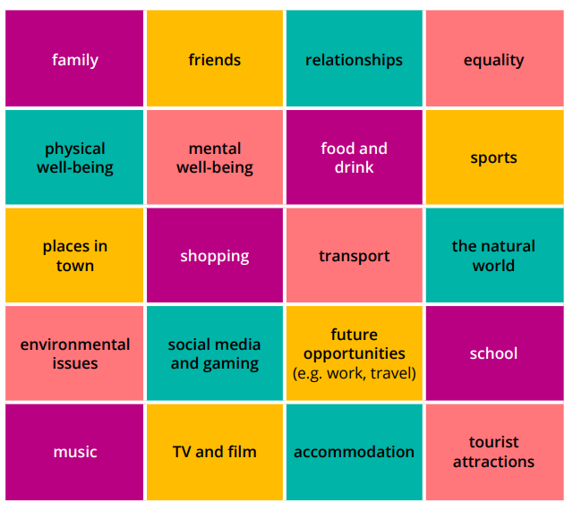
What will I learn about?
The thematic contexts of this course are:
My personal world
Lifestyle and wellbeing
My neighbourhood
Media and technology
Studying and my future
Travel and tourism
More specifically, you will be able to speak and write about a variety of subjects (see image).
Notes:
Whilst you’re studying French/Spanish or German you will be learning how to write, speak and understand language about 6 thematic contexts.
My personal world
Lifestyle and wellbeing
My neighbourhood
Media and technology
Studying and my future
Travel and tourism
Within these thematic contexts you’ll be able to talk about a variety of subjects, shown by the image onscreen.

Slide 4
What are the papers?
Notes:
So the next thing you’ll want to know is how you are examined. The papers follow the 4 skills structure you will already be used to, with assessments in speaking, listening, reading and writing. We’ll go into a little more detail about each now.

Slide 5
Paper 1 - Speaking
Worth 25% of the overall grade
Tasks include:
A reading aloud task
A transactional role play
A picture description and follow on conversation
Important to know:
In addition to your silent preparation time in another room, you will have a minute before the exam starts to practice the reading out loud, if you would like to.
The role plays are all transactional like booking hotels, buying clothes, going to the doctors so they’re useful in real life situations.
You will have a choice of two thematic contexts for your picture description and follow on conversation a few weeks in advance so you can be really prepared and confident.
Notes:
Paper 1 is the speaking. It’s worth 25% of your overall grade and you’ll have a short read aloud task, a roleplay and a picture description with a follow on conversation.
There are some things that would be useful for you to know:
You get some preparation time before your speaking exam in a silent room with an invigilator. The last minute of this time is for when you are in the exam room with your teacher-examiner. In this minute you can practice the read aloud out loud if you’d like to. You can read it all the way though, practice a few of the words that are most challenging or just carry on preparing in silence. It’s up to you.
The role play tasks are all set in real-life situations like buying things, going to the doctors, booking hotels etc, so they should be useful to you in the wider world beyond the exam.
Finally for the picture task and follow on conversation you’ll be given a choice of thematic context a few weeks in advance so you can be prepared and feel confident.

Slide 6
Paper 2 – Listening and Understanding
Worth 25% of the overall grade
5 minutes reading time at the start of the paper.
Section A: Listening - multiple-choice, multiple-response and short-answer open response questions. All questions set in English.
Section B: Dictation
Each extract will be played 3 times so that you can listen, respond and then check.
The extract will be spoken at a moderate pace and there will be gaps built in to give you time to answer.
Notes:
Paper 2, also worth 25% of the grade, is the listening.
At the start of this paper you get 5 minutes to go through and take a look at the questions and highlight or make notes as you wish.
On this paper you will answer different question types like multiple choice and short open responses. There is also a dictation task where you will listen to an extract and write down what you hear, either as a gap fill or full sentences.
You’ll listen to each extract 3 times so that you can listen, respond and finally check and these extracts will be spoken at a moderate pace with gaps built in to give you time to think and answer.
There will also be a couple of minutes at the very end of the paper if you wish to check anything over.

Slide 7
Paper 3 – Reading and Understanding
Worth 25% of the overall grade
Section A: Reading - multiple-choice, multiple-response and short-answer open response questions. All questions set in English.
Section B: Translation into English
There will be some pictures and glossed words (proper nouns like place names) to help you understand cultural topics.
Notes:
Paper 3 is the reading and that’s worth another quarter of the GCSE.
There are similar question types to the listening and also a translation into English.
To support you, where the question is about a cultural topic you might not have heard of there will be a supporting picture to help you. Proper nouns like place names will be explained with an asterisk too, so you are only being tested on your language knowledge.

Slide 8
Good to know about our reading and listening papers
The same question types will be in the same place for the same number of marks every year – so once you’re used to the past papers you know exactly how your exam will look.
Instructions are all in English, so you’ll always know what is expected of you.
The reading texts and listening extracts have been broken down into smaller chunks so they are more manageable for you and not a burden on your working memory.
The papers will only use names from a set list, so you aren’t confused by a French/Spanish/German name you’ve never seen before.
Notes:
Before we move onto writing there are a few things to let you know which will apply to both listening and reading.
Firstly, the same question types will be in the same place in the paper for the same number of marks each year. For example, if question one is a multiple choice question in our sample papers then it always will be in our exams. This means you know how the papers look and will be very familiar with the expectations.
All instructions are in English, so you will always know exactly what is expected from the question.
The reading and listening extracts have been broken down into shorter chunks. This makes them more manageable for you and is less of a strain on your working memory.
Finally the papers will only use a set list of names, so you’re not going to be confused by a French/Spanish/German name you’ve never seen before and try and work out what it means.

Slide 9
Paper 4 - Writing
Worth 25% of the overall grade.
Picture description task (foundation only)
Two open response writings (Foundation = 40-50 words & 80-90 words. Higher = 80-90 words and 130-150 words) with a choice of two for each so you can pick the one you feel more confident with.
Translation into French/Spanish/German – 5 sentences for Foundation, a short paragraph for higher.
We have guidance on gender-neutral language and you’ll gain equal credit when using these pronouns and agreements as you would using the masculine/feminine.
Notes:
The last paper is the writing paper.
In the foundation paper you will complete a picture description, a 40-50 word task and an 80-90 word task. For higher it’s a 80-90 word and a 130-150 word task. You’ll get two choices for each of these longer response questions so you can pick the one you feel more confident with.
For the translation part foundation candidates will get 5 sentences and higher will translate a short paragraph.
It’s important to note that if you wish to use gender-neutral language such as different pronouns or adjective agreement this is fine, we have some guidance available on this and you would receive equal credit as you would when using the masculine or feminine forms.

Slide 10
Can I find out more?
Notes:
Hopefully this presentation has covered everything you need to know about this new specification. But if not, there is plenty more on the Pearson Edexcel website that will support you.

Slide 11
Additional resources
2024 MFL GCSEs: Qualification at a glance (pearson.com)
Languages GCSEs: What do students want? (pearson.com)
4 Things to Know About Our New MFL Qualifications (pearson.com)
Preparing for Options Evening (pearson.com)
Notes:
Here are some links to various resources we have available. The bottom link is a document full of even more links to videos and other resources all about the importance of language learning. These include our work with footballer Eric Dier and a range of people who use languages in their every day lives.
Thank you for watching.

Slide 12
End of Presentation
Notes:
Closing Slide

