Slide 1

GCSE (9-1)
English Language
Guide to the exam papers

Slide 2
Aims and Objectives
To walkthrough each of the questions on the GCSE English Language papers and understand the requirements.
To understand the underpinning framework behind each question.
To see how you can use the papers and questions to reassure students who may be nervous about exams and to help them prepare.

Slide 3
GCSE English Language
Paper 1: 1 hr 45 (40%) | Paper 2: 2hr 5 (60%)
Section A: Unseen 19th century fiction Extract will be approximately 650 words in length. Shorter response questions will focus on close analysis of the text; longer response questions will ask students to show their understanding of the whole text. | Section A: Comparison of two unseen texts from the 20th and 21st century One non-fiction; one literary non-fiction. Extracts will be approximately 1000 words in total. Shorter response questions will focus on close reading of the texts; longer response questions will ask students to compare the texts.
Section B: Creative Writing Choice of two tasks linked to the theme of the 19th century fiction. One task will include images to help students address the task. Audience and purpose along with SPaG will be assessed. | Section B: Transactional Writing Choice of two tasks linked to the theme of the texts. Newspaper articles, letters etc. Audience and purpose along with SPaG will be assessed.
Notes:
.

Slide 4
Assessment Objectives for Reading
AO | Assessment Objective | % in GCSE
AO1 | Identify and interpret explicit and implicit information and ideas. Select and synthesise evidence from different texts. | 9.4
AO2 | Explain, comment on and analyse how writers use language and structure to achieve effects and influence readers, using relevant subject terminology to support their views. | 13.1
AO3 | Compare writers’ ideas and perspectives, as well as how these are conveyed, across two or more texts | 8.8
AO4 | Evaluate texts critically and support this with appropriate textual references | 18.8

Slide 5
Assessment Objectives for Writing
AO | Assessment Objective | % in GCSE
AO5 | Communicate clearly, effectively and imaginatively, selecting and adapting tone, style and register for different purposes and audiences Organise information and ideas, using structural and grammatical features to support coherence and cohesion of texts | 30
AO6 | Candidates must use a range of vocabulary and sentence structures for clarity, purpose and effect, with accurate spelling and punctuation | 20

Slide 6
Paper 1 – walkthrough

Slide 7
Paper 1 – Reading

Slide 8
Paper 1 – what changes and what stays the same?
Changes:
the text/extract
the topic of the questions
the writing tasks
Stays the same:
19th century fiction
timing of the paper
number of questions
focus of the questions
structure of the questions
AOs being assessed
number of marks per question

Slide 9






Paper 1 Reading: Facts and Figures
The text is unseen but:
it is always 19th century fiction
there are always 4 questions on the text
the first 3 questions focus on smaller parts of the text
Q4 is always on the WHOLE text

Slide 10
Paper 1 Reading: Facts and Figures
Assessment Objective | Question
AO1 – Identify and interpret explicit and implicit information and ideas. | Q1 and Q2
AO2 – Explain, comment on and analyse how writers use language and structure to achieve effects and influence readers, using relevant subject terminology to support their views. | Q3
AO4 – Evaluate texts critically and support this with appropriate textual references. | Q4

Slide 11
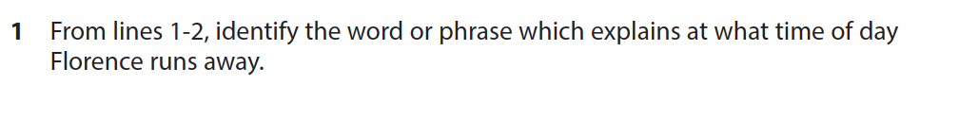
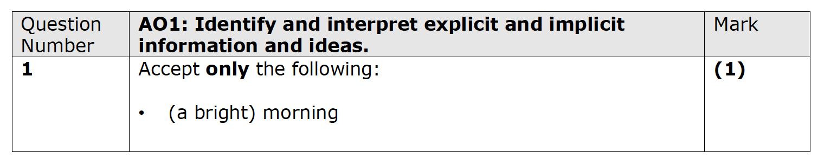
Paper 1 – Question 1
Question 1:
starts with the line references
asks candidates to ‘identify a word or phrase’
targets AO1
1 mark
can be lifted straight from the text
Notes:
Nov 21
Nov 20
June 19
MS – June 19

Slide 12
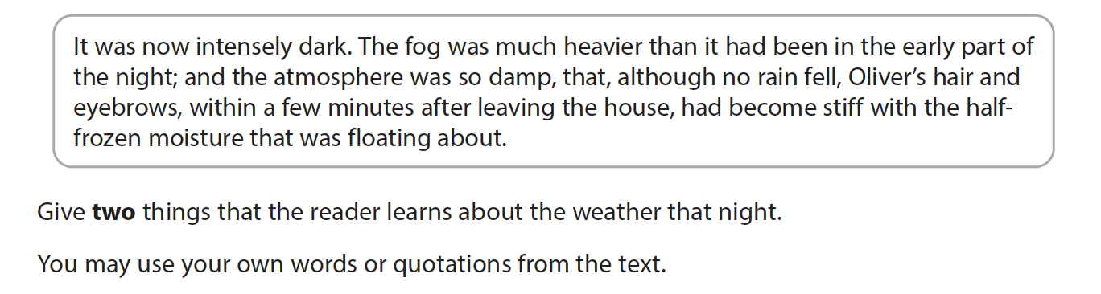
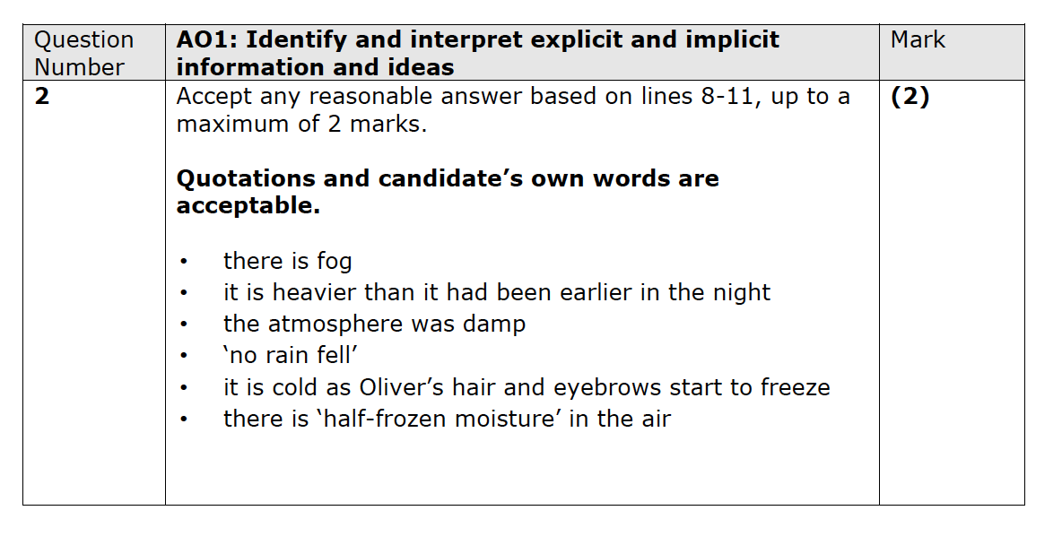
Paper 1 – Question 2
Question 2:
starts with ‘Read this extract’
the extract is within a separate box
asks candidates to ‘give two…’
can be candidate’s own words or a quotation from the text
targets AO1
2 marks
Notes:
Nov 21
Nov 20
June 19
MS – June 19

Slide 13
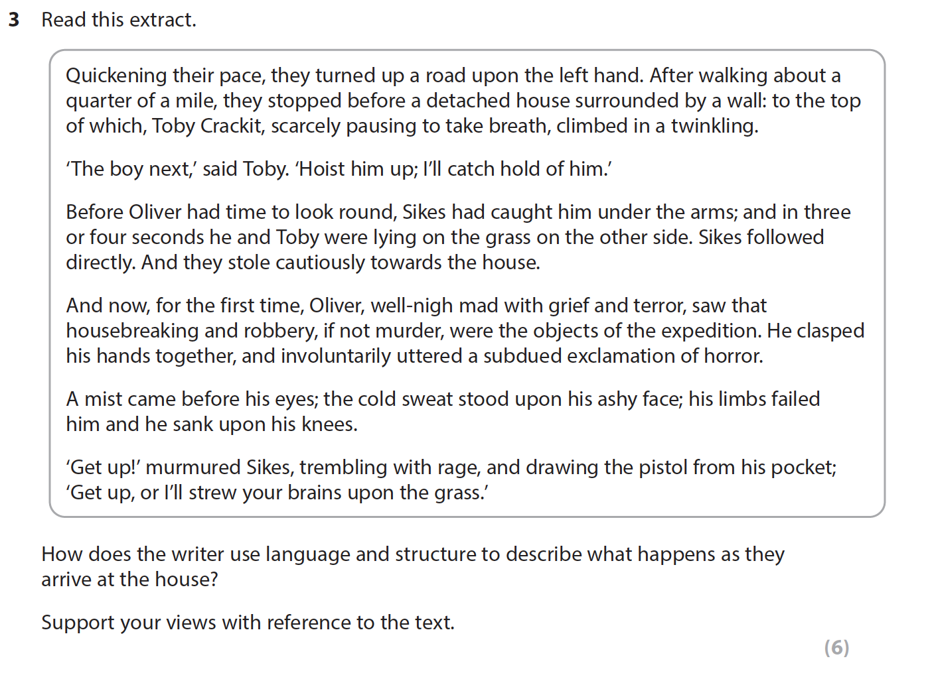
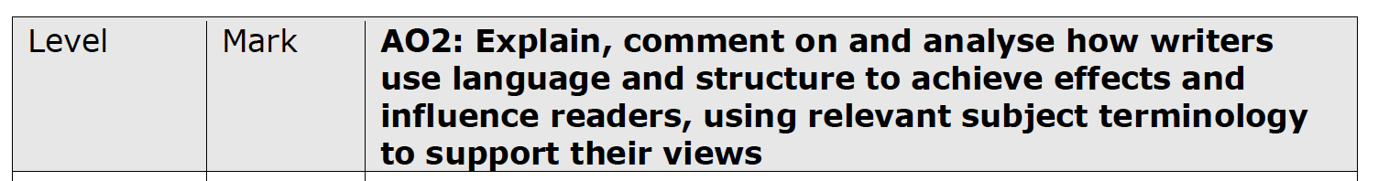
Paper 1 – Question 3
Question 3:
starts ‘Read this extract’
the extract is within a separate box
asks ‘how does the writer use language and structure to…’
asks for references
6 marks
targets AO2

Slide 14
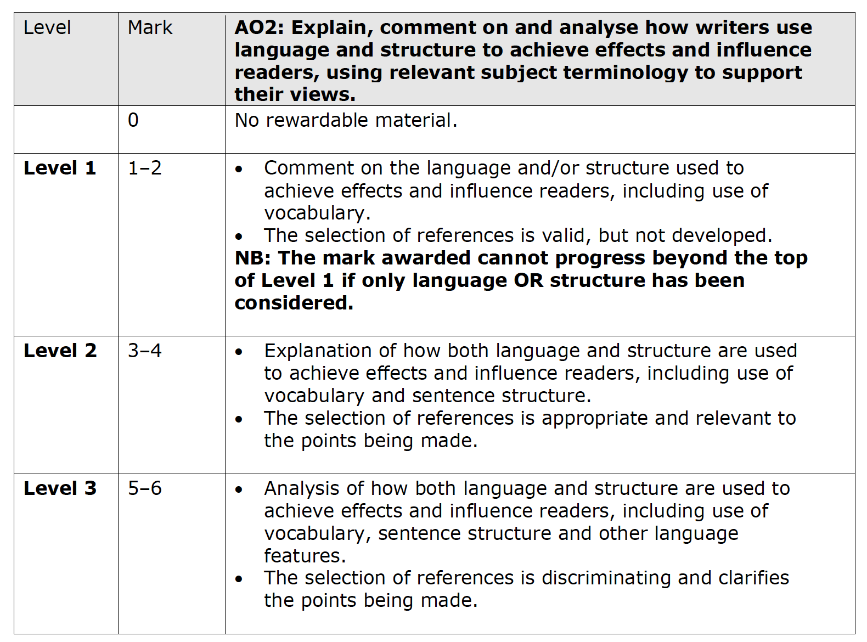
Question 3 – mark scheme

Slide 15
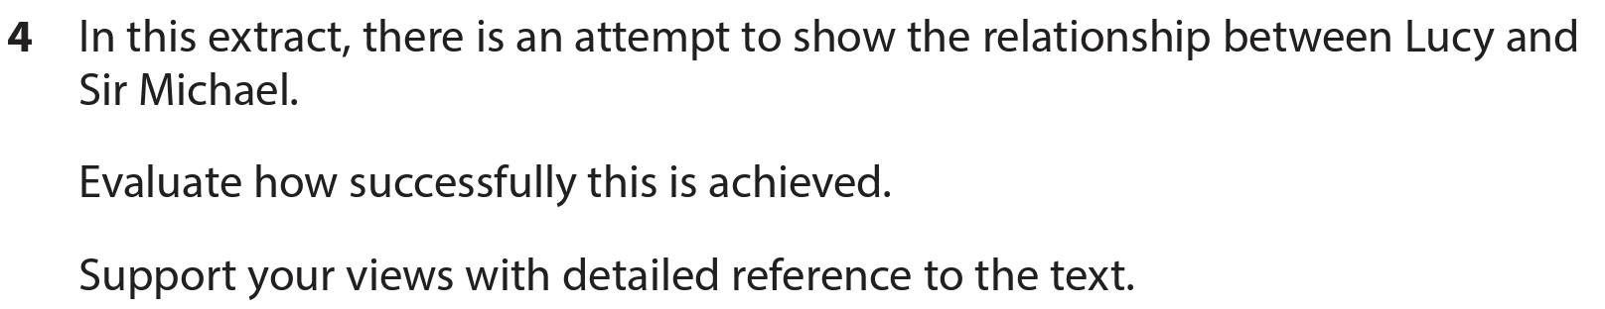
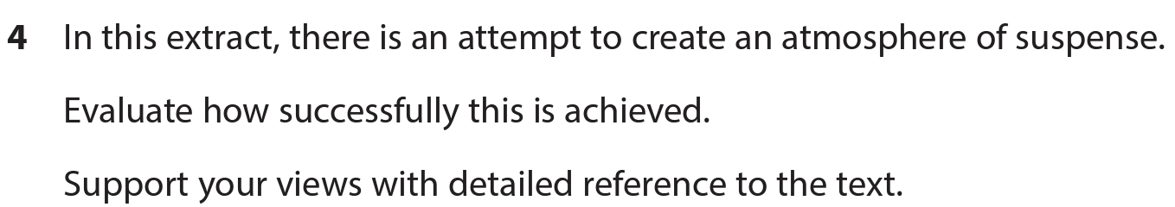
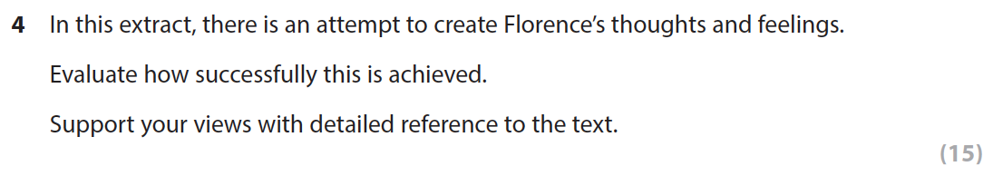
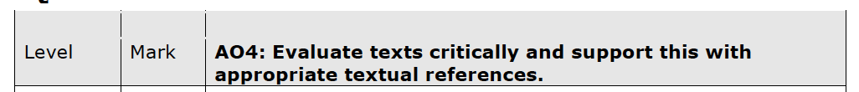
Paper 1 – Question 4
Question 4:
starts with ‘in this extract, there is an attempt to…’
asks candidates to ‘evaluate how successfully this is achieved’
asks for references
15 marks
targets AO4

Slide 16
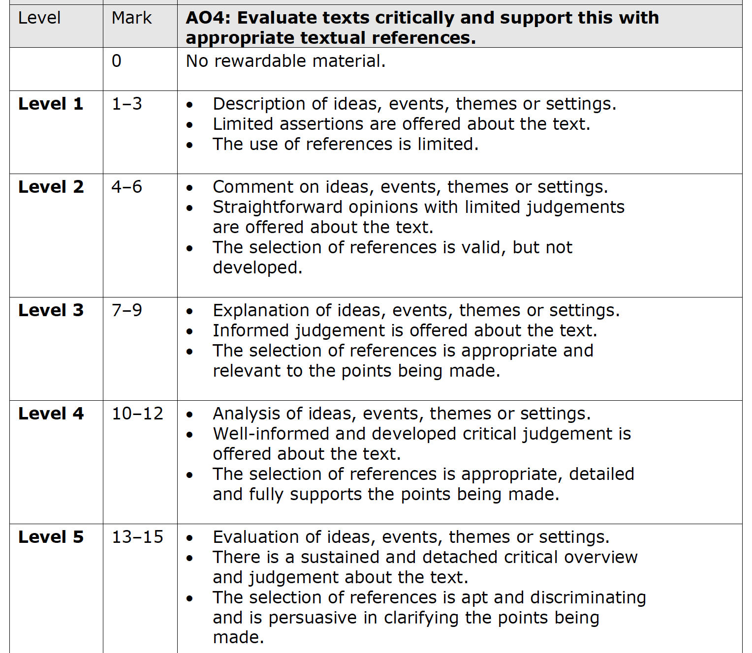
Question 4 – mark scheme

Slide 17
Paper 1 – Writing

Slide 18
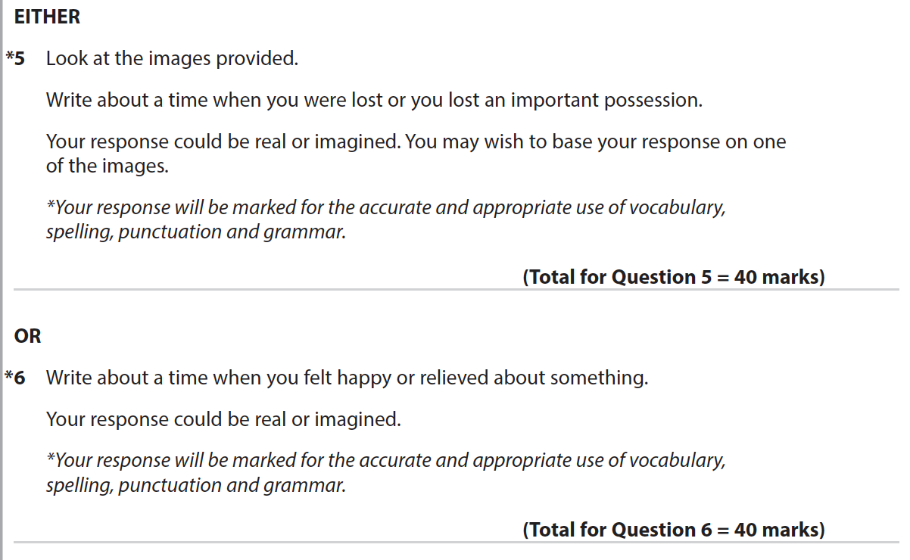
Paper 1 Writing: Facts and Figures
The tasks will change but:
there will always be a choice of two
they will always be imaginative writing tasks
one will always have 2 pictures
the tasks will always be linked to the reading texts

Slide 19
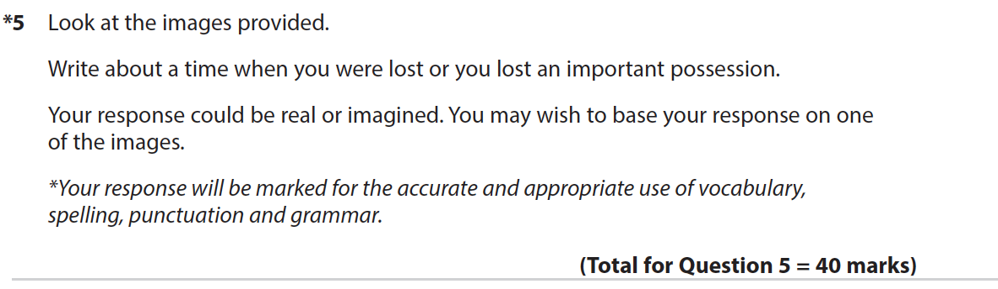
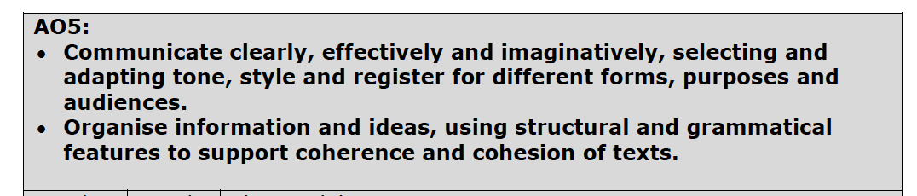
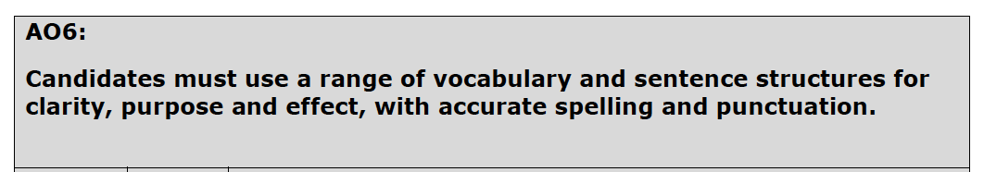
Paper 1 Writing: Facts and Figures
The tasks will change but:
they are always marked out of 40
they target 2 AOs - AO5 and AO6

Slide 20
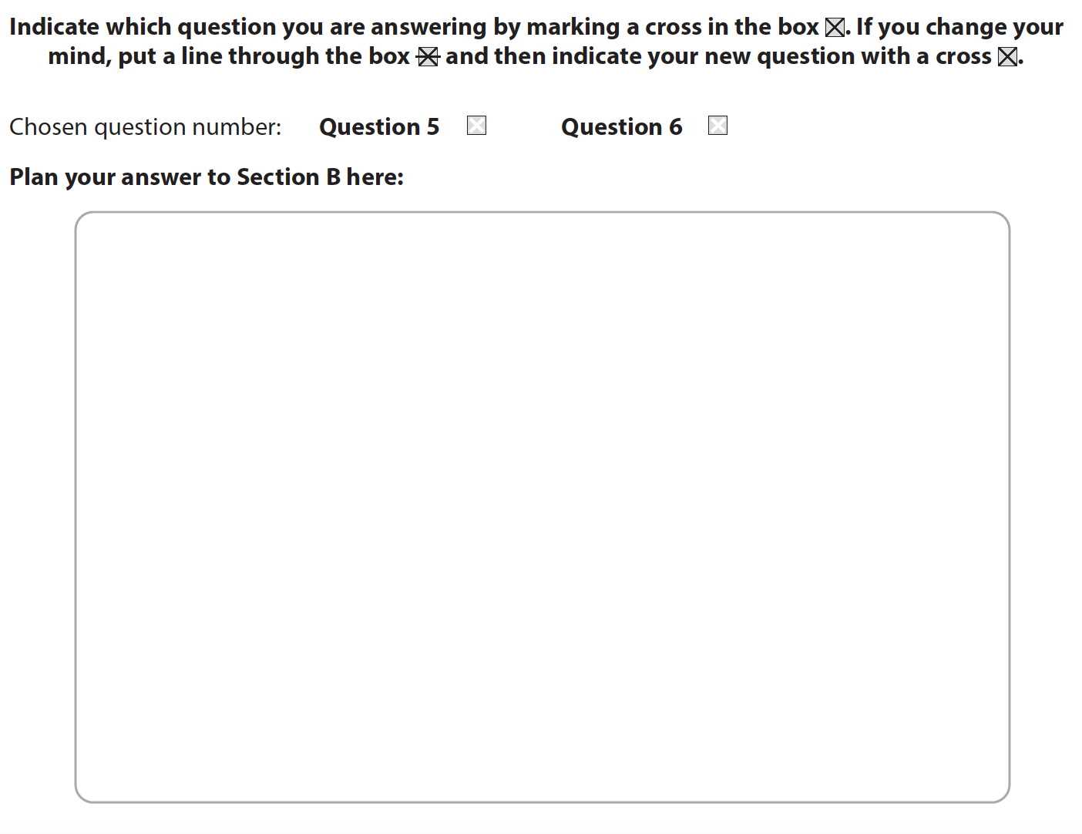
Planning Space

Slide 21
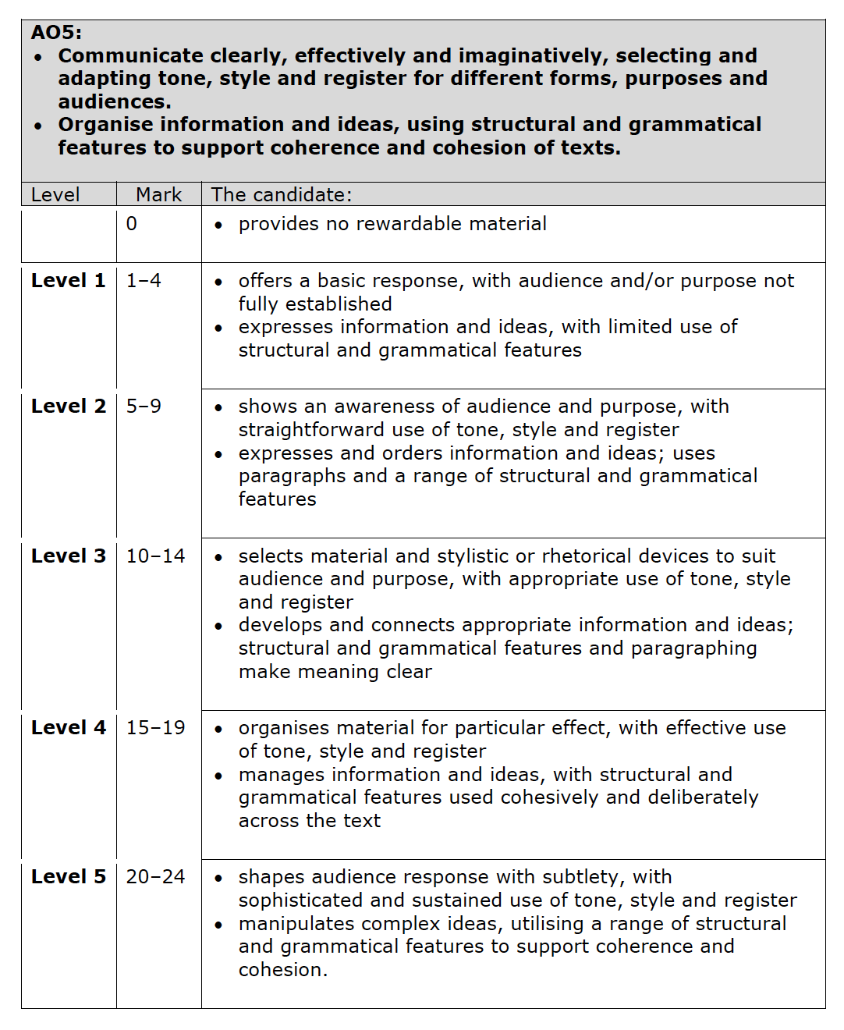
Questions 5 and 6 – AO5

Slide 22
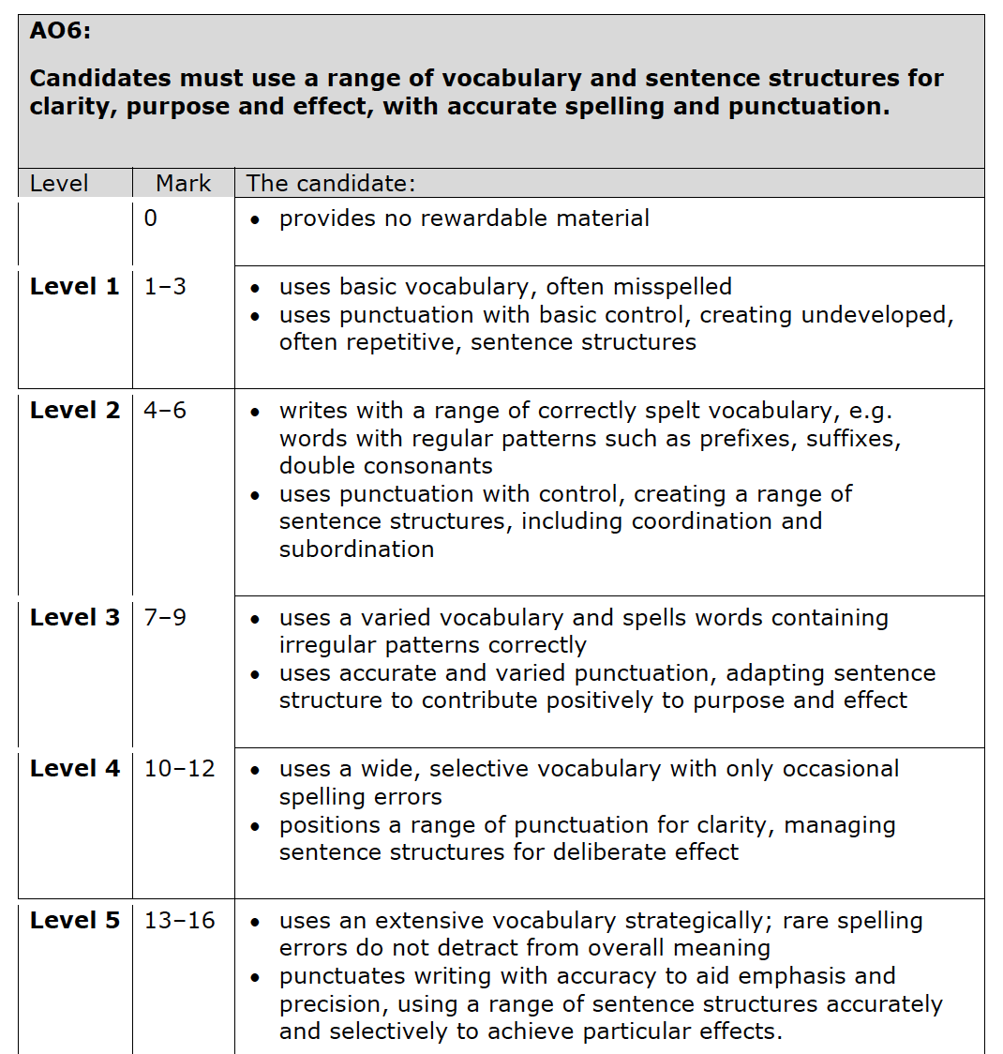
Questions 5 and 6 – AO6

Slide 23
Paper 2 – walkthrough

Slide 24
Paper 2 – what changes and what stays the same?
Changes:
the texts/extracts
the topics of the questions
the writing tasks
Stays the same:
20th and 21st century non-fiction and literary non-fiction
timing of the paper
number of questions
focus of questions
structure of questions
AOs being assessed
number of marks per question

Slide 25
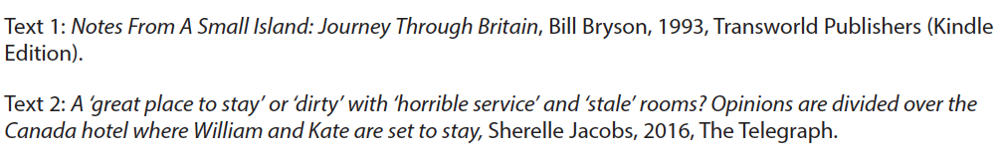
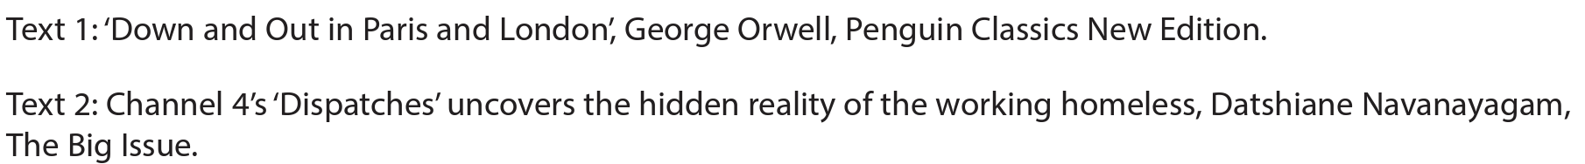

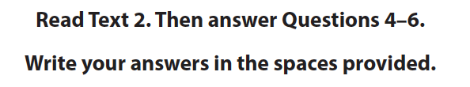

Paper 2 Reading: Facts and Figures
The texts are unseen but:
they are always 20th and 21st century non-fiction
there are always 3 questions on each text – 2 short and 1 long
Q7a and 7b always focusses on both texts

Slide 26
Paper 2 Reading Facts and Figures
Assessment objective | Question
AO1 – Identify and interpret explicit and implicit information and ideas. Select and synthesise evidence from different texts. | Q1, Q2, Q4, Q5 Q7a
AO2 – Explain, comment on and analyse how writers use language and structure to achieve effects and influence readers, using relevant subject terminology to support their views. | Q3
AO3 – Compare writers’ ideas and perspectives, as well as how these are conveyed, across two or more texts. | Q7b
AO4 – Evaluate texts critically and support this with appropriate textual references. | Q6

Slide 27
Paper 2 – Reading Text 1

Slide 28
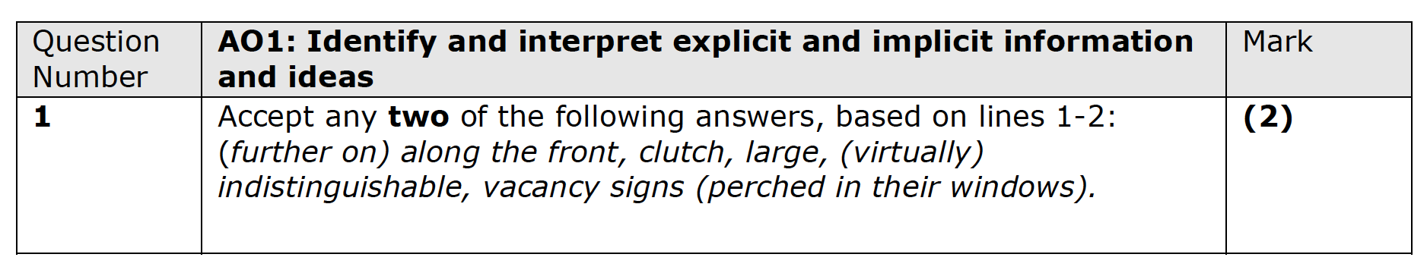
Paper 2 – Question 1
Question 1:
starts with the line references
asks candidates to ‘identify two’
targets AO1
2 marks
can be lifted straight from the text

Slide 29
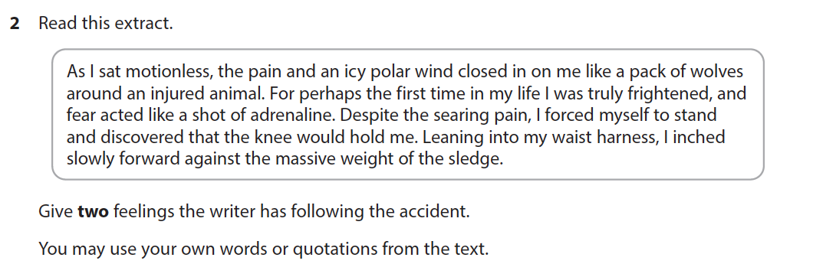
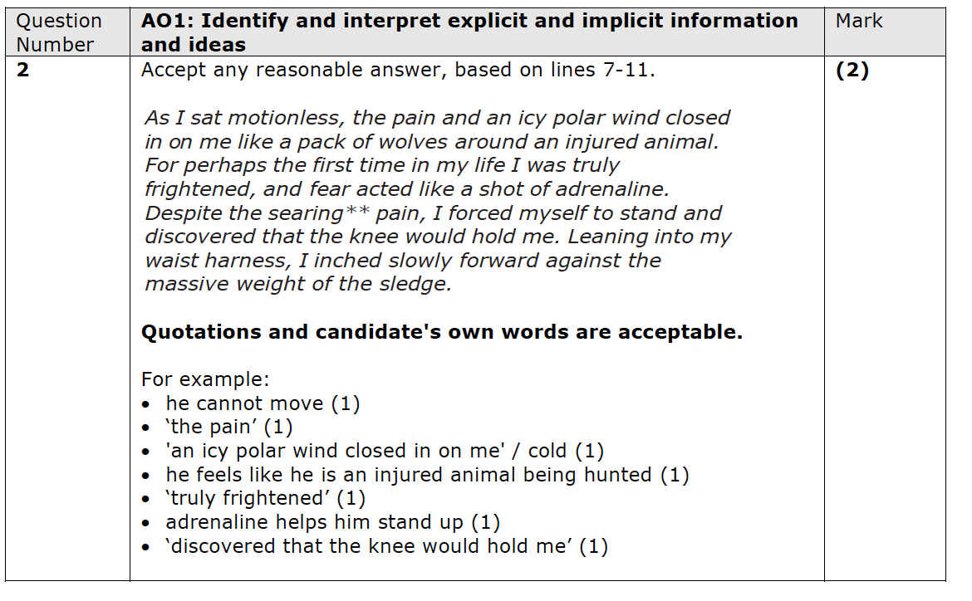
Paper 2 – Question 2
Question 2:
starts with ‘Read the extract’
the extract is within a separate box
asks candidates to ‘give two’
can be candidate’s own words or a quotation from the text
targets AO1
2 marks

Slide 30
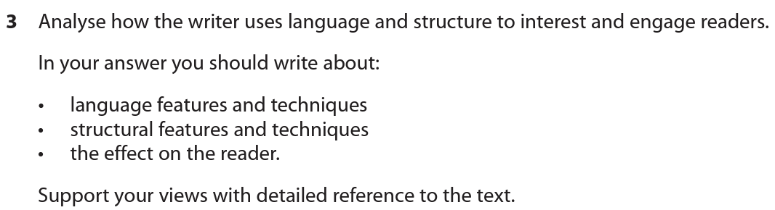
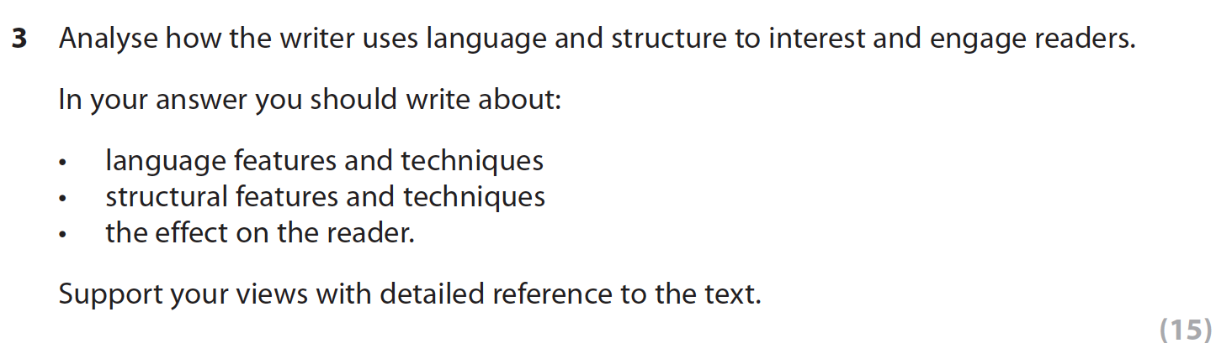
Paper 2 – Question 3
Question 3:
starts with the word ‘analyse’
is the same question series on series
has supporting bullets
asks for references
15 marks
targets AO2

Slide 31
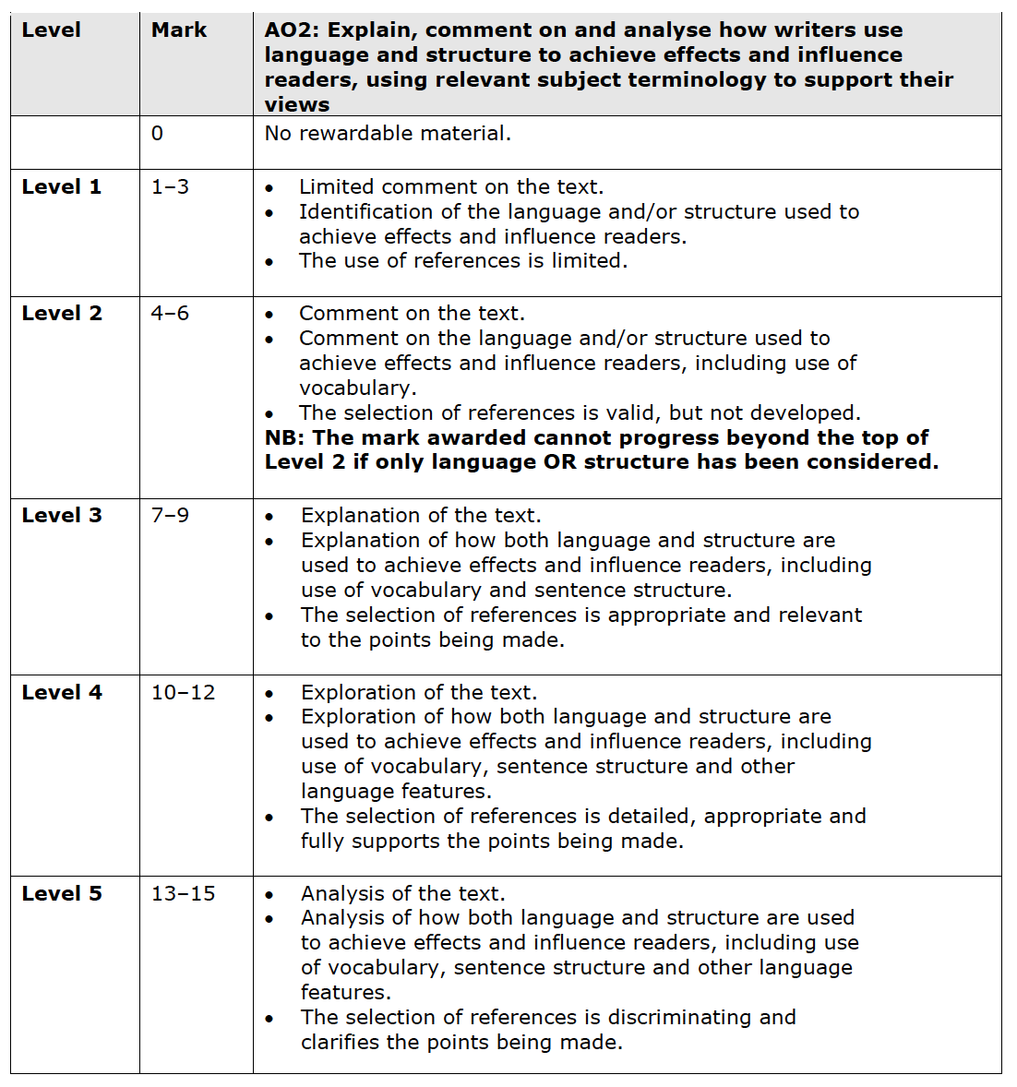
Question 3 – mark scheme

Slide 32
Paper 2 – Reading Text 2

Slide 33
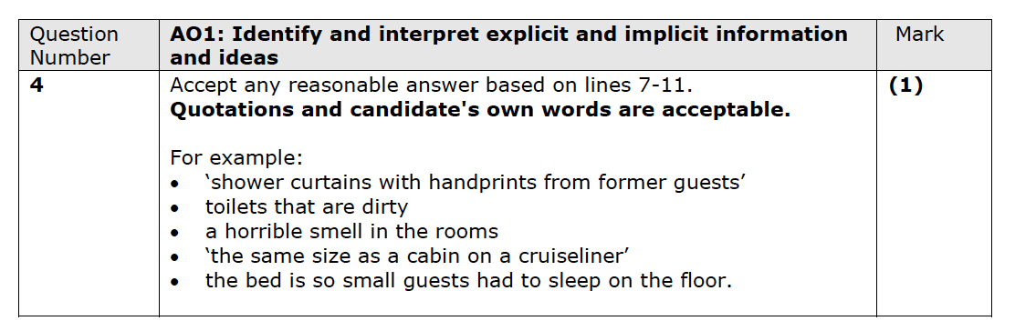
Paper 2 – Question 4
Question 4:
starts with the line references
asks candidates to ‘identify one’
targets AO1
1 mark
can be candidate’s own words or a quotation from the text

Slide 34
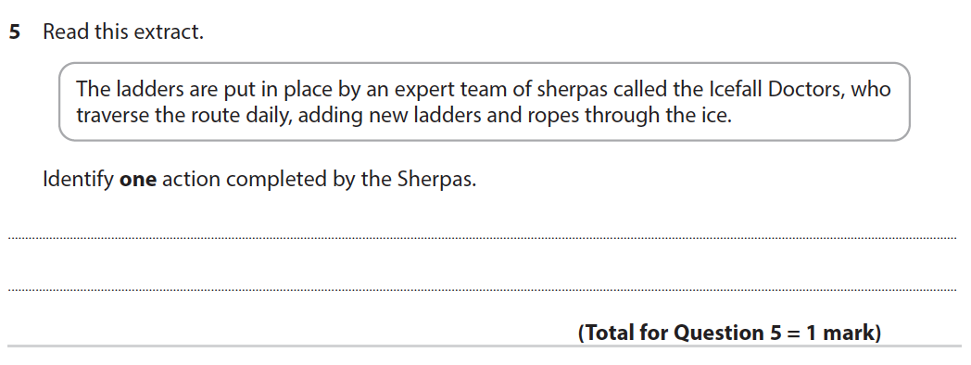
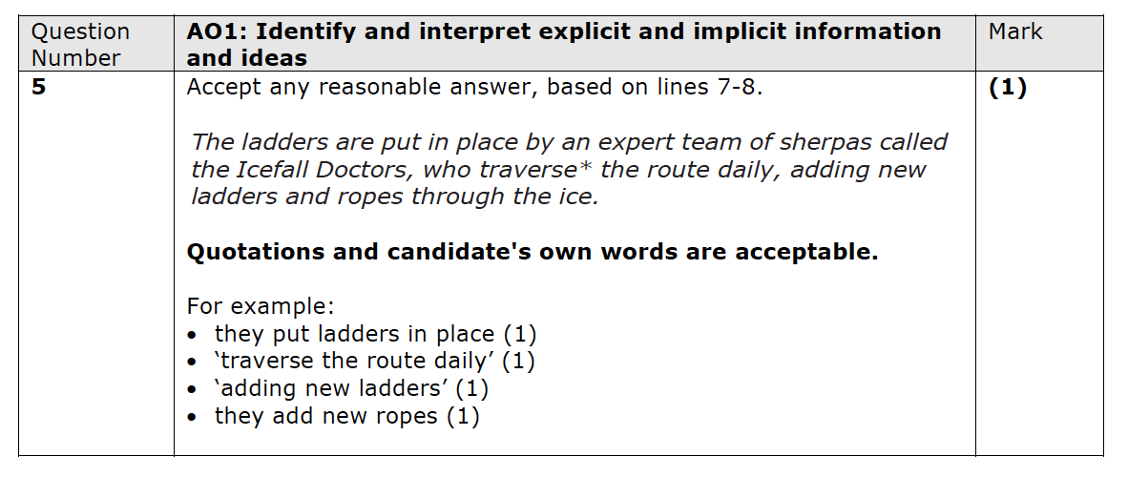
Paper 2 – Question 5
Question 5:
starts with ‘Read the extract;
the extract is within a separate box
asks candidates to ‘identify one’
targets AO1
1 mark
can be candidate’s own words or a quotation from the text
Notes:
Nov 21
Nov 20
June 19

Slide 35
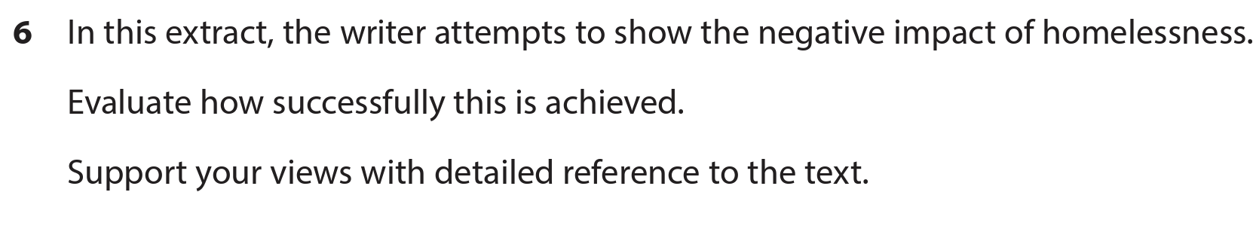
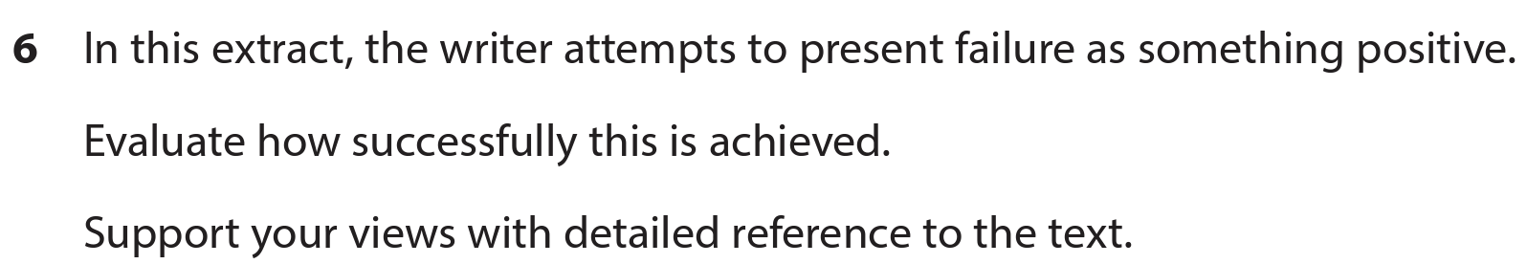
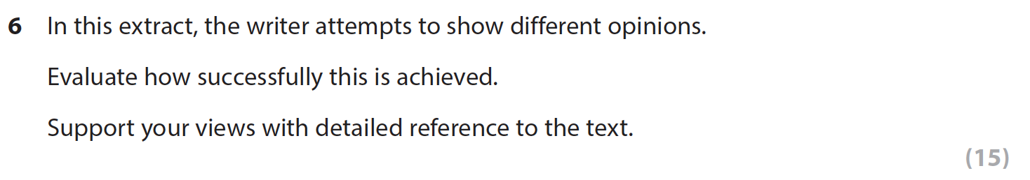
Paper 2 – Question 6
Question 6:
starts with ‘in this extract, there is an attempt to…’
asks candidates to ‘evaluate how successfully this is achieved’
asks for references
15 marks
targets AO4

Slide 36
Question 6 – mark scheme

Slide 37
Paper 2 – Reading synthesis and comparison

Slide 38
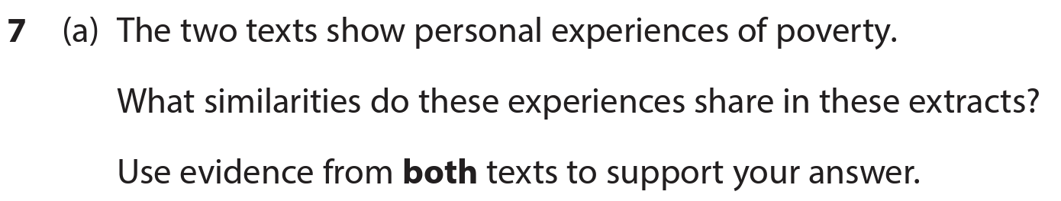
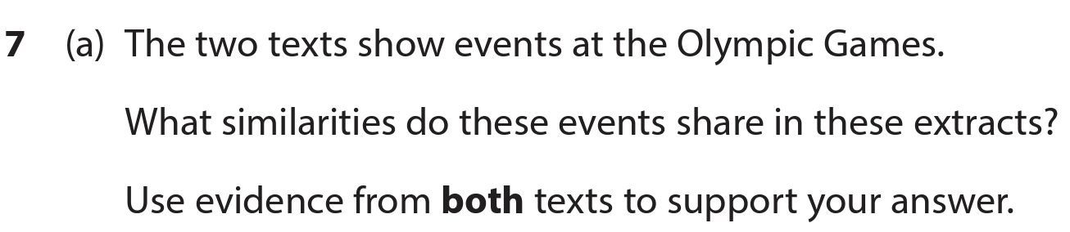
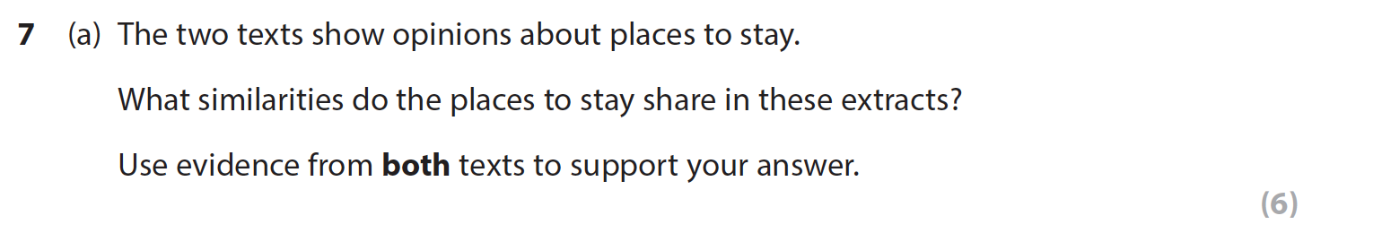
Paper 2 – Question 7a
Question 7a:
starts with a statement about the two texts
asks candidates to discuss the ‘similarities’ the texts share based on the statement
asks for references from both texts
6 marks
targets AO1

Slide 39
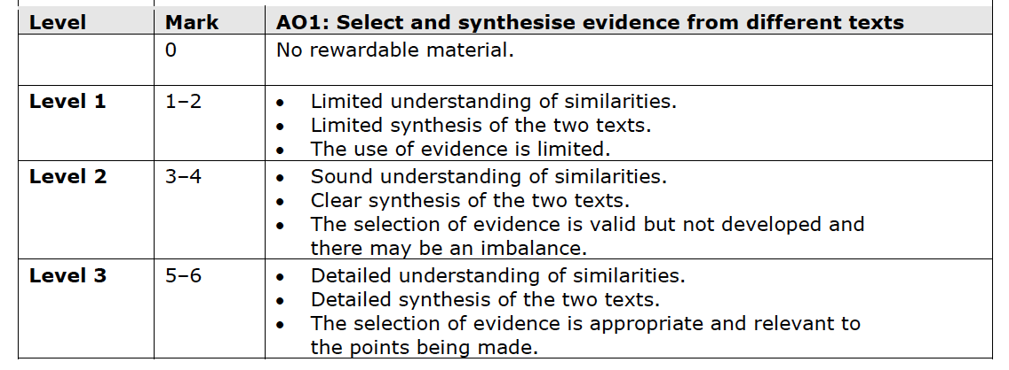
Question 7a Mark Scheme

Slide 40
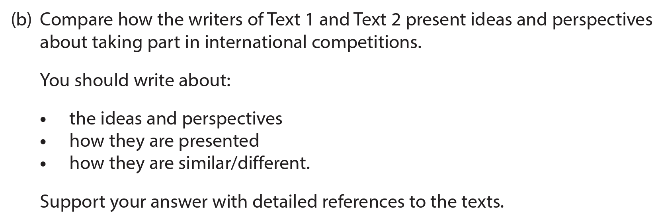
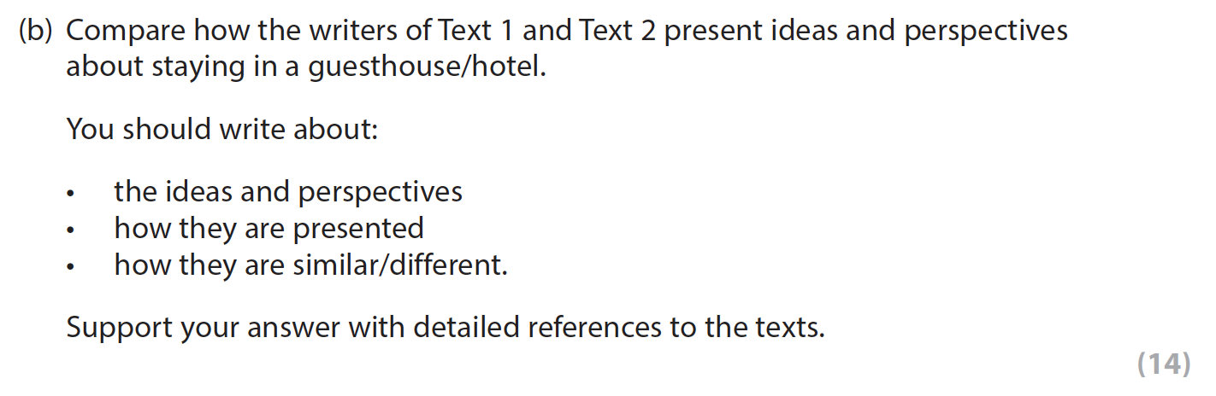
Paper 2 – Question 7b
Question 7b:
asks candidates to ‘compare how the writers of Text 1 and Text 2 present ideas and perspectives…’
has 3 supporting bullet points
asks for references from the texts
14 marks
targets AO3

Slide 41
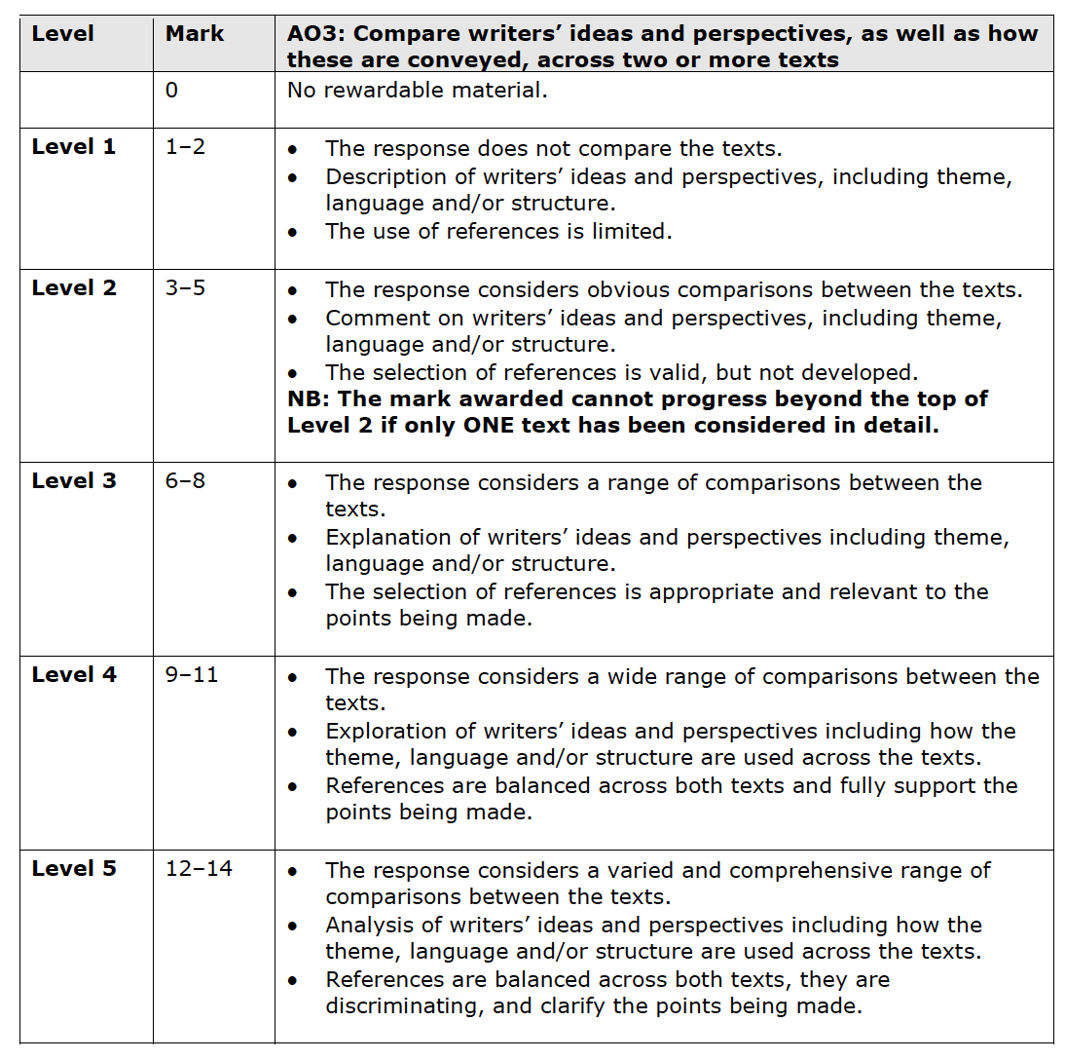
Question 7b Mark Scheme

Slide 42
Paper 2 – Writing

Slide 43
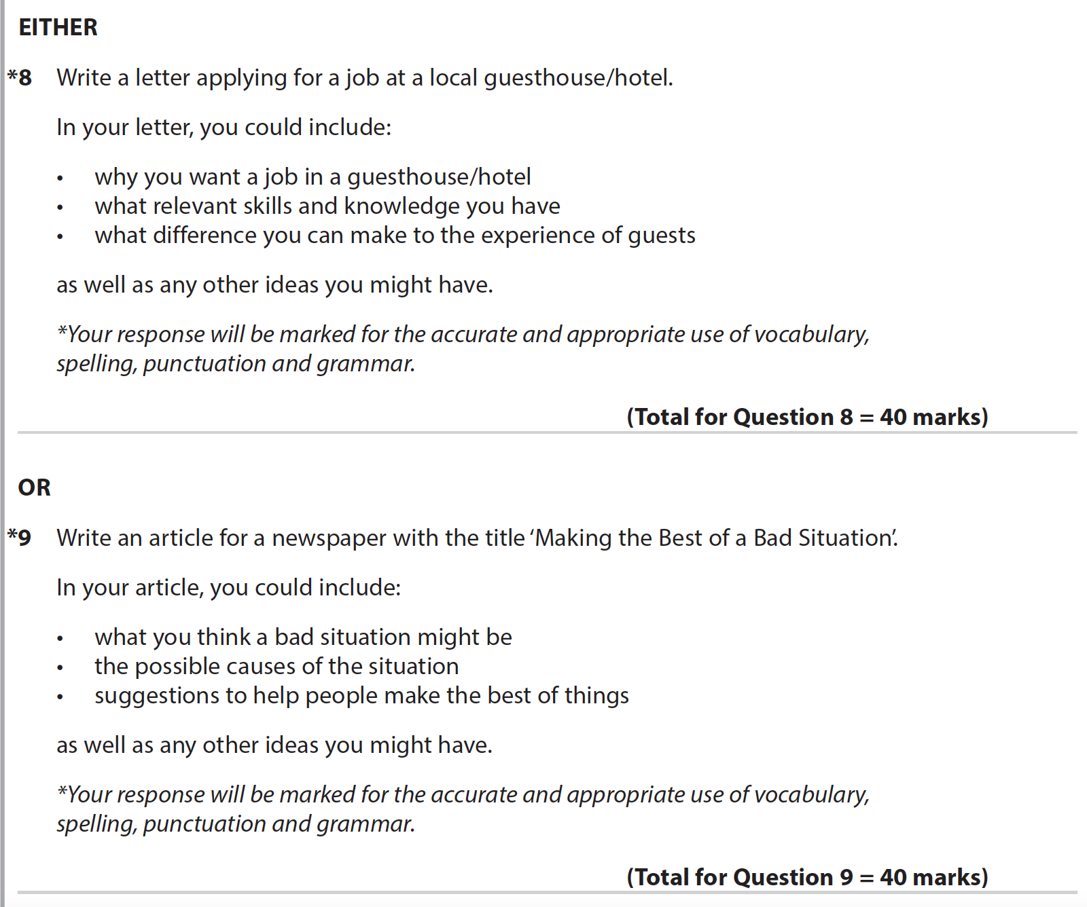
Paper 2 Writing: Facts and Figures
The tasks will change but:
there will always be a choice of two
they will always be transactional writing tasks
there will always be supporting bullets
the tasks will always be linked to the topic of the reading texts

Slide 44
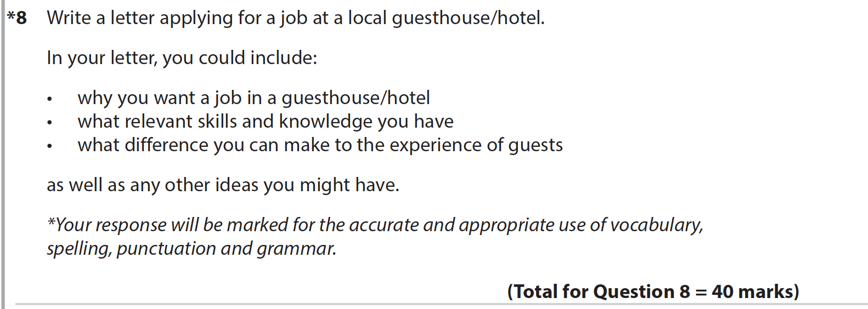
Paper 2 Writing: Facts and Figures
The tasks will change but:
they are always marked out of 40
they target 2 AOs - AO5 and AO6

Slide 45
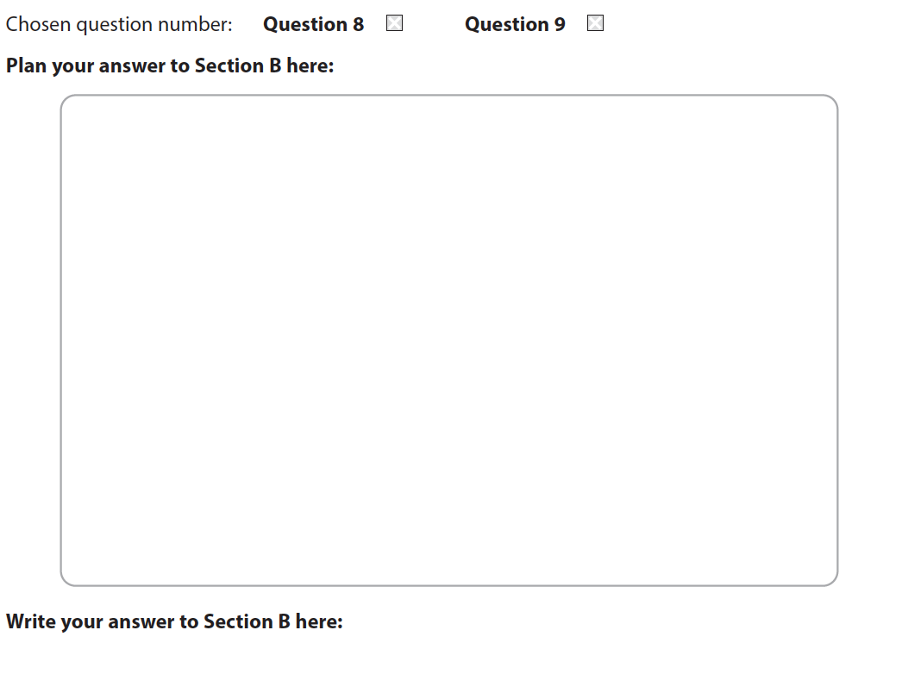
Planning Space

Slide 46
Questions 8 and 9 – AO5

Slide 47
Questions 8 and 9 – AO6

Slide 48
Support

Slide 49
Where to find the past papers
You can download all of our past papers from the website:
In this presentation, we have used examples from Nov 21, Nov 20, June 19 and June 2022
All other past papers can be found in the exam materials area on the website
There are also some specimen papers in the teaching and learning materials area on the website
Summary documents of the questions from all series can be found in the teaching and learning materials area on the website.
For all queries, please contact Clare Haviland on TeachingEnglish@Pearson.com

Slide 50
Thank you!

