Slide 1
Pearson Edexcel GCSE (9-1)
Planning and Delivering Computer Science
Paper 2 - Application of Computational Thinking

Slide 2
Aims and objectives
To support the delivery of the new Pearson Edexcel GCSE Computer Science Paper 2 for first teaching from September 2020.
This session will look at:
• the structure of the six compulsory questions in Paper 2
• the different stages that students will follow when problem solving with programming
• the supporting provision available to students: coding files, Programming Language Subset (PLS) and hard copies of the paper
• a consideration of teaching strategies for going beyond learning the syntax/semantics of Python and moving towards problem solving.
Notes:
Welcome to our online event – ‘Getting started on Paper 2’, which concerns the application of computational thinking and is all about the more practical aspects of computer science.

Slide 3
Agenda
Time (minutes) | Item
3 | Aims and Objectives
17 | Paper 2 Overview
14 | Sample Assessment Material Q1 & Q2
10 | Activity 1 – Identify the topic content
41 | Sample Assessment Material Q3 - Q6
7 | Teaching Strategies
8 | Activity 2 – PRIMM
10 | Activity 3 – Planning Exercise
6 | Available support
3 | Questions
1 | Next steps
Notes:
It will take approximately two hours to cover all of these topics and we have included some activities for you to engage with.

Slide 4
Paper 2 overview

Slide 5
Overview of our new qualification
 | Content | Assessment
Paper 1: Principles of Computer Science | Topic 1: Computational thinking Topic 2: Data Topic 3: Computers Topic 4: Networks Topic 5: Issues and impact | 75 marks Written examination: 1 hour 30 minutes 50% of the qualification
Paper 2: Application of Computational Thinking | Topic 6: Problem solving with programming. The main focus of this paper is: decompose and analyse problems read, write, refine and evaluate programs. | 75 marks Practical on-screen examination: 2 hours 50% of the qualification
Notes:
Two papers each weighted at 50%. Paper 1 will assess topics 1 to 5 as shown.
Paper 2 - will assess Topic 6: Problem solving with programming.
The main focus of this paper will be understanding how to decompose and analyse problems; and the ability to read, write, refine, and evaluate programs.
This practical paper requires students to design, write, test, and refine programs in order to solve problems.
Total assessment time reduced from 3 hours and 40 minutes to 3 hours and 30 minutes.
The current 20-hour programming project – has been removed from the qualification.

Slide 6
Specification content
Paper 2 addresses Topic 6: Problem solving with programming. There are
6 sub-topics:
6.1 Develop code ‘Be able to use, write, refine………
6.2 Constructs ‘Be able to identify, write…………..
6.3 Data types and structures ‘Be able to write…………………….
6.4 Input / output ’Be able to write……………………
6.5 Operators ‘Be able to write……………………
6.6 Subprograms ‘Be able to write…………………….
Notes:
The specification content illustrates the practical nature of the paper 2. All of the ‘Students should’ statements in the content start with a verb which goes on to describe an activity related to programming.
There are 6 sub topics:
6.1 Refers to using decomposition and abstraction, writing and refining code, converting algorithms into code, making programs easy to understand, correcting errors and evaluating a programs efficiency.
6.2 Lists the structural components and constructs students need to be able to identify and use.
6.3 Describes the use of data types, data structures, variables, constants, and string handling
6.4 Refers to responding to user input, use of csv text files and validation
6.5 Identifies the operators students should be able to use.
6.6 Covers sub-programs, including library routines, functions and procedures, including parameters, global and local variables

Slide 7
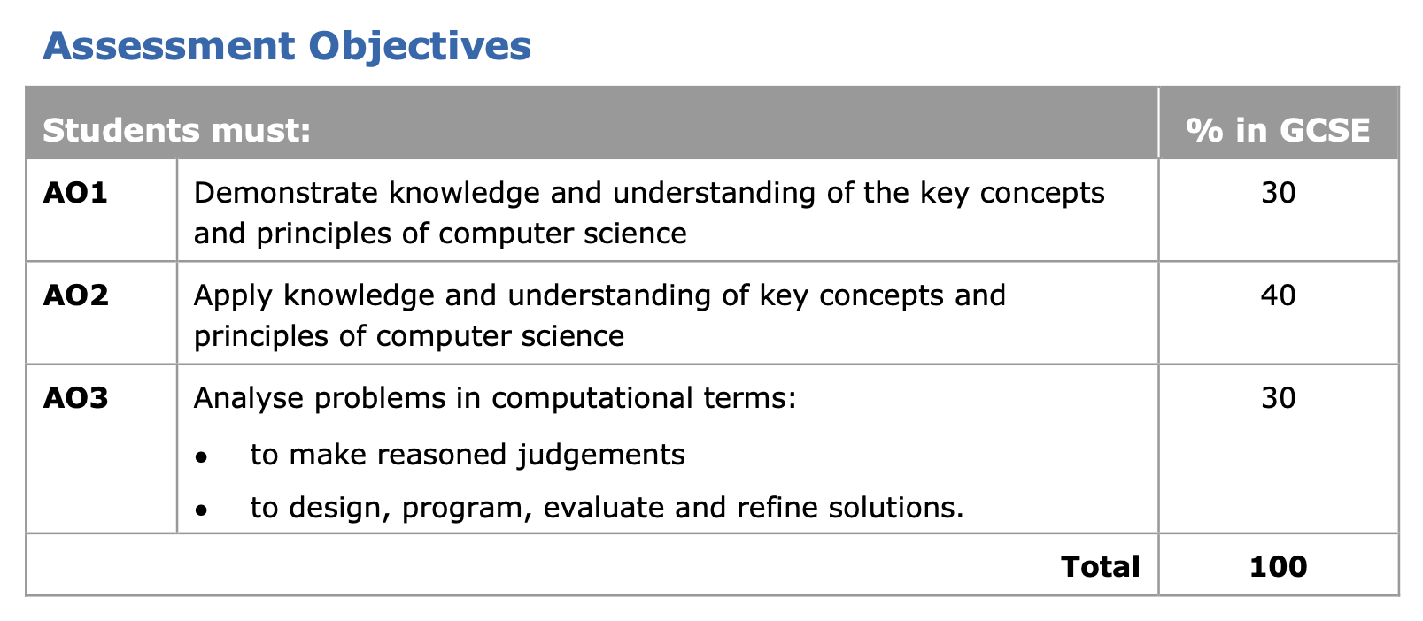
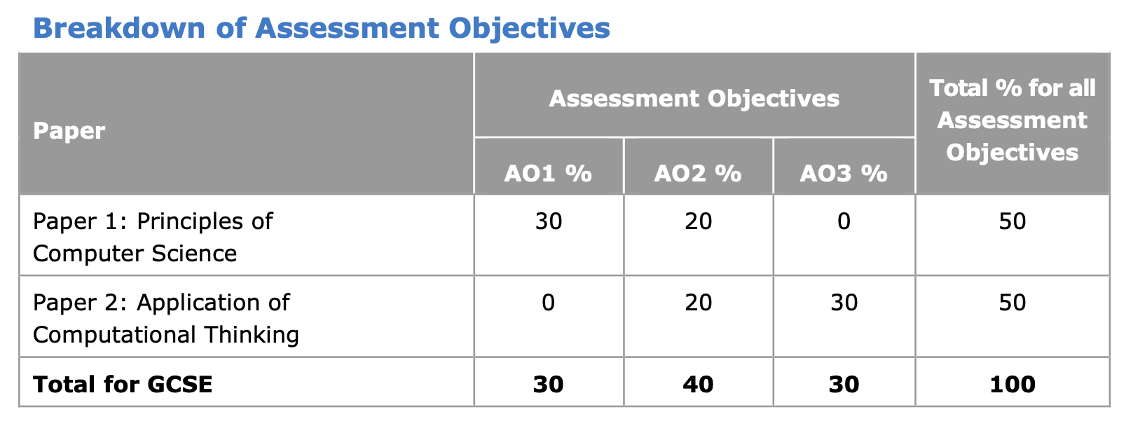
Assessment Objectives
Assessment objectives (AOs) refer to the skills that candidates need to demonstrate in their responses to questions in Papers 1 and 2.
Notes:
Ofqual has set three assessment objectives (AOs) for GCSE Computer Science, to which all specifications must adhere.
The assessment objectives describe the skills that a candidate should gain throughout the course and then be applied by the candidate to the summative assessments of the course.
AO1 – the demonstration of knowledge and understanding of the key concepts and principles of computer science. These skills are demonstrated through written responses to Paper 1 questions. Questions targeting AO1 require candidates to demonstrate what they have learned about the subject content of the specification.
AO2 – apply knowledge and understanding of key concepts and principles of computer science. The skills are demonstrated through the application of knowledge to given contexts. Both Paper 1 and Paper 2 contain questions based on AO2. Questions targeting AO2 require candidates to apply what they have learned about an aspect of the subject content to a particular context or contexts.
AO3 – Analyse problems in computational terms to make reasoned judgements and to design, program, evaluate and refine solutions. This AO is only assessed through Paper 2 where candidates are required to demonstrate practical programming skills.

Slide 8
Assessment Objectives
Assessment objectives 2 and 3 are further split into the following sub sections:
AO2.1a – apply knowledge of key concepts and principles of computer science
AO2.1b – apply understanding of key concepts and principles of computer science
AO3.1 – make reasoned judgements
AO3.2a – design solutions
AO3.2b – program solutions
AO3.2c – evaluate and refine solutions.
Notes:
Paper 2 is marked out of 75 marks – 30 marks for AO2 and 45 marks for AO3. The allocation of marks to assessment objectives is clearly set out in the Sample Assessment Materials which will allow teachers to gain a thorough understanding of the structure of the Paper and the skills candidates need to demonstrate.
AO2 - Questions targeting AO2 require candidates to apply what they have learned about an aspect of the subject content to a particular context or contexts.
AO3 is split into two distinct areas:
AO3.1 – making reasoned judgements - ‘Reasoned judgements’ are those based on a logical chain of thinking.
AO3.2 is further split subdivided into:
AO3.2a – designing solutions in a given context
AO3.2b – programming solutions to a problem in a given context
AO3.2c – evaluating programming solutions to a problem and, following the evaluation, refining the program.

Slide 9
Assessment Principles
 | Paper 2
Ramped demand within the paper | ✓
Command words linked to particular skills and mark tariffs Only ‘amend’ and ‘write’ for Paper 2 | ✓
Clear and consistent levels-based mark schemes | ✓
Application of key principles and concepts; being able to analyse problems computationally | ✓
Onscreen, with the use of your favoured Integrated Development Environment (IDE) to write and amend programs in response to the questions. | ✓
Notes:
Ramped demand within papers and across the entire qualification
Command words linked to particular skills and mark tariffs and two command words for this paper
Clear and consistent levels-based mark schemes
Paper 2 the focus is on assessing the application of key principles and concepts and being able to analyse problems computationally. Questions in this paper are based on the students’ ability to design, write, test and refine programs.
This paper will require students to use their Integrated Development Environments to write and amend programs in response to the questions. This will be done on a computer in a ‘locked-down’ exam profile. Learners will be required to save their programming code which will then be transferred digitally for marking.
The assessment is onscreen – not online – and students will not have access to the internet.

Slide 10
Background
In 2019, Ofqual announced changes for the GCSE in Computer Science.
The main change concerned the assessment of programming skills.
Programming skills (design, write, test and refine programs) is now to be assessed under examination conditions.
The assessment of programming skills must be taken at the same time by all candidates.
The emphasis on programming in our new Computer Science GCSE specification encourages and rewards practical programming skills.
Notes:
In 2019, Ofqual announced changes to their conditions and guidance documents for the GCSE in Computer Science.
The main change is how programming skills will be assessed. These changes will come into effect for first teaching from September 2020 and first assessment from summer 2022.
Programming skills (design, write, test and refine programs) will now be assessed under examination conditions where awarding organisations set and mark the assessment.
The assessment of programming skills has to be taken at the same time by all candidates.
The development of practical programming skills is encouraged by the specification and rewarded by the assessment weighting for Paper 2.

Slide 11

Paper 2 Structure
2 hour examination with 6 compulsory questions.
Maximum mark = 75
Questions are practical in nature
Questions require students to design, write, test and refine programs.
All responses to be in Python 3
Two question types – either to amend (a given piece of code) or to write code.
Notes:
The slide covers the basic structure to be used for Paper 2.

Slide 12
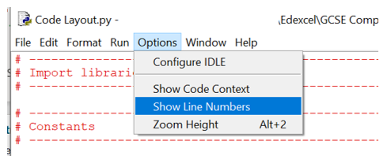
Paper 2 Approach 1
Students complete the assessment on screen using their Integrated Development Environment (IDE) of choice. There are many suitable IDEs available to freely download online. Teachers are advised to evaluate several IDEs before selecting the most suitable one for their students. | IDLE is an example (IDE) for Python. The Python installer for Windows contains the IDLE module by default. IDLE 3.8 has an option to display line numbers, as shown.
Notes:
Students will need experience using an IDE to write, run and debug their programming code. Developing skills in using an IDE will allow students to be more productive, especially in time-constrained activities.
A suitable IDE includes these functionalities:
an editor, with line numbers
a syntax highlighter and checker
breakpoints and stepping
a variable inspector.

Slide 13
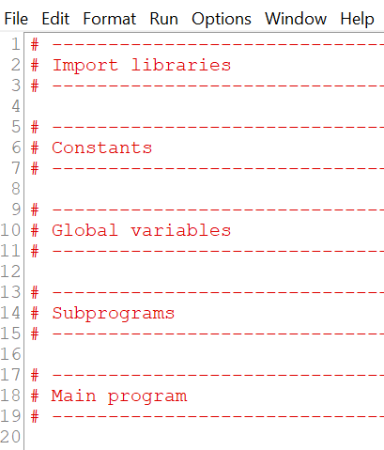
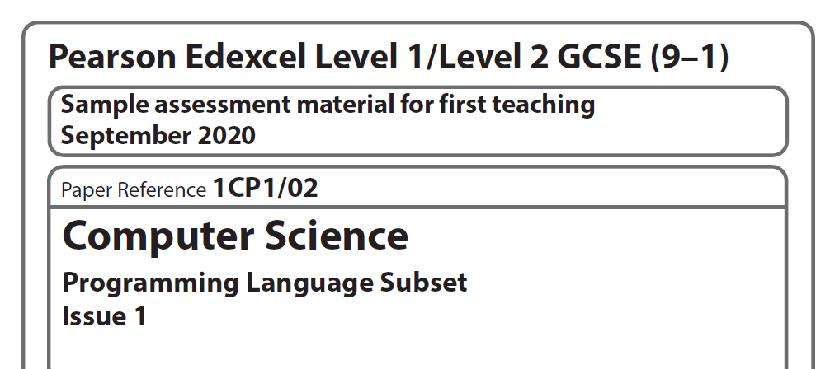
Paper 2 Approach 2
 | Students will be provided with: Coding files in Python 3 CSV text files, if required An electronic copy of The Programming Language Subset (PLS) document. Hard copies of the PLS and examination paper Link to Tim’s video
Notes:
All the code provided for the assessment will be structured as shown. Responses should follow the structure provided.
The PLS represents a specific set of constructs that are sufficient to successfully answer any question in Paper 2. Any student successfully using more esoteric or complex constructs or approaches not included in the PLS will still be awarded marks in Paper 2 if the solution is valid. The PLS will be valid for the lifetime of the qualification. However, if updates are required, we will ensure the latest version is published by the 31st of January in the year of the examination.. The PLS is available to download on the GCSE in Computer Science section of the Pearson website.
The link opens Tim Brady’s video demonstrating how to organise the code files for the Paper 2 assessment.

Slide 14
Paper 2 Approach 3
Instructions for the Conduct of the Examination (ICE) is available for download from the Pearson website.
ICE
Frequently Asked Questions on administering the Paper 2 examination.
FAQs
No internet access is required or permitted.
Notes:
There are bound to be some questions regarding the logistics involved with the new onscreen examination.
Most of these will be answered in either the ICE (Instructions for the Conduct of the Examination) or the FAQ document – both of which are available on the Pearson website. (Links provided.)

Slide 15
Sample Assessment
Material

Slide 16
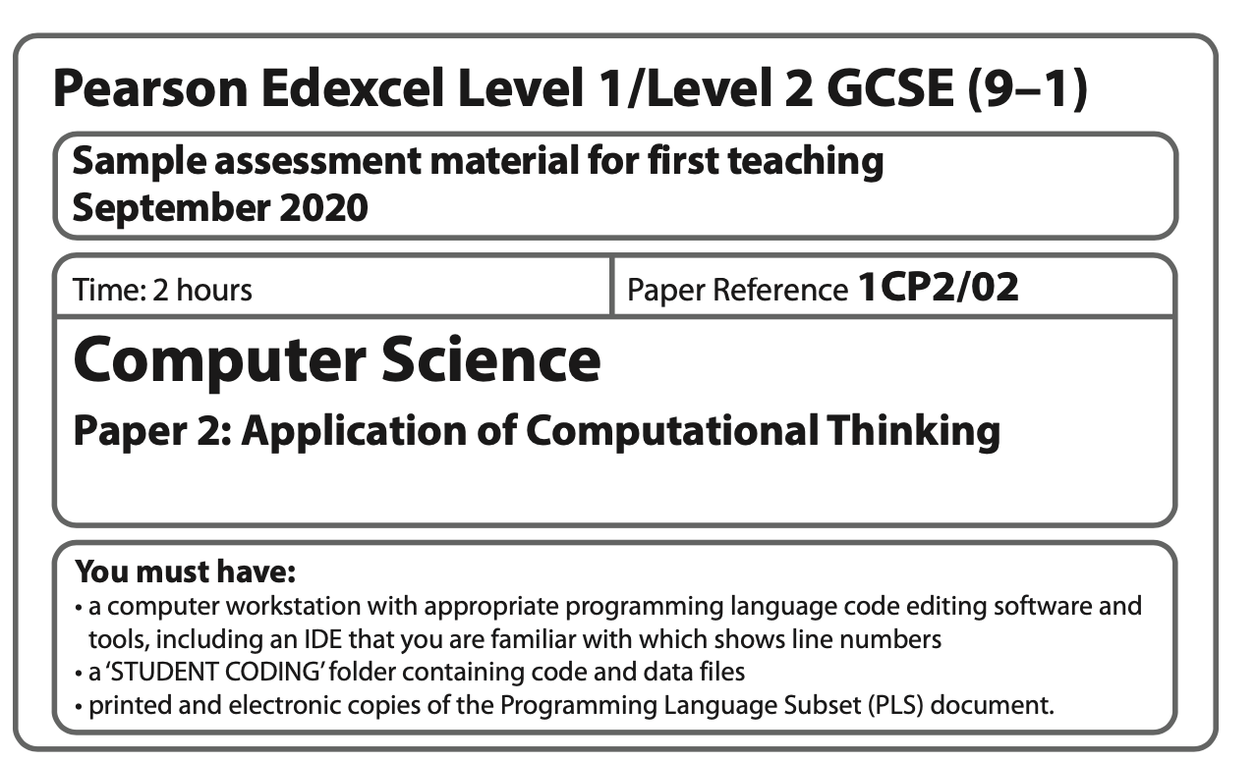
Sample Assessment Materials (SAMs) – Paper 2
The sample assessment materials have been developed to support this qualification and should be used as the benchmark to develop an understanding of the nature and complexity of the assessment students will take.
The SAM for Paper 2 includes a sample examination paper and a detailed mark scheme that identifies the assessment objectives for each question and/or part of question.
Notes:
The sample assessment materials have been developed to support this qualification and should be used as the benchmark to develop an understanding of the nature and complexity of the assessment students will take.
The SAM for Paper 2 includes a sample examination paper and a detailed mark scheme that identifies the assessment objectives for each question and/or part of question. A system of colour coding has been used to identify the marks awarded for each AO:
AO2.1a and AO2.1b
AO3.1, AO3.2a, AO3.2b and AO3.2c
This colour coding will allow teachers to identify the ways in which the AOs are examined to support the development of teaching strategies and reinforcement activities for their students.

Slide 17
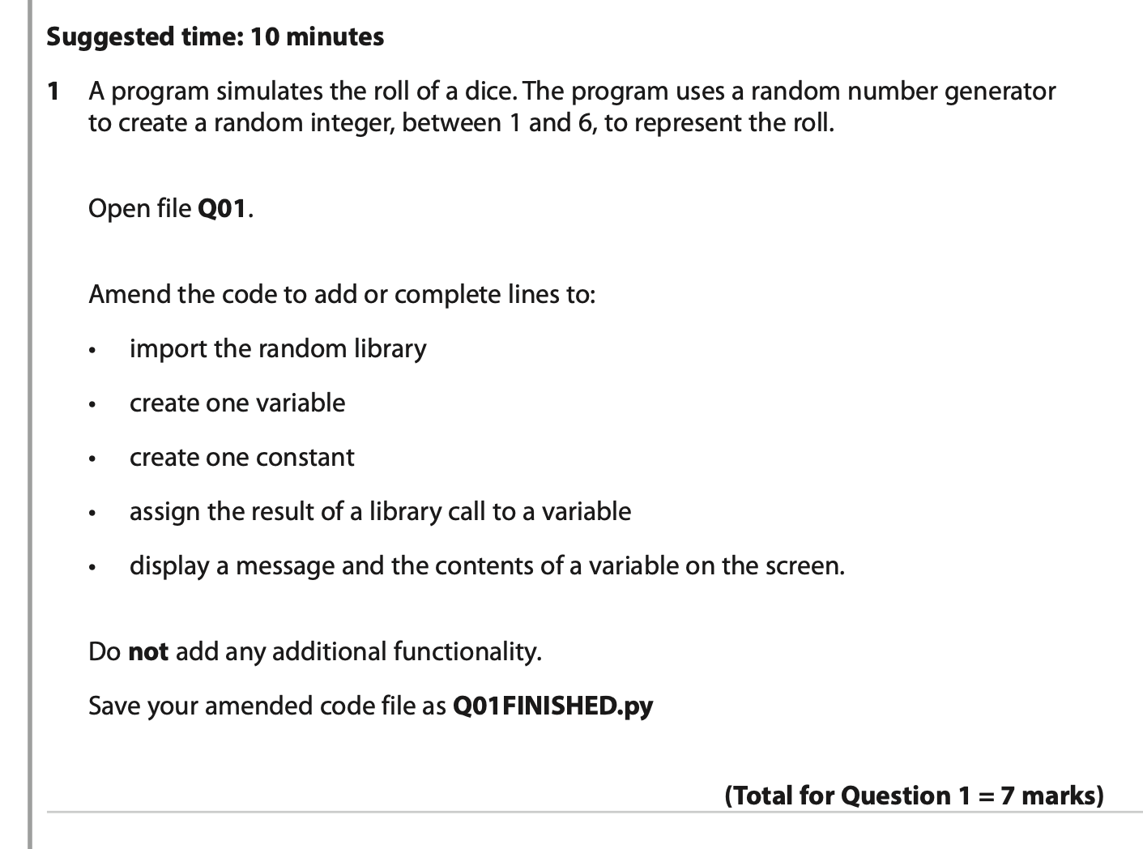
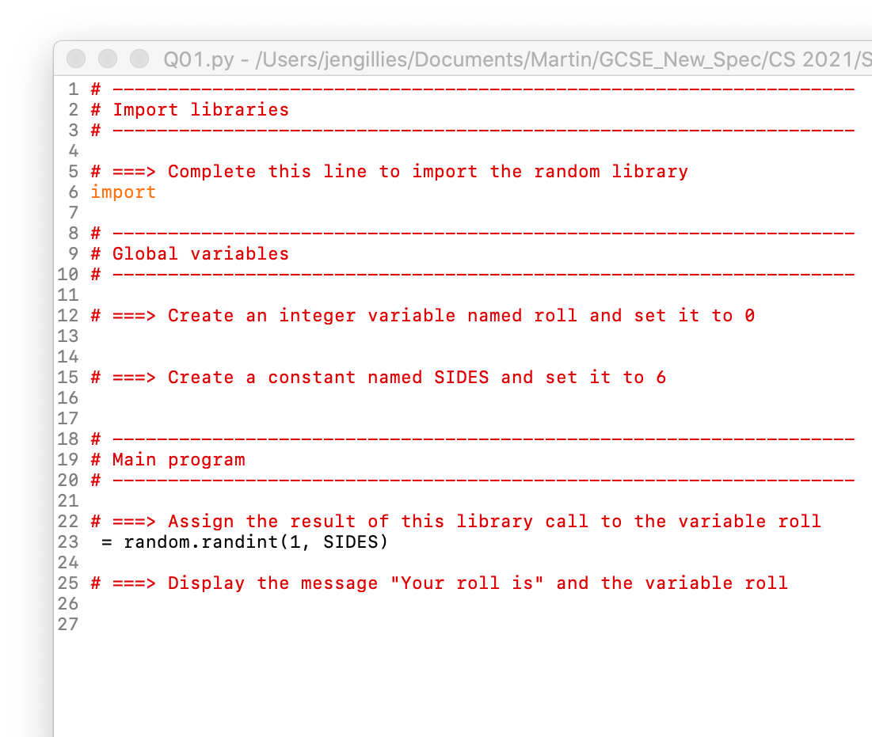
SAM – Paper 2 – Question 1
Notes:
Question 1
The stem of the question sets the context for the program to be created. The program is required to use a random number generator to create a random integer between 1 and 6, thus modelling the roll of a die.
It is suggested that the candidate should spend 10 minutes on this task.
Students must use the file Q01.py and save their amended code as Q01FINISHED.py
The question paper asks the candidate to:
Import the random library
Create one variable
Create one constant
Assign the result of a library call to a variable
Display a message and the contents of a variable on the screen.
The code contains clear annotation in the format of the established layout and has a prompt at line 6 for the import line and line 23 contains part of the assignment statement.

Slide 18
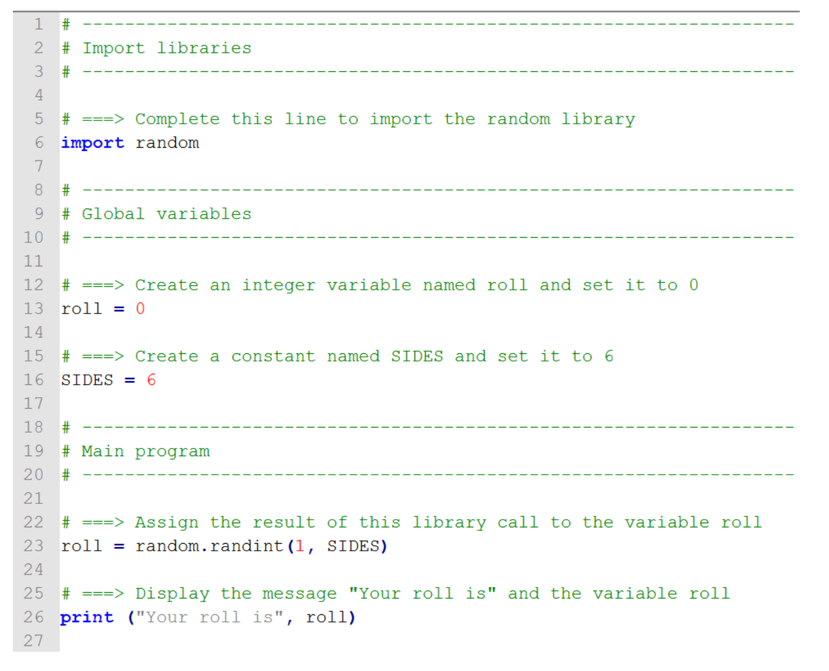
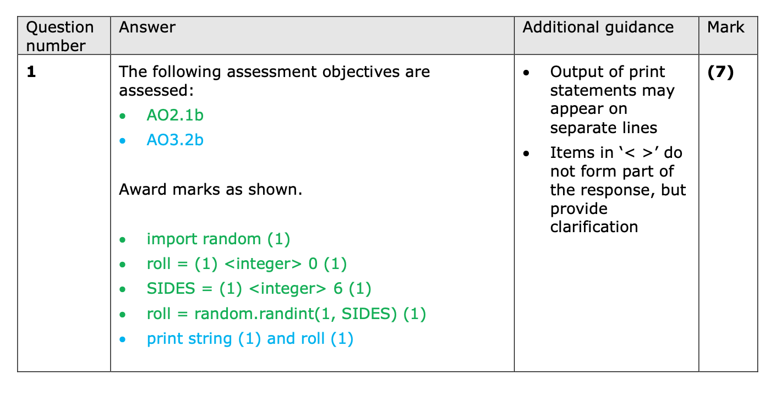
SAM – Paper 2 – Question 1 Mark Scheme
Notes:
The mark scheme clearly identifies the assessment objectives being tested.
AO2.1b – apply understanding of key concepts and principles of computer science.
Annotation provides sufficient guidance to allow candidates to apply their understanding to complete the lines.
AO3.2b – the annotation for the instruction to display requires the candidates to know how to write a statement to display on a screen using their understanding of the print statement.

Slide 19
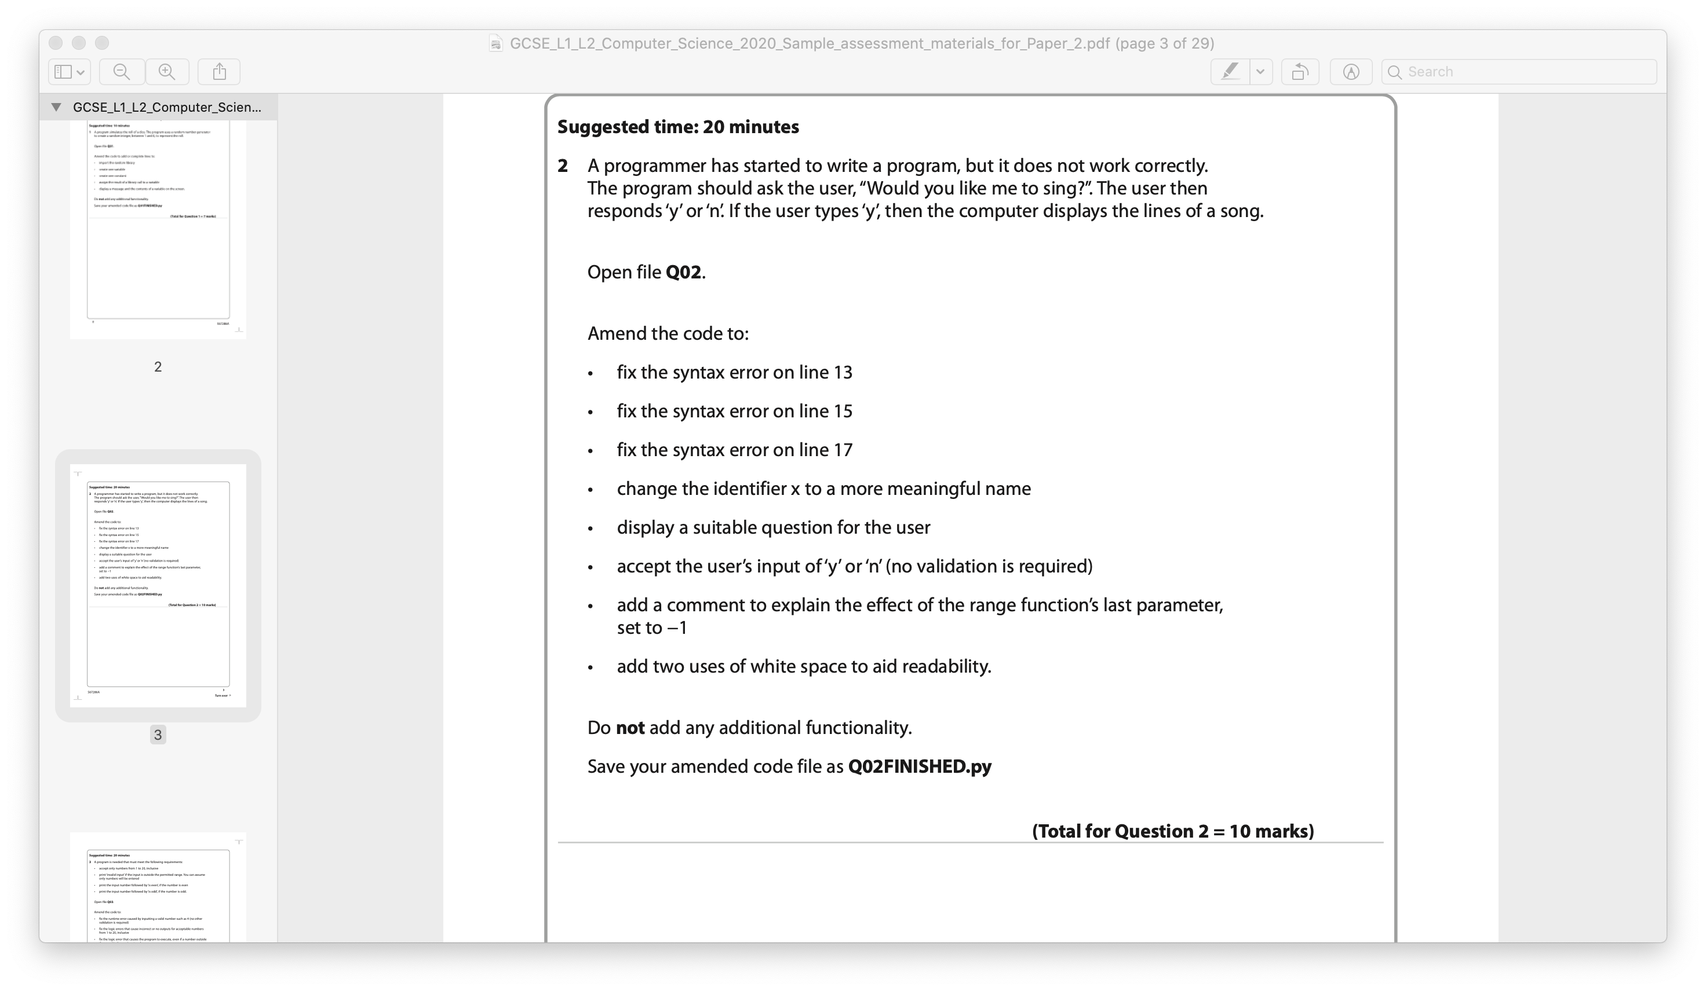
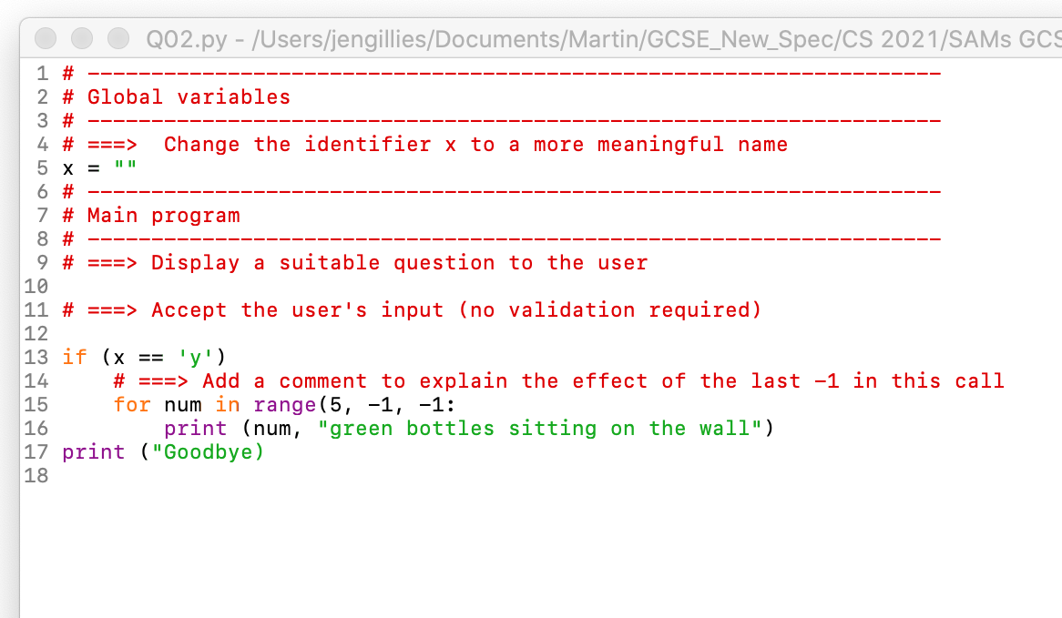
SAM – Paper 2 – Question 2
Notes:
The stem of the question sets the context i.e. the program does not work properly.
The program should ask the question “Would you like me to sing?”. Depending on the user’s response it will display a number of lines of a song.
The candidate is asked to fix three syntax errors, rename a variable, add a comment to explain a parameter and to add white space to make the program more readable.
The question requires the candidate to:
Read to identify errors
Write to fix errors (debugging the program)
Write to add meaningful variable names
Write to add a facility for data entry
Write – to add a selection statement

Slide 20
Activity 1

Slide 21
SAM – Paper 2 – Question 2 – Activity 1
Consider the skills and knowledge needed to answer Question 2
Can you identify the subtopics, such as 6.x.x, in Topic 6 that relate to the bullet points in the question
Notes:
Ask the delegates to consider the activity – give them 2 - 3 minutes to identify the subtopics.
6.1.2 - be able to read, write, analyse and refine programs written in a high-level programming language
6.1.4 -be able to use techniques (layout, indentation, comments, meaningful identifiers, white space) to make programs
easier to read, understand and maintain
6.1.5 – be able to identify, locate and correct program errors (logic, syntax, runtime)
6.2.1 - understand the function of and be able to identify the structural components of programs (constants, variables, initialisation and assignment statements, command sequences, selection, repetition, iteration, data structures, subprograms, parameters, input/output)
6.2.2 - be able to write programs that make appropriate use of sequencing, selection, repetition (count-controlled, condition-controlled), iteration (over every item in a data structure) and single entry/exit points from code blocks
and subprograms
6.4.1 – be able to write programs that accept and respond appropriately to user input

Slide 22
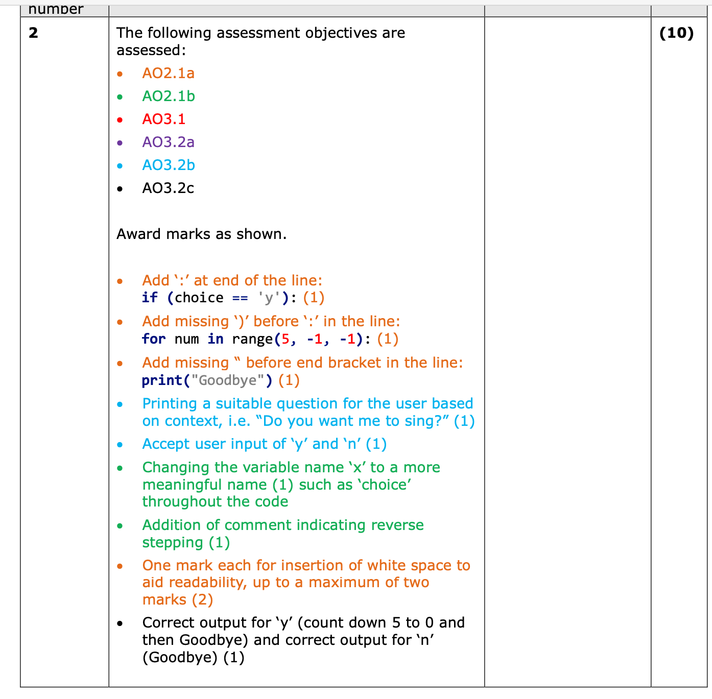
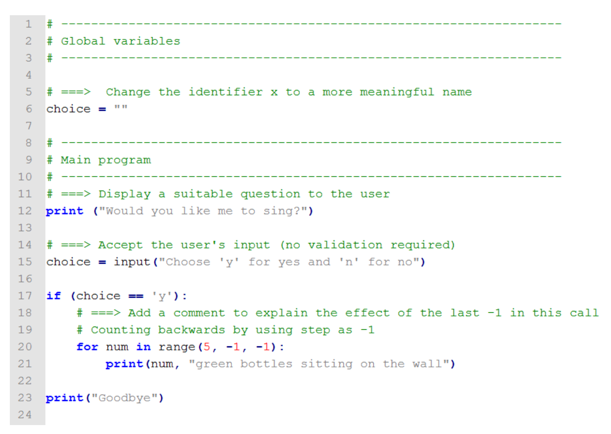
SAM – Paper 2 – Question 2 Mark Scheme
Notes:
The mark scheme clearly identifies the assessment objectives being tested:
AO2.1a – apply knowledge of key concepts and principles of computer science – fixing the syntax errors
AO2.1b – apply understanding of key concepts and principles of computer science – creating a meaningful variable name
AO3.1 – make reasoned judgements – explanation of parameter
AO3.2a – design solutions – if statement, for statement, print statement
AO3.2b – program solutions – printing a suitable question for the user context, accepting ‘y’ or ‘n’
AO3.2c – evaluate and refine solutions – correct output for ‘y’ - output for count 5 – 0, correct output for ‘n’ - Goodbye

Slide 23
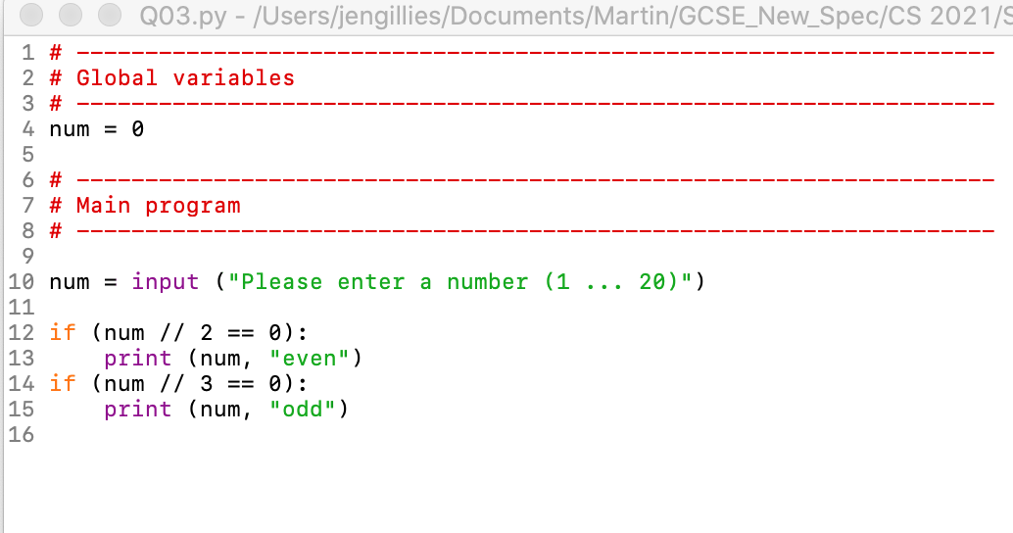
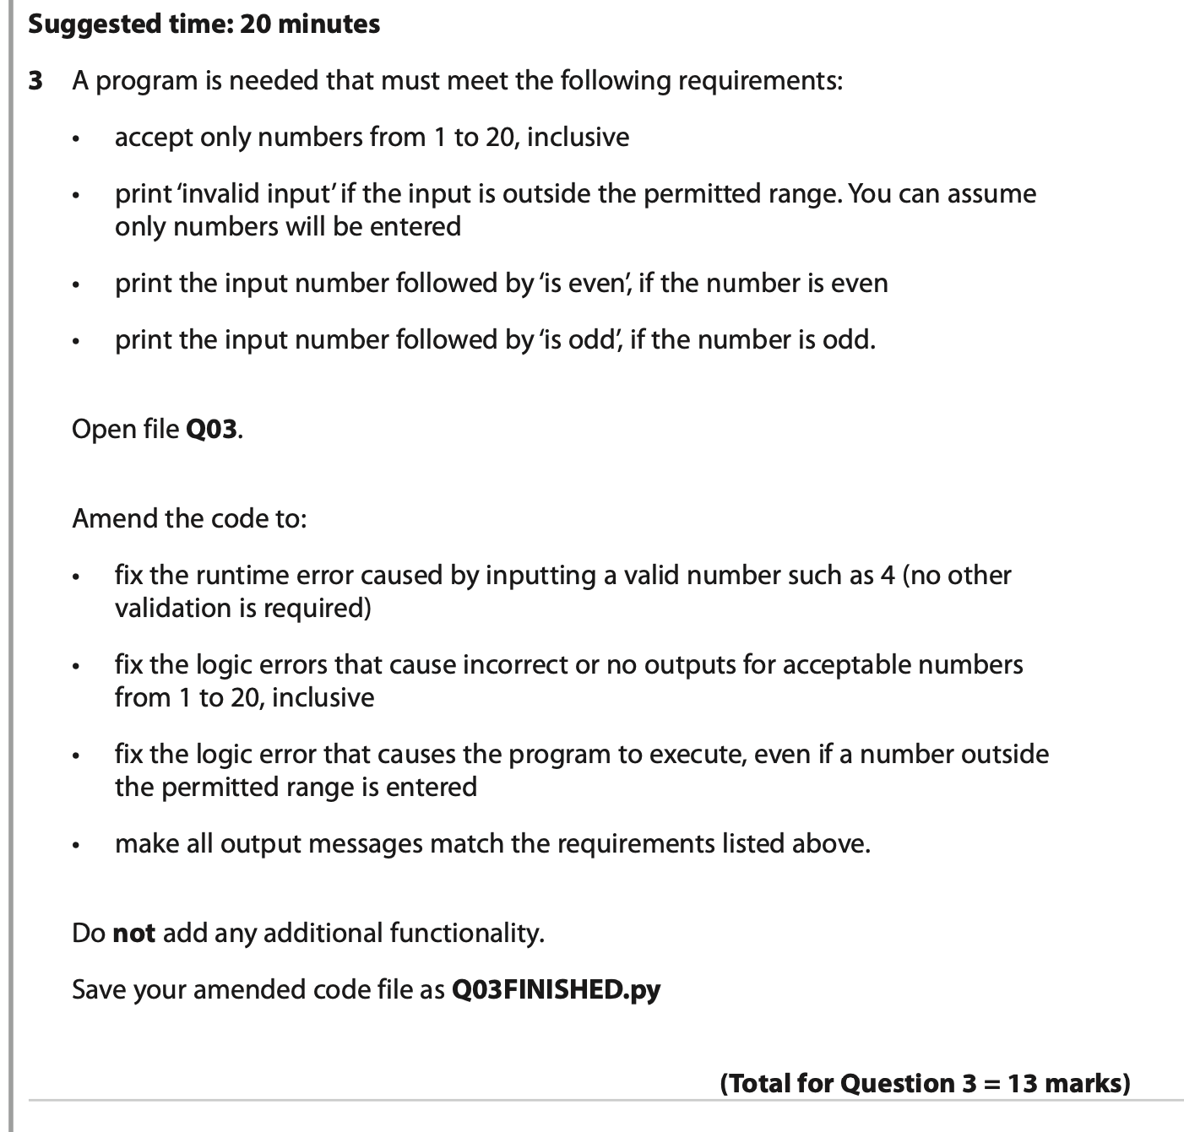
SAM – Paper 2 – Question 3
Notes:
The stem of the question sets out the requirements for the program that is needed. It must:
Accept only numbers from 1 to 20 inclusive
Print ‘invalid input’ if the input is outside the permitted range, assuming only numbers will be entered
Print the input number followed by ‘is even’, if the number is even
Print the input number followed by ‘is odd’ if the number is odd.
The code provided is shown on the slide and the candidates are required to:
Fix the runtime error caused by entering a valid number such as 4
Fix the logic errors that cause incorrect or no outputs for acceptable numbers
Fix the logic error that causes the program to execute, even if the entered number is outside the given range
Make all output messages match the requirements.

Slide 24
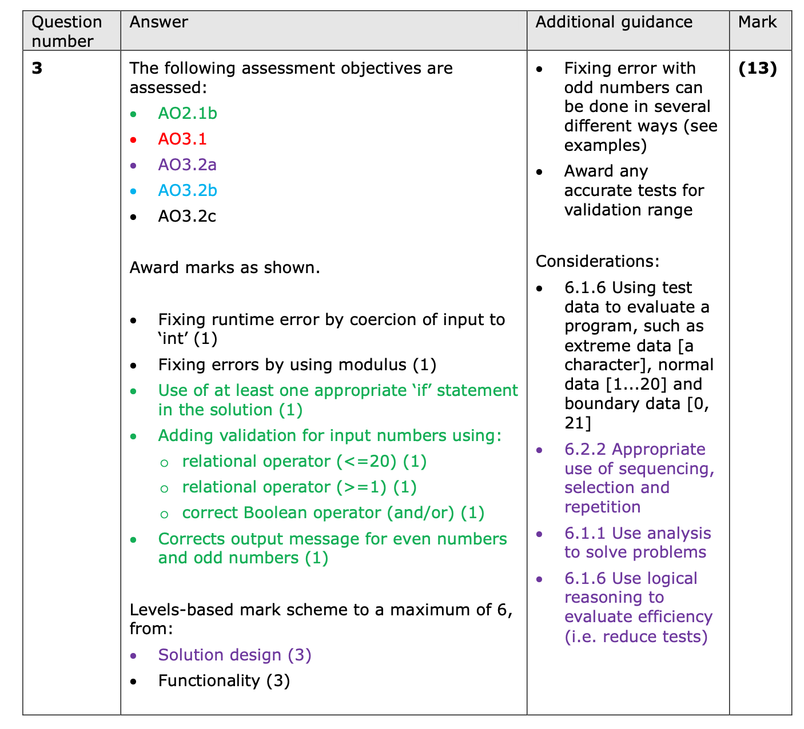
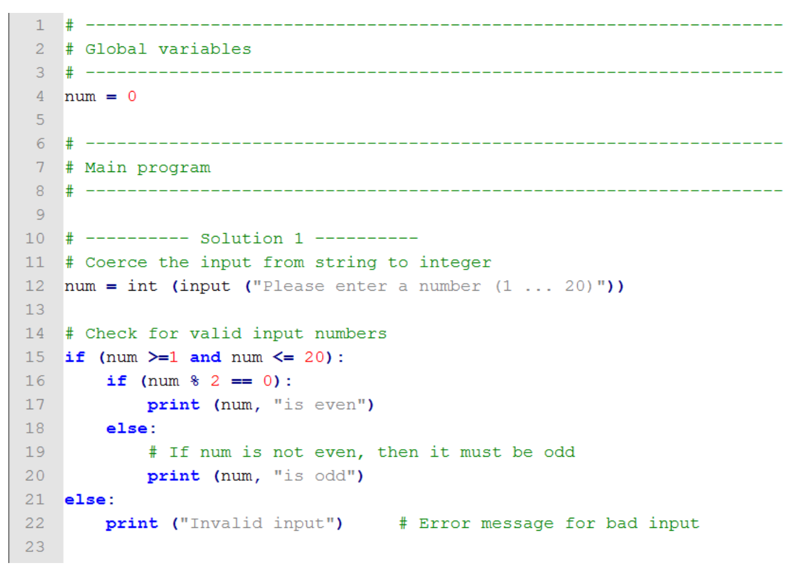
SAM – Paper 2 – Question 3 Mark Scheme
Notes:
Once again, the mark scheme clearly identifies the assessment objectives being tested:
AO2.1b – apply understanding of key concepts and principles of computer science – use of ‘if’ statement, addition of validation, correct output message for even numbers and output numbers
AO3.2c – evaluate and refine solutions – fixing runtime error and fixing error using modulus
The remaining 6 marks are allocated through two levels-based mark schemes, shown on the next slide.

Slide 25
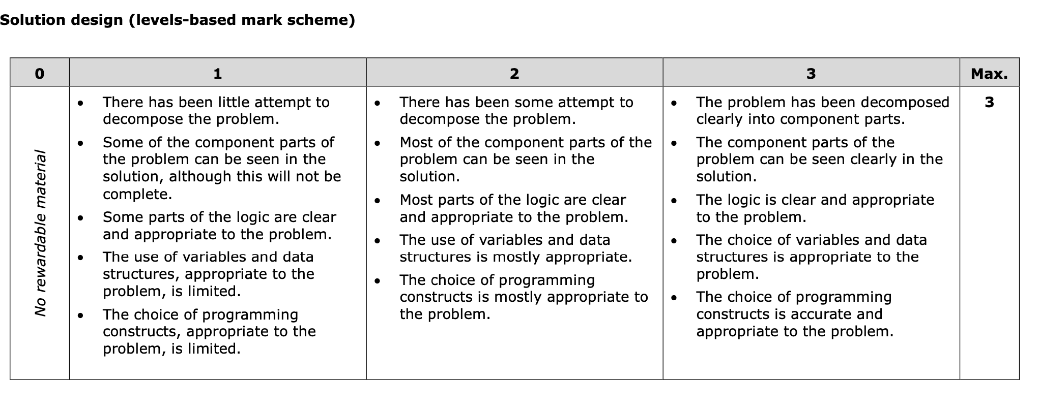
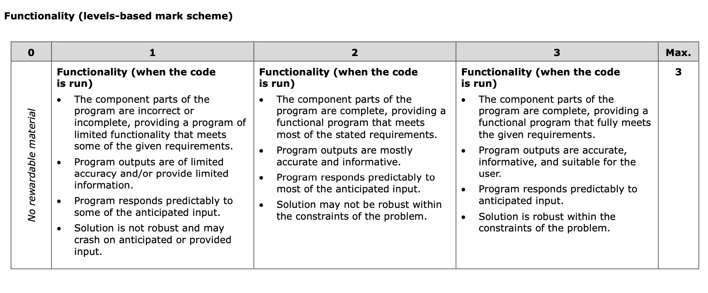
SAM – Paper 2 – Question 3 Mark Scheme
Notes:
There are two levels-based mark schemes used to assess the remainder of the marks for this question. A mark band includes levelled descriptors of candidate performance that allow an examiner to award the relevant marks to an individual candidate.
The mark bands for solution design cover the candidates’ ability to:
decompose the problem into component parts that can be seen clearly in the solution
create a solution in which the logic is clear and appropriate to the problem
choose variables (and data structures) that are appropriate to the problem
choose programming constructs that are appropriate to the problem.
The mark bands functionality consider the way in which:
component parts of the program are complete and provide a functional program that fully meets the given requirements
program outputs are accurate, informative and suitable
the program responds predictably to anticipated input
the solution is robust within the constraints of the problem.

Slide 26
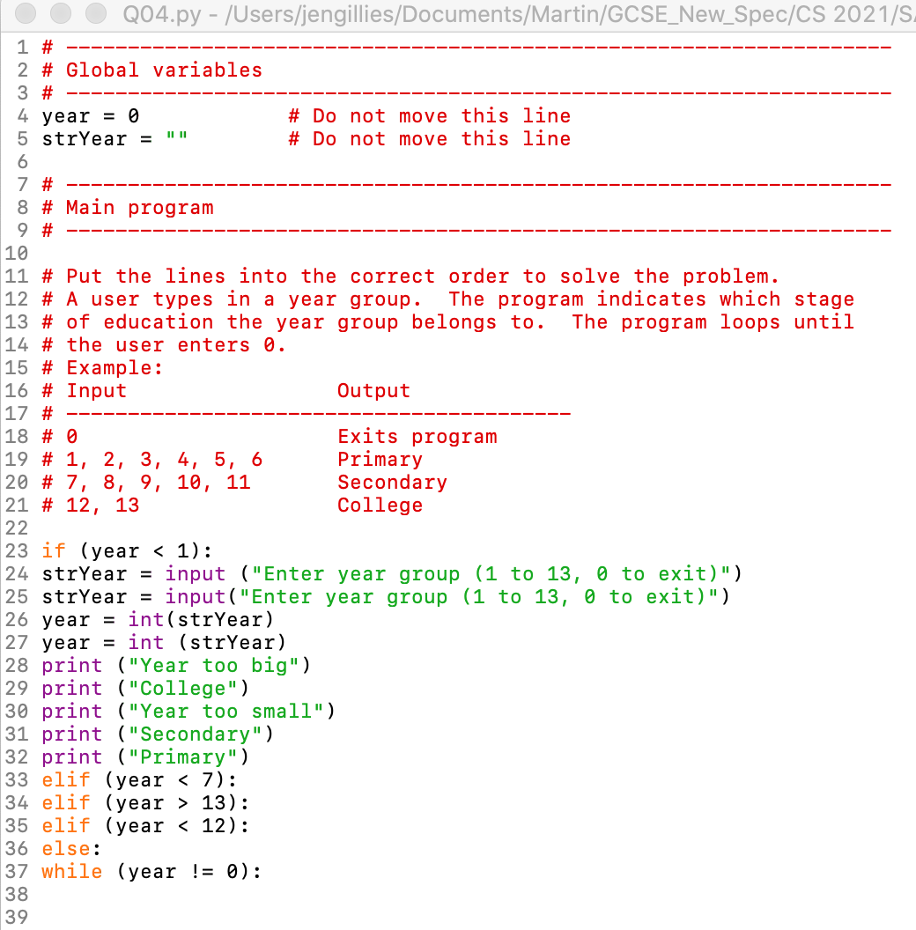
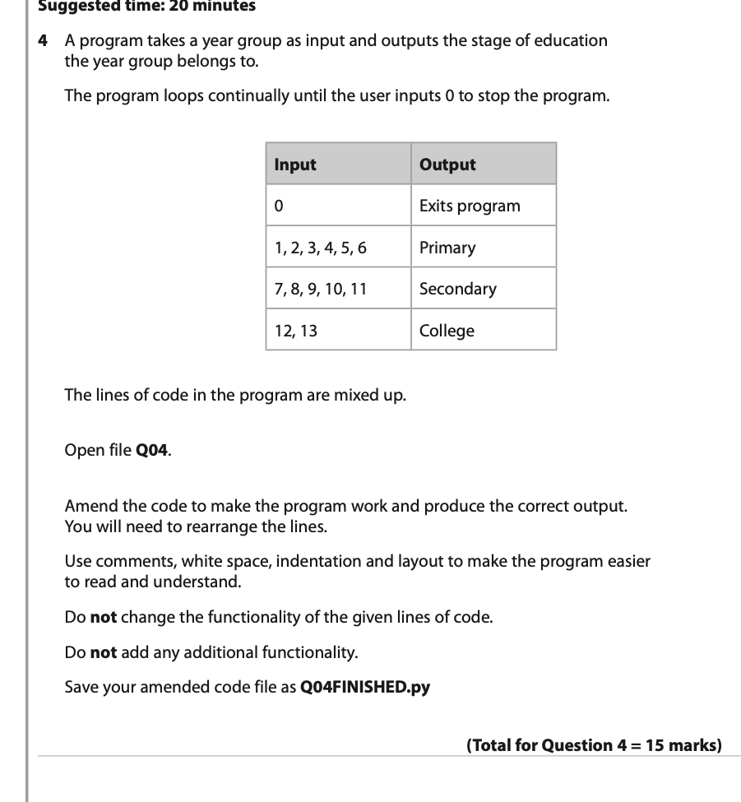
SAM – Paper 2 – Question 4
Notes:
The stem of the question describes the program to be created by the candidates.
The program will take a year group as an entry and should output the stage of education to which that year group belongs.
The program should loop continually until the user enters 0 to stop the program.
The code provided to the candidate contains lines of code that are mixed up.
Candidates are asked to amend the code to make the program work and produce the correct output by rearranging the lines.
They should use comments, white space, indentation and layout to make the program easier to read and understand.
Candidates are not allowed to change the functionality of the given lines of code or add any additional functionality.

Slide 27
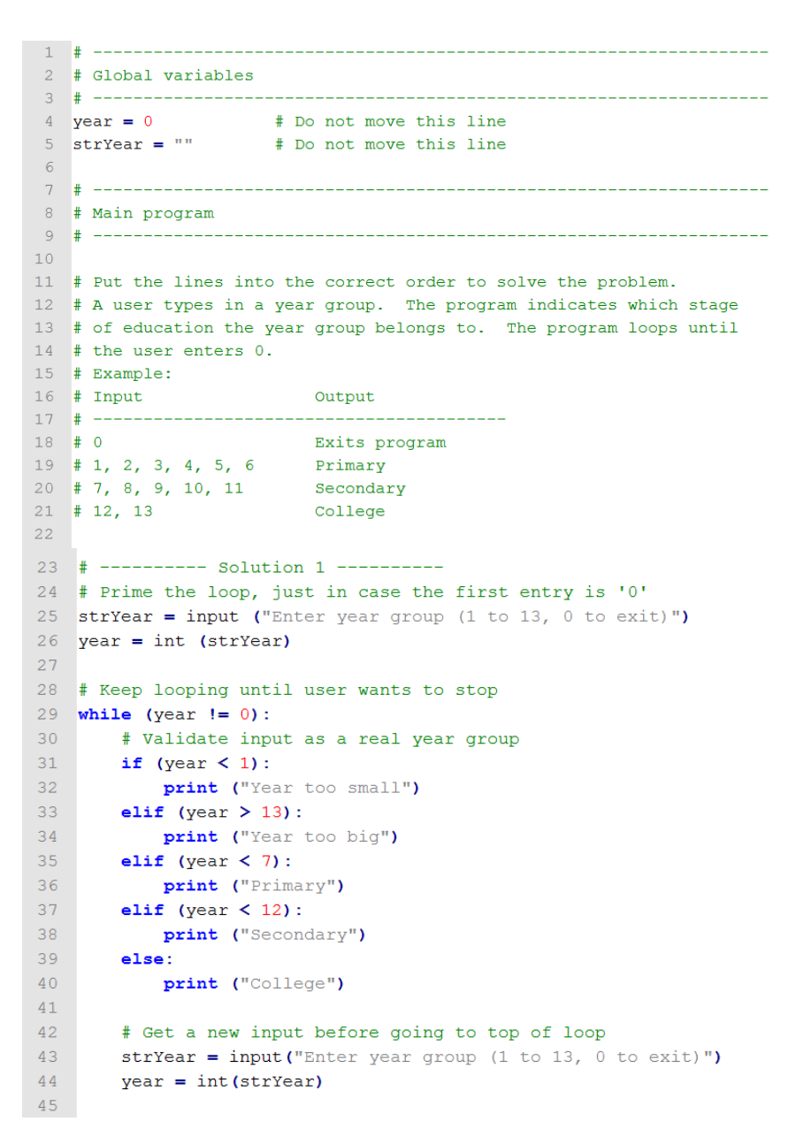
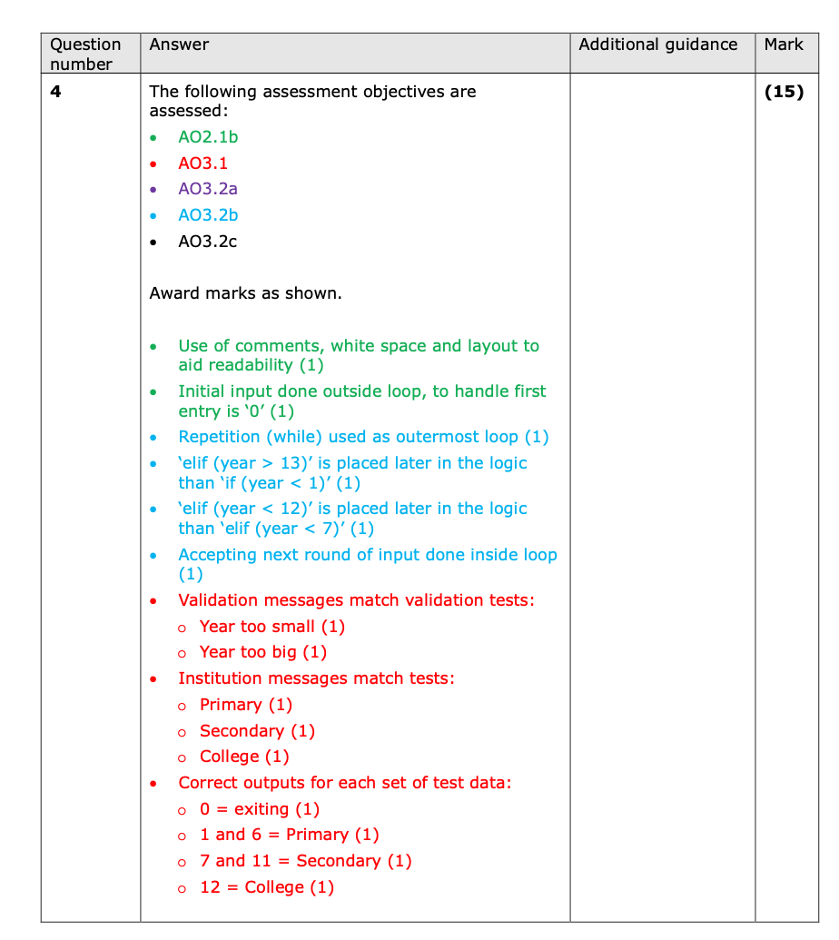
SAM – Paper 2 – Question 4 Mark Scheme
Notes:
The SAM mark scheme presents two possible solutions to the question, one of which is shown on the slide. There are no levelled mark bands for this question.
AO2.1b
use of comments, white space to improve readability
Initial input is done outside loop to handle first data entry incase it is ‘0’
AO3.1
Validation messages match validation tests
Institution messages (Primary etc.) match validation tests
Correct outputs
AO3.2b
Repetition (while) outermost loop
elif (year > 13) placed later in the logic than ‘elif (year < 1)
elif (year <12) is later in logic than elif (year < 7)
Next round of input is done inside the loop

Slide 28
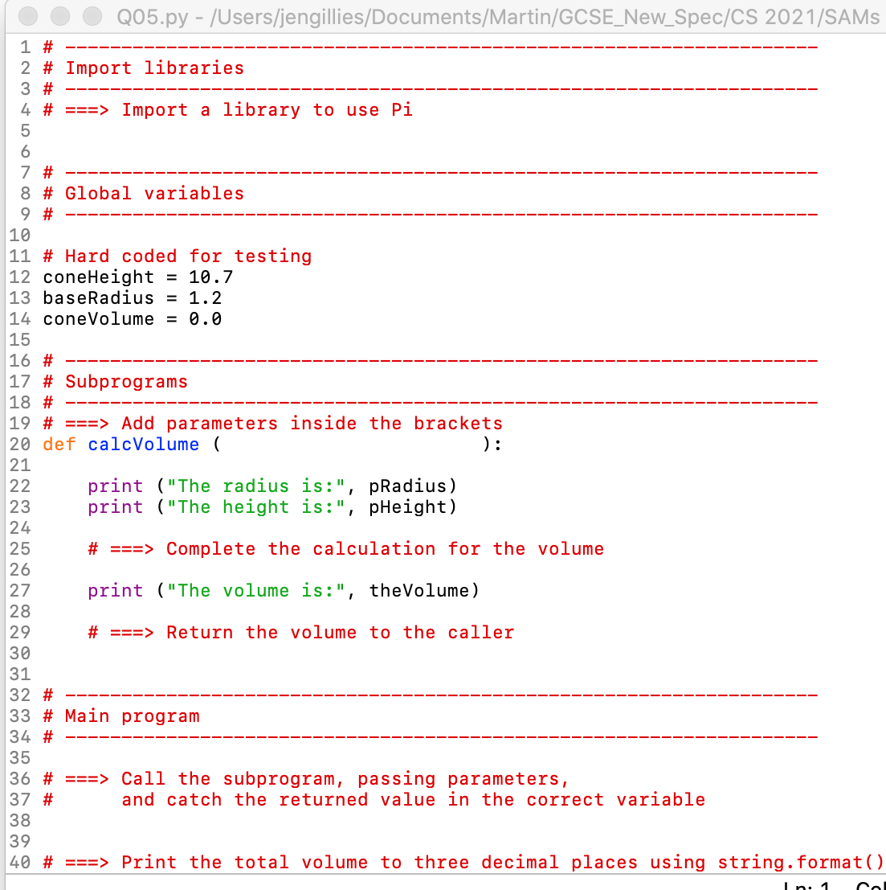
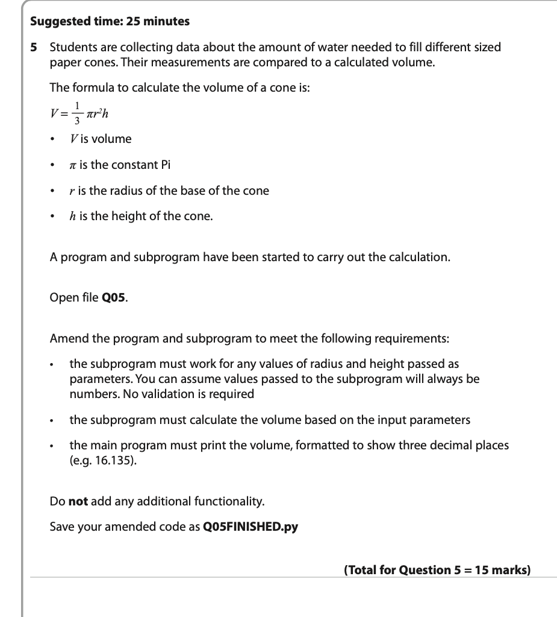
SAM – Paper 2 - Question 5
Notes:
The stem of the question describes students collecting data about the amount of water needed to fill paper cones of different sizes. Their measurements are compared with a corrected volume.
They are given the formula for calculating the volume of a cone.
The candidates are provided with the start of a program and subprogram to carry out the calculation.
Candidates are asked to amend the program and subprogram to meet the following requirements:
The subprogram must work for any values of radius and height passed as parameters.
The subprogram must calculate the volume based on the input parameters
The main program must print the volume, formatted to three decimal places.
Candidates are not allowed to add any additional functionality.

Slide 29
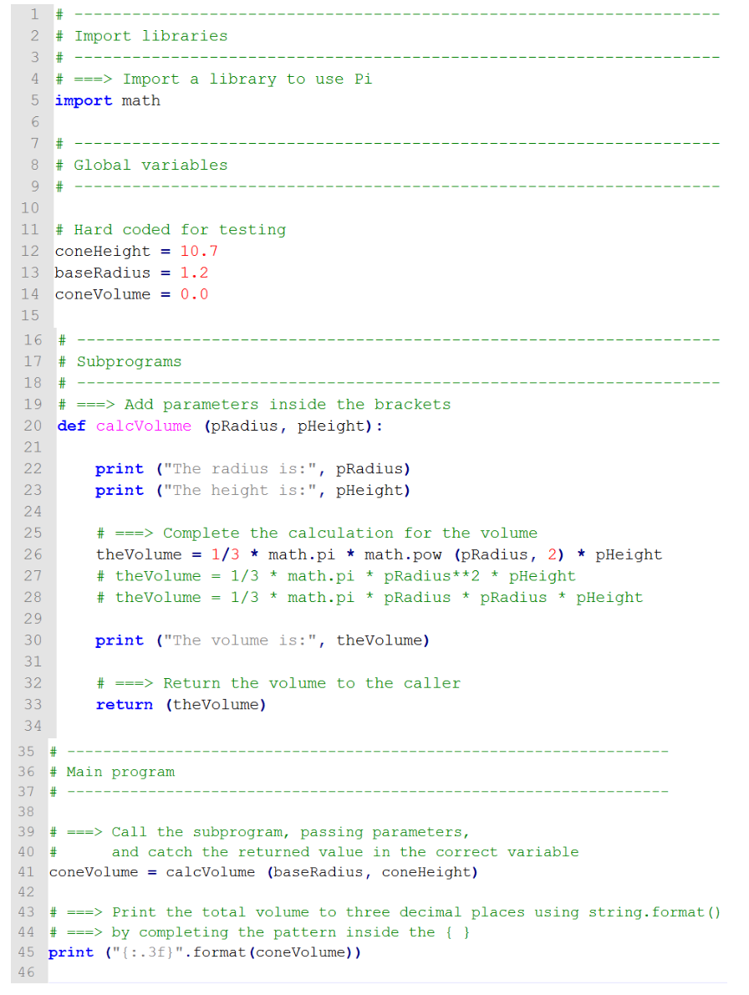
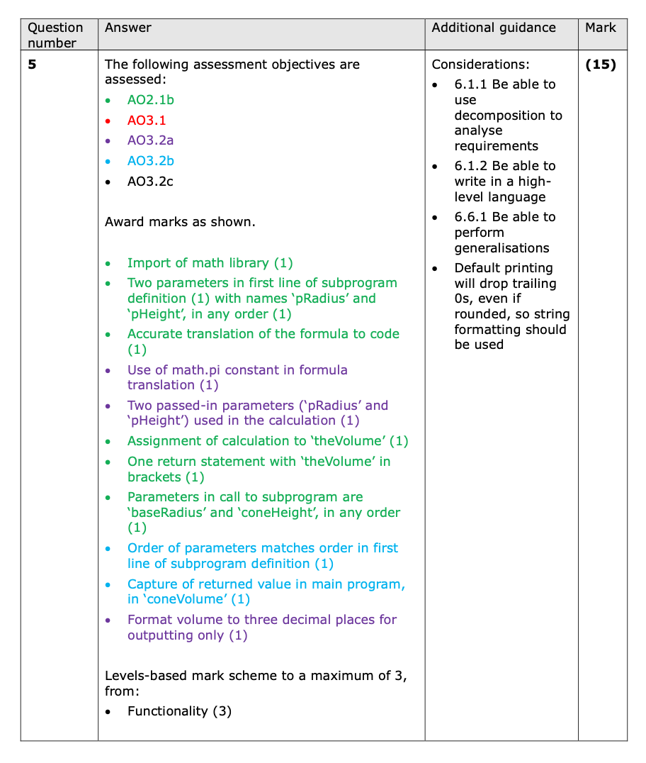
SAM – Paper 2 – Question 5 Mark Scheme
Notes:
The mark scheme clearly indicates where assessment objectives are tested.
AO2.1b
Import math library
Two parameters in the first line of the subprogram with the names ‘pRadius’ and ‘pHeight’ ( any order)
Accurate translation of the the formula for volume to code
Assignment of calculation to ‘theVolume’
One return statement with ‘theVolume’ in brackets
Parameters in the call to the subprogram are ‘baseRadius’ and ‘baseHeight’
AO3.1 – marked on the functionality of the program using the normal functionality mark band
AO3.2a
Use of math constant pi
Two passes-in parameters used in calculation
Format of volume to 3 decimal places for output only
AO3.2b
Order of parameters matches order in first line of the subprogram
Capture of returned value in main program for ‘coneVolume’

Slide 30
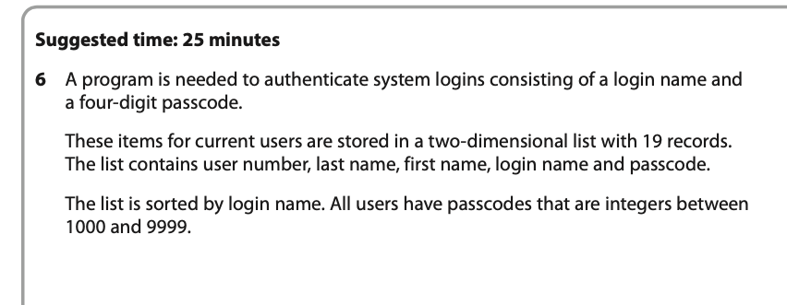
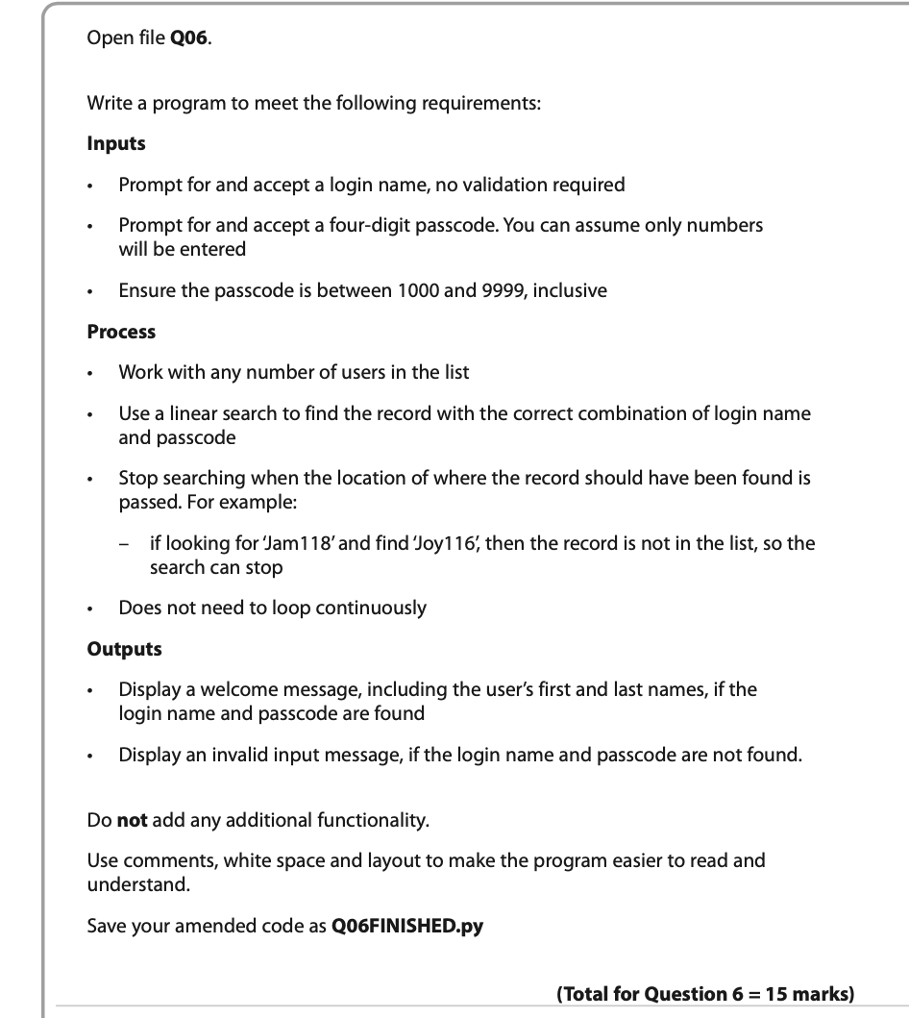
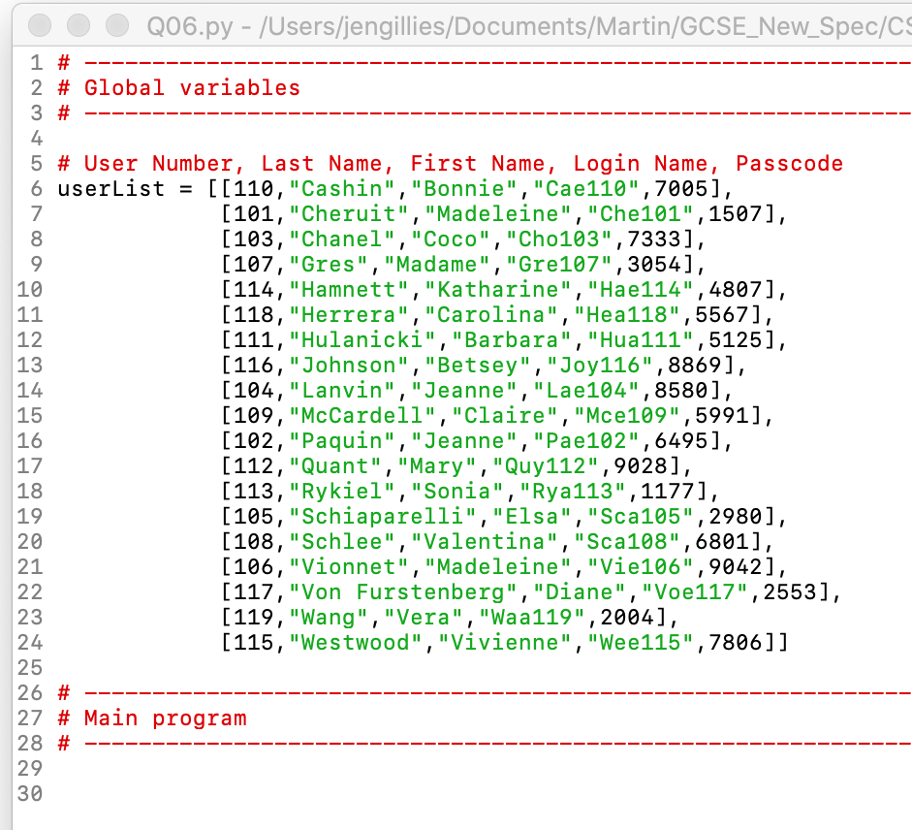
SAM – Paper 2 – Question 6
Notes:
A program is needed to authenticate system logins consisting of a login name and a four-digit passcode.
These items for current users are stored in a two-dimensional list with 19 records. The list contains user number, last name, first name, login name and passcode.
The list is sorted by login name. All users have passcodes that are integers between 1000 and 9999.
The candidates are asked to write a program to meet the following requirements:
Inputs
Prompt for and accept a login name
Prompt for and accept a four-digit passcode.
Check that the passcode is between 1000 and 9999, inclusive
Process
Work with any number of users in the list
Use a linear search to find the record with the correct combination of login name and passcode
Stop searching when the location of where the record should have been found is passed. For example:
– if looking for ‘Jam118’ and find ‘Joy116’, then the record is not in the list, so the search can stop
• Does not need to loop continuously
Outputs
Display a welcome message, including the user’s first and last names, if the login name and passcode are found
Display an invalid input message, if the login name and passcode are not found.
Candidates are not allowed to add any additional functionality
The code provided for the candidates simply contains the data to be used in the implementation. All other scaffolding has been removed challenging the candidates to carry out the full process of designing, reading, writing and testing their code.

Slide 31
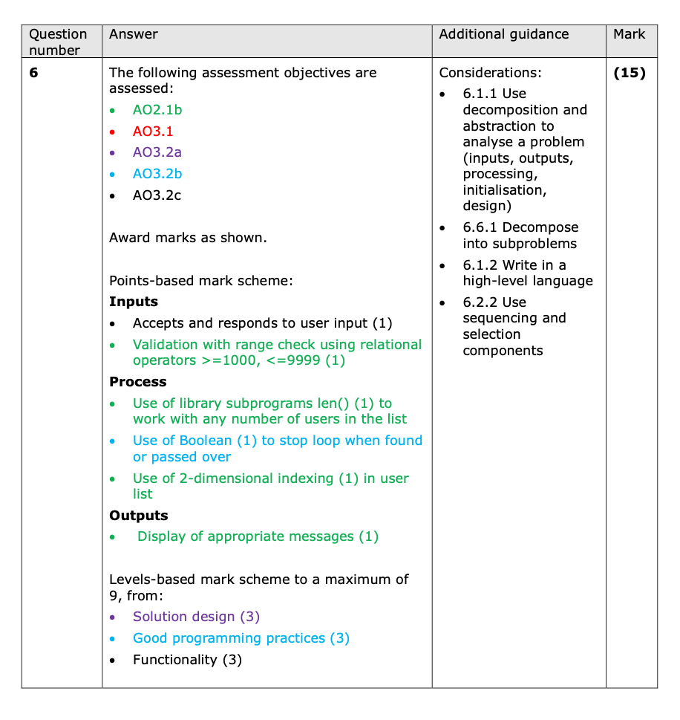
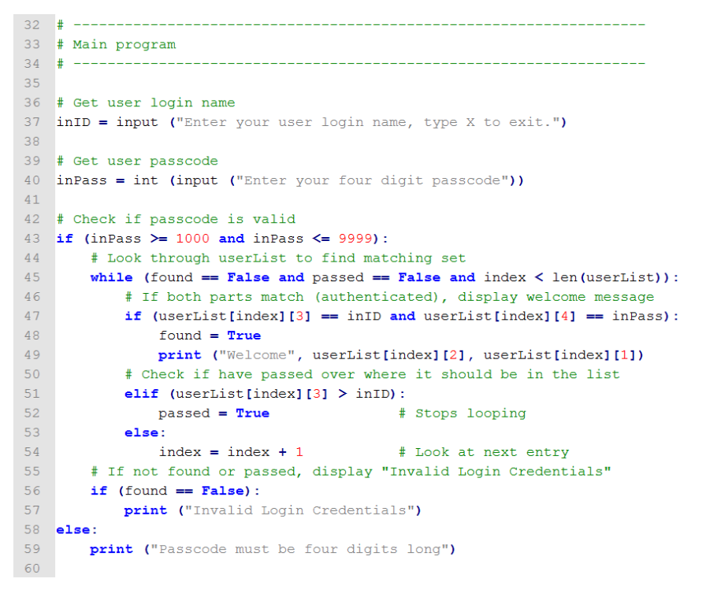
SAM _ Paper 2 – Question 6 Mark Scheme
Notes:
The mark scheme clearly identifies the assessment objectives to be tested. In this case the mark scheme comprises a mixture of individual marks for identified parts of the program and three levels-based mark bands for solution design, good programming practices and functionality.
AO2.1b
Validation with range checks using relational operators >= 1000, <= 999
Use of library subprogram len() to work with any number of users in the list
Use of 2-dimensional indexing in the user list
Display of appropriate messages
AO3.2a – levels-based mark scheme for solution design
AO3.2b
Use of Boolean to stop the loop when found or passed over
Levels-based mark scheme for good programming practices
AO3.2c – levels-based mark scheme for functionality
The three levels-based mark schemes are shown on the next slide.

Slide 32
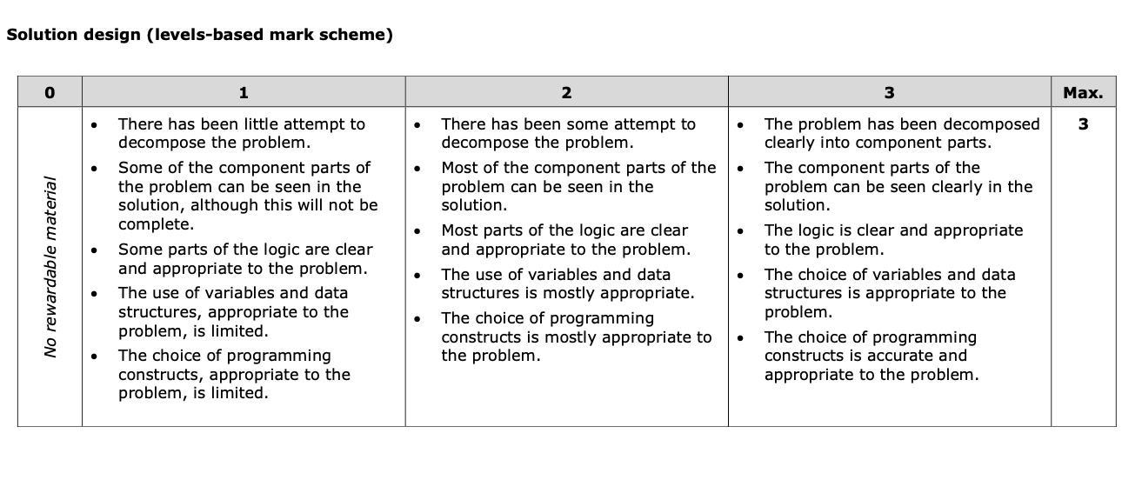
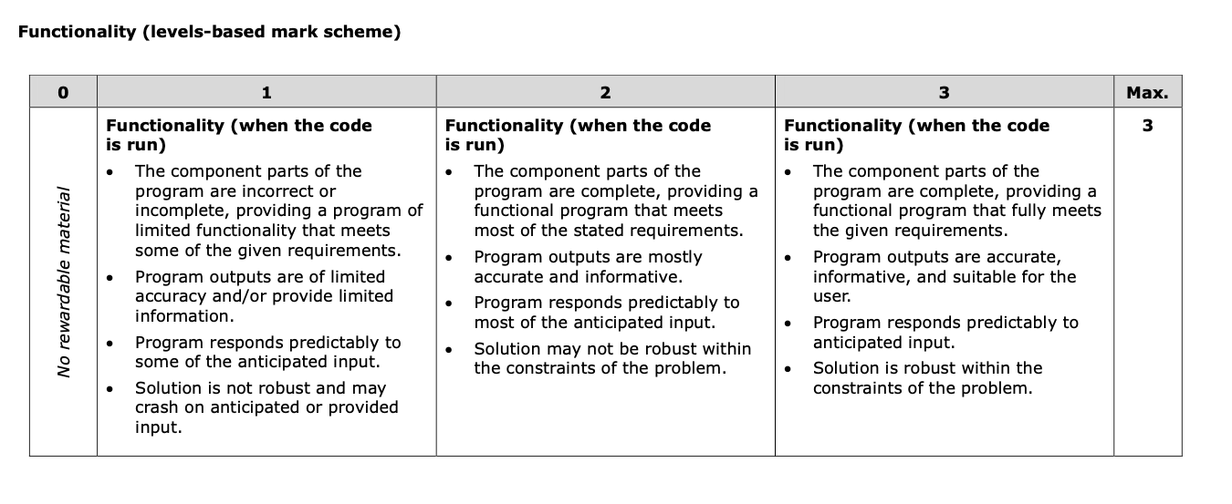
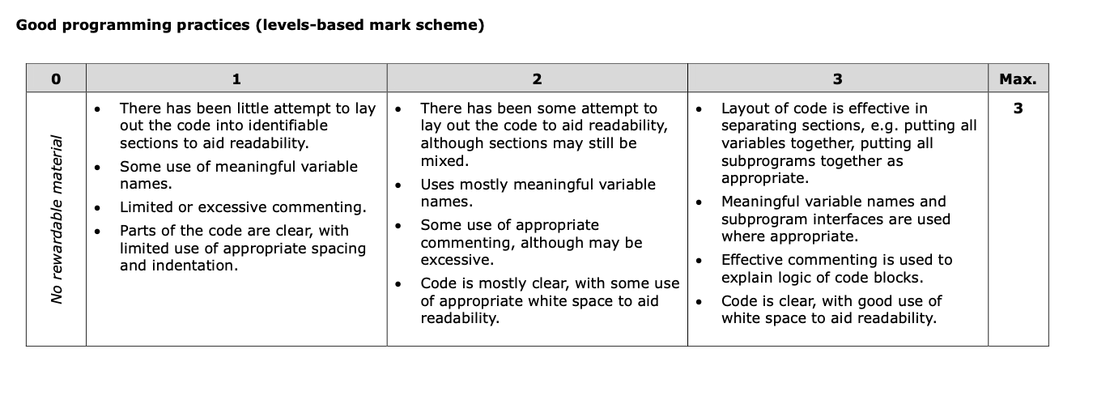
SAM – Paper 2 – Question 6 Mark Scheme
Notes:
See previous slide notes

Slide 33
Teaching
Strategies
Notes:
Welcome to our online event – ‘Getting started on Paper 2, which concerns the application of computational thinking and is all about the more practical aspects of computer science.

Slide 34
Classroom strategies
Consider the strategies outlined in the specification, including:
● Unplugged activities, which focus on reading and tracing code before attempting to write code.
● Correcting errors in code, both on paper and in an IDE.
● PRIMM (predict, run, investigate, modify, make) to build on small steps.
● Paired programming to write and debug code.
● Faded worked examples, where scaffolding is slowly removed.
● Parsons problems, where code must be arranged in order.
Notes:
Several professional organisations exist for computing and computer science teachers. It is advisable to join one or more of these organisations to keep up to date and share current best practice in the teaching of computer science.
This slide outlines a range of strategies that teachers could consider in their teaching programming.
Use the chat to clarify any questions regarding these strategies.

Slide 35

PRIMM
PRIMM is an approach that can help structure lessons in programming.
PRIMM stands for:
Predict What will the code do?
Run Downloading and running code to check predictions
Investigate Identifying components of existing programs
Modify Simple leading to more complex modifications
Make Make a new program to solve a problem.
Experience using the chosen IDE to write, run and debug programming code in time-constrained activities.
Notes:
PRIMM is an approach that can help structure lessons in programming.
The Predict phase involves students looking at short programs and trying to decide what it will do. This can be a starter, can be done in pairs, or you could even spend a whole lesson on this phase.
The Run phase involves downloading the code and then running it to check your prediction. It does not involve any copying in of code and as the program is given, the student can focus on what it does and not whether they typed it in correctly.
The third stage is Investigate, which should be varied – there are many exercises that you can do to investigate the code – annotate it, ordering, debugging, trace tables, label the variables, etc.
The fourth stage is to modify the code by changing first something simple, and then make more modifications, which can add differentiation.
Finally, the students make a new program, when they can borrow bits of code from the original program, but it will have a new function, context or problem to be solved.
These five phases may not be in every lesson, depending on the topic. And you may cycle through the first three or four phases several times.

Slide 36
Activity 2

Slide 37
Modelling PRIMM - Q6 SAM 2020 – Activity 2
Question 6 requires a program with a linear search of a list to check if input data (login name and passcode) exist, as a pair. Two outputs are required to confirm the outcome of the search.
A linear search is one of the four standard algorithms listed in the specification.
Adapt the solution provided for Q6 of the SAM for teaching, following the PRIMM model.

Slide 38
Modelling PRIMM - Q6 SAM 2020 (PRIMM)
PREDICT: Students should be familiar with the four standard algorithms and be able to identify and differentiate purpose when viewing coded examples.
RUN: Downloading and running the coded examples to check predictions.
INVESTIGATE: Improving versions of the program code by adding comments to identify program constructs, improving variable names, correcting errors etc.
MODIFY: Improving the efficiency and / or extending the functionality of given code.
MAKE: Set a similar problem, to involve reading from a csv file and including a pre-conditioned loop.
Notes:
PREDICT: Investigating pseudocodes and program codes, covering the four standard algorithms (bubble sort, merge sort, linear search and binary search). Considering processes in relation to input data and predicting outputs.
RUN: Running the program code to check
INVESTIGATE: Based on versions of the solution for Q6, with comments removed, abbreviated variable names and errors introduced.
MODIFY: Based on a versions of the solution to Q6 with the ‘passed’ condition removed.
MAKE: Address a similar question, running through all stages including de-composition.
All codes given to students should follow the paper 2 structure previously outlined.

Slide 39
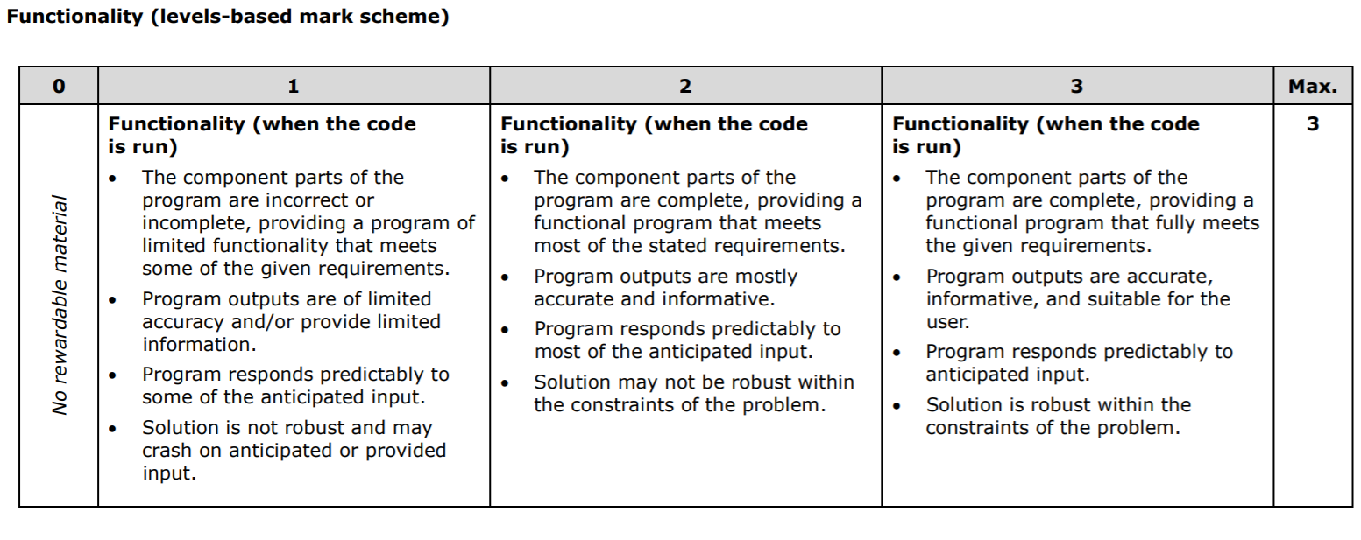
Levels
Notes:
This is an example of a levels-based mark scheme for ‘functionality’
Progressing through the levels involves increasing completeness and accuracy. Teaching tasks that support this progression can be targeted at a single set of criteria or cover the full set of criteria. The tasks need to increase in complexity as students gain in confidence and competence.

Slide 40
Activity 3

Slide 41
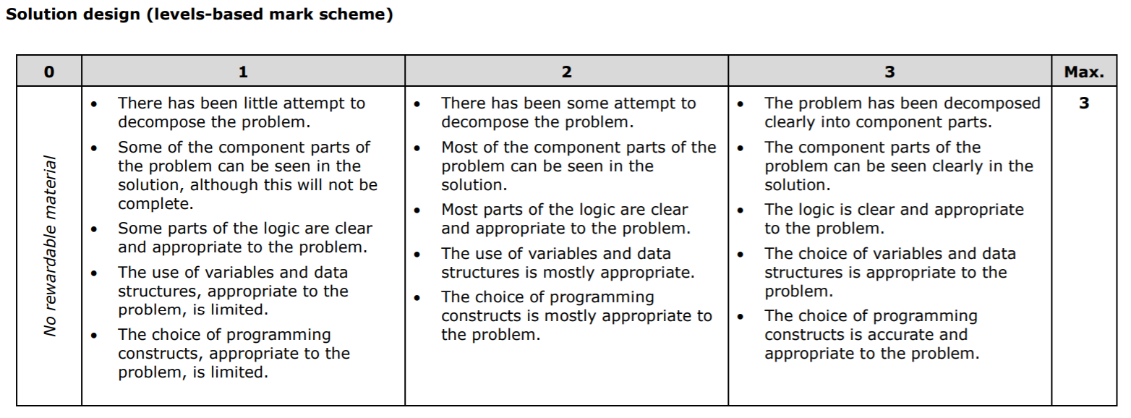
Activity 3
Notes:
This is the levels-based mark scheme for solution design.
Activity
Consider a lesson activity that will help students to progress from level 1. The activity should include strategies for demonstrating this progression when taking the Paper 2 examination.

Slide 42
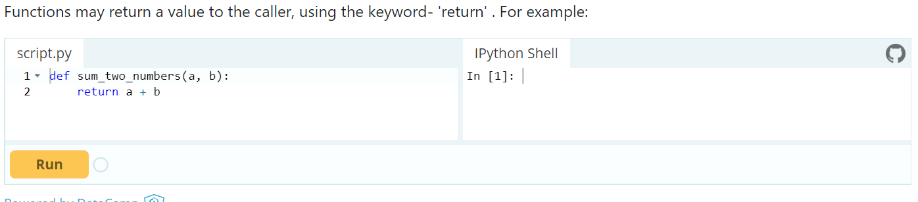
Programming environments
Online guided tutorials.
Experience using the chosen IDE to write, run and debug programming code in time-constrained activities.
Notes:
Online guided tutorials can be useful in motivating and engaging students. They normally present small challenges where students copy or reproduce code to achieve a short-term goal. Using these environments exclusively may not prepare students for the type of problems they will encounter in Paper 2. Teachers should consider highlighting how each level relates directly to the requirements of the specification. For example, if students use a while loop, then the corresponding structure of the while loop could be explored in a non-graphical text-based environment, including on paper.
Students will need experience using an IDE to write, run and debug their programming code. Developing skills in using an IDE will allow students to be more productive, especially in time-constrained activities.

Slide 43

Getting Ready to Teach events
May/June 2020
Getting Started guide detailed guidance on the specification and assessment
February 2020
Editable Scheme of Work
That underpins the interactive SoW
March 2020
Specimen Papers
3 complete sets
1 set for Sept 2020
2 sets for Sept 2021
Exemplar student work and examiner commentaries generated from students
September 2020
Progression Guide outlining how our new GCSE Computer Science progresses on AQA and OCR A level and our L3 BTEC Nationals
Exam Wizard for building practice papers and mocks
ResultsPlus for tracking student progress for GCSE
Access to scripts provides visibility and transparency of marking
Subject Advisor support from Tim Brady
Notes:
This event is one of Getting Ready To Teach events which have been prepared to introduce the 2020 specification. These events will cover the resources that are available such as the getting started guide and editable scheme of work and the resources being worked on, such as the specimen papers and exemplar student work with examiner commentaries to be issued in September 2020.
These events also deal with progression beyond GCSE and point towards existing online resources and services that you may have already used including Exam Wizard, ResultsPlus and Access to scripts.
Full contact details for Tim Brady, the subject advisor will be confirmed later.

Slide 44
Interactive SoW
Sept 2020
A wealth of content from Pearson Edexcel, NCCE and other resource providers.
Edexcel’s recommended order of teaching and approved resources.
Maths Demo
Practical programming activities and solutions
theory and practical
Real world case studies
from industry partners, video and downloadables
Boot Up
teacher guidance
creative ideas and resources for practical programming lessons
Student book 2.0
June 2020
Revision guide 2.0
February 2021
Revision workbook 2.0
February 2021
Notes:
The June 2020 version is a basic SoW with editable content.
September will see additional resources added to the Interactive SoW form Pearson Edexcel, National Centre for Computing Education (NCCE) and others, which will include:
A range of practical programming activities with solutions
Real World Case Studies
Free videos and downloadable PDFs of people in industry talking about how they use the skills students are learning in Computer Science. We are working with big industry names that students will recognise to try to help make content feel relevant and exciting.
Boot up teacher guidance
Creative ideas and resources for practical programming lessons such as a library of Python programs with live data sources
Step by step guidance in tricky areas for anyone who wants to refresh their knowledge. For example, Boolean logic in the Edexcel spec - how much depth, what do students need to know, where can I find more support for this area that is relevant to the spec?
All Free and to be available from Sept 2020.
Also to be made available is a new Student Book, a Revision Guide and Workbook to be issued during the first year of teaching.

Slide 45
GCSE Computer Science student book
Our brand new Pearson Edexcel GCSE Computer Science Student Book provides all of the content, activities and exam support that you need to deliver the specification, including:
practical activities for programming that follow the PRIMM pedagogy
real world examples and case studies of Computer Science in Action
worked examples and activities using the PLS or ‘Programming Language Subset’
exam-style questions using only the Edexcel command words
simplified content to make it as accessible as possible.
Notes:
You don't have to purchase any resources, including those from Pearson, to deliver our qualifications. However, our brand new Pearson Edexcel GCSE Computer Science Student Book follows the practical teaching and learning approach being used for the interactive scheme of work and provides all of the content, activities and exam support that you need to deliver the specification meaning you have everything in one place.

Slide 46
Questions?

Slide 47
Next steps
Sign up to monthly updates from our Subject Advisor Tim Brady -https://qualifications.pearson.com/en/forms/subject-advisor-updates-for-teachers-and-tutors.html to receive updates and any key dates.
Pearson Computer Science Community
Follow us on Twitter @Pearson_CS
Collaborate with colleagues on Facebook GCSE Computer Science Facebook group
Need to talk to us the please contact us at: https://support.pearson.com/uk/s/qualification-contactus
UK: 0333 016 4160/ International: +44 (0) 333 016 4160
Notes:
The links in the presentation are active, so please download the presentation and you will be able to follow them.
Please do sign up to updates from Tim, join the community, follow him on Twitter and Facebook. An excellent network of support is available in all those spheres.
If you need a more formal response, (or just don’t like social media!) then please use the link to contact us or give us a call!

Slide 48
Thank you

Slide 49


