Slide 1
Pearson Edexcel GCSE (9-1)
Planning and Delivering Computer Science
Paper 1 - Principles of Computer Science
Notes:
Welcome to the Pearson Edexcel GCSE in Computer Science.
Please refer to your pack to find the Sample assessment materials (which include the Question Paper and Mark Scheme) and the Specification.
You will see some polls on screen, please fill those out as you are waiting for us to get going.

Slide 2
Aims and objectives
This online event will support you in delivering the new Pearson Edexcel GCSE Computer Science in preparation for student assessment on Paper 1.
This session will provide you with:
• An overview of the qualification
• An overview of Paper 1 and then look at the following:
  the structure of five compulsory questions and the headings of their respective course topics
  what a multiple-choice question looks like
  what a short response question looks like
  what a medium response question looks like
  what an extended response question looks like
  examples of tabular, diagrammatic and mathematic questions
• Discuss best practice and share ideas with other teachers.
Notes:
Today, we’re going to cover Paper 1, looking first at an overview of the qualification before looking at the structure of the five compulsory questions and their key content areas. We’ll look at the different question types: multiple choice, short, medium and extended response as well as questions that require the completion of tables and diagrams and questions that require the application of computational mathematics. We will conduct a deeper dive into an extended response question, including the use of command words, structure of the response, and the assessment approach from a centre perspective.
You will have opportunities to discuss and share best practice and we’ll also have a quick look at some of the ways that Pearson Edexcel can support you in delivering this qualification.

Slide 3
Agenda
Time (minutes) | Item
5 | Welcome and polls
5 | Aims and agenda
5 | Overview of the qualification
5 | Overview of Paper 1, structure of the five compulsory questions
5 | Multiple choice questions
10 | Activity 1 – design a multiple choice question
5 | Short response questions
10 | Activity 2 – design a short response question
10 | Medium response questions
10 | Activity 3 – design a medium response question
15 | Extended response questions
15 | Computational mathematics questions
5 | Tabular and diagrammatic questions
10 | Available support
5 | Q&A
Notes:
It will take approximately two hours to cover all of these topics. There are some activities you can access in the delegate’s booklet.

Slide 4
Overview of our 2020 qualification
Two papers: 50% each
Paper 1 uses a topic-based approach
Paper 2 uses practical assessment of computational thinking
Programming assessed authentically
No malpractice concerns associated with the programming project
Python only – no variance in assessment approaches
Clearly defined subset of Python as PLS allows focused delivery in centres.
Command words have been reduced
Clarification of subject content
Amplification and guidance of content points
Notes:
Paper 1 uses a topic-based approach, so each of the five questions are related to one of the five topics from the specification, rather than being context-based with the content tested being from any part of the specification.
Practical assessment of computational thinking allows for programming to be assessed in an authentic way. Unlike a written paper, students can run their code and iterate the development of their solution. Having this possible in a high-control examination setting removes malpractice concerns that are associated with Non Examined Assessment (NEA).
Using only Python sets clear expectations and improves validity as reduces variance introduced by approaches available in different languages.
Using only a clearly defined subset of Python as the Examination Reference Language (ERL) ensures centres can focus their delivery.
Removal of a separate ERL (referred to colloquially as ‘pseudocode’) also removes confusion around assessing students ability to demonstrate precise knowledge of something which is, by definition, imprecise.
The list of command words has been consolidated and the taxonomy updated.
Specification content has been clarified with specific requirements, examples and techniques.
Further amplification and guidance of the specification points is provided at the end of this document. This includes references to Sample Assessment Material (specimen paper) questions that exemplify the specification point, explanations and examples of the depth of content students are expected to demonstrate in the assessment.
The weighting of each of the two papers is now 50%.

Slide 5
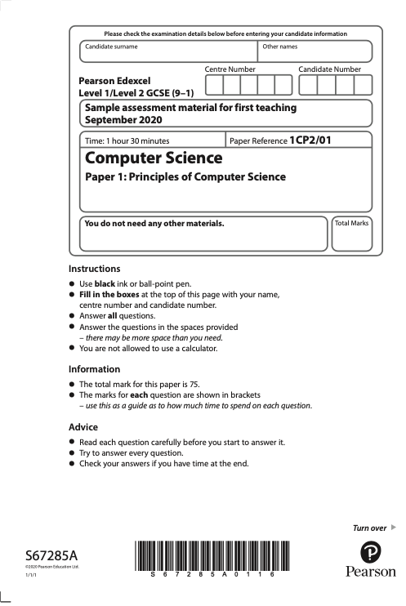
Overview of Paper 1 (1CP2/01)
Principles of Computer Science
50% of the qualification
1 hr 30 mins
Written examination
75 marks
Common command words
(more on those later)
Five compulsory questions
(split into multiple ‘part-questions’)
Notes:
Paper 1 assesses the Principles of Computer Science.
The paper requires students to demonstrate and apply knowledge and understanding of key principles and concepts outlined in the specification content.
It is an un-tiered paper that has been specifically designed to allow candidates of all ability ranges to find questions that are both challenging and interesting throughout. This paper is worth 50% of the GCSE.
‘Command words’ are used consistently in the paper to indicate the type of response expected.

Slide 6
Overview of Paper 1 (1CP2/01)
Topic-based approach
Reduces cognitive load
Clear which part of the specification
is being tested:
  Computational thinking
  Data
  Computers
  Networks
  Issues and Impact
Notes:
The topic based approach removes the additional cognitive load otherwise required of candidates who may have had to first determine which part of the specification was being tested by an individual ‘item’ (part-question).
All five topics will be tested in every paper. Each of the five compulsory questions will use the headings of the five topics in the specification as shown on this slide. It is important to note that the order of topics will change from series to series allowing topic areas to be tested at different levels each series.

Slide 7
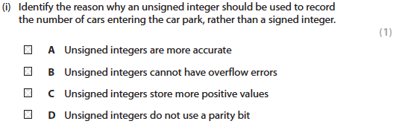
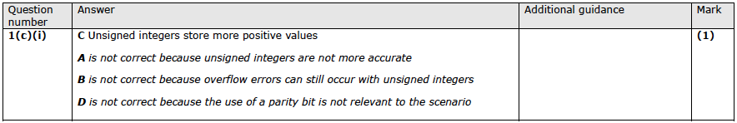
Multiple Choice / Multiple Response Questions
Four MCQs / MRQs
Command word: ‘Identify’
1/4 2/5 3/7
Notes:
There will be four multiple choice questions (MCQs) / multiple response questions (MRQs).
Question (command word will always be ‘Identify’
Mark (always 1)
Multiple-choice questions (MCQ) and multiple-response questions (MRQ) are items in which candidates select the correct answer from a set of options.
MCQs (multiple-choice questions) have 1 correct answer from 4 choices.
MRQs (multiple-response questions) have 2 correct answers from 5 choices, or 3 correct answers from 7 choices.
Language will be concise, simple and unambiguous. Distractors will be of comparable detail and length, and will come from the specification or be common misconceptions. The correct answer will not be possible to ‘work out’ using logic or language (unless that is the intended construct).
Questions will be written in positive terms and should not rely on a candidate’s ability to pick out negative terms (e.g. “Which of these is NOT…”).
In MCQs - Four options will be arranged in alphabetical order.
Mark scheme will show why the distractors were not correct.

Slide 8
Activity 1

Slide 9
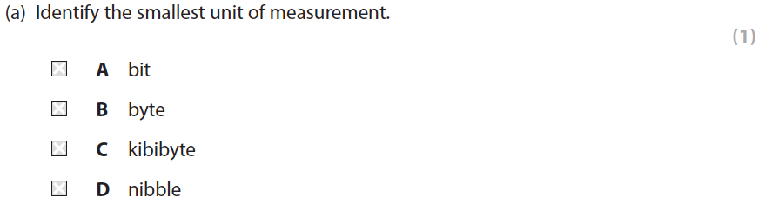
Activity 1
a) Design your own MCQ or MRQ
b) Spend some time looking at the other MCQs.
Ask questions in the chat
Notes:
Design your own MCQ or MRQ (2 from 5 or 3 from 7)
5 mins to design them
Pick an area of the spec from any topic
Think carefully about your distractors – can you design a mark scheme that shows clearly that they are the wrong answer? If not – are they good distractors?
Share some with the group in the chat and trainer discusses some of them. (5 mins)

Slide 10
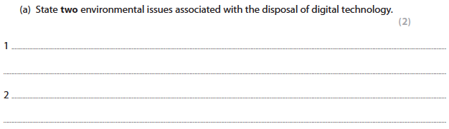
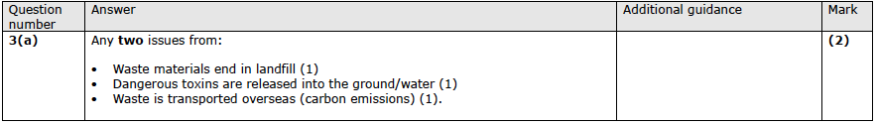
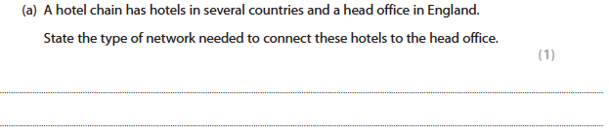
Short Response Questions
Command words:
Give / State / Name / Define
Notes:
Short open responses are items in which candidates provide information in short, structured responses, usually a word or short response and will usually be 1 mark. Although a two-mark item can be scaffolded, requiring the identification of two discrete things, as in the first example here.
There are usually two lines per mark allocated to a question, unless a simple statement is required from the response. Extended questions are given a full page of answer lines. Candidates should write in the space provided, although examiners are asked to mark positively and award marks for correct responses where they are not in the space provided.
Use of stem for context
Notice how the second example uses a stem. A stem can be used to introduce a question. In this case the stem is used to introduce context to the question. It is important to understand that questions will only be placed in context when application of the context is required to answer the question. So, if candidates see context in questions, they must apply their understanding. This cognitive demand allows the testing of the assessment objectives that require higher-order cognition.
Mark scheme
The mark scheme for a short response question will contain a selection of acceptable correct answers. Where possible, this list will be complete. However, where there are more correct answers than it is reasonable to include in the mark scheme, indicative responses will be provided and examiners will award as appropriate.
All short and medium open response questions will be marked using a points-based mark scheme, which consists of:
the following four columns:
Question number
Answer
Additional Guidance
Mark
a rubric that describes how each mark is awarded.
example responses that demonstrate what a candidate would say in order to achieve the marks, as the rubric has described. These will:
Be written as a candidate would write a response, including linked responses where required
Show the minimum response that is required to achieve the marks, avoiding unnecessary language
include marking points – (1) – to indicate where each mark is awarded
Give example responses to show the breadth of acceptable answers
Include alternative answers from the same derivative distinguished by ‘/’

Slide 11
Activity 2

Slide 12
Activity 2
a) Design your own short response question. Try placing it in a required context if you have time
b) Spend some time looking at the other short response questions
Ask questions in the chat.
Give / State / Name / Define
Notes:
Design your own Q and MS
Pick an area of the spec from any topic.
Think about all the different responses that could be given to your question. If there are many different responses, then is it focussed enough?
If you have time, add context.
Do all command words work in context? (Not ‘define’)
5 mins to design them
Share some with the group in the chat and trainer discusses some of them. (5 mins)

Slide 13
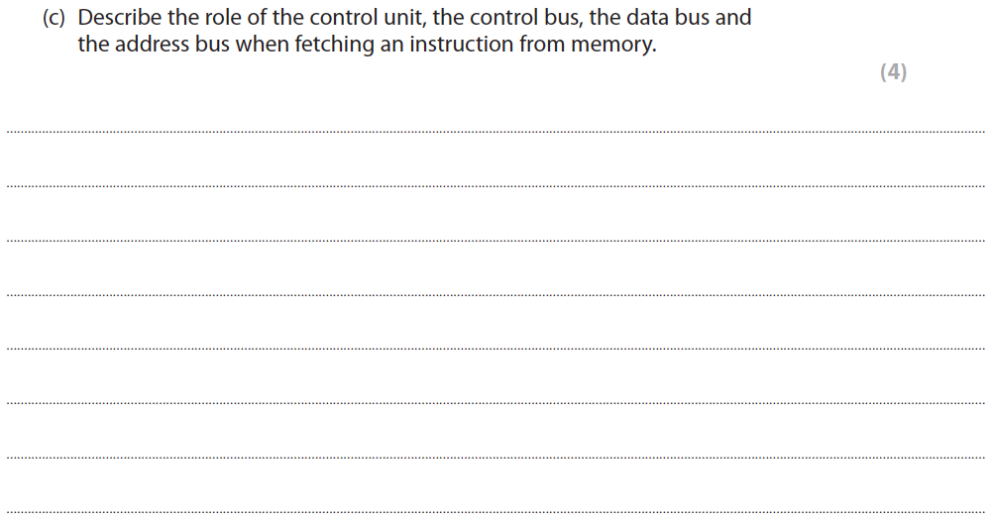
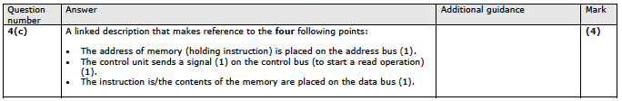
Medium Response Questions
Command words:
Describe, Explain
Notes:
Open response questions usually require responses that are a couple of sentences in length or a very short paragraph. Will usually require some structure to the answer and it will be clear to the candidate precisely what information is required to answer the question. To ensure clarity for candidates, one command word is used.
The mark scheme will show linked responses and will demonstrate how partial marks can be awarded.
Medium response questions are marked using a points-based mark scheme, in which a mark is awarded for each piece of relevant and accurate information provided.
The command word ‘Describe’ requires a candidate to give an account of something, or a linked process by which something happens. Statements in the response need to be developed, as they are often linked, but do not need to include a justification or reason.

Slide 14
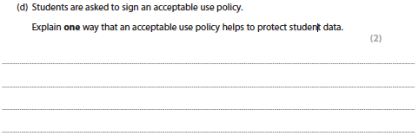
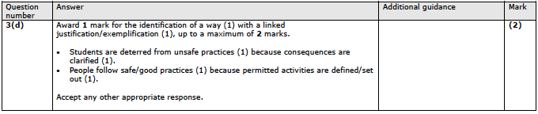
Medium Response Questions
Command words:
Describe, Explain
Notes:
An explanation requires a justification/exemplification of a point. The answer must contain some element of reasoning/justification, this can include mathematical/logical explanations. The mark scheme will have marking points which are linked.
Mark schemes will demonstrate a model structure for responses, using connectives like ‘because’, which can be used by candidates to structure their answers.
Other connectives include: result of / associated with / reason for / connected to

Slide 15
Activity 3

Slide 16
Activity 3
a) Design your own ‘Describe’ or ‘Explain’ question and mark scheme. If you have time, try placing it in a required context.
b) Spend some time looking at the other medium response questions
Ask questions in the chat.
Describe / Explain
Notes:
Design your own describe/explain question and MS worth 2 or 4 marks.
When designing the MS, for which statements would you award marks? Are there multiple paths to the right answer? If there are only 4 linked points, are you sure the Q leads to a response that includes all 4, or are there other ways of wording the response that mean candidates might not think to include all 4 points. In which case, should your 4 point question be a 2 point question that allows 2 points to be made from 4, and then, does that make it too easy?
Pick an area of the spec from any topic.
5 mins to design them
Consider how the explain question will lead to the use of connectives like because of / result of / associated with / reason for / connected to.
Share some with the group in the chat and trainer discusses some of them. (5 mins)

Slide 17
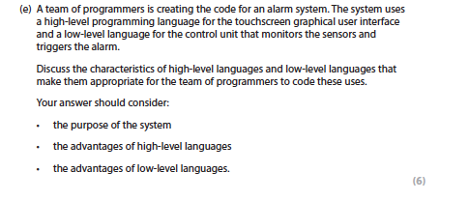
Extended Response levels-based
6 marks
Command word – Discuss
One extended response per paper
Notes:
Extended response questions will always be worth 6 marks and will always use the command word ‘Discuss’.
‘Discuss’ questions require candidates to identify the issue/situation/problem/argument that is being assessed within the question, explore all aspects of an issue/situation/problem/argument and investigate the issue/situation by reasoning or argument.
Candidates are expected to produce an extended piece of writing.

Slide 18
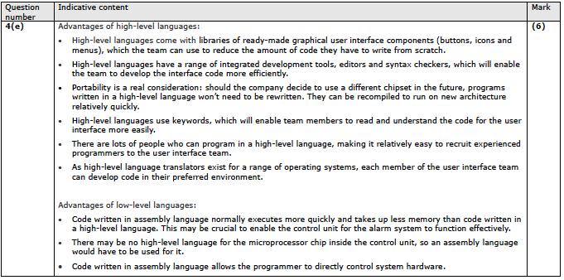
Extended Response levels-based
Indicative content
Levels-based mark scheme with descriptors
Notes:
The extended response questions are the more ‘traditional’ type that require a response through written prose and are marked using levels based mark schemes, which consists of two sections:
indicative content that reflects specific points that a candidate might make when answering that particular question.
level descriptors that articulate the related skills that a candidate is expected to show when answering the question.
Indicative content is, by its very nature, not required. It is the type of factual content that candidates could have used when constructing their answer.
Few links and constructions are provided. This is for two reasons. Firstly, all of those higher order skills are in the descriptors; this is what is being assessed. Secondly, the indicative content is not a model answer.

Slide 19
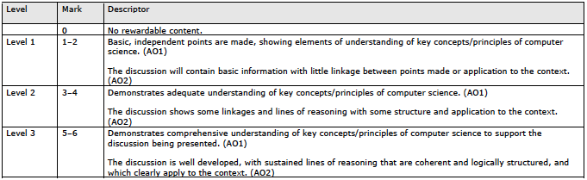
Extended Response Questions
Indicative content
Levels-based mark scheme with descriptors
Notes:
The levels-based mark scheme demonstrates how the assessment objectives will be covered.
Although the indicative content will change from series to series based on the content being assessed, the levels-based mark scheme will not change from series to series.

Slide 20
Activity 4

Slide 21
Activity 4
Study the indicative content and the levels-based mark scheme with descriptors
Ask questions in the chat.
Notes:
Take 2 or 3 minutes to study the Q, Indicative content and LBMS.
You will find these in the Sample assessment materials (question 4e)
Ask questions in the chat.

Slide 22
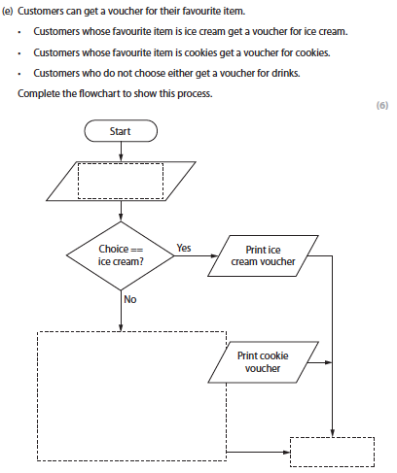
Extended response points-based
Not an essay
Flowchart / Complex network diagram
Final item of question 5
Notes:
The other extended response question will be a points-based question, not an essay.
Examples of task could be a flowchart (e.g. 5e here), or another way of representing an algorithm; or a network diagram etc.

Slide 23
Computer-related mathematics
demonstrate understanding of arithmetic and logical operators such as MODULUS, AND, OR, or the use of the relational operators
perform an arithmetical or logical calculation
construct or derive an expression/equation
apply logical shifts
use binary notation.
Notes:
The OfQual subject criteria for Computer Science requires that some marks for AO2 are assigned to computer-related mathematics. Both external assessments will each have marks allocated to the assessment of computer-related mathematics, which will include mathematics assessed in AO2.
Questions having computer-related mathematics are those where students are:
required to demonstrate their understanding of arithmetic and logical operators such as MODULUS, AND, OR, or the use of the less than symbol (<)
performing an arithmetical or logical calculation
constructing or deriving an expression/equation
applying logical shifts
using binary notation.

Slide 24
Activity 5

Slide 25
Activity 5
Identify and then map the questions in the Sample assessment material that assess Computer-related mathematics:
  demonstrate understanding of arithmetic and logical operators such as MODULUS, AND, OR, or the use of the relational operators
  perform an arithmetical or logical calculation
  construct or derive an expression/equation
  apply logical shifts
  use binary notation.
Notes:
For this activity, please Identify the questions in the sample assessment material that assess Computer-related mathematics and then map them against these five types.
Please take 5 minutes to do this.

Slide 26
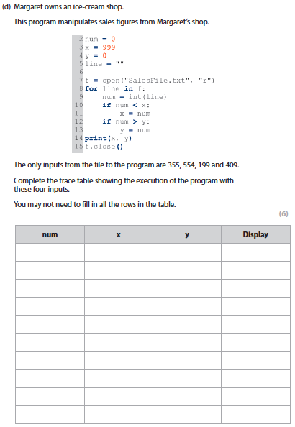
Activity 5
demonstrate understanding of arithmetic and logical operators such as MODULUS, AND, OR, or the use of the relational operators
Notes:
This question Is 5d and it requires students to apply their knowledge of relational operators to complete the trace table

Slide 27
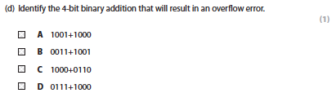
Activity 5
perform an arithmetical or logical calculation
Notes:
1d is a question that requires candidates to be able to carry out a binary addition to know which one will result in an overflow error.

Slide 28
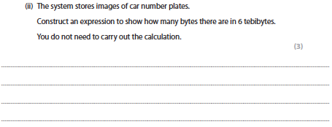
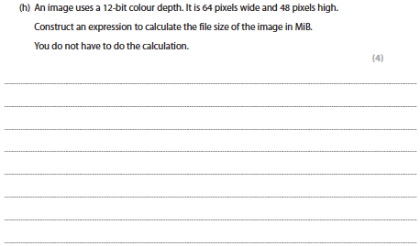
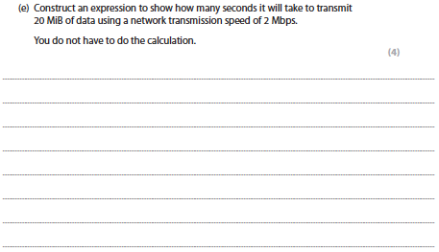
Activity 5
construct or derive an expression/equation
Notes:
1cii
1h
2e

Slide 29
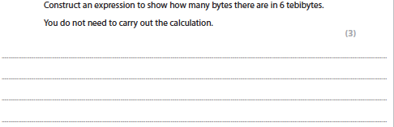
Computer-related mathematics
‘Construct an expression’
Not required to carry out the calculation
Apply understanding of the process
Notes:
This term requires clarification.
There is no requirement for students to carry out the calculation. That is what calculators are for(!)
We need to see that students have the ability to understand the process.
1cii

Slide 30
Activity 5
apply logical shifts
Notes:
There are no questions in the SAM that require candidates to apply a logical shift. Examples of these questions can be found in papers from 1CP1

Slide 31
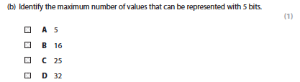
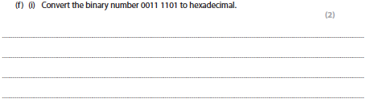
Activity 5
use binary notation
Notes:
1b
1fi

Slide 32
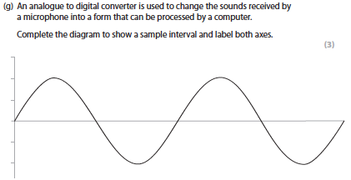
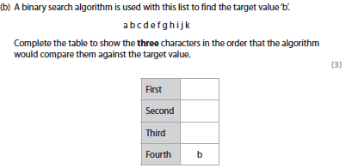
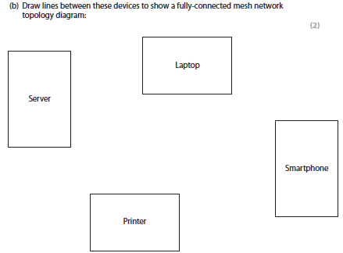
Tables / Diagrams
Notes:
1g
2b
5b
These questions require students to draw diagrams or flowcharts or complete tables or diagrams with the correct information.
These questions are marked using a points-based mark scheme for each accurately drawn/completed element of the table/diagram.

Slide 33

Getting Ready to Teach events
May/June 2020
Getting Started guide detailed guidance on the specification and assessment
February 2020
Editable Scheme of Work
That underpins the interactive SoW
March 2020
Specimen Papers
3 complete sets
1 set for Sept 2020
2 sets for Sept 2021
Exemplar student work and examiner commentaries generated from students
September 2020
Progression Guide outlining how our new GCSE Computer Science progresses on AQA and OCR A level and our L3 BTEC Nationals
Exam Wizard for building practice papers and mocks
ResultsPlus for tracking student progress for GCSE
Access to scripts provides visibility and transparency of marking
Subject Advisor support from Tim Brady
Notes:
This event is one of Getting Ready To Teach events which have been prepared to introduce the 2020 specification. These events will cover the resources that are available such as the getting started guide and editable scheme of work and the resources being worked on, such as the specimen papers and exemplar student work with examiner commentaries to be issued in September 2020.
These events also deal with progression beyond GCSE and point towards existing online resources and services that you may have already used including Exam Wizard, ResultsPlus and Access to scripts.
Full contact details for Tim Brady, the subject advisor will be confirmed later.

Slide 34
Interactive SoW
Sept 2020
A wealth of content from Pearson Edexcel, NCCE and other resource providers.
Edexcel’s recommended order of teaching and approved resources.
Maths Demo
Practical programming activities and solutions
theory and practical
Real world case studies
from industry partners, video and downloadables
Boot Up
teacher guidance
creative ideas and resources for practical programming lessons
Student book 2.0
September 2020
Revision guide 2.0
February 2021
Revision workbook 2.0
February 2021
Notes:
The June 2020 version is a basic SoW with editable content.
September will see additional resources added to the Interactive SoW form Pearson Edexcel, National Centre for Computing Education (NCCE) and others, which will include:
A range of practical programming activities with solutions
Real World Case Studies
Free videos and downloadable PDFs of people in industry talking about how they use the skills students are learning in Computer Science. We are working with big industry names that students will recognise to try to help make content feel relevant and exciting.
Boot up teacher guidance
Creative ideas and resources for practical programming lessons such as a library of Python programs with live data sources
Step by step guidance in tricky areas for anyone who wants to refresh their knowledge. For example, Boolean logic in the Edexcel spec - how much depth, what do students need to know, where can I find more support for this area that is relevant to the spec?
All Free and to be available from Sept 2020.
Also to be made available is a new Student Book, a Revision Guide and Workbook to be issued during the first year of teaching.

Slide 35
GCSE Computer Science student book
Our brand new Pearson Edexcel GCSE Computer Science Student Book provides all of the content, activities and exam support that you need to deliver the specification, including:
practical activities for programming that follow the PRIMM pedagogy
real world examples and case studies of Computer Science in Action
worked examples and activities using the PLS or ‘Programming Language Subset’
exam-style questions using only the Edexcel command words
simplified content to make it as accessible as possible.
Notes:
You don't have to purchase any resources, including those from Pearson, to deliver our qualifications. However, our brand new Pearson Edexcel GCSE Computer Science Student Book follows the practical teaching and learning approach being used for the interactive scheme of work and provides all of the content, activities and exam support that you need to deliver the specification meaning you have everything in one place.

Slide 36
Next steps
Sign up to monthly updates from our Subject Advisor Tim Brady -https://qualifications.pearson.com/en/forms/subject-advisor-updates-for-teachers-and-tutors.html to receive updates and any key dates.
Pearson Computer Science Community
Follow us on Twitter @Pearson_CS
Collaborate with colleagues on Facebook GCSE Computer Science Facebook group
Need to talk to us the please contact us at: https://support.pearson.com/uk/s/qualification-contactus
UK: 0333 016 4160/ International: +44 (0) 333 016 4160
Notes:
The links in the presentation are active, so please download the presentation and you will be able to follow them.
Please do sign up to updates from Tim, join the community, follow him on Twitter and Facebook. An excellent network of support is available in all those spheres.
If you need a more formal response, (or just don’t like social media!) then please use the link to contact us or give us a call!

Slide 37
Questions?

Slide 38
Thank you

Slide 39


