Slide 1
A level
in Japanese
Getting ready to teach

Slide 2
Objectives
Explore the question papers and mark schemes and take part in activities
Look at teaching and learning strategies for integrating newer elements of the course
Find out more about the support available to guide you through these changes
Have the opportunity to network, discuss best practice and share ideas with other teachers

Slide 3
Agenda
A level reforms and new requirements for Japanese
Overview of new specification content
Themes
Paper 2 Assessment content
Teaching and learning activities
Paper 1 Assessment content
Teaching and learning activities
Paper 3 Assessment content
Teaching & learning activities
Support and resources

Slide 4
Languages for All
Content that engages, inspires and motivates your students
Manageable content and clear, structured assessment
Assessments that enable all students to reach their potential
Rich choice of popular and accessible works covering contemporary and classical titles from a range of directors and authors
Straightforward and clear mark schemes
Specification that builds transferable skills for progression to Language or other degrees

Slide 5
AS & A level reforms
This qualification is offered at A level only.
All new A levels are fully linear. This means that all 3 papers must be taken in the same examination session at the end of the course.
The new A level is for first examination in 2020.

Slide 6
Key changes
A listening assessment has been added.
‘Topics and texts’ are now ‘Texts and Films’.
A synoptic task assessing mixed skills has been added (listening, reading and writing).
The kanji list has been updated.
Renewed focus on culture with a specific assessment objective (AO4) that assesses knowledge and understanding of the TL culture

Slide 7
Themes
All teaching and assessment will be centred around the following four themes:
テーマ １：変わっていく若者の生活
テーマ ２：変わっていく文化
テーマ ３：変わっていく人生観
テーマ ４：東日本大震災後の日本

Slide 8
A detailed look at the themes
テーマ １： 変わっていく若者の生活
教育 教育制度やその改革(ゆとり教育以降)：試験や塾：文部科学省によるカリキュラム管理 若者の健康(身体面と心理面) 若者にかかるプレッシャー：それが健康や食生活に与える影響：いじめ 自由研究のテーマ 家族関係や人間関係 伝統的な家族構成：核家族：家庭内の人間関係

Slide 9
A detailed look at the themes
テーマ 2： 変わっていく文化
変わるポピュラー・カルチャー アニメや漫画：音楽：武道・武術 テクノロジーの影響 テクノロジーの進歩：ロボット：オートメーション 自由研究のテーマ 変わっていく行事 伝統的な祭りや現代的なイベント：イベントや祭りと観光業の影響：西洋行事の流入

Slide 10
A detailed look at the themes
テーマ ３： 変わっていく人生観
変化する労働 終身雇用制度の崩壊：仕事に対する意識の変化：仕事のための移住 長引く不景気 日常生活への影響：政府の対応：経済の国際化：移住外国人労働者の受け入れ 自由研究のテーマ 高齢化社会 高齢者の孤立：家族からのサポート：社会的支援

Slide 11
A detailed look at the themes
テーマ ４： 東日本大震災後の日本
3月11日とその直後 地震と津波の被害：避難生活：救出と援助：海外の反応 復興への政策 被災地の立て直し：ボランティアや国民の団結：困難を乗り切る力：心のケア 自由研究のテーマ 福島原発事故後の省エネ生活 日常生活の中の省エネ：エネルギー供給をめぐる議論：省エネに関する昔の知恵

Slide 12
Delegate Activity 1
Talk with the person next to you about the themes:
Which do you feel confident teaching?
Which do your learners enjoy?
Which are you concerned about?
Do you have suggestions of good resources to use?

Slide 13
Assessment Objectives
 |  | Weighting
AO1 | Understand and respond in writing to spoken language drawn from a variety of sources | 20%
AO2 | Understand and respond in writing to written language drawn from a variety of sources | 30%
AO3 | Manipulate the language accurately, in written forms, using a range of lexis and structure. | 30%
AO4 | Show knowledge and understanding of, and respond critically and analytically to, different aspects of the culture and society of countries where the language is spoken. | 20%

Slide 14
Breakdown of assessment objectives
 | Assessment Objectives
 | AO1 % | AO2 % | AO3 % | AO4 % | Total for all Assessment Objectives
Paper 1:Translation into English, reading comprehension and writing (research question) |  | 25 | 5 | 10 | 40%
Paper 2:Translation into Japanese and written response to works |  |  | 20 | 10 | 30%
Paper 3: Listening, reading and writing | 20 | 5 | 5 |  | 30%
Total for GCE A level | 20 | 30 | 30 | 20 | 100%

Slide 15
Paper 1: Translation into English, reading comprehension and writing (research question)
Section | Assessment 2 hours 30 minutes 40%
Section A: Translation into English (20 marks) | An unseen passage to be translated from Japanese into English.
Section B: Reading (20 marks) | A reading assessment based on a variety of text types and genres. Students must respond to a series of comprehension questions.
Section C: Writing (research question) (40 marks) | A reading and writing question based on an aspect of the student’s chosen research subject. Students read a text and then answer a question. Students must use information and ideas both from the text and their research findings.

Slide 16
Paper 2: Translation into Japanese and written response to works
Section | Assessment 2 hours 40 minutes 30%
Section A: Translation into Japanese (20 marks) | An unseen passage to be translated from English into Japanese.
Section B: Written response to works (literary texts) (45 marks) | An extended response on either one or two of the prescribed literary texts. Students select one question from a choice of two. If a student answers questions on two literary texts, they do not complete Section C.
Section C: Written response to works (films) (45 marks) | Students who answer only one question from a literary text in Section B must write an extended response on one of the films. Students select one question from a choice of two.

Slide 17
Paper 3: Listening, reading and writing
Section | Assessment 2 hours 15 minutes 30%
Section A: Listening comprehension (30 marks) | A listening assessment based on a recording that features male and female Japanese speakers. Students respond to comprehension questions.
Section B: Listening, reading and writing questions (30 marks) | Students summarise a listening source and a text that are based on the same sub-theme. Students evaluate the points of view in both sources, stating which views they agree with and why.

Slide 18
A more detailed look at each paper

Slide 19
Paper 2
Translation into Japanese and written response to works

Slide 20
Section A Translation into Japanese
Students must translate an unseen text from English into Japanese.
The content of the text will be from one of the themes.
30 minutes (recommended timing)
20 marks
Points based mark scheme in 20 sections

Slide 21
Section A Translation into Japanese
Question from SAMs (p.45)
Every year the Embassy of Japan in London runs a competition called ‘Manga Jiman’. Artists have to create a story around a theme; this year’s theme was ‘Bright Young Things’. The top prize is two return flights to Japan.
On Friday 18 March 2016, the Otaku News Team went to the awards ceremony. The entries were on display and before the winners were announced, guests discussed who they thought would win. The hospitality was amazing. Everyone particularly enjoyed the silver trays of sushi.

Slide 22
Sections B and C:Written response to works (literary texts/films)
Students must answer two questions
They may answer at least one question on a literary text (from Section B) and one question on a film (from Section C) OR two questions on a literary text. They must NOT answer two questions on a film.
Each question offers a choice of essay title (a) or (b)
The answers are written on 原稿用紙.
Recommended length of each essay is 600-700 characters

Slide 23
Prescribed literary texts
Students MUST study one of these, and may study two.
どんどん読めるいろいろな話、秋元 美晴・糸川 優 編著、1991 (short-story collection)
キッチン、吉本ばなな、1998 (novel)
窓際のトットちゃん、黒柳徹子、1991 (autobiography)

Slide 24
Example from SAMs (p.57-58)
どんどん読めるいろいろな話
(a) 「どんどん読めるいろいろな話」の話の中で、不思議な世界は、どのように作り出されていますか。「どんどん読めるいろいろな話」の話から最低三つにふれて、説明しなさい。
OR
(b) 「どんどん読めるいろいろな話」の話を通して、登場人物、また、読者は どんなことを学びますか。「どんどん読めるいろいろな話」の話から最低 三つにふれて、分析しなさい。

Slide 25
Example from SAMs
キッチン (吉本ばなな)
(a) 桜井みかげが人のために料理を作ってあげることには、どんな意味があり ますか。説明しなさい。
OR
(b) 吉本ばななは、「キッチン」の中で、社会から外れた人の立場をどのよう に表現していますか。考察して、あなたの意見を述べなさい。

Slide 26
Example from SAMs
窓際のトットちゃん (黒柳徹子)
(a) 校長先生が作った「トモエ、トモエ、トモエ」という校歌は、校長先生の 教育方 ほうしん 針をどのように表していますか。説明しなさい。
OR
(b) 校舎が電車であるということは、生徒たちにとって、どんな意味がありま すか。考察して、あなたの意見を述べなさい。

Slide 27
Section C:Written response to works (films)
Students MAY answer one question from section C.
They MUST answer one question from section C if they only answered one question in section B.
Each question offers a choice of essay title (a) or (b)
The answers are written on 原稿用紙.
600-700 characters

Slide 28
Prescribed films
Students MAY study one of these.
千と千尋の神隠し、宮崎駿監督 (2001)
ディア・ドクター、 西川美和監督 (2009)
誰も知らない、是枝裕和監督 (2004)

Slide 29
Filming techniques
If students are studying a film, they will need to think about filming techniques such as:
Camera work
Sound
Position of characters
Lighting
Music
Colours
Movement

Slide 30
Filming techniques
Aspects that questions may include:
Why did the director use that technique?
What is the impact on the viewer?
Are the techniques effective? Why or why not?

Slide 31
Example questions from SAMs
(p. 54-55)
千と千尋の神隠（宮崎駿）
(a)「千と千 尋の神隠」には、アニメらしい工夫が いくつかあります。 それらは、どのように使われていますか。考察して、あなたの意見を述べなさい。
OR
(b) 「千と千尋の神隠」の中で、登場人物の名前には重要な意味がありま す。どのように重要ですか。分析しなさい。

Slide 32
Example questions from SAMs
ディア・ドクター (西川美和)
(a) 「ディア・ドクター」の話の中で、いなかの医療と都会の医療はどのように表されていますか。理由も含めて、あなたの意見を述べなさい。
OR
(b) 「ディア・ドクター」の最初の場面は、映画全体の展開に効果的です。 どうしてですか。分析しなさい。

Slide 33
Example question from SAMs
誰も知らない (是枝裕和)
(a) 「誰も知らない」の話の中で、大人はどのように表現されていますか。 分析しなさい。
OR
(b) 「誰も知らない」の話の中で、明と京子の行動は、お母さんがいなくなったあと、どのように変わりますか。考察して、あなたの意見を述べ なさい。

Slide 34
Texts and Films Questions Marking
These essays are marked according to 3 mark grids. (Specification, p. 24 – 27).
The marking criteria are:
  Critical analysis and response (20 marks)
  Range of grammatical structures and vocabulary (15 marks)
  Accuracy of language (10 marks).

Slide 35
What is required in sections B and C
Have a detailed look at the mark scheme.
Note the importance of critical analysis.
Essays must be critical and analytical, not purely descriptive. (Students will lose marks if they simply re-tell the story).
Supporting evidence must be given from the text or film.

Slide 36
Paper 3
Listening, reading and writing

Slide 37
Section A Listening Comprehension
4 questions, requiring a mixture of responses eg multiple choice, short answer open response.
Includes inference questions.
Students will have individual control of the recording.
Recommended time 45 minutes.
30 marks.
Marked according to a points-based mark scheme.

Slide 38
Section A (Listening Comprehension)
SAMs p. 82 – 87
Where an open-response, written answer is required, this must be in Japanese.
Note form is acceptable, whole sentences are not required.
Students should not transcribe whole chunks.
Question 3 (b) (i) requires a summary.
Recordings of the SAMs may be found on the website.

Slide 39
Section B Listening, reading and writing
Students listen to a recording and read a written text.
Students summarise points of view in both sources.
Students answer a question in writing which requires them to evaluate the viewpoints in both sources.
Students draw conclusions.
Recommended time 1 hour 30 minutes.
30 marks.
Students should write approximately 400 – 500 characters.

Slide 40
Section B Listening, reading and writing
Question 5 (a) – students note down 4 key points about opinions / viewpoints from a spoken passage.
Question 5 (b) – students note down 4 key points about opinions / viewpoints from a written passage.
The theme and content of 5 (a) and 5 (b) will be the same.

Slide 41
Section B Listening, reading and writing
In section 5 (c), students must write in Japanese.
They must evaluate both points of view.
They must state their own conclusion.
The writing is assessed on 3 criteria according to levels-based mark grids:
  understand and respond to spoken language (6 marks)
  understand and respond to written language (6 marks)
  accuracy and range of language (10 marks)

Slide 42
A look at the SAMs
The synoptic question (question 5, parts (a), (b) and (c)) is on p. 95 – 90 of the SAMs. (Candidates work backwords through the exam paper for this section).

Slide 43
Paper 1
Translation into English, reading comprehension and writing (research question)

Slide 44
Section A Translation into English
A short passage to be translated from Japanese into English.
Based on one of the themes.
Points based mark scheme.
Recommended time 20 mins.
20 marks.

Slide 45
Translation into English SAMs question (SAM p.27)
2027年開通のリニア新幹線は全車両が指定席で完全予約制だ。もう紙の切符は要らなくなるので、新しい駅には切符を売る駅員もいなく、待合室もない。でも、体が不自由な人には利用しにくいので、この計画を心 配する人もいる。また、駅はだれにでも使いやすい場所にしようという声もある。

Slide 46
Section B Reading Comprehension
4 different passages to read.
One is a literary text but this will not be from one of the set texts (building on GCSE).
Different types of question – multiple choice, short, open-response answers and so on.
Recommended time 45 minutes.
20 marks.
Points based mark scheme.
See SAMs pages 2 to 14.

Slide 47
The research topic
Students have a choice of 4 research topics. There is one research topic linked to each Theme (see p. 8 and 9 of specification)
Students choose one and research it independently
It is important that this is independent research. Guidance on what help teachers can / cannot offer is on p. 12-13 of the specification.
They must use at least 2 authentic sources.
The focus is on understanding an aspect of Japanese culture.

Slide 48
Teachers can
Give guidance on developing research skills.
Give guidance on the content of the research subjects.
Comment on the availability of resources and time constraints.
Advise and direct students to the Assessment Objectives.

Slide 49
Teachers must
Explain what independence means.
Confirm that students’ research meets all of the aspects of the research subject.
Ensure that students do not intend to use any of the literary works or films they have studied for Paper 2.
Monitor the research subjects and make sure that students are not working together.

Slide 50
Teachers must not
Teach the content of the research subjects.
Provide sources.

Slide 51
Section C Writing (Research Question)
In the exam:
Students choose ONE question.
Recommended time 1 hour 25 minutes.
Write 600 to 700 characters.
Write on 原稿用紙

Slide 52
It is vital that
Students use information from the text printed in the exam paper.
Students bring in extra information from their own research.
Students address the bold statement printed at the bottom of the written text which is linked to the question and the research subject.

Slide 53
Example question from the SAMs
SAMs p. 23 Reading passage:
私は最近、父の仕事の関係で引っこしました。母も仕事をしていて母は 仕事の関係で、すぐに引っこすことができませんでした。それで先に、 私と父が引っこして、今新しい町に住んでいます。二人だけでは ちょっと大変なので、今おじいさんと おばあさんにも来てもらって、おばあさんが家事をしています。私もおばあさんに料理が習えるので、楽しいです。母は私と料理する時間がほとんどありません。
父は全然おこらない人で、今の生活は静かで、とてもいいです。このあいだ、ジョークで父に「今の生活が続くといいな。」と言ったら、父が母に電話で言ったようです。そして、母に電話で「私と住みたくないの？そちらに引っこしてほしくないの？」と言われました。母が来ると宿題も教えてもらえるし、母に悪かったとは思っています。でも、母は いつも おこるから複雑な気持ちです。

Slide 54
The question
下のコメントを読みなさい。
「両親や祖父母の仕事は、その子どもに影響を与えます。」
あなたの自由研究と上の文章の両方を考察して、上のコメントに関する あなたの意見を述べなさい。

Slide 55
Marking of research question
There are three levels-based mark grids to be applied to this question.
These are:
knowledge and understanding of society and culture (via research) (20 marks)
understand and respond to written language in writing (10 marks)
accuracy and range of language (10 marks)
See specification p. 16 – 19.

Slide 56
Preparing students for the research question
Have a detailed look at the mark scheme.
Note that students gain most marks for their research rather than for their referencing of the unseen text.
Students must link their research to the unseen text. However, the point of the exercise is not to analyse the unseen text.

Slide 57
Plenary

Slide 58
Teaching and learning support
Support around literary works and films
Support around independent research project
https://qualifications.pearson.com/en/qualifications/edexcel-a-levels/japanese-2018.coursematerials.html#filterQuery=Pearson-UK:Category%2FTeaching-and-learning-materials

Slide 59
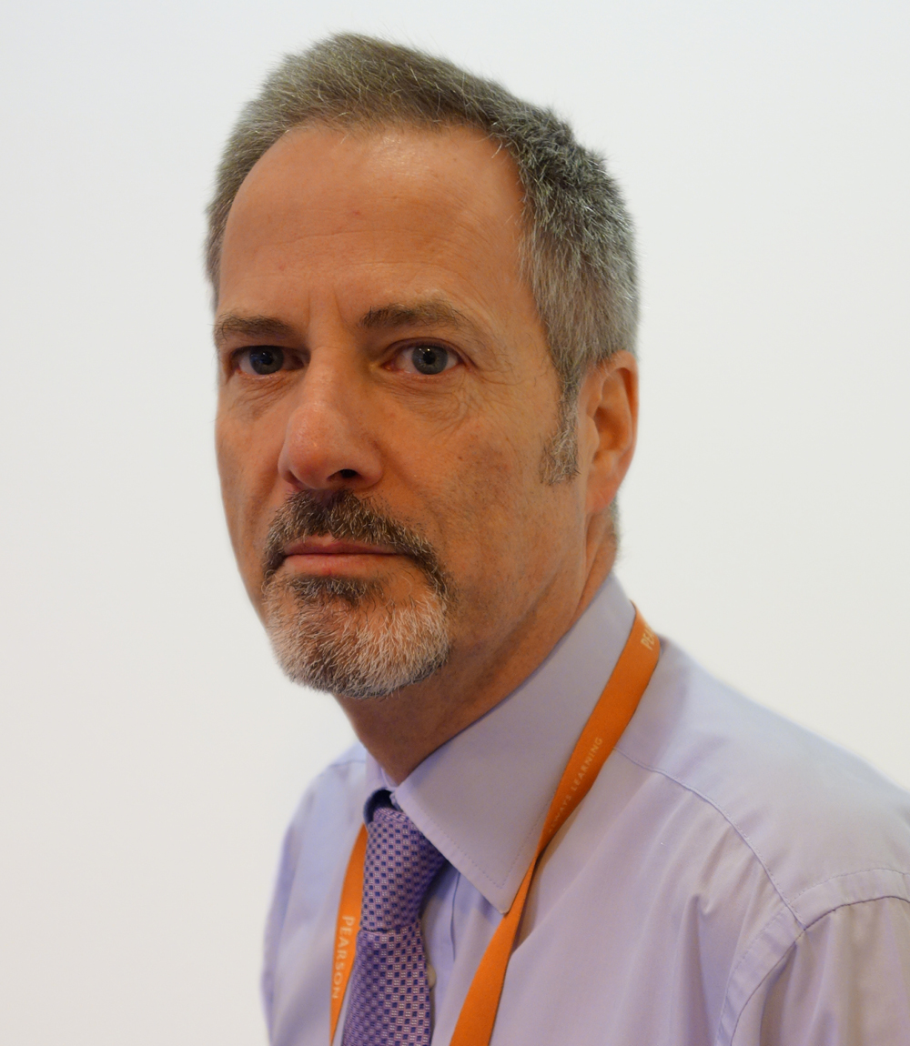
Contact details
Alistair Drewery, Subject Advisor
Phone:
UK: 0844 576 0035
Intl: +44 (0) 207 010 2187
Email: TeachingLanguages@pearson.com
Twitter: @PearsonMFLquals
Sign up today to receive Subject Advisor emails

Slide 60
ResultsPlus
ResultsPlus provides the most detailed analysis available of your students’ exam performance. This free online service helps you identify topics and skills where students could benefit from further learning, helping them gain a deeper understanding of languages.

Slide 61
Next steps
  Please complete your evaluation form for today’s event – in your pack
  Sign up to our updates:
  email - TeachingLanguages@pearson.com
  Visit the website to download further copies of the draft specification and support materials:
  https://qualifications.pearson.com/en/qualifications/edexcel-a-levels/A-level-from-2017.html

Slide 62
Thank you!

