Slide 1


Changes to Chinese and Japanese
A levels 2024
For first assessment 2026
Notes:
This presentation will take you through the recent changes to the Chinese and Japanese A levels, which were published in July 2024.

Slide 2

Summary
1 | | | Overview of amendment
2 | | | Changes to Chinese A level assessment
3 | | | Changes to Japanese A level assessment
4 | | | Support
Notes:
I will give you an overview and reasons for the change, how the assessments for Chinese and Japanese A levels will change. Lastly, I’ll show you where you can find our updated materials and support.

Slide 3
Overview of amendment
The Department for Education ran a consultation in April 2023 regarding Chinese and Japanese A-Levels, which resulted in an update to the GCE AS and A level subject content for modern foreign languages in July 2023.
As a result, the following changes to the Pearson Edexcel Level 3 Advanced GCE in Chinese and Pearson Edexcel Level 3 Advanced GCE in Japanese have been made:
Questions and responses to comprehension (listening and reading) tasks now appear in English instead of the target language (unless writing skills are also intentionally being assessed).
Questions about the literary works and films now appear in both the target language and English. Students will still be required to respond in the target language to these questions.
These changes are applicable for first assessment in 2026.
Notes:
So let’s get started with an overview of the amendment, which was sparked by a consultation run by the Department for Education in 2023. The outcomes aim to make assessments for both Chinese and Japanese more accessible to taught learners.
As a summary, the outcomes are that for first assessment in 2026, comprehension questions (that’s listening and reading tasks) will now be presented and answered in English instead of the target language (unless writing skills are also intentionally being assessed), and that questions about literary works and films which assess Writing will now be presented in both the target language and English.
Now I’ll walk you through the Paper-by-paper changes to the Chinese A level assessment, which are published on our updated Sample assessment materials.

Slide 4
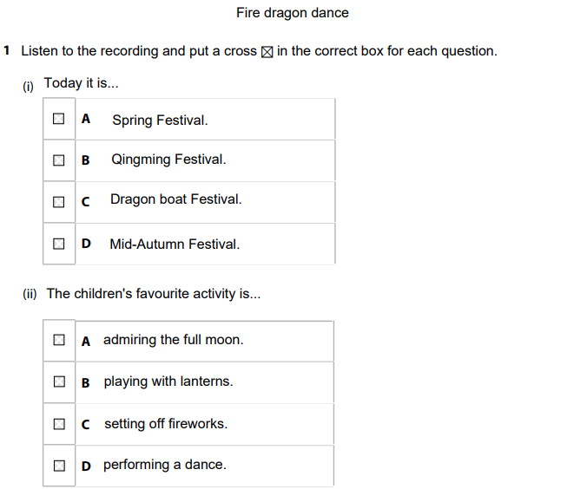
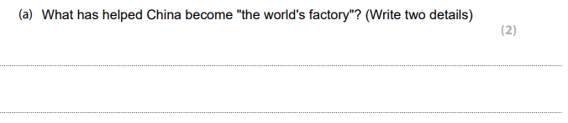
Changes to Chinese A level – Paper 1
Question titles now appear in English
Questions and rubrics now appear in English
Answers must now be in English
Notes:
For paper 1 (listening and reading comprehension), question titles now appear in English. This also applies to the recording that students will hear. On the answer papers, questions and multiple choice answers will now be presented in English instead of Chinese. Students must now answer the whole of paper 1 in English.

Slide 5
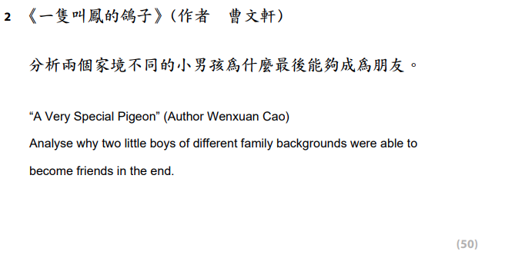
Changes to Chinese A level – Paper 2
Question rubrics for the translation task now appear in English
Questions now appear in both Chinese and English
Students are still required to answer in Chinese
There are no changes to Paper 3 (Speaking) on the Chinese A level
Notes:
For Paper 2, (response to set works), the rubrics for the tasks, including the translation task, will now appear in English. In addition, Questions about the set works will appear in both Chinese and English. Students are still required to answer the whole of Paper 2 in Chinese.
There are no changes to the assessment of Paper 3, which is the Speaking paper.

Slide 6
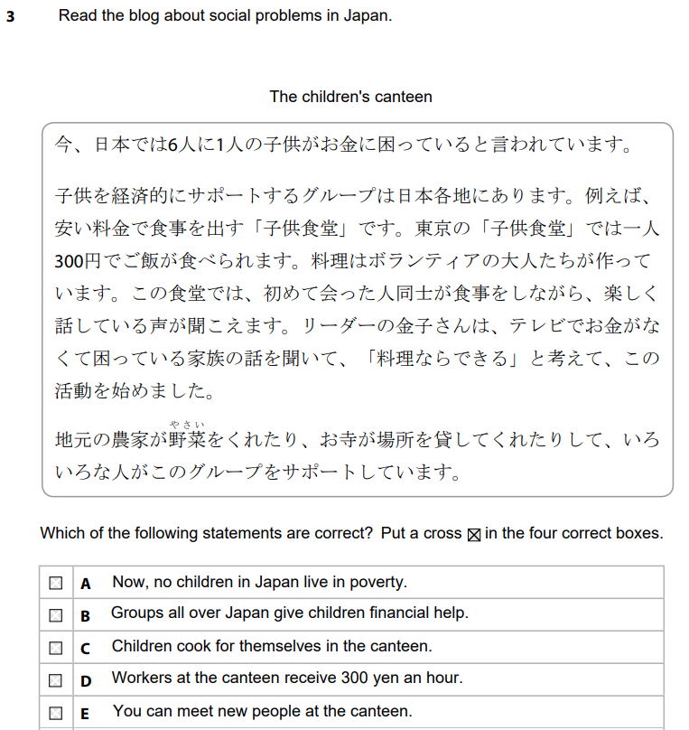
Changes to Japanese A level – Paper 1
Sections A and B
Question titles now in English
Questions and rubrics in English
Answers must now be in English
Section C
Question titles and rubrics in English
Students are still required to answer in Japanese
Notes:
Now, let’s run through the changes to Japanese A level.
Similarly to the Chinese assessments, question titles and question rubrics will now appear in English.
For Sections A and B (the – translation into English and comprehension tasks), answers must now be in English. For Section B, students are still required to answer in Japanese since writing is intentionally assessed here. It is clearly indicated in bold where students must answer in English, and where students should answer in Japanese.

Slide 7
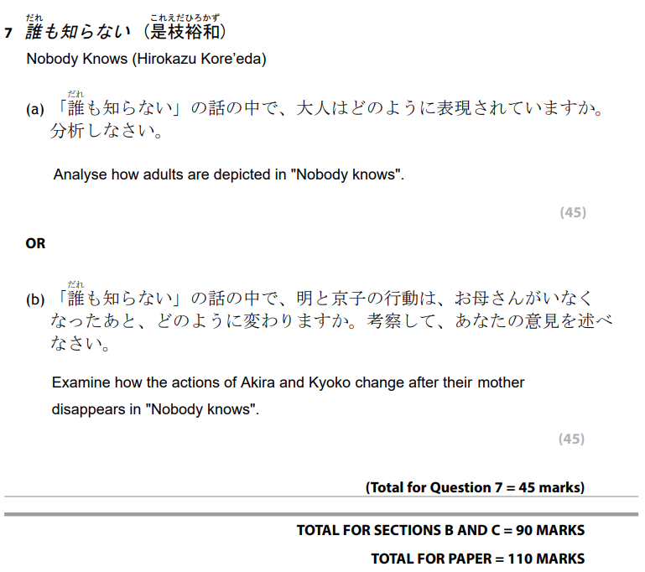

Changes to Japanese A level – Paper 2
Question rubrics for the translation task are now in English.
Questions for set works now appear in both Japanese and English
Students are still required to answer in Japanese
Notes:
For Paper 2, all question rubrics will now be in English. Questions about the set works will appear in both Japanese and English. Students are still required to answer the whole of Paper 2 in Japanese.

Slide 8
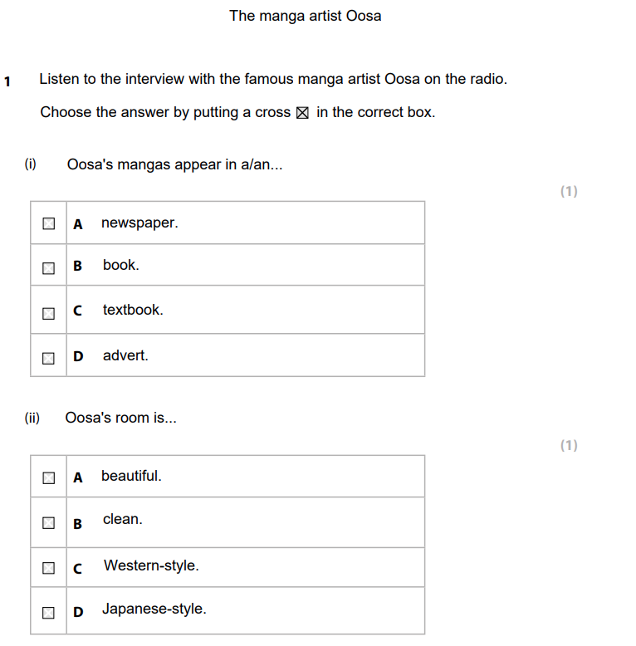
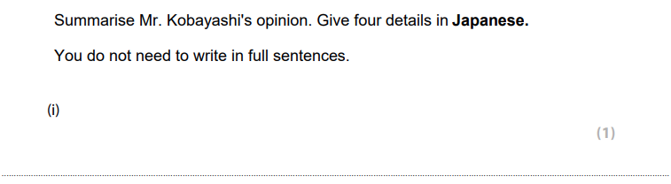
Changes to Japanese A level – Paper 3
Question titles, questions and rubrics now in English
Answers must now be in English for Section A
Students are still required to answer in Japanese for Section B
Notes:
For Paper 3, question titles, questions and rubrics will now be in English. For Section A answers must now be in English. Students must still answer in Japanese for Section B. Again, it is clearly indicated where students are expected to answer in Japanese.

Slide 9


Support
View our resources
For Chinese
For Japanese
Ask our subject advisor
teachinglanguages@pearson.com
Notes:
So that wraps up the changes to the Chinese and Japanese A levels for first assessment in 2026. If you would like to see the changes please access our Sample assessment materials for each qualification on our website. There is also a handy guide there which shows the differences between the old and new assessment.
If you have any further questions about this, feel free to contact our Subject advisor at teachinglanguages@pearson.com.

Slide 10
End of Presentation
Notes:
Thank you for listening.

