Slide 1
Dyslexia in the Level 1 Classroom- What to look out for and how to support
Kelly Adams
Product Manager Level 1 below including Workskills and Personal Growth and Wellbeing

Slide 2
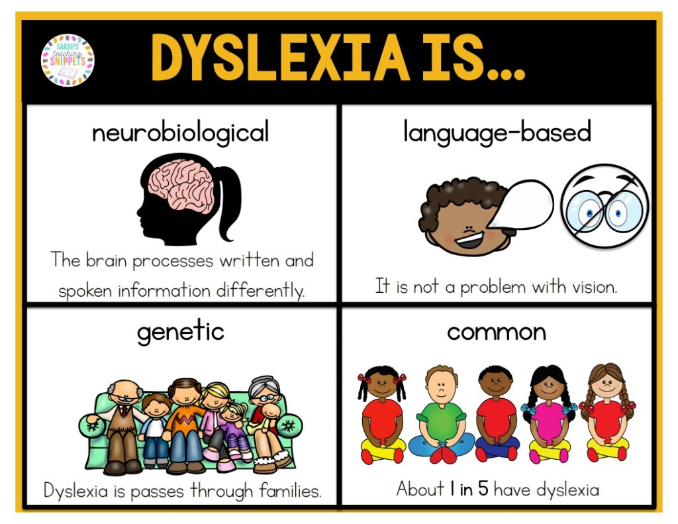
What is Dyslexia?
Dyslexia is a specific learning disability that primarily affects a person's ability to read, spell, and write. It is often characterized by difficulties in phonological processing.
Approximately 5-17% of the population is affected by dyslexia.
©All about Dyslexia - Sarah's Teaching Snippets (sarahsnippets.com)

Slide 3
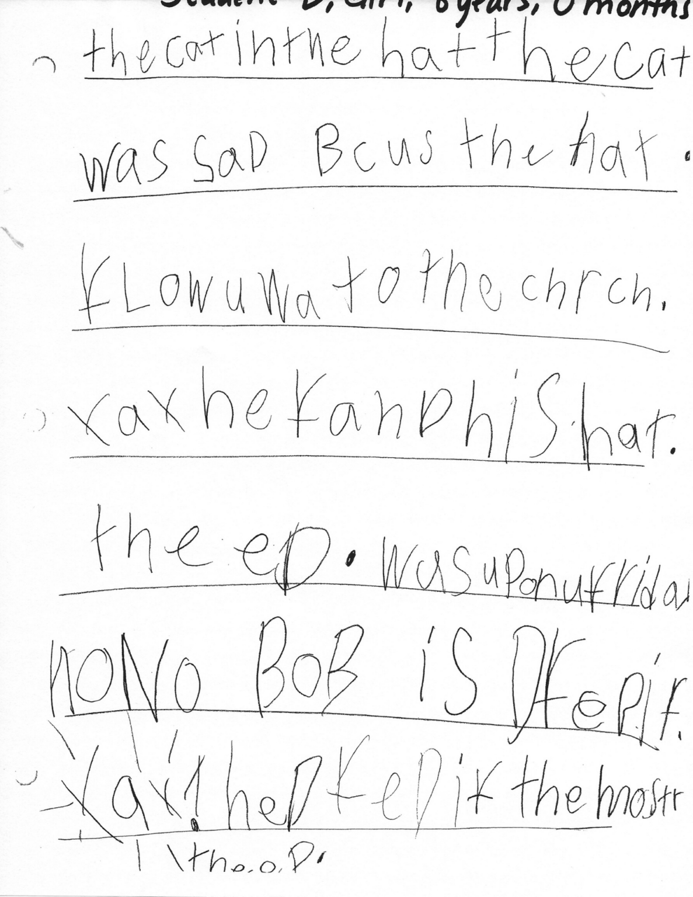
Symptoms of Dyslexia
Difficulty with reading fluency and accuracy.
Struggles with spelling and writing.
Slow and laborious reading.
Challenges with phonemic awareness and decoding.
Poor working memory for verbal information.
Difficulty in processing and manipulating the sounds of language.
©Dyslexia Affects Writing, Too - Nashville Dyslexia Center

Slide 4

How Dyslexia affects learning
Reading Difficulties:
  Poor reading fluency can hinder comprehension.
Writing and Spelling Challenges:
  Difficulty in expressing thoughts in writing.
Impact on Academics:
  Lower performance in reading-based subjects.
Emotional Impact:
  Frustration, low self-esteem, and anxiety can develop.

Slide 5
Strategies for the learner
Structured Literacy Programs: Using evidence-based methods to teach reading, spelling, and writing.
Assistive Technology: Tools and software to aid in reading and writing.
Multisensory Instruction: Engaging multiple senses to reinforce learning.
Individualized Education Plans (IEPs): Tailored support in schools, including accommodations and modifications.
Audiobooks and Text-to-Speech: Alternative ways to access content.

Slide 6
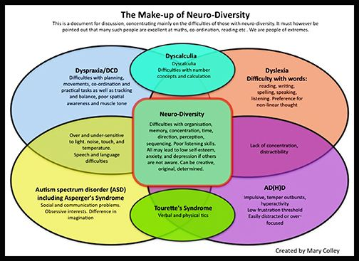
Links between SpLD conditions
©Pin on Books Worth Reading (pinterest.co.uk)

Slide 7
To discover more about the qualifications we offer in this suite please visit
BTEC Entry Level | Level 1 | Level 1 Introductory | Pearson qualifications

Slide 8
End of Presentation
Notes:
Closing Slide

