Slide 1
ASC in the Level 1 Classroom- What to look out for and how to support
Kelly Adams
Product Manager Level 1 below including Workskills and Personal Growth and Wellbeing

Slide 2
What is ASC (Autistic Spectrum Condition)
Autism Spectrum Conditions (ASC) refer to a range of neurodevelopmental disorders characterized by challenges in social interaction, communication, and repetitive behaviours.
It is estimated that at least 1 in 100 people in the United Kingdom has an ASC.
Each individual with ASC may exhibit unique strengths and challenges.
“If you have met one person with autism you have met one person with autism”
Notes:
Content Slide color accent left

Slide 3
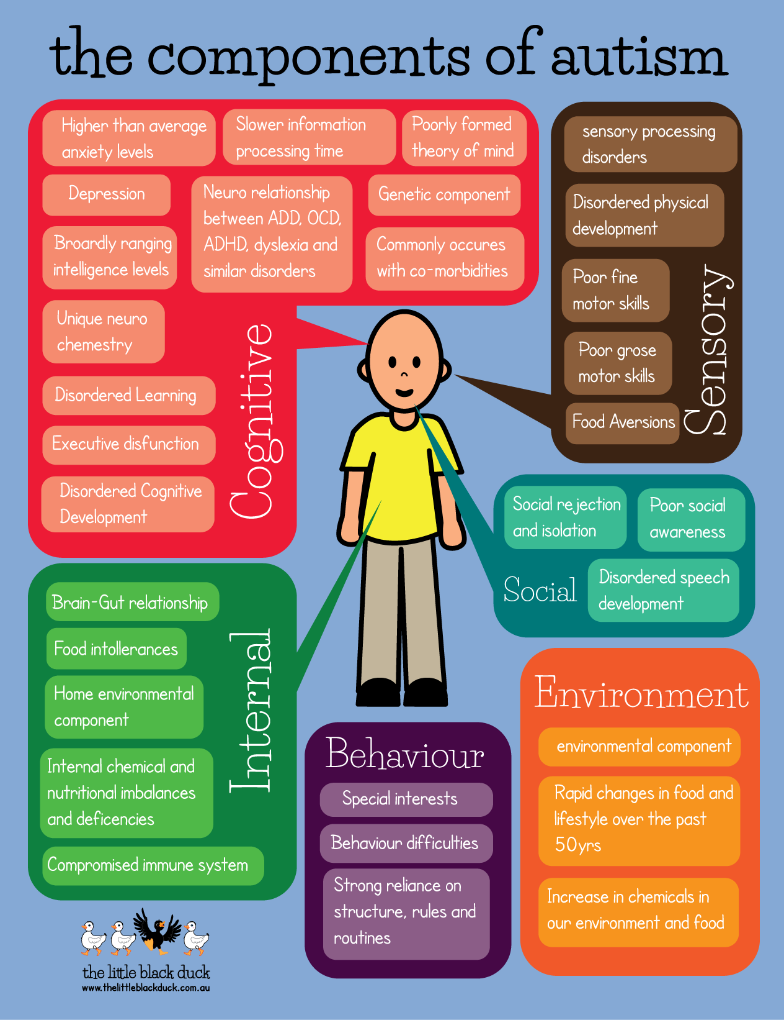
Characteristics of ASC can include
Challenges in social interactions and communication.
Special interests and repetitive behaviours.
Sensory sensitivities.
Varied levels of language development.
©Autism treatment — EmCell — World's pioneers of stem cell research and therapy

Slide 4
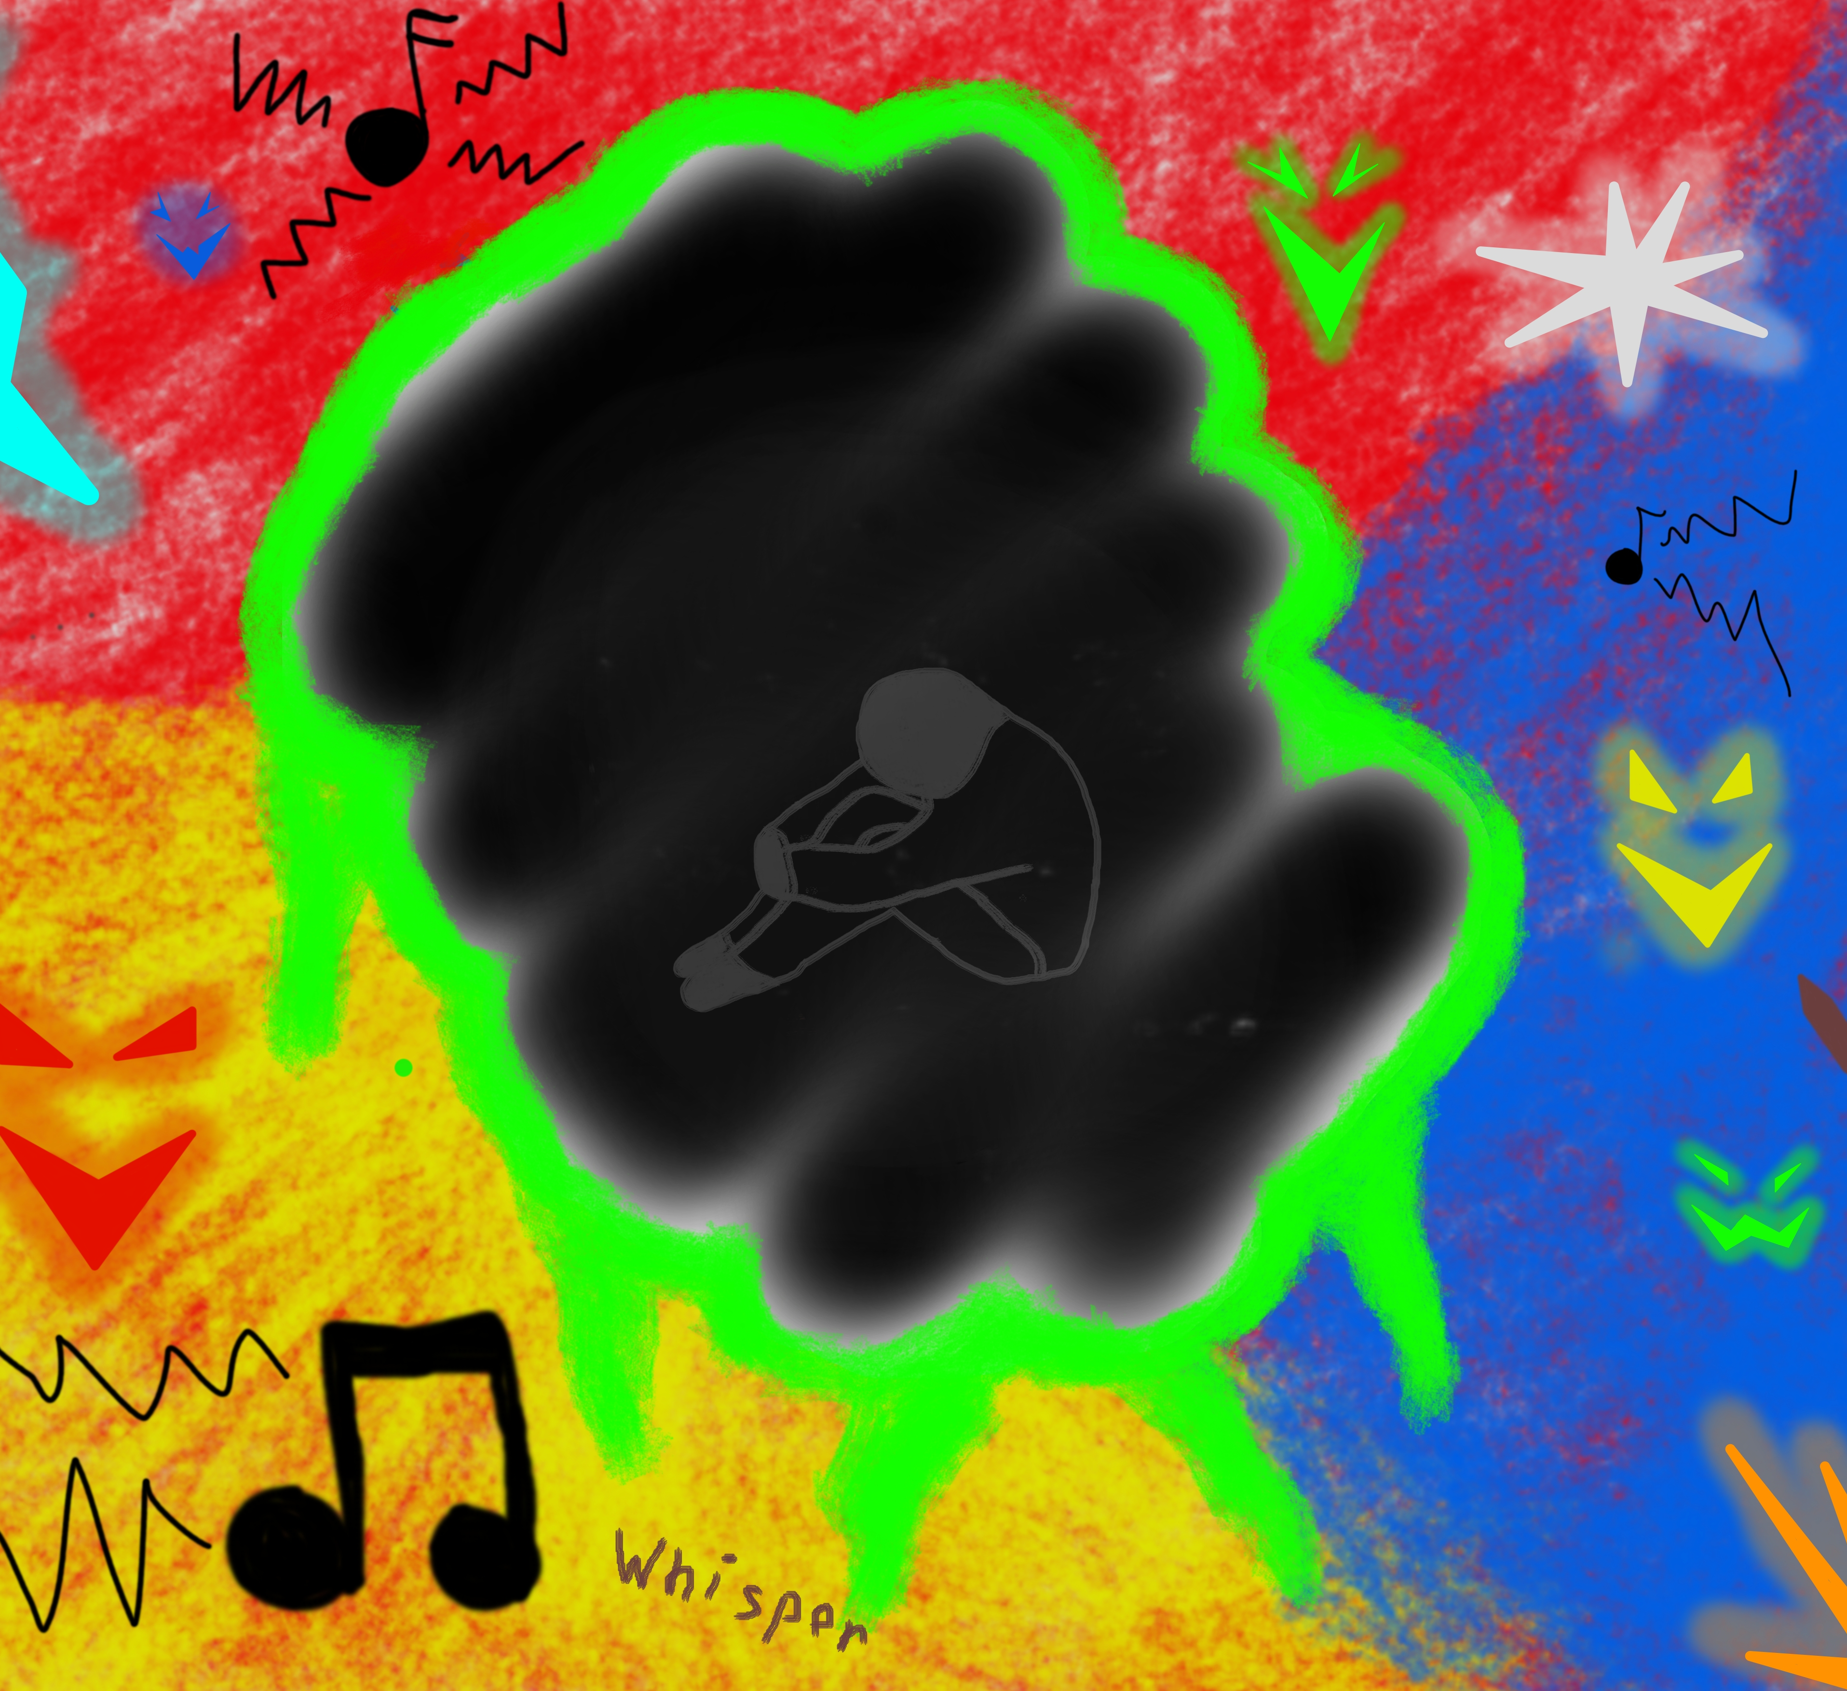
How ASC effects learning
Social Interaction:
  Difficulty in understanding social cues and building relationships.
Communication:
  Challenges in expressive and receptive language.
Repetitive Behaviours:
  May affect focus and engagement.
Sensory Sensitivities:
  Certain sensory stimuli can be overwhelming.
Strengths and Interests:
  Some individuals have exceptional skills or interests in specific areas.
This Photo by Unknown Author is licensed under CC BY

Slide 5
Strategies to support learners with ASC
Individualized Education Plans (IEPs): Tailored support in schools, including accommodations and modifications.
Structured Routines: Consistent schedules and visual aids for organization.
Social Skills Training: Teaching social communication and interaction.
Sensory Support: Creating a sensory-friendly environment.
Inclusive Classroom Practices: Promoting understanding and empathy among peers

Slide 6
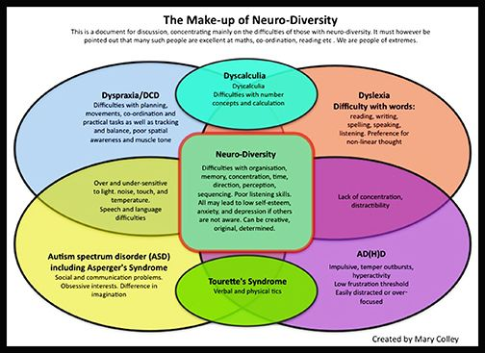
Links between SpLD conditions
©Pin on Books Worth Reading (pinterest.co.uk)

Slide 7
To discover more about the qualifications we offer in this suite please visit
BTEC Entry Level | Level 1 | Level 1 Introductory | Pearson qualifications

Slide 8
End of Presentation
Notes:
Closing Slide

