Slide 1
ADHD in the Level 1 Classroom- What to look out for and how to support
Kelly Adams
Product Manager Level 1 below including Workskills and Personal Growth and Wellbeing

Slide 2
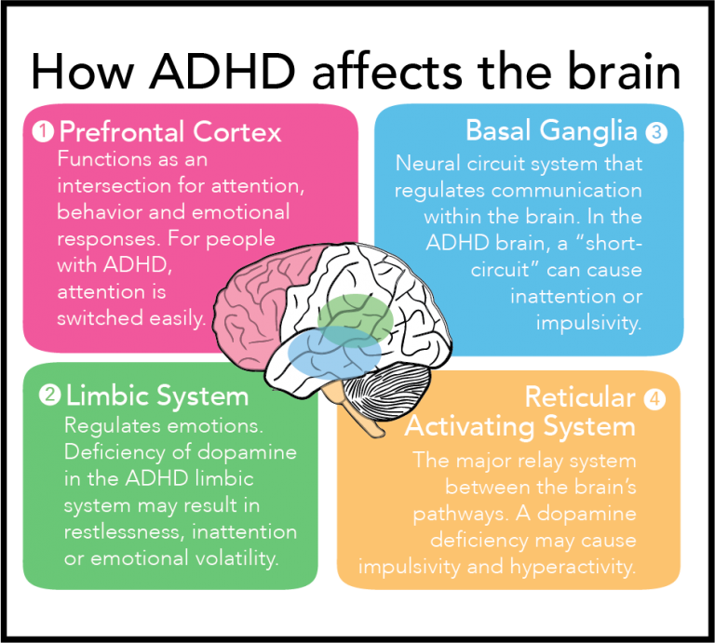
What is ADHD?
ADHD is a neurodevelopmental disorder that affects a person's ability to pay attention, control impulses, and regulate their activity level. It includes two main subtypes: inattentive, hyperactive-impulsive, or combined.
It is one of the most common childhood disorders, affecting approximately 5-10% of children.
©Empower ME: What are the benefits in cognitive development and the development of ADHD? - Logopsycom

Slide 3

Symptoms of ADHD
Inattentive Type:
  Difficulty sustaining attention, following through on tasks, and organizing activities.
Hyperactive-Impulsive Type:
  Fidgeting, restlessness, difficulty waiting one's turn, and impulsive decision-making.
Combined Type:
  A combination of inattentive and hyperactive-impulsive symptoms.

Slide 4
How ADHD affects learning
Inattention: Difficulty staying on task, completing assignments, and following instructions.
Impulsivity: Trouble with impulse control, leading to impulsive decisions.
Hyperactivity: Restlessness and difficulty sitting still in a classroom setting.
Academic Challenges: Lower academic performance and potential for underachievement.
Social and Emotional Impact: Difficulty with peer relationships and self-esteem.

Slide 5
Strategies for the learner
Individualized Education Plans (IEPs): Tailored support in schools, including accommodations and modifications.
Medication: When recommended by a healthcare professional.
Behavioral Interventions: Techniques to improve self-regulation and focus.
Structured Routines: Consistent schedules and organization.
Classroom Accommodations: Preferential seating, shorter assignments, and extra time for tasks.
Supportive Environment: Creating a classroom conducive to focus and attention.

Slide 6
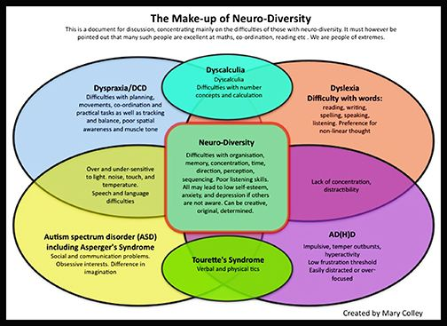
Links between SpLD conditions
©Pin on Books Worth Reading (pinterest.co.uk)

Slide 7
To discover more about the qualifications we offer in this suite please visit
BTEC Entry Level | Level 1 | Level 1 Introductory | Pearson qualifications

Slide 8
End of Presentation
Notes:
Closing Slide

