Slide 1
BTEC LEVEL 1 Intro
A2 Developing a Personal Progression Plan

Slide 2
Using this resource
This resource is provided to you by Pearson for educational use as part of the Level 1 Introductory qualification suite.
The resource is a starting point to teaching the named unit on the title page. The intended purpose of this resource is to support teaching by helping to explore some of the key themes within the unit.
This resource does not cover nor is intended to cover all the full content for the unit and should be used in conjunction with additional teaching and learning materials to ensure full coverage.
All content is accurate at of time of publication and should be reviewed by the user before use in the classroom to ensure it is appropriate for centre needs
Any external content has been fully credited with the owner of the resource

Slide 3




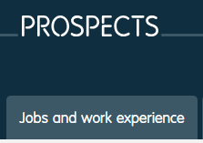
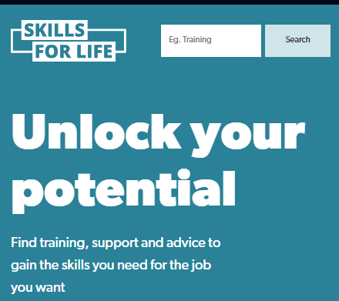
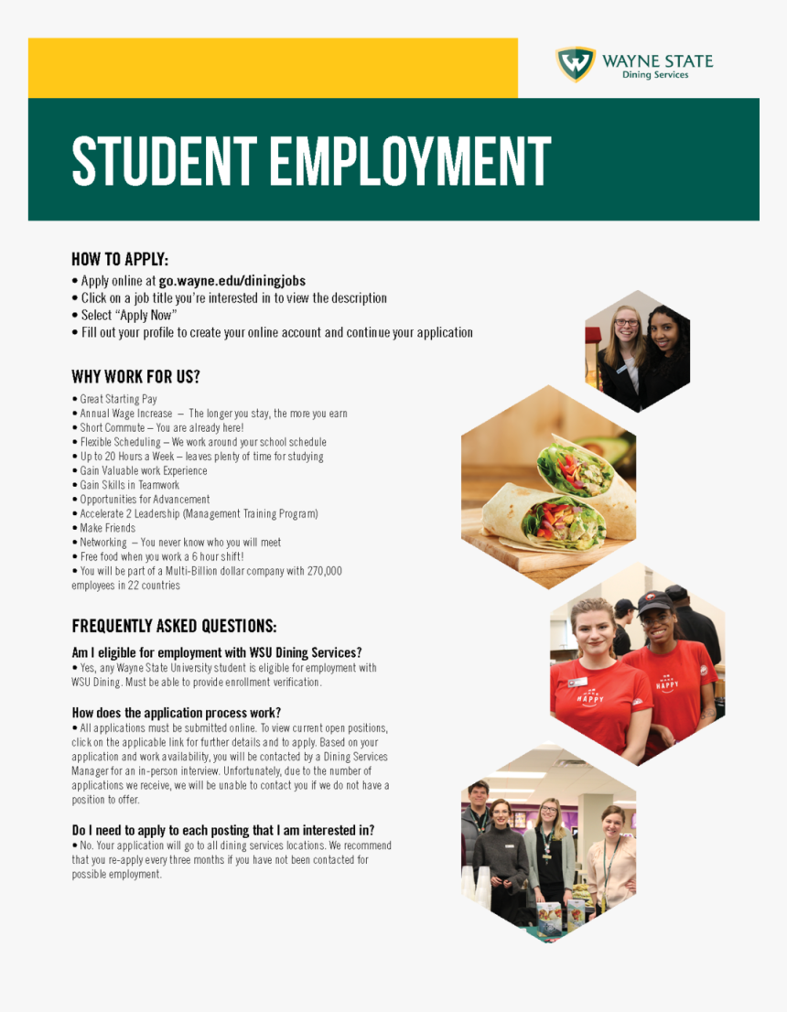
Where can I find out about my next steps?
©Careers appointment guidance | Careers & Employability Service | The University of Sheffield
©COD Newsroom
©How To Get The Most From Your Visits To The Jobcentre | Renovo UK
©Prospects.ac.uk
©Student Employment Handout, HD Png Download - kindpng
©Unlock your potential - Skills for Life

Slide 4
Skills Audit- Initial Ideas
How can lack of skill hold you back?
Why do you need to develop them?
What skills do you need to develop for the future
How can these skills help you move to the next step?

Slide 5

What kind of skills are needed in jobs?
©(39) 8 Employability Skills - YouTube

Slide 6

Spot the correct behaviour
©(39) Soft Skills--Enthusiasm And Attitude - YouTube
Notes:
(39) Employability Skills – YouTube This play list can be used to support and discuss with learners appropriate behaviour in the work place.

Slide 7
Work in small groups
To identify where you can find out about progression opportunities for your area of interest

Slide 8

Why Volunteer?
©(39) What are the benefits for the volunteer? - YouTube

Slide 9
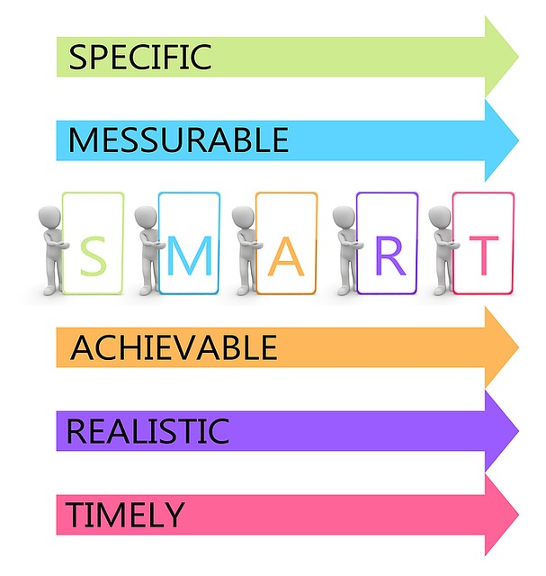
Goal Setting
Why is it important?
What is the difference between long term and short term goals?
What is a SMART Goal?

Slide 10
Is it clear and achievable? SMART GOALS
Walk 24 miles in a day

Slide 11
Is it clear and achievable? SMART GOALS
Develop a progression plan for the next month

Slide 12
Is it clear and achievable? SMART GOALS
Eat 3 vegetables a day

Slide 13
Is it clear and achievable? SMART GOALS
Hand homework in on time

Slide 14
Is it clear and achievable? SMART GOALS
Pass all your courses by end of next week

Slide 15
Is it clear and achievable? SMART GOALS
Learn and master a new sport this week

Slide 16


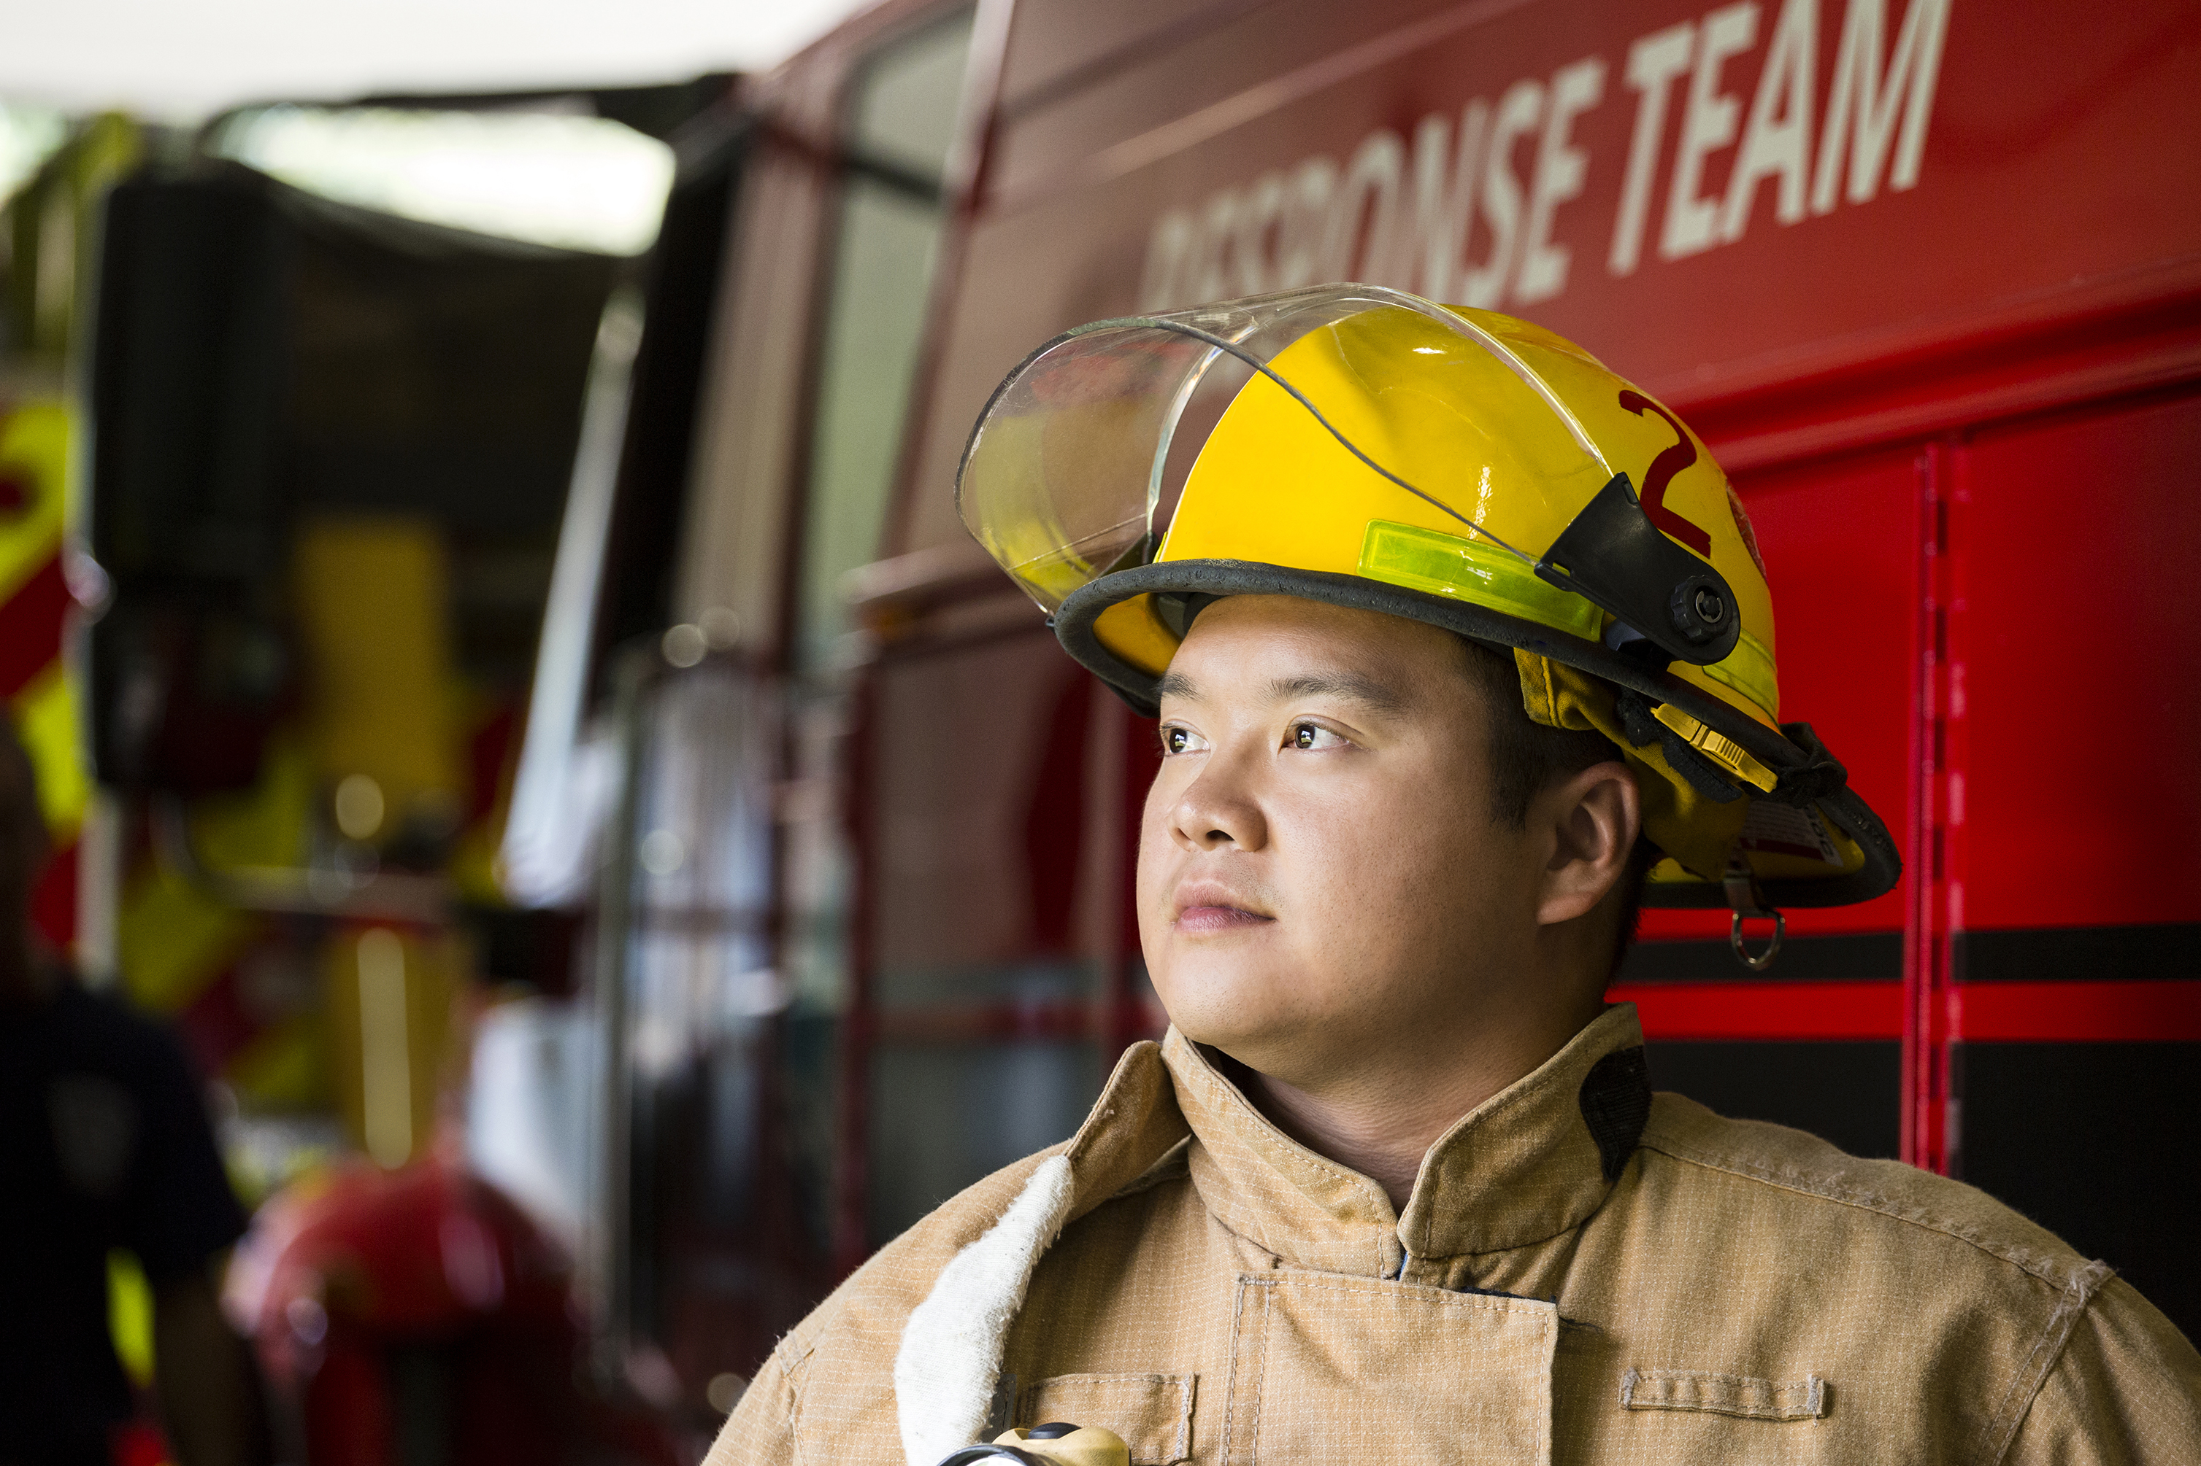

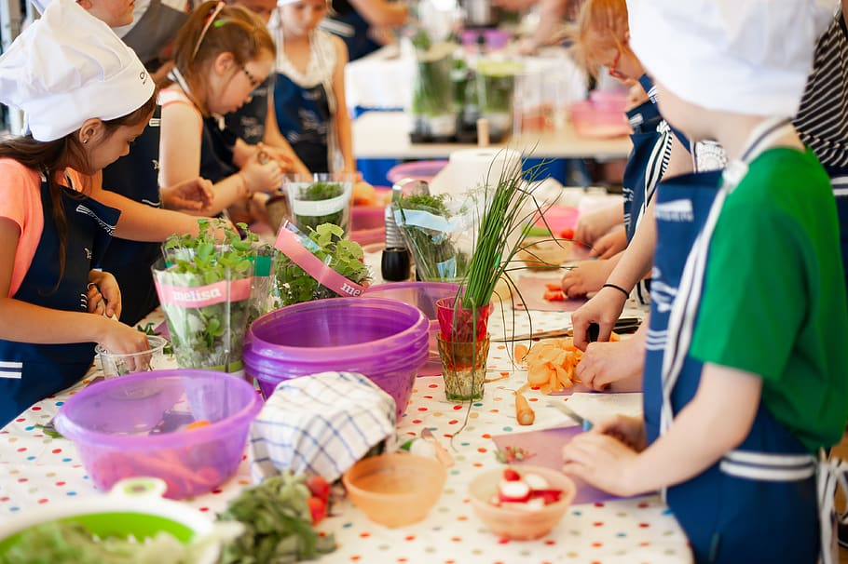

Identify the skills that are needed for each job role

Slide 17
Identify the skills that are needed to study each subject
Engineering
Business
Digital Media
Land Based Study
Public Services
Art and Design

Slide 18
End of Presentation
Notes:
Closing Slide

